Slide 1
Anomaly Detection in Data Plane Systems using Packet Execution Paths
Archit Sanghi, Praveen Tammanna, Saurabh Joshi, IIT Hyderabad, India
Krishna P. Kadiyala, Texas Christian University, Fort Worth, TX
ACM SIGCOMM Workshop on Secure Programmable Network INfrastructure (SPIN 2021)

Slide 2
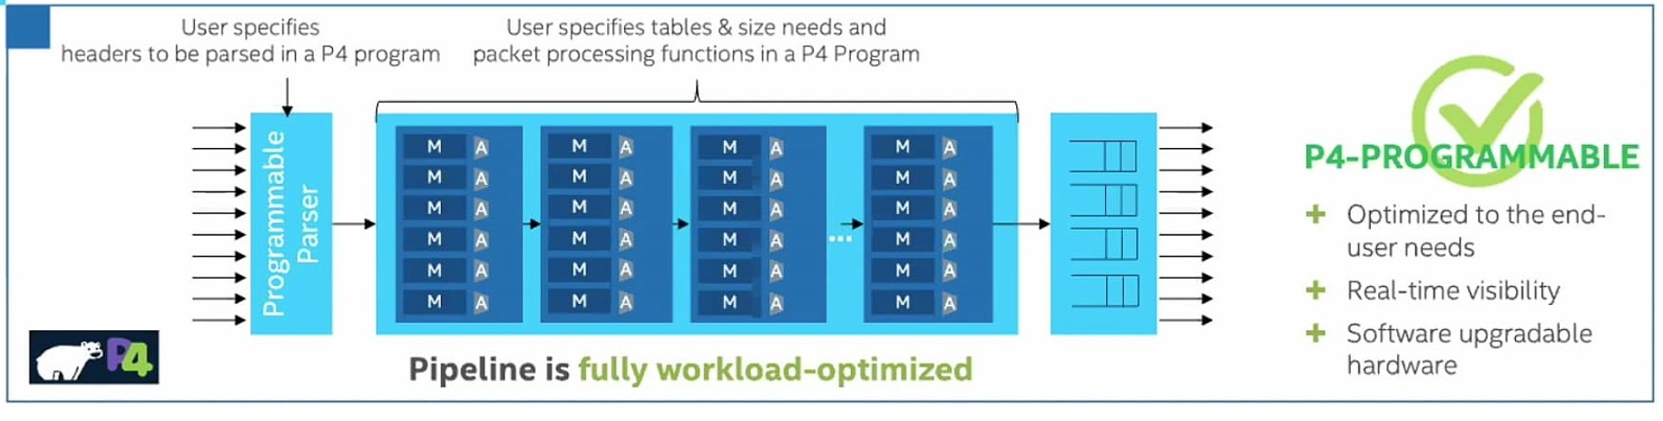
Programmable Data Planes
Enable programming packet-processing behavior in the data plane.
Use high-level domain-specific networking languages like NPL and P4.
Provide opportunities to solve complex network problems
Notes:
Recent advancements of programmable switches enable programming packet-processing behavior in the data plane.
One can use high-level domain-specific networking languages like NPL and P4 to program the software or hardware-based dataplanes.
This ecosystem provides a wide range of opportunities to solve network problems considered hard and complex in traditional fixed pipeline switches.

Slide 3
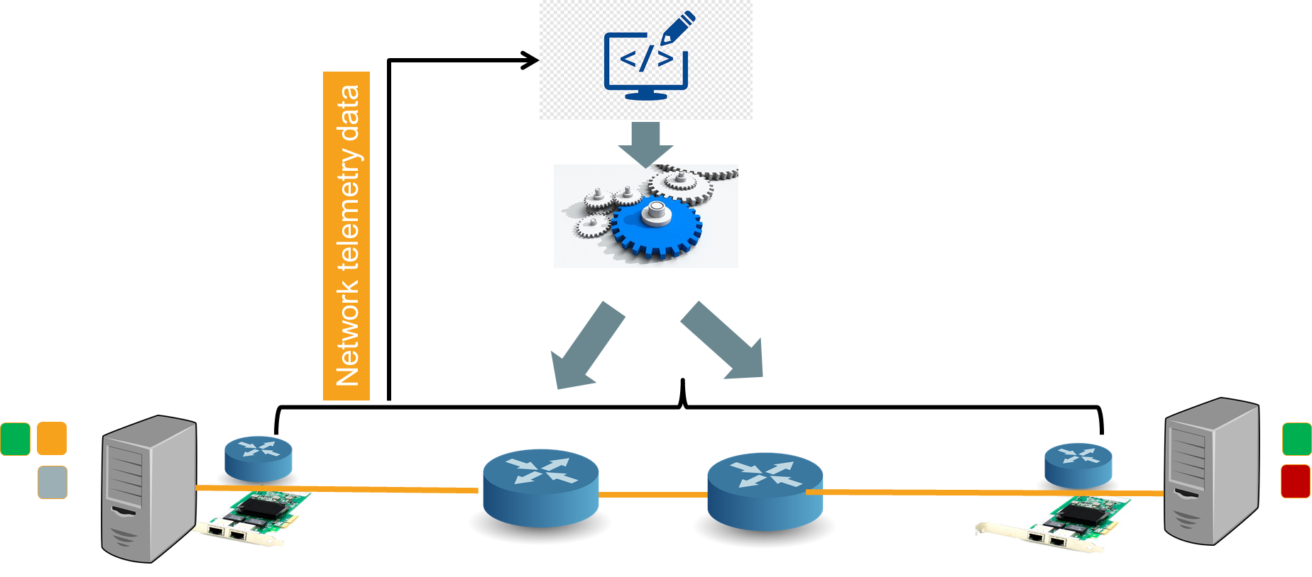
Data-driven Data-plane systems
Leverage programmable capabilities to better handle network dynamics and realize fast, accurate, and data-driven control-loop decisions.
Control in the data plane –
HULA (SOSR ‘16)
Blink (NSDI ‘19)
Control out of the data plane –
FlowRadar (NSDI ’16)
Silkroad (SIGCOMM ‘17)
NetCache (SOSP ‘17)
Poise (SEC ‘20)
Real-time data-driven control loop decisions.
Notes:
Leverage programmable capabilities to better handle network dynamics and realize fast, accurate, and data-driven control-loop decisions. The core of these systems are packet-processing algorithms that continuously monitor traffic conditions or listen to data-plane signals and quickly respond to adapt to the network conditions in small timescales (e.g., tens of nanoseconds). They can broadly be categorized into systems that have control in the data plane system, and control out of the data plane system.
They have fast control loop runs operates entirely in the dataplane:
HULA – listens to network feedback carried in probes and quickly responds with decisions to avoid performance degradation.
BLINK – leverages TCP induced signals to detect failures and reroute traffic based on data plane signals rather than control-plane ones.
the Hula [13] system generates probes that carry network path performance information, and propagates them across the network; programmable switches can then extract path metrics from these special packets, and optimize their routing tables on-the-fly. The data plane in the Blink [10] system detects large-scale TCP retransmissions across flows, uses it as a signal for remote link failure, and triggers re-routing to backup paths.

Slide 4



Problem: High programmability increases attack surface
Network attacks
- Adversarial control inputs
- Malicious data traffic
- Man in the middle
- Exploit protocol vulnerabilities
Network telemetry data
Notes:
Though such novel data-driven data-plane systems seem promising to achieve better performance, they run the risk of a larger attack surface because these systems respond to data plane signals, and hence, may be vulnerable to network attacks not seen before.
For example, a network attacker could potentially exploit the semantics of the control logic and craft adversarial network inputs. Such inputs would directly influence the decisions made by the systems and can negatively impact the behavior of a large portion of the traffic, potentially leading to severe performance degradation.
Interestingly, to generate fake data-plane signals attackers do not need specific privilege since many of these data-plane systems can be tricked by spoofed and manipulated data-plane signals, or crafted traffic patterns from compromised hosts.

Slide 5
Possible attacks
CPU exhaustion – frequently trigger CPU intensive path
Network performance degradation – influence decision making to pick wrong path
Corruption of in-network statistics – evade from being detected by misleading analyzer
Memory saturation – trick system to install rules for malicious traffic
Notes:
CPU exhaustion – packet-processing in the data plane is very fast and packets that invoke the control plane are processed slowly. Hence, it is good practice to invoke the control plane at larger timescales. However, An attacker may craft inputs exclusively to invoke the control plane continuously, successfully depleting switch CPU resources.
Network Performance degradation – To quickly handle dynamic network events (e.g., congestion, link/switch failure), some systems take decisions
immediately in the data plane before the control plane responds. An adversary could potentially exploit the semantics of the control logic to craft network inputs (e.g., modify/delay probes) and influence decisions in the data plane.
Network statistics corruption – To perform monitoring at line rate, compact data structures like bloom filter and its variants are commonly used. an adversary can pollute bloom filters such that the false positives rate increases significantly, thus misleading learning algorithms and successfully evading from being detected.
Memory saturation – In some systems, control-plane agents continuously update match-action rules whenever there is a signal from the data plane. One example is the NetCache system’s key classification that we will look at in detail next. An adversary can take advantage of this process and craft traffic with an objective to access distinct keys, eventually leading to rule installation for too many keys, discarding legitimate key requests due to lack of space, thereby increasing end-to-end latency.

Slide 6



NetCache data plane system
Controller
Add hot
key value K1
KV
KV
GET key K1
> Threshold
Next GET key K1
KV
KV
Reply
Reply
KV
KV
Cache
Cache
Notes:
NetCache is a new key-value store architecture that leverages the power and flexibility of new generation programmable switches to cache data in the network for dynamic load balancing. The core of Net-Cache is a packet-processing pipeline that exploits the capabilities of modern programmable switch ASICs to efficiently detect, index, cache and serve hot key-value items in the switch data plane. The NetCache system classifies a key as "hot" if the key is requested beyond a certain threshold.
The controller then installs this key-value pair in the table, so that the switch would respond to subsequent key requests without having to visit a storage server, thus reducing latency.

Slide 7

Memory saturation attack on NETCACHe
Eviction of legitimate keys increases response time
Controller
Add hot
key value K99
KV
GET key K99
KV
Attack: Requests too many
distinct hot keys
Reply
KV
Cache
Notes:
In the NetCache system, the attacker can deduce the threshold for classifying a key as "hot" by observing the difference in response times before and after a key becomes hot. Once an attacker discovers the threshold, he/she can craft traffic with distinct hot keys to cause:
installation of unwanted keys in cache; and
eviction of legitimate keys when the cache is full, thus increasing response time for legitimate traffic

Slide 8
Problem: How do we detect attacks?
Network attacks
- Adversarial control inputs
- Malicious data traffic
- Man in the middle
- Exploit protocol vulnerabilities
Network telemetry data
Objective: Secure data-driven data plane systems from adversaries
Notes:
The big question is: How can we detect whether the data-plane systems are under the influence of adversaries?
Our goal is to secure data-driven systems from adversarial network inputs. In working towards this goal, we propose an anomaly detection system that performs statistical analysis on packet execution paths in the data plane to detect whether data-plane systems are under the influence of adversaries.
Preliminary experiments to demonstrate the effectiveness of proposed system.

Slide 9

Our Approach
Raise alerts
1. Original P4 program
4.Classification based on expected behavior
Augment
Export features
2. Augment P4 program for collecting features
3. Extract features at run-time
Packets
Notes:
The main objective of this work is to detect at run-time if a dataplane system is under attack.
Our key idea is to instrument P4 programs to collect telemetry data or features that is essential to do analysis and find whether the system is under the influence of adversaries.
Our system monitors traffic under normal conditions where an encoded p4 program running in the data plane tracks and maintains packet execution path statistics. The control plane periodically collects statistics and constructs a packet execution path distribution, which will be the expected distribution.
Extract features at runtime: We capture expected behavior by building a reference model from the extracted features using statistical analysis techniques.
Classification: Next we compare the observed behavior with the expected, and whenever significant deviation is detected between the two, raise an alerts.
However, realizing this approach has many challenges.

Slide 10
Challenge: resource constraints
Per-packet time budget: 10’s of nanosecs
Per-packet memory accesses: 15-20
Memory in switch data plane: 10’s of MBs
Notes:
The main challenge in implementing our idea is that programmable data planes are resource-constrained with limited per-packet time budget (100’s of nano secs), a limited number of per-packet memory accesses (1-2 per-pipeline stage), and limited storage capabilities (order of MBs). We carefully design our system to work under these constraints.

Slide 11
System Components
Feature: Packet execution path --- Track using Ball-Larus encoding technique
Maintain path statistics --- Hash tables
Model expected behavior --- Null hypothesis
Validate observed behavior --- Chi-squared test
Notes:
To be specific, our system has the following components:
1. First, we found PEP statistics would rightly capture the packet-processing behavior by a p4 data plane algorithm. However, tracking each packet’s execution path in the data plane under the constraints is challenging. To this end, a recent work, P4track [20], proposed a technique to track the execution path of every packet using Ball-Larus encoding and has shown that it works well under Intel’s barefoot Tofino switch constraints. In this work, we propose to build our system on top of this work and integrate it with our approach to detect malicious packet-processing behaviors
2. Second, it is important to maintain packet execution path statistics with minimal-to-no impact on packet-processing throughput. To achieve this, we maintain statistics in a hash table.
3. Third, we model expected distribution from periodically collected per-path statistics maintained in the hash table and define NULL hypothesis
3. Fourth, to detect abnormal behavior, one has to compare the tracked packet execution path statistics (or observations) with the expected (or normal) behavior. To do so, we use Pearson’s chi-squared test to determine whether there is significant deviation between the expected behavior and the observed behavior.
Let’s take a deep look into the first component..

Slide 12
Feature: Packet Execution Paths distribution
A packet’s execution through the P4 program.
A significant variation of packet execution path statistics at run-time would hint at abnormal behavior.
Leverage the Ball-Larus encoding technique by augmenting the original P4 program.
Original P4 program
Augment
BL encoding for collecting packet execution path statistics
Packets
Notes:
A packet’s execution through the P4 program – identifies the sequence of tables hit and the actions applied in the data plane.
The statistics of packet execution paths in P4 programs can be used to understand non-adversarial behavior (normal) such that a significant variation of these statistics at run-time would hint at abnormal behavior or behavior that is most likely observed if the system is under attack. For example, paths in P4 program that invoke the switch CPU are typically expensive and not seen often. However, if we suddenly observe too many packets taking this path, we can consider this abnormal behavior.
We leverage the Ball-Larus encoding technique by augmenting the original P4 program for collecting packet execution path statistics.

Slide 13
Augmenting a P4 program
NetCache P4 program
Path profiling
Encoded P4 program
A
+1
control Ingress {
//switch ingress.
apply {
if (cache.hit==false)
if(query == hot)
copy_to_cpy()
else
Server_request()
else if (cache.hit==true)
…
// operations
}
B
C
BL_CODE = 0
control Ingress {
//switch ingress.
apply {
if (cache.hit==false)
BL_CODE += 1
if(query == hot)
copy_to_cpy()
else
BL_CODE += 1
Server_request()
else if(cache.hit==true)
…
// operations
}
A
+1
C
D
E
D
Path | BL code
AB | 0
ACD | 1
ACE | 2
E
B
Notes:
On the left here we have a NetCache P4 program. The control flow graph of this P4 program is a Directed Acyclic Graph where where each node represents a program statement. The Ball-Larus encoding algorithm performs reverse topological ordering of the DAG and assigns a label to each edge such that, as a given input packet transitions from one program statement to the next, the packet’s path variable maintained in the Packet Header Vector is added to the associated edge label.
Finally, at the end of the program processing, the path variable value uniquely represents the path that the packet has taken in the program.
To the right we have an encoded P4 program augmented using the Ball-Larus algorithm.

Slide 14
System Components
Feature: Packet execution path --- Track using Ball-Larus encoding
Maintain path statistics --- Hash tables
Model expected behavior --- Null hypothesis
Validate observed behavior --- Chi-squared test
Notes:
We next look at how we maintain the packet execution path statistics.

Slide 15
Maintain Path Statistics
The annotated P4 program tracks packet execution path.
Packet execution path counts are maintained in a hash table.
Leverage stateful registers in SRAM to store and update hash table entries at line rate.
Notes:
We use a hash table to maintain per-path statistics. The path variable value (𝑉) is hashed and the hash value is used as a key to lookup an entry in the hash table. If the key is present, we increment the existing counter. Otherwise, we allocate and initialize an entry with the key.
We leverage stateful registers in SRAM to store and update hash table entries at line rate.
we deploy P4 program annotated with Ball-Larus algorithm and hash table on the switch, and collect packet execution path distribution of real traffic over a period of time (training phase).
One might argue that the number of paths would explode in a large P4 program, thus requiring large memory to keep the hash collision probability low. However, in practice, packets traverse a small subset of all possible paths – thus, the memory required is reasonably low compared to the SRAM available in the switches [27]. In our experiments, we observe that packets inNetcache.p4 [8] traverse around10paths out of600possible paths, and it is60out of108in Blink.p4 [14]. We also observed that the number of paths across different windows remains the same most of the time and if it changes, the percentage change is very small. So, given a hash table of size500KB, with100keys, the expected number of collisions is0.077which is in the generally recommended limits of 0.1% of the number of keys (i.e.,100).
One may also consider the count-min sketch data structure [3] to achieve an acceptable trade-off between memory and accuracy at the cost of packet-processing complexity.

Slide 16
System Components
Feature: Packet execution path --- Track using Ball-Larus encoding
Maintain path statistics --- Hash tables
Model expected behavior --- Null hypothesis
Validate observed behavior --- Chi-squared test
Notes:
In the next step, we model the expected behavior.

Slide 17
Modeling Expected behavior
The control plane collects path counts for ‘n’ windows.
The distribution captures the number of packets on each execution path in the P4 program.
Define NULL hypothesis: Probability corresponding to each path.
Expected distribution
Notes:
The control plane periodically collects statistics and constructs a packet execution path distribution, which will be the expected distribution.
We define the null hypothesis as the probability corresponding to each path. for each path, number of packets expected (probability) ---path prob = #per-path packets/#total packets
since the number of packet per path in a window varies, we calculate null hypothesis over multiple windows. this distribution (per-path prob) is considered normal over a period of time.
​
we calculate the same at runtime (sample) and compare with the null hypothesis -- if difference is high (p value) we consider it as abnormal..

Slide 18
System Components
Feature: Packet execution path --- Track using Ball-Larus encoding
Maintain path statistics --- Hash tables
Model expected behavior --- Null hypothesis
Validate observed behavior --- Chi-squared test
Notes:
Finally, we validate observed behavior.

Slide 19
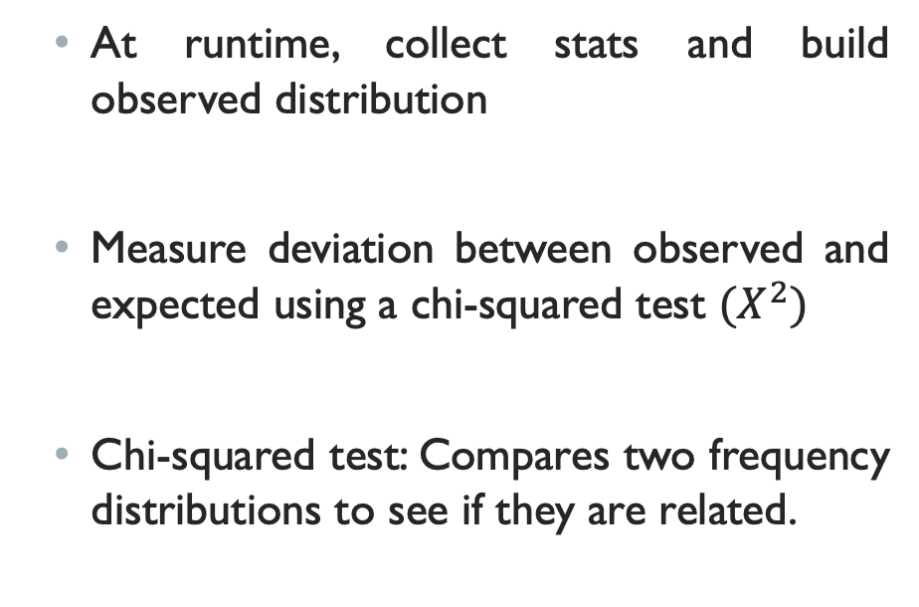
Validate observed with expected
At runtime, collect stats and build observed distribution
Measure deviation between observed and expected using a chi-squared test ${(X}^{2})$
Chi-squared test: Compares two frequency distributions to see if they are related.
Notes:
Given a benchmark for expected traffic distribution, we now have to identify whether the observed traffic falls outside a regular pattern. To do so, after the training phase, we collect per-path traffic statistics maintained in the hash table and compare the observed distribution with expected behavior. A chi-squared test (𝜒2) for independence compares two frequency distributions to see if they are related. A small chi-square value means that the observed distribution data fits expected data extremely well. On the other hand, a large chi-square value means that the observed data deviates significantly from the expected data. We report that the observed distribution deviates from the expected when the standard chi-square value is improbably large according to the chi-squared p-value table.

Slide 20
EXPERIMENTS and Metrics Evaluated
Evaluation: Accuracy of system and attack traffic percentage.
Memory saturation attack on NetCache system – randomly generated keys.
Experiment setup: Mininet v2.3.0 with one P4 switch, eight key-value storage hosts, one client requesting keys, one controller updating switch cache.
Workload: 10% of the keys account for 60-90% of queries.
Notes:
We want to evaluate:
Accuracy of our system – Is our system is able to detect abnormal behavior?
Attack traffic percentage – how much attack traffic should be generated to detect attack?
Attack: the keys in the attack traffic are randomly generated with the intent to create more hotkeys
Our experiments were conducted in Mininet v2.3.0 with one P4 switch, eight key-value storage hosts, one client requesting keys, one controller updating the switch cache with hotkeys, and a collector which reads packet execution path statistics and measure deviation.
We run the experiment multiple times using a bash script with each experiment containing around 40000 queries, taking 3 minutes to run. The code for BL encoding, collection, and validation is written in Python.

Slide 21
Our system detects abnormal behavior
chi-squared value after attack
- - - Threshold
Attack end
Attack start
chi-squared value before attack
- - - Threshold
Time window
Time window
The circle thick green line indicates that when there is no attack traffic the chi-squared value is below the threshold (dashed red line).
When under attack, the chi-squared value increases and saturates; here we observe eviction happens to accommodate space for new hot keys.
Notes:
To interpret the chi-square test results, we compare the actual chi-squared values with the pre-set chi-squared threshold. The dashed red line indicates that the chi-squared p-value is set to 21— this aligns with the standard threshold when the number of classes (or paths observed) is less than 11.
( In our experiments, we observe that packets in Netcache.p4 [8] traverse around 10 paths out of 600 possible paths. )
By comparison, if the actual/observed values are below the given chi-square threshold, it denotes that the system behavior is as expected. If the actual/observed values rise above the threshold value, we can conclude that the system is displaying abnormal behavior.
The thick green line in the left figure indicates that when there is no attack traffic the chi-squared value is below the threshold. When the system is under attack, as depicted in the figure on the right, the chi-squared value increases and saturates; here we observe eviction happens to accommodate space for new hotkeys. This experiment shows that our anomaly detection approach is able to detect abnormal behavior in this system.

Slide 22
detection when attack query percentage is low
The difference between the actual and the threshold is averaged over multiple runs.
When there are no attack queries, the mean value turns out to be negative.
When the percentage of attack queries increases, we see a positive mean value.
Percentage of attack queries
Notes:
This figure summarizes the results of experiments carried out over multiple runs for NetCache. The X-axis represents the percentage of attack queries and the Y-axis depicts how far the actual chi-squared value is from the threshold chi-squared value. The difference between the actual and the threshold is averaged over multiple runs. We vary the percentage of attack queries from $0$ to $50$ and record the mean value for each scenario. When there are no attack queries (\ie, $0$ attack percentage), the value turns out to be negative, as depicted by the green bar plot, denoting that there was no attack. When the percentage of attack queries increases, we see a positive mean value, depicted by the blue bar plots here, which indicate our system is successfully able to detect attacks even when the attack traffic percentage is low.

Slide 23
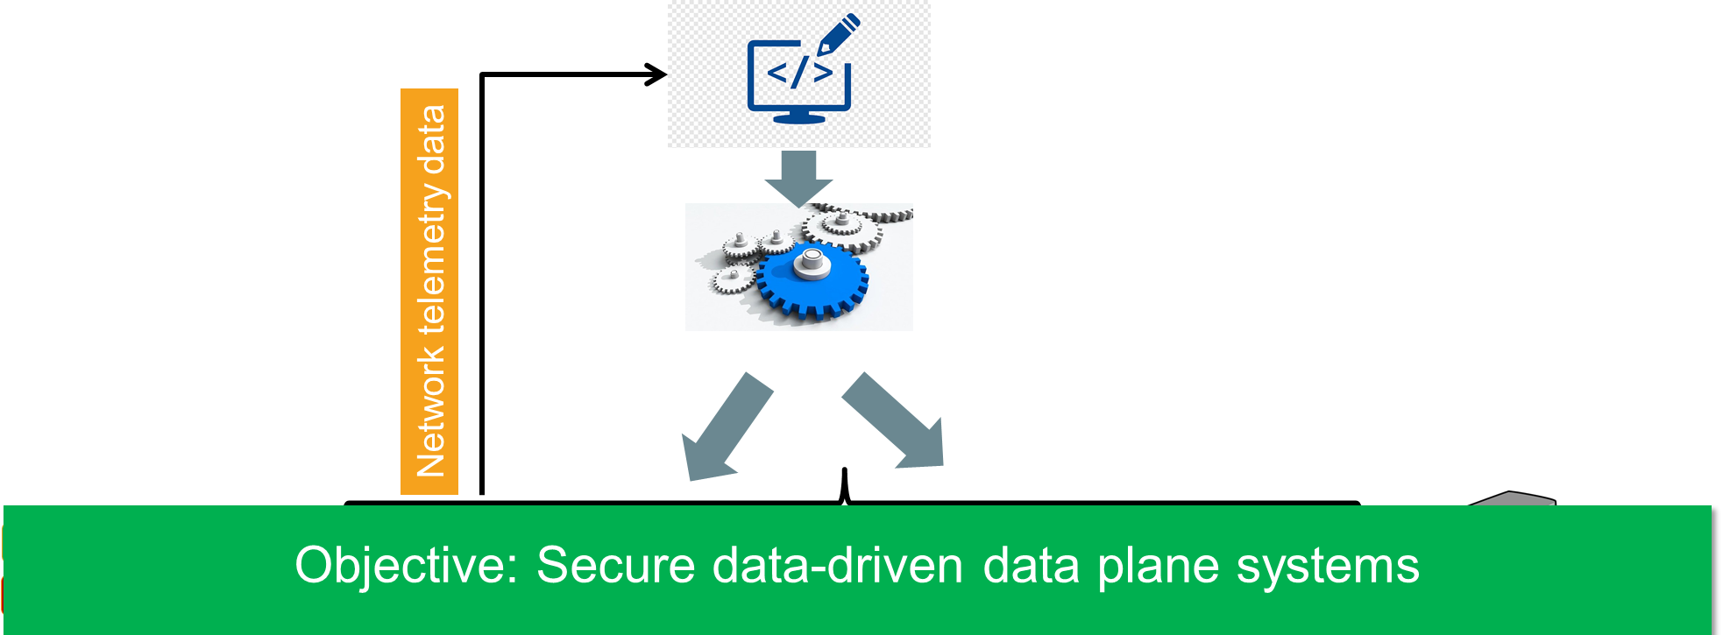
summary
Preliminary experimental results indicate our methodology is able to detect abnormal behavior due to a memory saturation attack on the NetCache system.
Notes:
Programmable data planes provide exciting opportunities to realize fast, accurate, and data-driven control-loop decisions.
Despite their benefits, automatic response to network events lead to increase in potential sources of inputs, and hence, increase in attack surface.
This paper takes a step towards securing such systems by identifying possible attacks and designing a scalable tool for detecting such attacks at run time.
Our approach models plausible expected behavior and measures deviation between observed and expected distribution using a chi-squared test.
Preliminary experimental results indicate our methodology is able to detect abnormal behavior due to a memory saturation attack on the NetCache system.

Slide 24
Future work
Improve the model to distinguish between data-plane systems designed for data centers and the Internet.
Validate our detection technique on a wide range of data-plane systems.
Avoid false alerts and make the design robust to other possible attacks.
Notes:
Improve the model to distinguish between data-plane systems designed for data centers and the Internet.
Validate our detection technique on a wide range of data-plane systems.
Avoid false alerts through continuous learning and make the design robust to the possible attacks.
Evaluate the system using real traces and associated overhead in terms of resources consumed.

Slide 25
Open for Questions.
Thank you!
Notes:
One might argue that the number of paths would explode in a large P4 program, thus requiring large memory to keep the hash collision probability low. However, in practice, packets traverse a small subset of all possible paths – thus, the memory required is reasonably low compared to the SRAM available in the switches [27]. In our experiments, we observe that packets inNetcache.p4 [8] traverse around10paths out of600possible paths,
If MVBL encoding is in place, for multiple path variables, one for each sub-DAG, it requires additional memory to maintain statistics such that the collision rate will be under the limits. One may also consider the count-min sketch data structure to achieve an acceptable trade-off between memory and accuracy at the cost of packet-processing complexity.
Scenarios for an attacker to be able to send adversarial inputs — a compromised host, or a Man in The Middle(MiTM) attacker. For both types of attackers, we assume they know which packet header values and the order of packets, would influence the decision making in the data-plane system under attack. Thereby the attackers can trick the system by injecting malicious traffic into the network, or by manipulating the original control packets, or by creating fake control packets

