Slide 1
Stock Virtual Machine
Sujal Patel
Linisha Basu
Sujay Patel

Slide 2
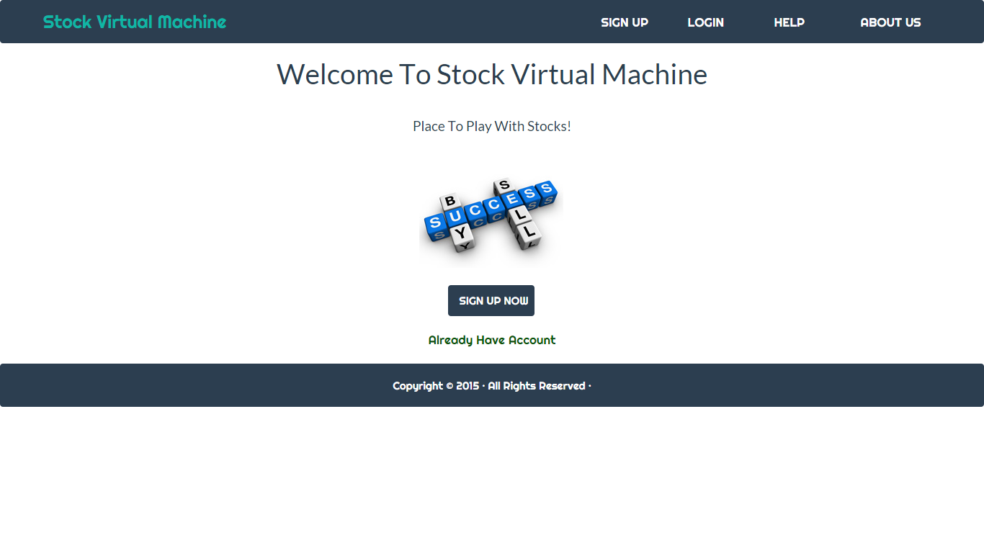
Home

Slide 3
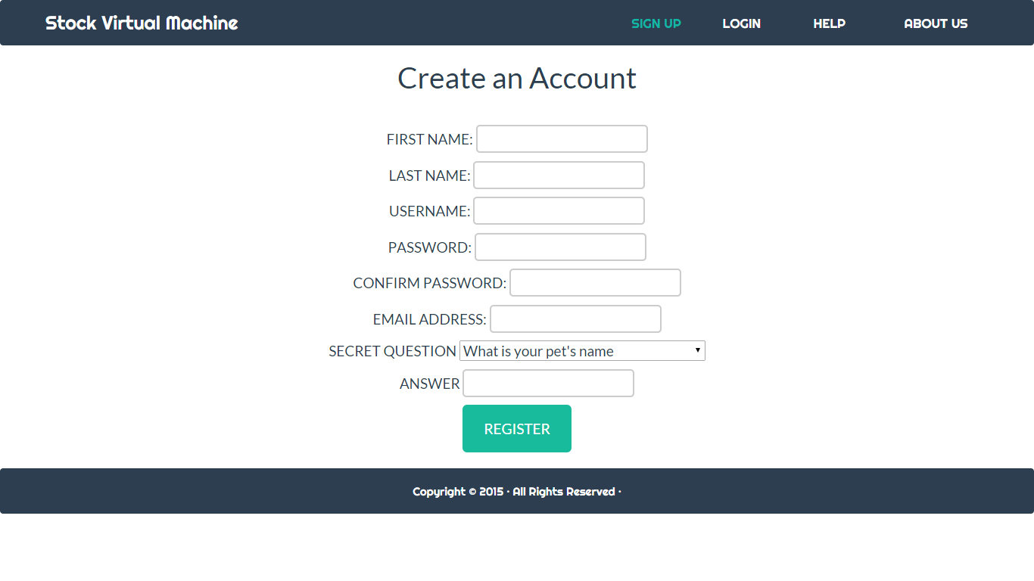
Registration

Slide 4
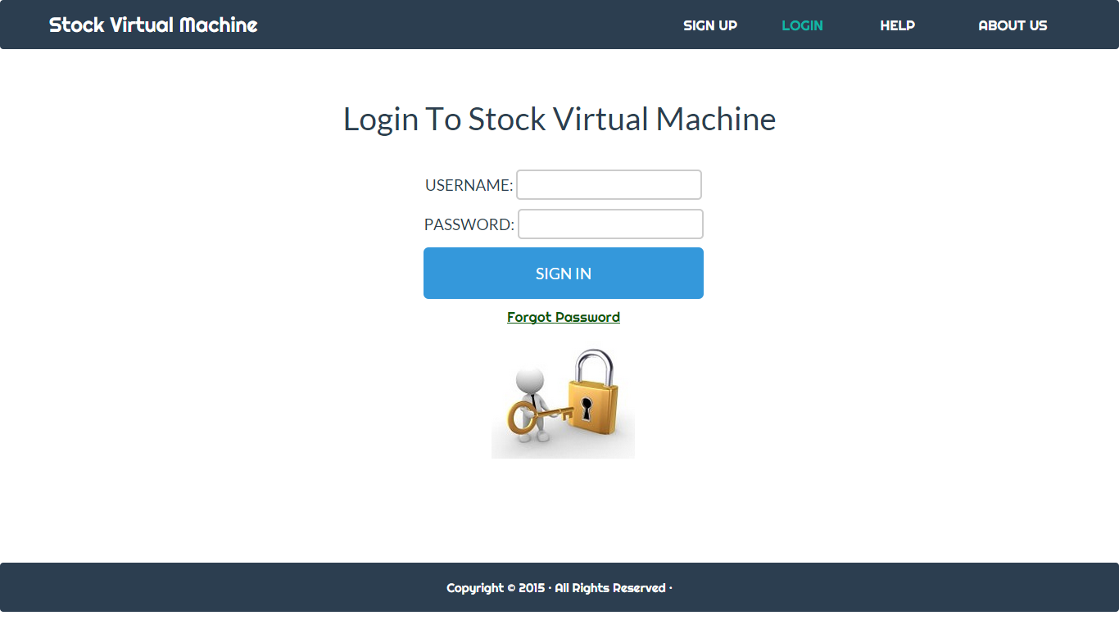
Login

Slide 5
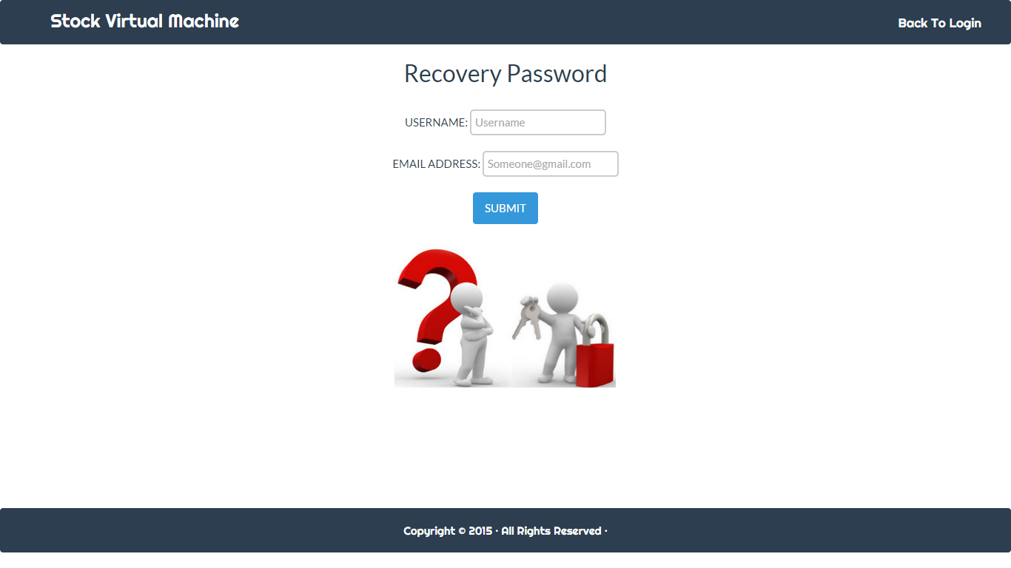
Forgot Password

Slide 6
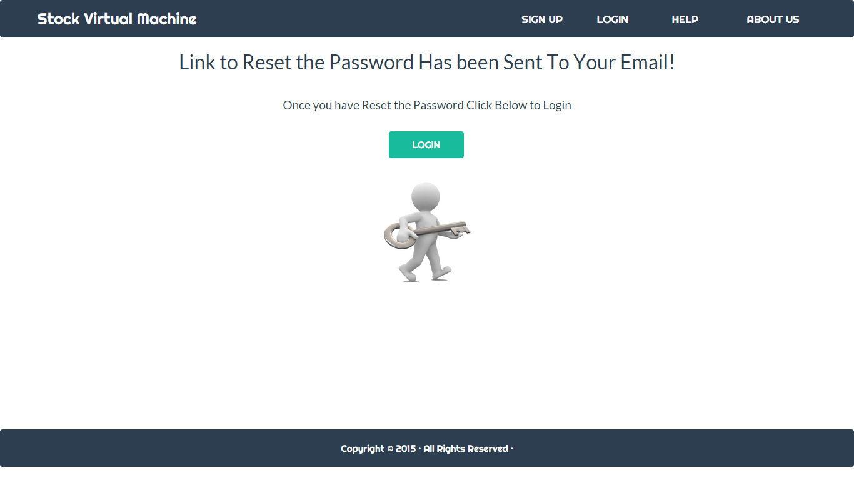
Forgot Password

Slide 7
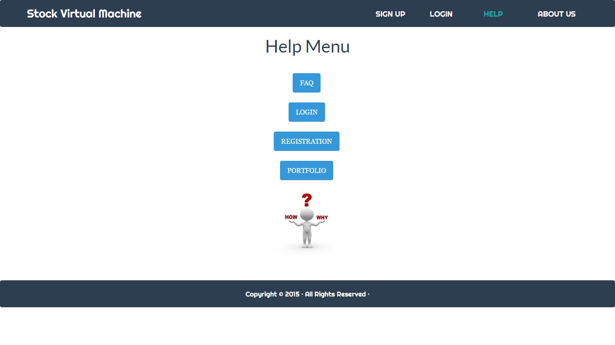
Help

Slide 8
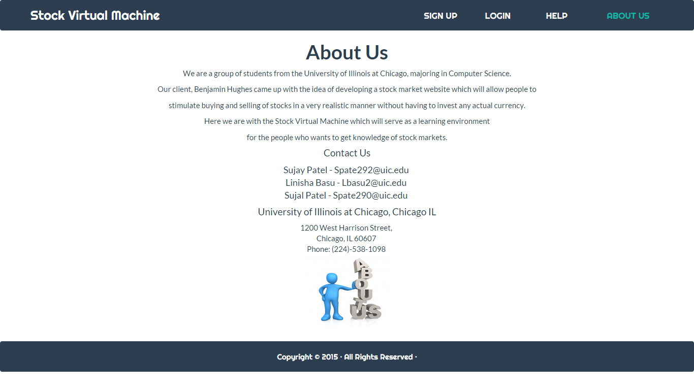
About us

Slide 9
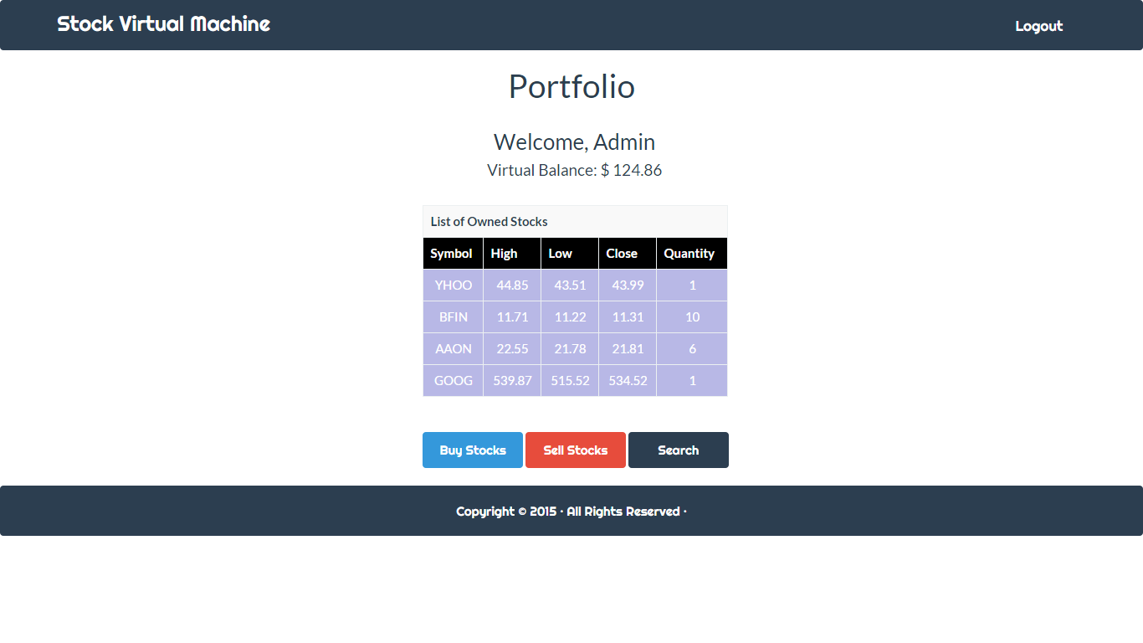
Portfolio

Slide 10

Any Questions or Comment?

