Slide 1
courseadvisor- Agentic AI for Personalized Course Pathways
CAPSTONE PROJECT
Presented By:
1.SUJAY SARVESH K K-SATHYABAMA INSTITUTION OF SCIENCE AND TECHNOLOGY -ECE

Slide 2
OUTLINE
Problem Statement
Proposed System/Solution
System Development Approach
Algorithm & Deployment
Result (Output Image)
Conclusion
Future Scope
References
IBM certifications

Slide 3
Problem Statement
Example: The online education space is saturated with thousands of platforms and courses, often leaving students confused and directionless. Without proper guidance, many learners pick courses that don't align with their career aspirations or current skill levels. Traditional academic counseling is limited in scalability, and learners need a modern, AI-powered solution that continuously adapts to their evolving interests and learning style.

Slide 4
Proposed Solution
CourseAdvisor reposes an intelligent, agentic AI-based solution that acts as a dynamic course advisor for students seeking clarity in their learning paths. Unlike static recommendation engines, CourseAdvisor operates in an interactive and adaptive fashion, using powerful large language models to:
Engage in natural language conversations with users to understand their goals, current knowledge level, and preferred learning domains
Generate a structured and evolving roadmap tailored to the user’s career aspirations (e.g., Data Scientist, Cybersecurity Analyst, Frontend Developer)
Recommend high-quality resources including online courses, certifications, tools, and practice platforms mapped to the learner’s journey
Continuously adapt the roadmap based on the user’s progress, feedback, or shifting interests over time
Provide monthly or milestone-based breakdowns that are digestible, practical, and goal-oriented
Encourage certifications from recognized bodies (e.g., IBM, Google, CompTIA) that enhance job readiness
The system relies on IBM Watsonx Granite language models for intelligent text generation and user understanding. It mimics expert human guidance by synthesizing vast knowledge from course catalogs, certification frameworks, and learning pathways into actionable study plans customized per individual.
CourseAdvisor offers a scalable, cloud-deployable solution that can empower educational institutions, online platforms, or self-learners with real-time, personalized AI coaching support.

Slide 5
System Approach
Tools and Technologies Used:
IBM Watsonx.ai: LLM experimentation and prompt testing
IBM Granite Model: Context-aware roadmap generation
Python: API integration and local testing
IBM Cloud Object Storage: To manage prompt and output assets
GitHub: Version control, collaboration, and project documentation
Libraries Used:
requests: To send prompt data to the Watsonx API
json: For parsing and formatting model responses
dotenv: For secure API key management (optional)
Workflow:
Define user personas and inputs
Develop prompt templates for varied learning domains
Test prompt accuracy and diversity using Watsonx
Extract structured outputs and format them into roadmap objects

Slide 6
Algorithm & Deployment
Process Flow:
User submits query such as "I want to become a cloud architect"
Prompt engineered for IBM Granite instructs the model to:
Analyze the input
Select relevant domains, tools, and certifications
Build a progressive monthly plan
The response includes a timeline-based learning roadmap with tools, topics, and platforms
The generated response is returned via the Watsonx interface or consumed via Python code
Deployment:
Prompt tested and deployed via Watsonx Prompt Lab
Output previewed in JSON format and via chat simulation
Can be embedded into websites, learning dashboards, or Slack bots
Future version to include API endpoints using IBM Cloud Functions or App Runtime

Slide 7
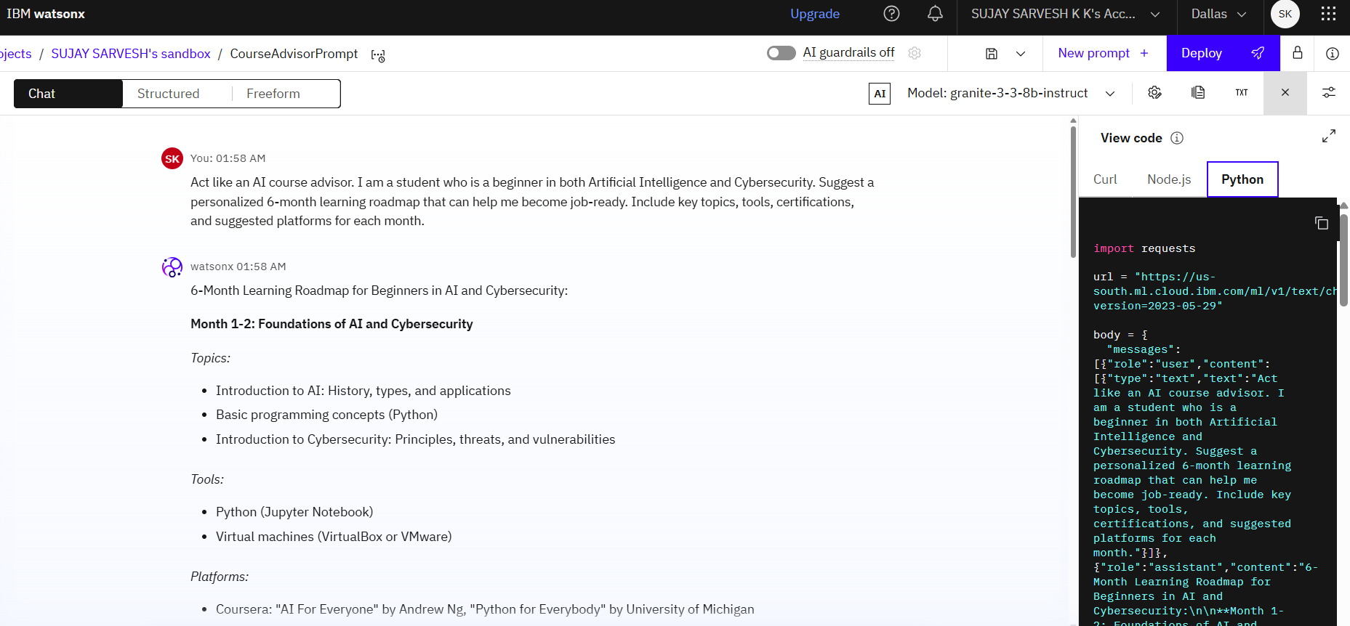
Result
IBM GRANITE MODEL : granite-3-3-8b-instruct result

Slide 8
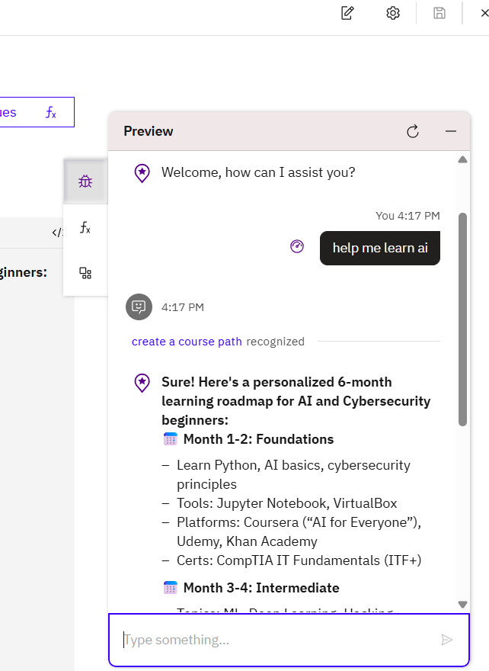
LLM-integrated Watsonx Assistant conversation with LLM support via Granite

Slide 9
Conclusion
CourseAdvisor effectively showcases how an Agentic AI assistant can guide students in their learning journey with minimal manual intervention. With powerful LLMs like IBM Granite, it becomes possible to personalize learning at scale, supporting thousands of learners at once. The roadmap generation was highly contextual, meaningful, and tailored to each learning goal. The project also demonstrated prompt engineering, AI integration, and dynamic roadmap generation within a cloud-native environment.

Slide 10
Future scope
Enable student login and session history storage
Add skill quizzes to fine-tune roadmap difficulty
Include milestone tracking and progress visualization
Embed career mapping with job role matching (e.g., Road to Backend Developer)
Add voice-to-text and chat UI for accessibility
Integrate with external APIs such as Coursera, LinkedIn Learning, and job portals
Enable feedback loop to retrain prompts based on user success

Slide 11
References
IBM Watsonx.ai: https://www.ibm.com/products/watsonx
IBM Granite Model documentation
Prompt Engineering resources from IBM
AI research on LLMs and personalization
Course catalogs from Coursera, edX, Udemy
Agentic AI design principles and use cases (OpenAI, Microsoft Research)

Slide 12
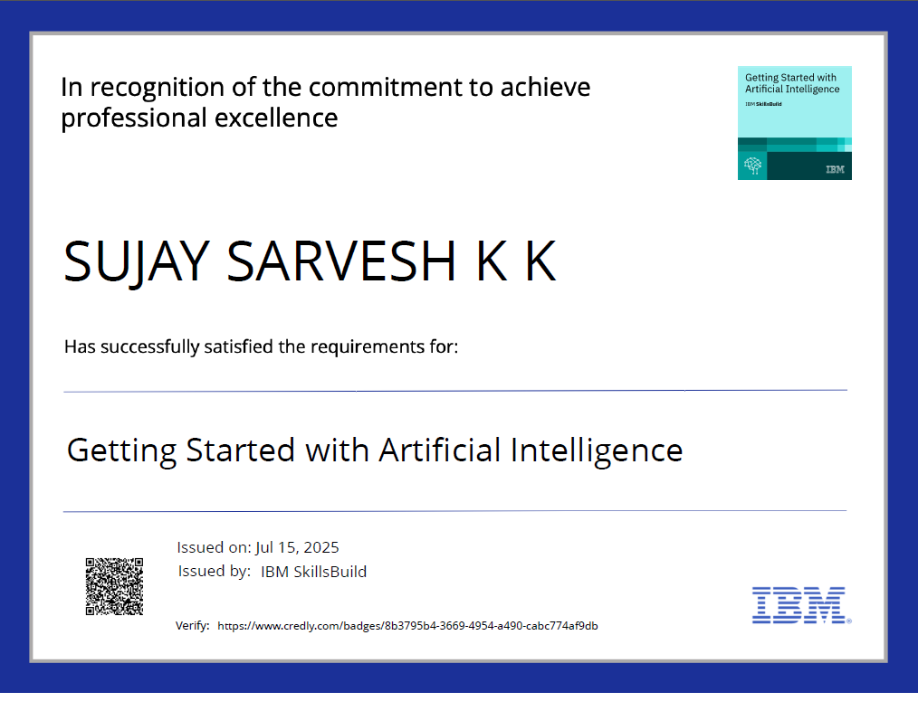
IBM Certifications
Getting Started With Artificial Intelligence

Slide 13
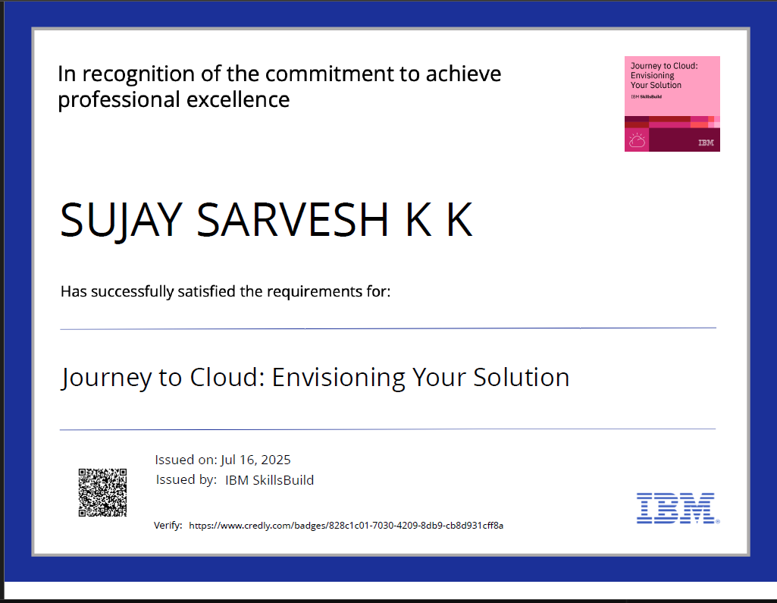
IBM Certifications
Journey to cloud

Slide 14
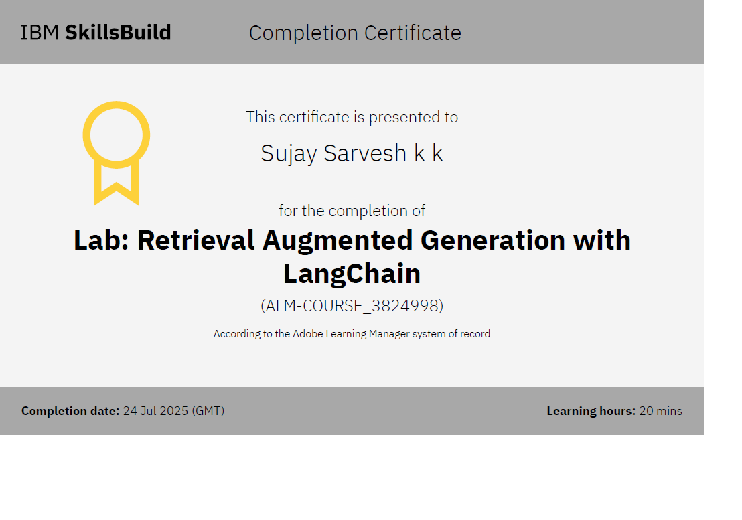
IBM Certifications
RAG LAB

Slide 15
THANK YOU
Let AI guide your learning journey Empowering learners with personalization, flexibility, and clarity — powered by IBM Granite.

