Slide 1
Excel Templates and Parsing with Python

Slide 2
Python Library
xlwings is a python2 compatible library that provides wrapper functions for use with VBA (Excel language)
Python has advantages of readability over VBA and other external libraries that are helpful for organizing data

Slide 3
Python Integration in Excel
Provide a template Excel file to be modified or organized
Has been used to generate a working schedule and calendar in Excel
Automation of these tasks are highly scalable and optimized to accept many different inputs and data ranges (such as endpoints on a calendar)

Slide 4
Other Input Formats to be Considered
.txt (plaintext) and .csv formats are other popular choices to pass input data due to condensed structure formats
Faster to parse through than input data in Excel, which requires VBA calls

Slide 5
Requirements
Python 2.7
xlwings module (can be downloaded through a package manager such as pip2)
Microsoft Excel (2016 or later preferred but not required)
Currently stable on Windows platform (MacOS compatibility will be added later)

Slide 6
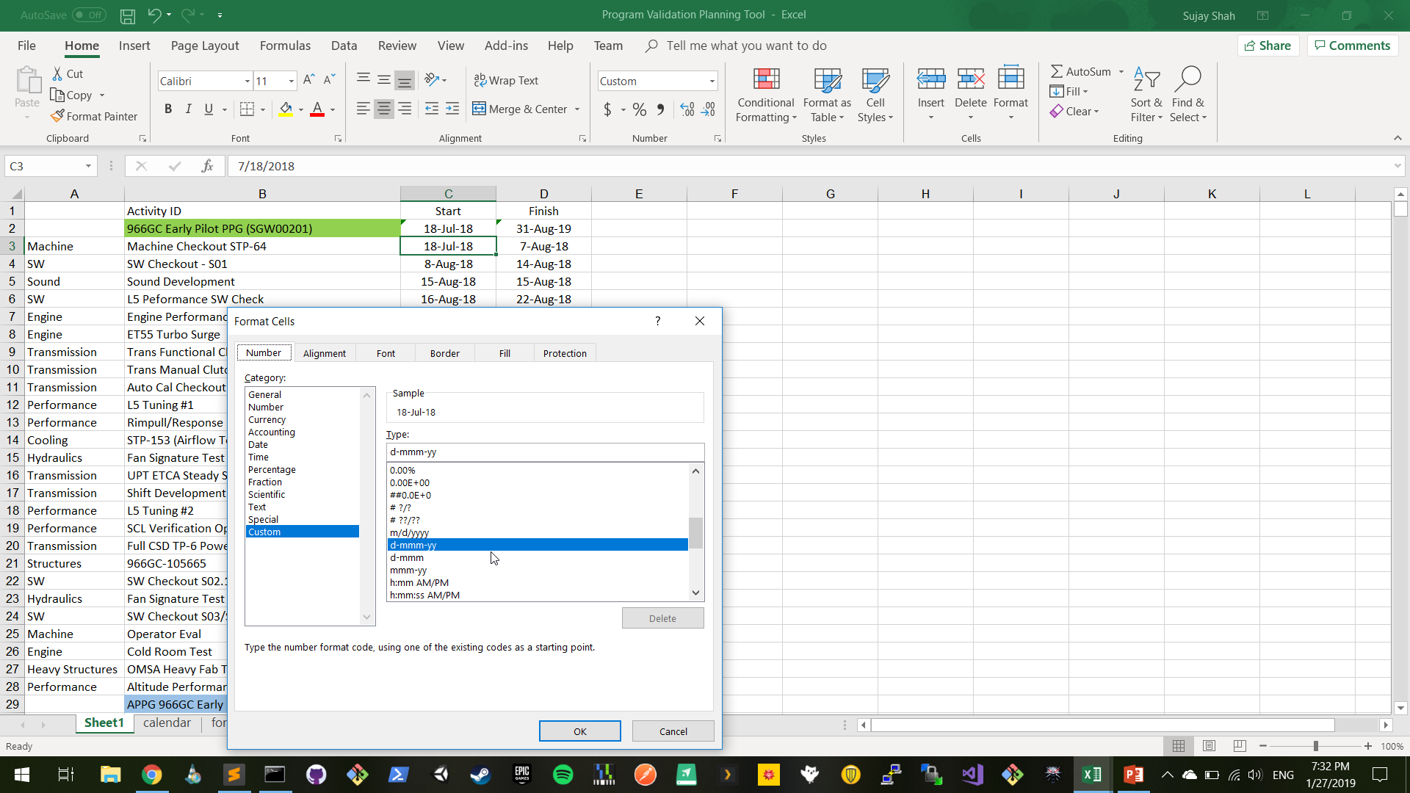
Program Validation
Date Format

Slide 7
Resource Validation
Need to enter input file

