Slide 1
Executive Summary
Objective: Predict visa certification outcomes using ML
Dataset: 25,480 applications, no missing values
Key Drivers: Wage, Education, Experience, Full-time status
Final Model: Tuned Gradient Boosting Classifier
Test F1 Score: 0.819 (strong generalization)

Slide 2
Business Problem
Manual visa review is slow and resource-intensive
Incorrect decisions carry economic & workforce risks
Need data-driven screening for efficiency & consistency

Slide 3
Analytical Approach
Exploratory Data Analysis (EDA)
Data cleaning & preprocessing
Class imbalance handling (SMOTE & undersampling)
Multiple model evaluation
Hyperparameter tuning & final selection

Slide 4
Data Quality & Preparation
Duplicates detected: 0
Missing values detected: 0
Corrected 33 negative employee counts (data entry errors)
Categorical variables encoded using one-hot encoding
Stratified train/validation/test split

Slide 5
Key EDA Insights
Higher education strongly linked to certification
Doctorate holders show highest approval likelihood
Experienced applicants certified more frequently
Higher prevailing wages correlate with approvals
Full-time roles dominate certified cases

Slide 6
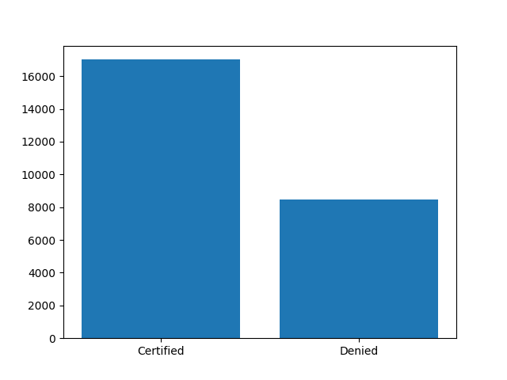
Visa Outcome Distribution

Slide 7
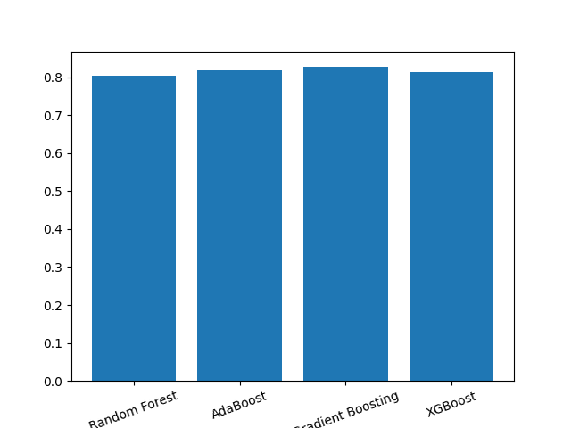
Validation Performance (F1 Score)

Slide 8
Final Model Selection
Gradient Boosting delivered best validation stability
Balanced precision–recall tradeoff
Reduced overfitting vs Random Forest
Chosen for production suitability

Slide 9
Test Performance
Accuracy: 0.737
Recall: 0.892 (excellent detection of certified cases)
Precision: 0.758
F1 Score: 0.819

Slide 10
Business Recommendations
Prioritize high-wage, high-skill applicants
Advanced education significantly improves approval odds
Prior experience is a major positive signal
Deploy ML model for initial application triage
Use model insights to guide policy & audits

Slide 11
Key Takeaways
Ensemble models outperform single classifiers
Sampling strategies improve minority learning
Feature patterns align with labor market logic
ML enables scalable & consistent decision support

