Slide 1
Privacy Management System
in Drones Data Collection
By
By
CODE SLAYERS
http://www.free-powerpoint-templates-design.com

Slide 2

To Implement Privacy Policies to Protect the Data in the Drone

Slide 3
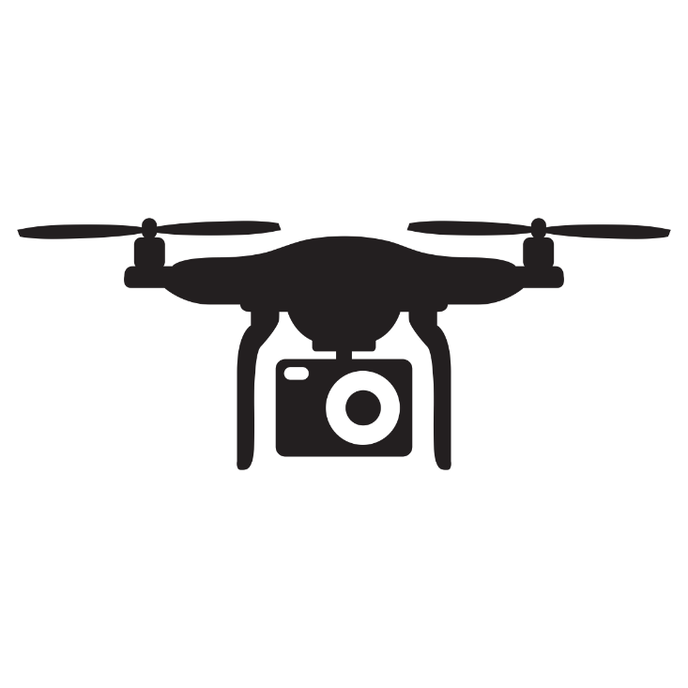


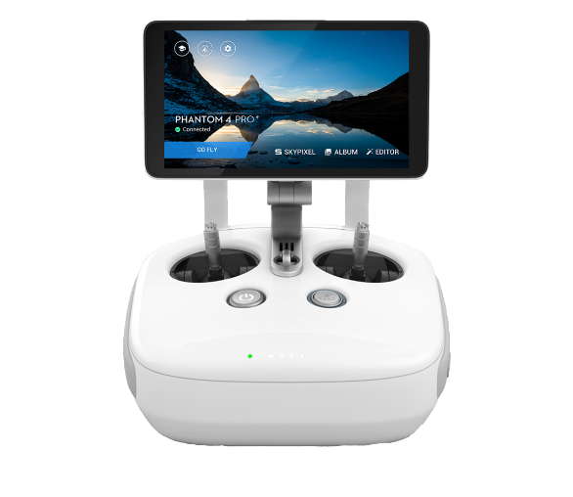
Current Mode of Saving Data in Drone
The camera sends
The data to the drone
firmware
The data gets stored
In the SD card
Camera
Secondary Storage
Control of drone
and live video
transmission
Disadvantages:
If the drone is hacked by the hijackers the
Data in the SD card can be retrieved by the hijackers
Which results in data loss

Slide 4
GOAL
01
To implement privacy policy
02
To provide Data Security and Integrity
03
Simplified Encryption of data
from Drone
04
Use of Cloud Technology

Slide 5



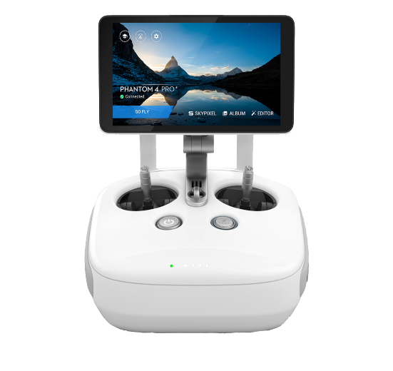
Our Method of Saving Data
The drone Encrypts
the data and sends it
to the Local server
The camera sends
The captured data to
the drones firmware
Video
Transmission
Cloud
Control of drone
The data is encrypted
And sent to the cloud
By AES algorithm
Local Server
Video for User
User with Drone
Controller
Drone Controller

Slide 6



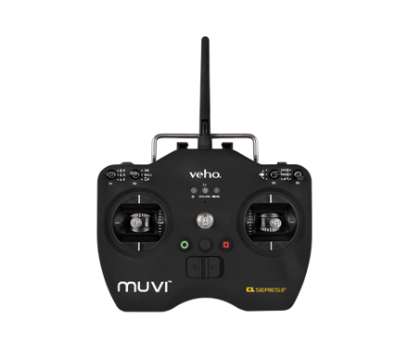
IMPLEMENTATION
Drone Firmware
The stored data is sent to the firmware for Encryption
Data is sent to
the Local Server
Memory
The Encryption of
Data is done by
X-OR Algorithm
The recorded data is
Stored in the Memory
Mobile Network
Tower
Local Server
Live Video
Transmission
4G Internet
Connectivity
Camera
Control Unit With
4G Connectivity
The data is encrypted
By AES Algorithm and
Stored in the Private
Cloud storage
Controls the drone
User controls the Drone
Drone Controller
USER
Cloud

Slide 7


Data Encryption and Decryption Mechanism using X-OR Algorithm
X-OR Encryption
Client - Server
X-OR Decryption
Drone Side
Client - Server
User Side
The data is Encrypted by the Drone by the and it is sent to the local Server
Used for live transmission
Of video to the user and to send the data to cloud
The data is Decrypted at the user side by the user defined key

Slide 8
Data Encryption and Decryption Mechanism using AES Algorithm
Encryption
Cloud
Decryption
User Side
Cloud Server
User Side
Used to store and retrieve the encrypted data from the cloud storage
The data is Decrypted at the user side by the user defined key
The data is Encrypted by the Server by AES Algorithm and it is sent to the cloud

Slide 9
AES Algorithm
Has 128/192/256 bit keys for 128 bit data
Processes data as block of 4 columns of 4 bytes
Operates on entire data block in every round
key is expanded to array of words
designed to have:
resistance against known attacks
speed and code compactness on many CPUs
design simplicity

Slide 10
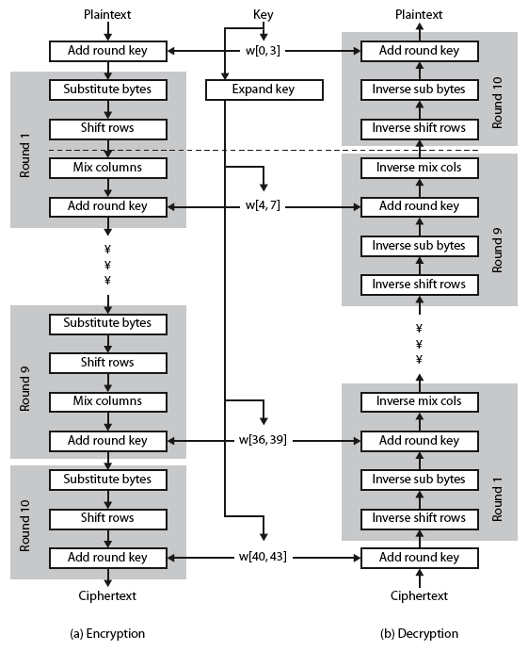

Slide 11
Data Collected by Drone
Mapping and Surveying
Take Measurements
Pictures, videos, etc
Used to locate oil on the sea floor. They collect data from the seabed using sensors.
Communicate its position using GPS for Mapping
Type of Data Collected by Drone
Structured Data - organized into a formatted repository
according to the given category during
fly time

Slide 12
Applications of Drones
Military
Hospitality
Aerial photography
Digital archeology
Environmental analysis
Agricultural analysis
Gas mapping
Coastal surveys

Slide 13
Thank You
Presented By
CODE SLAYERS

