Slide 1


Optimizing Perovskite Solar Cells using SCAPS-1D and Machine Learning Models
Focus: Optical Modeling via Transfer Matrix Method (TMM)
Team: V.Sujay(B22CS063), M. Suresh(B22CS031)
Course: Design Credit Project

Slide 2
Acknowledgements
Mentorship & Guidance: Sincere thanks to Dr. Ravi Prakash Srivastava and TA Nishant Agarwal for their continuous support during this Design Credit Course.
Cross-Disciplinary Learning: Grateful for the opportunity to apply computer science methods to solve complex materials engineering problems.
The "Going Green" Imperative: This project highlighted the critical need for renewable technologies like perovskite solar cells to secure India’s energy future and reduce reliance on depleting fossil fuels.

Slide 3
Objectives & Scope
Bridge the gap between raw optical data and electrical simulation (SCAPS-1D).
Develop an automated Python pipeline to execute the Transfer Matrix Method (TMM) across the 300–900 nm solar spectrum.
Calculate layer-by-layer optical absorptance (A) within the device stack.
Extract the Maximum Theoretical Photocurrent (Jmax) and quantify parasitic optical losses.
Map the internal Electric Field intensity to verify optimal light trapping within the active layer

Slide 4
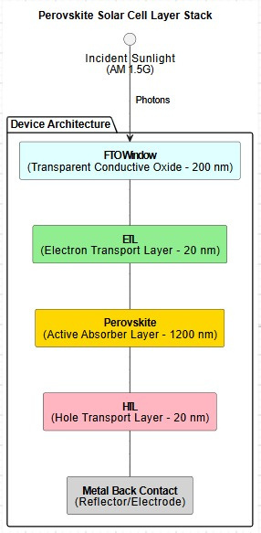
Device Architecture
Illumination Source: Standard AM 1.5G Solar Spectrum (1000 W/m²).
FTO Window (200 nm): Transparent Conductive Oxide.
ETL (20 nm): Electron Transport Layer.
Perovskite (1200 nm): The Active Light-Absorbing Layer.
HTL (20 nm): Hole Transport Layer.
Metal Contact: Back reflector and electrical contact.

Slide 5
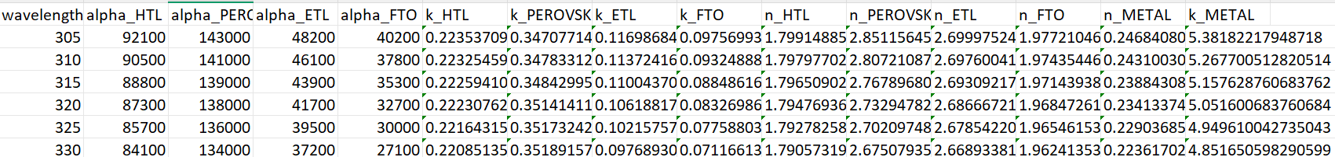
Data Pipeline & Optical Constants
The Challenge: Initial SCAPS data only provided the Absorption Coefficient (α). TMM requires the Complex Refractive Index.
Calculating Extinction Coefficient (k): Measures how fast light energy decays in the material.
k = (αλ) / (4π)
(Where α is absorption coefficient and λ is wavelength)
Estimating Real Refractive Index (n): Measures how much light slows down and bends. Values for the specific stack were curated from established materials literature.
Result: A complete dataset of wavelength-dependent n and k values spanning 300 nm to 900 nm.

Slide 6
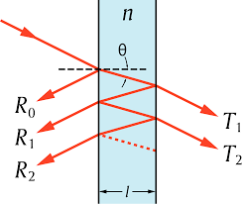
The Transfer Matrix Method (TMM)
The Physical Phenomenon: Thin films cause forward and backward light waves to crash into each other, creating optical interference.
The Mathematical Model: TMM uses linear algebra to track this interference.
Complex Refractive Index (Ñ): Combines bending and absorbing properties into one matrix parameter:
Ñ = n + ik
Algorithm Execution: By multiplying Interface Matrices (reflection) and Propagation Matrices (phase shift), the algorithm calculates the exact fraction of light Reflected (R), Transmitted (T), and Absorbed (A) in each layer.

Slide 7
Results : Optical Absorption Profile
Perovskite Absorption: Exceeds 90% across the visible light spectrum (400 nm - 750 nm), proving the 1200 nm thickness is highly effective.
Parasitic Losses: The FTO layer (blue area) exhibits heavy parasitic absorption in the Ultraviolet range (< 400 nm), turning potential energy into wasted heat.
Reflectance: Demonstrates minimal light lost to bouncing off the front glass.

Slide 8
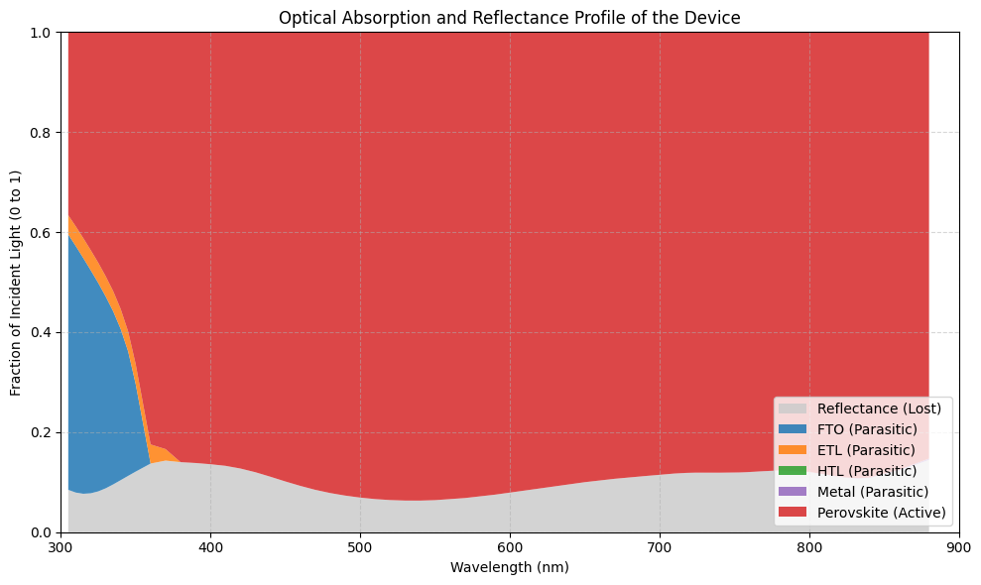
Results : Optical Absorption Profile

Slide 9
Results : Theoretical Photocurrent (Jmax)
Goal: Convert optical absorptance percentages into real-world electrical current generation potential.
Integration: Absorptance is mapped against the AM 1.5G standardized solar photon flux.
Photocurrent Formula: Assuming 100% Internal Quantum Efficiency (1 photon = 1 electron):
J = q · Φ · A
(Where q is electron charge Φ is solar photon flux, and A is TMM absorptance)
Result: The model calculates a Maximum Theoretical Photocurrent (Jmax) of 41.22 mA/cm².

Slide 10
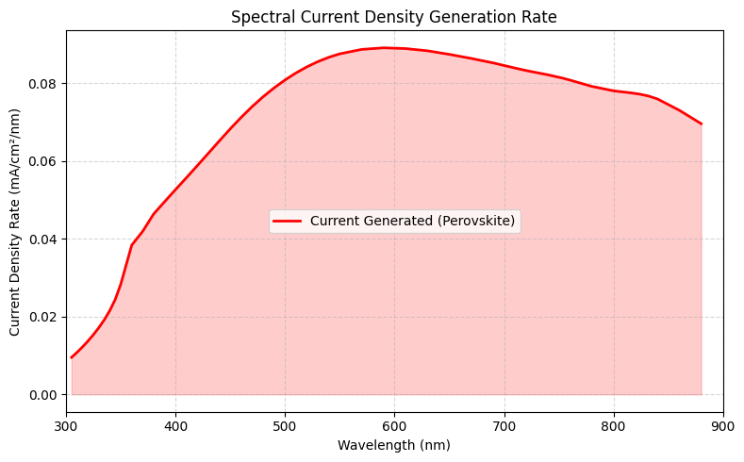
Results : Theoretical Photocurrent (Jmax)

Slide 11
Results : Internal Electric Field Profile(|E|2)
Purpose: To verify where the light energy is physically localized inside the solar cell depth.
The Math: Total electric field is the sum of forward and backward waves. Optical intensity is the square of this field:
Intensity = |Eforward + Ebackward|2
Analysis:
Complete Optical Absorption: Rapid exponential decay proves the 1200 nm perovskite layer successfully absorbs nearly 100% of incident light.
No Interference Spikes: Because light is fully absorbed before reaching the rear mirror, no backward waves exist to create standing waves.
Conclusion: Validates that the device architecture effectively traps light for maximum exciton (electron-hole) generation.

Slide 12
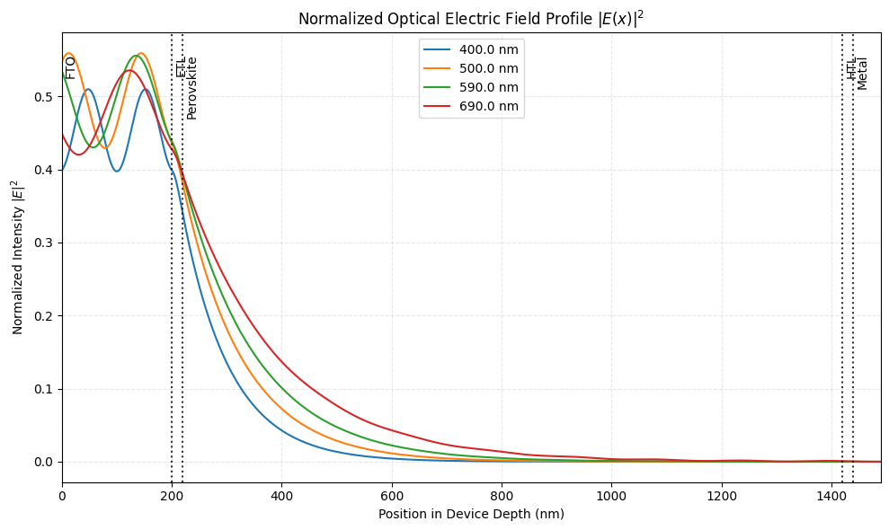
Results : Internal Electric Field Profile(|E|2)

Slide 13

Conclusion
Successfully built an automated, Python-based optical simulation environment.
Quantified the absolute optical limits of the provided device architecture.
Extracted the critical Jmax parameter.
Next Steps: This verified optical data is now ready to be fed into the Machine Learning models and SCAPS-1D for the electrical optimization phase.

Slide 14
References
[1]Benatto, L., et al. (2024). TMM-Sim: A versatile tool for optical simulation of thin-film solar cells. Computer Physics Communications, 300, 109206.
[2]Saikia, D., et al. (2022). Performance evaluation of an all inorganic CsGeI3 based perovskite solar cell by numerical simulation. Optical Materials, 123, 111839.
[3]Byrnes, S. J. (2016). Multilayer optical calculations. arXiv preprint arXiv:1603.02720. (Source methodology for the Python tmm module).

Slide 15

Thank you

