Slide 1
Rethinking Evaluation Methods for Unsupervised Word Embeddings
Tobias Schnabel, Igor Labutov, David Mimno, Thorsten Joachims
Presented by: - V Sujay (B22CS063)
- Nikshiptha S (B22CS050)
- Aiswarya K (B22CS028)

Slide 2
How do we accurately measure if a machine understands the meaning of a word?
A Simple Exercise: How similar are the words "tiger" and "fauna" on a scale from 0 to 10?
The Problem: Standard human datasets (like WordSim-353) score this as 5.62, but with a massive standard deviation of sigma=2.9
Agenda: We will explore the mathematical flaws in traditional evaluations, introduce comparative and set-based evaluation methods, and analyze downstream model performance

Slide 3
Background - The Geometry of Meaning
Word Embeddings: A mapping that transforms a word w from a vocabulary V into a real-valued vector w in a high-dimensional space.
Dimensionality: In these experiments, words are embedded into a 50-dimensional space (eg: D = 50).
The Goal: The geometric relationship between two vectors should directly mirror the linguistic relationship between the two words.
Evaluated Models: The paper evaluates six representative models, including prediction-based models (CBOW, C&W) and reconstruction-based models (GloVe, TSCCA, Random Projections, Hellinger PCA).

Slide 4

The Mathematics of Similarity
Measuring Distance: To determine how close two words are in the vector space, we calculate the cosine similarity.
The Formula:
Nearest Neighbors: We evaluate a query word $w$ by sorting all other words $v$ in the vocabulary in descending order based on this similarity score

Slide 5
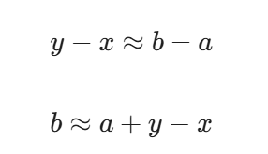

Intrinsic Metrics: The Mathematics of the Analogy Task
The Goal: Measuring if semantic relationships translate to geometric translations in the vector space.
The Analogy Format: Find a term b for a given term a so that a:b best resembles a sample relationship x:y
Vector Arithmetic:
Workout Example:
Evaluation: The model is scored on absolute accuracy—whether the closest vector to the calculated coordinate is the exact correct word.

Slide 6
The Flaw in Absolute Intrinsic Evaluation
Current Standard: Datasets ask humans for absolute similarity scores, and models are evaluated based on correlation coefficients.
Conceptual Flaws:
Arbitrary Aggregation: It forces humans to order completely unrelated pairs. For example, deciding if the pair (dog, cat) is mathematically more similar than (banana, apple).
Opportunistic Data: Existing query inventories were collected heuristically and are poorly calibrated to real-world corpus statistics.

Slide 7
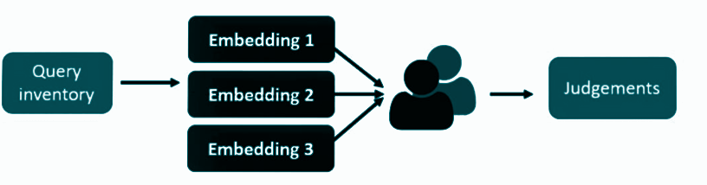
Proposed Method 1 - Comparative Evaluation
The Shift: Instead of absolute scores, present the task as a direct choice problem for human evaluators.
Advantages:
Directly reflects human preferences.
Asking for relative judgments is cognitively easier for humans than assigning absolute numerical scores.

Slide 8
Designing a Better Query Inventory
The Goal: The query inventory must aim for linguistic insight through diversity and balancedness.
Balancing Criteria:
Balance rare vs. frequent words (e.g., play vs. devour).
Balance POS classes (e.g., skillfully vs. piano).
Balance abstractness vs. concreteness (e.g., eagerness vs. table).
Workout Example:
Query: skillfully
Options: (a) swiftly, (b) expertly, (c) cleverly, (d) pointedly
Human Consensus: $8/8$ votes for (b) expertly

Slide 9
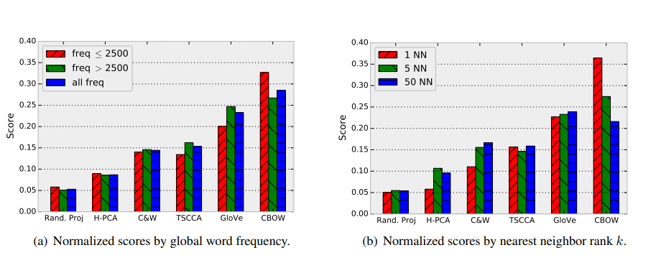
Results of Comparative Evaluation
Overall Performance: The CBOW model generally performed the best, while Random Projections performed the worst.
The Nuance: Performance heavily varies with word frequency.
Rank Falloff: Models exhibit different falloff behaviors; for example, CBOW excels at finding the exact first nearest neighbor (1 NN) but its accuracy drops for neighbors further away.

Slide 10
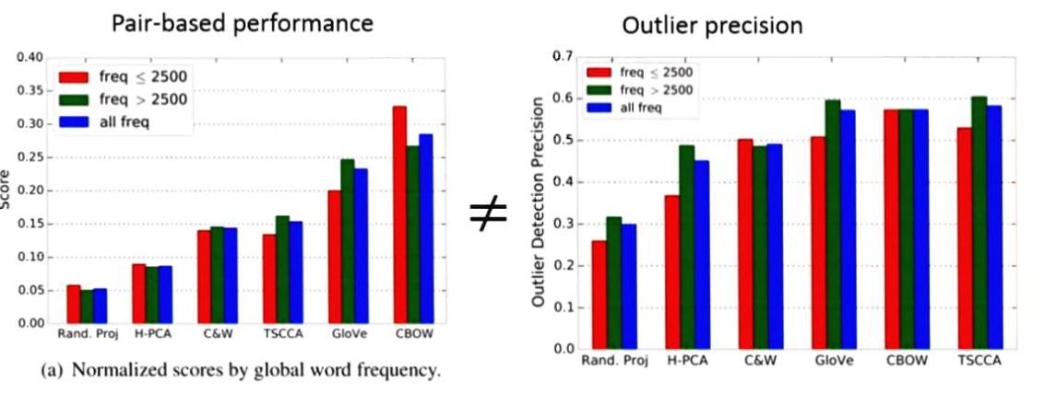
Workout Demo - The Intrusion Task
Task: What word belongs the least to the following group?
(a) finally
(b) eventually
(c) put
(d) immediately
Result: The answer is put (8/8 human votes).
Implication: Embeddings that group "put" with time-based adverbs lack local geometric coherence.

Slide 11
Proposed Method 2 - Set-Based Evaluation (Coherence)
The Limitation of Pairs: Standard metrics only evaluate the similarity between two specific words, which ignores global properties.
Set-Based Evaluation: We must look at the neighborhood of words as a whole considering all interactions.
Goal: Measure coherence. Good embeddings should have tight, consistent local neighborhoods.
The Intrusion Task: Take three close neighbors from a model, inject an "intruder" word of similar corpus frequency, and test if humans can identify the outlier.

Slide 12
Code Demo - Automating the Intrusion Task
Interactive Demo: colab link
The Goal: Build a script that mimics human intuition by automatically detecting the semantic outlier in a vector space.
Algorithm Steps:
Load the multi-dimensional word embeddings.
Define a "centroid" or query word for the local cluster (e.g., eventually).
Calculate the Cosine Similarity for all words in the candidate pool.
Automatically flag the word with the lowest mathematical similarity as the "Intruder".
Visualize the geometric distance.

Slide 13
Extrinsic Tasks (The Downstream Reality)
Extrinsic Evaluation: Using word embeddings as input features for downstream supervised NLP tasks.
The Core Hypothesis: Better intrinsic quality also gives better downstream performance.
The Tasks Tested:
Noun phrase chunking: Highly sensitive to syntactic information.
Sentiment classification: Highly sensitive to semantic information using 50K movie reviews.

Slide 14
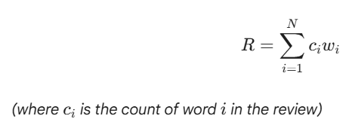
Extrinsic Architecture: From Vector to Classification
The Question: How do we convert single word embeddings into a prediction for an entire document?
Sentiment Classification Architecture:
Dataset: 50,000 movie reviews.
Document Feature Vector Equation: Compute a linear combination of word embeddings weighted by their frequency in the text.
Classifier: The resulting vector $\vec{R}$ is fed into a LIBLINEAR logistic regression model.
Noun Phrase Chunking Architecture: Word vectors are normalized to unit length and fed into a Conditional Random Field (CRF).

Slide 15
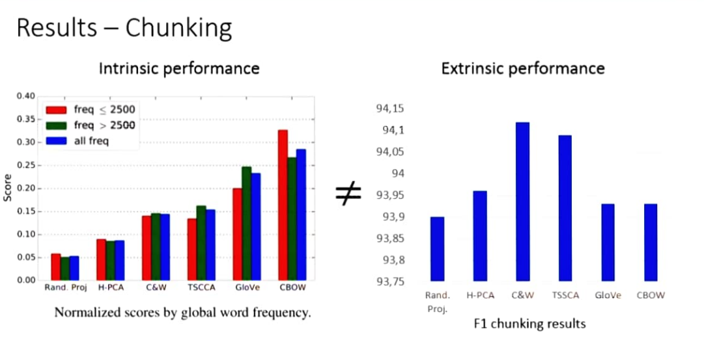
The Mismatch - Intrinsic vs. Extrinsic
The Findings: The core hypothesis is false; better intrinsic performance does not lead to better extrinsic results.
Conclusion: Different tasks favor different embeddings. We cannot use generic intrinsic metrics as a proxy for abstract embedding quality.

Slide 16
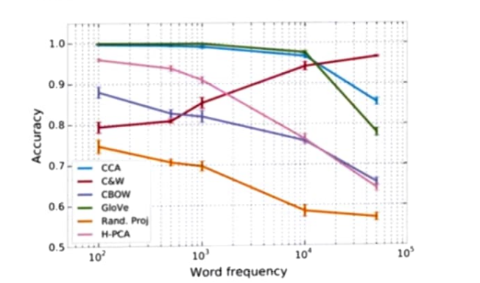
The Hidden Culprit - Word Frequency
The Twist: Embeddings encode unwanted information—specifically, word frequency.
The Experiment: The authors trained a logistic classifier to predict if a word was rare or frequent based purely on its normalized vector.
The Result: Models like GloVe and TSCCA achieved nearly 100% accuracy in predicting frequency.

Slide 17
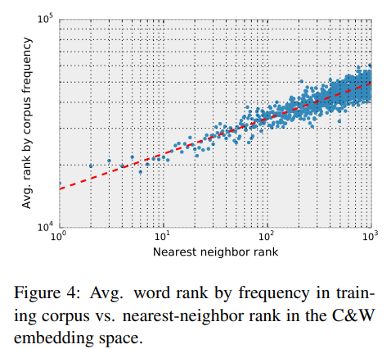

The Mathematics of Frequency Bias
The Power Law Relationship: A word's nearest-neighbor rank is mathematically bound to its frequency in the training corpus.
The Equation:
The Implication: Frequent words are geometrically pulled closer to all other words, meaning cosine similarity naturally conflates a word's meaning with its popularity.

Slide 18
Implications & Conclusions
The Core Issue: Cosine similarity gets polluted by frequency-based effects. Frequent words are artificially pulled closer together in the vector space.
Practical Recommendations:
Specify Goals: Specify the exact downstream goal of an embedding method before evaluating.
Better Data: Use data from comparative experiments to do offline evaluation.
Custom Metrics: We must learn custom metrics for specific tasks (e.g., semantic relatedness vs. syntactic similarity) rather than blindly relying on cosine similarity.

