Slide 1
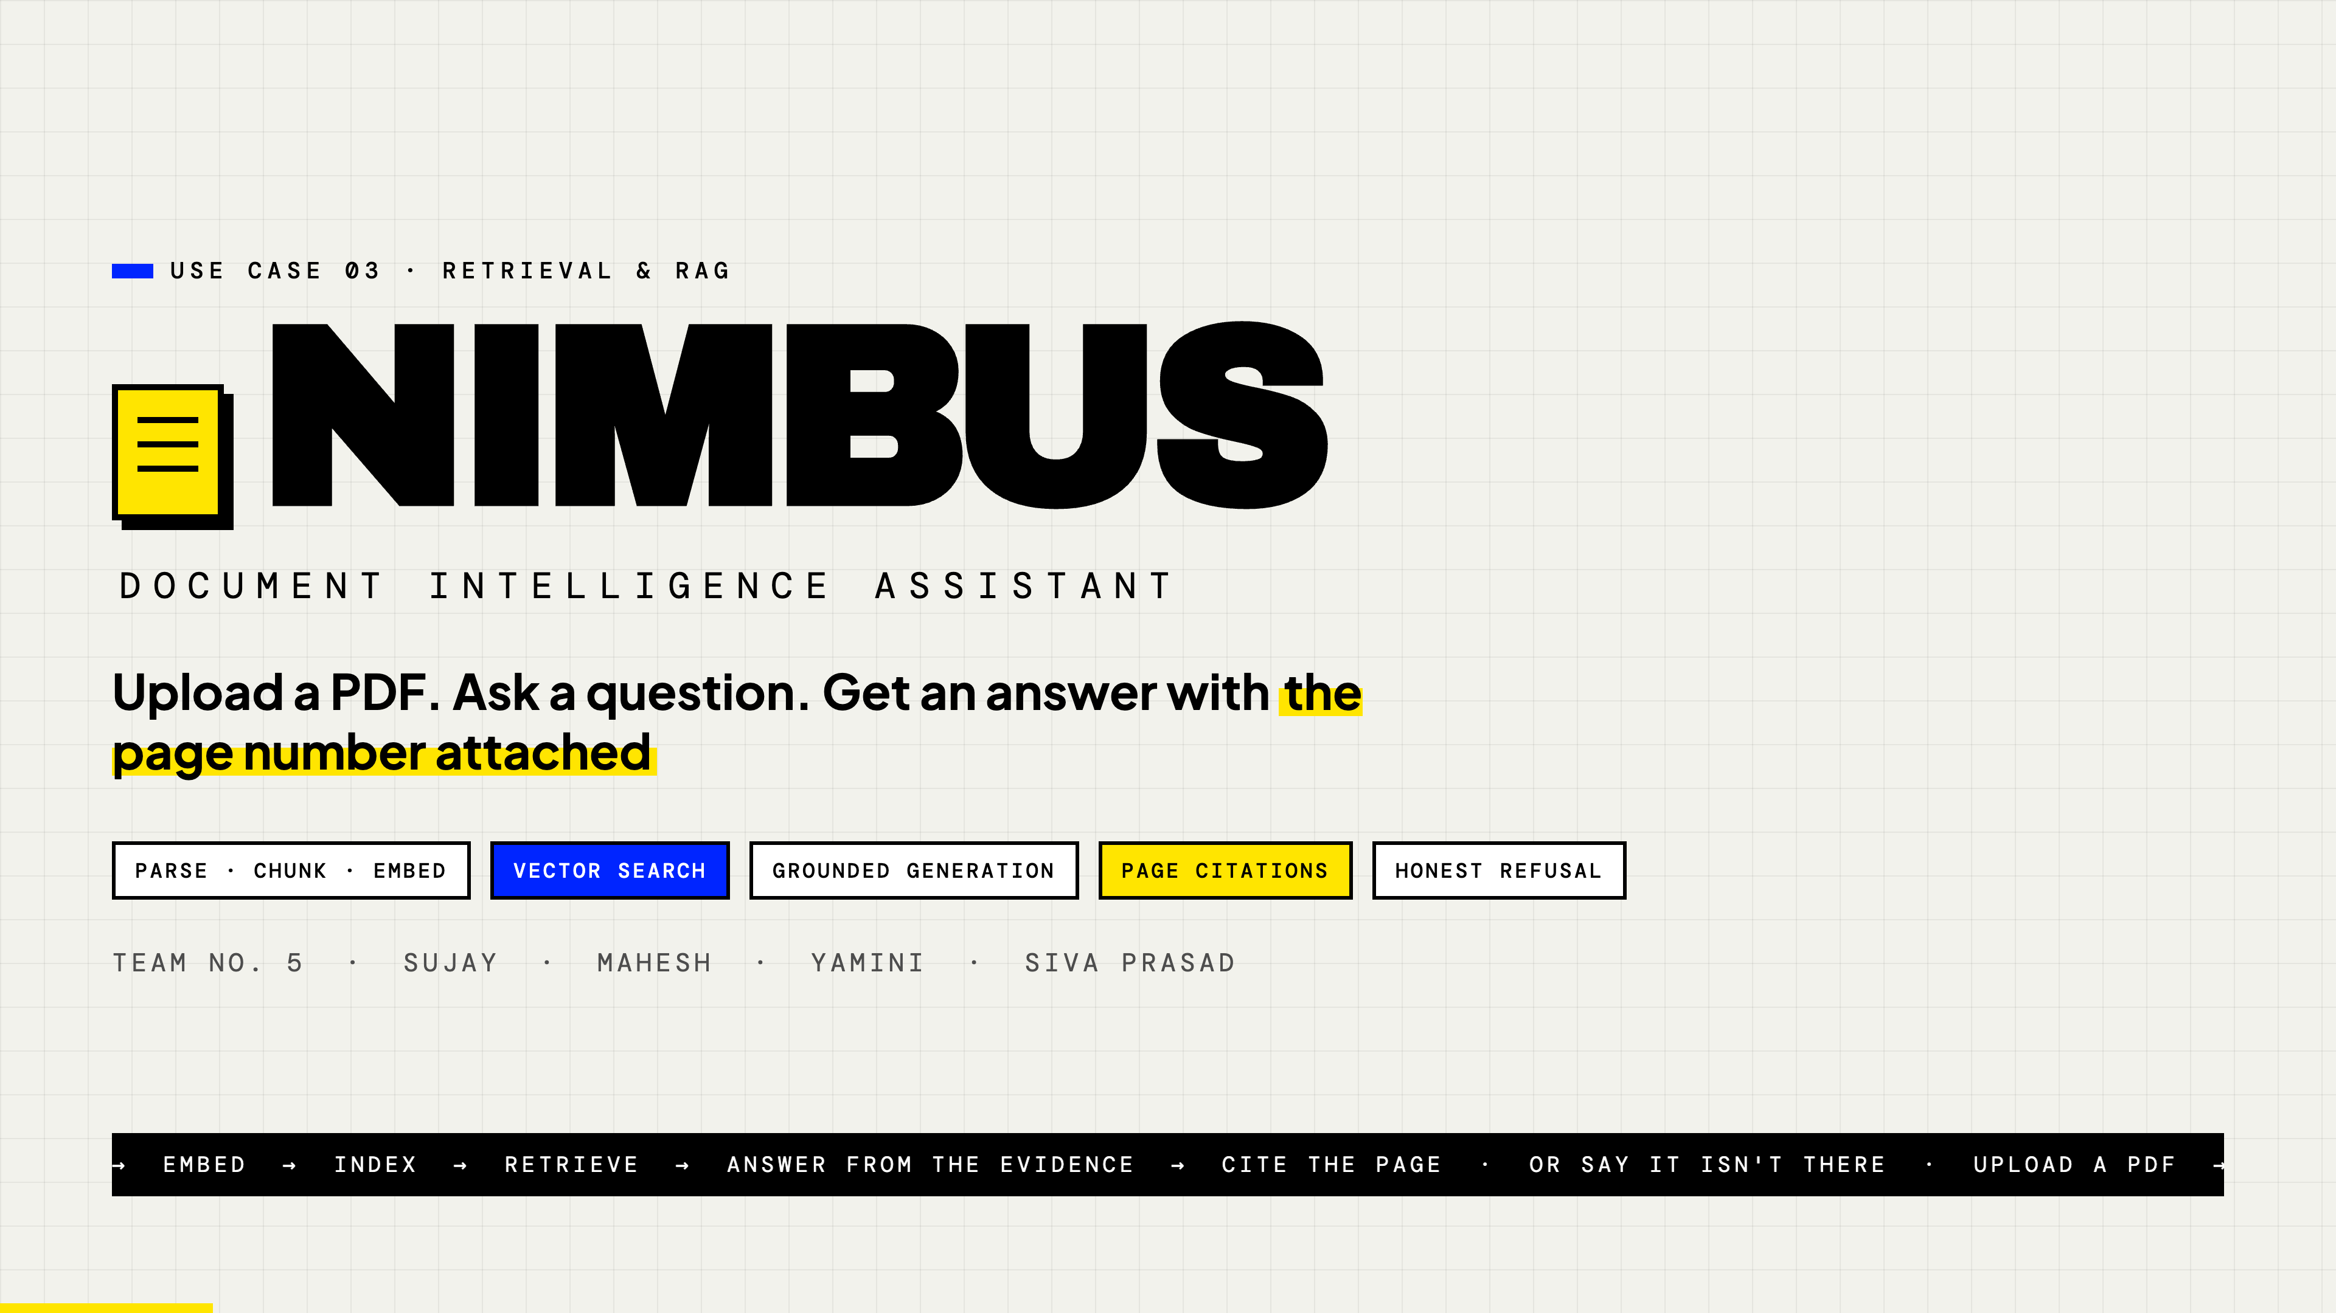
Notes:
Title — Nimbus
Open here while people settle.
SAY: "We're team 5. Our use case was Retrieval and RAG: build something that lets you
upload a PDF and ask it questions. What we built is called Nimbus. The one thing I'd like
you to watch for is the page number on every answer — that's the whole point of the project."
Keep this to about 20 seconds. Don't read the chips.

Slide 2
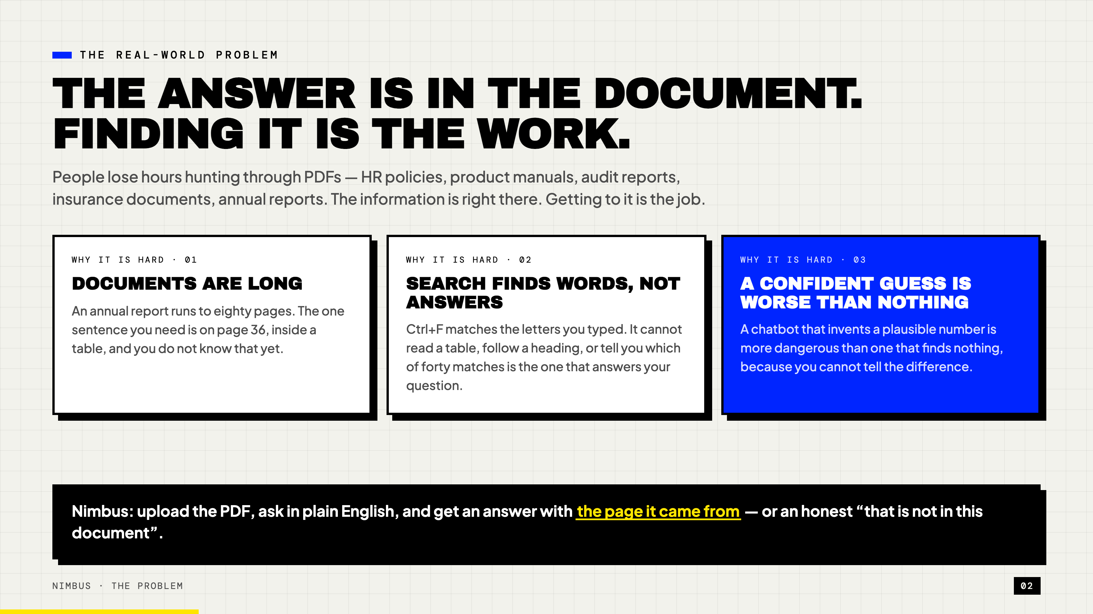
Notes:
The real-world problem
SAY: "The problem isn't that the information is missing. In an eighty-page annual report,
the answer is definitely in there. The problem is that finding it takes twenty minutes.
Ctrl+F doesn't solve it, because Ctrl+F matches letters, not meaning. Search 'how much did
we earn' and you get nothing, because the document says 'total revenue'.
And the obvious fix — just ask ChatGPT — creates a worse problem. A model that invents a
plausible-looking number is more dangerous than one that finds nothing, because you can't
tell which one you got."
That third card is the setup for everything after it. Land it.

Slide 3
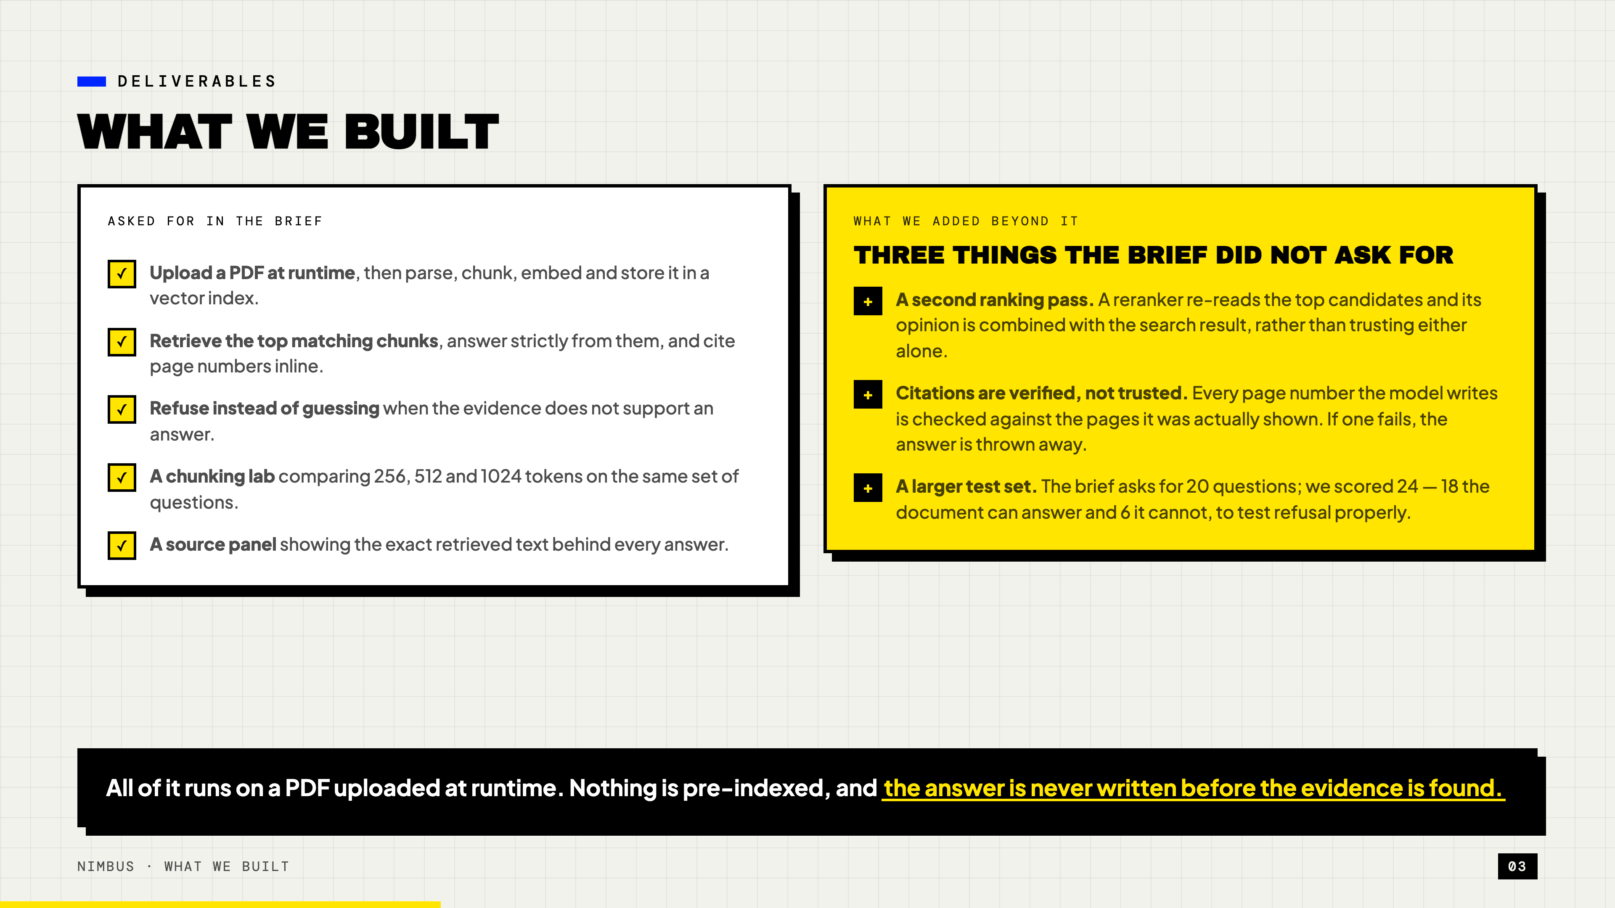
Notes:
What we built
This slide exists so the evaluators can tick their own checklist. Go left to right, fast.
SAY: "Left side is what the brief asked for — all five, all working. Upload at runtime,
retrieve and cite, refuse instead of guessing, a chunking experiment, and a source panel.
Right side is what we added. The one I'd point at is the middle one: we don't trust the
model's citations. Every page number it writes gets checked against the pages it was
actually shown, and if one doesn't match, we throw the whole answer away and refuse instead."
IF ASKED why 24 questions instead of 20: 18 the document can answer, 6 it can't. You can't
test refusal without questions that have no answer.

Slide 4
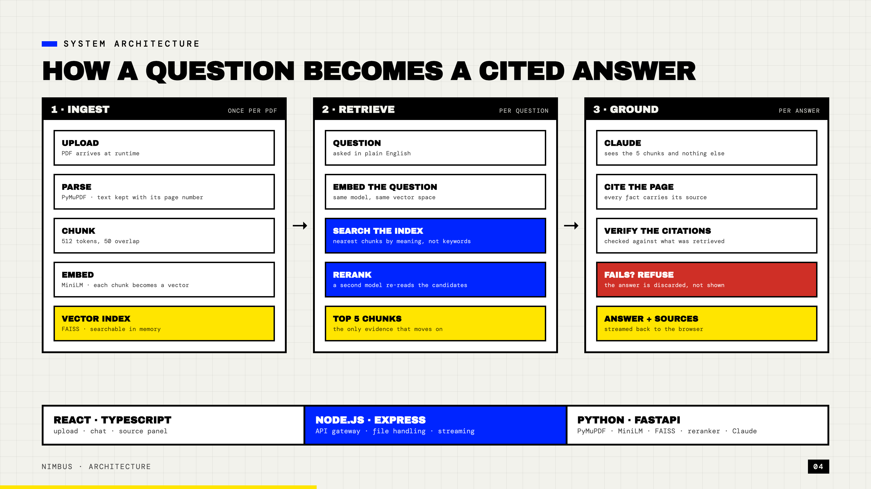
Notes:
Architecture
The most important slide. Slow down here. Walk the three lanes left to right.
SAY: "Read this left to right. Lane one happens once, when you upload a PDF. We pull the
text out page by page, cut it into 512-token chunks, turn each chunk into a vector, and put
those vectors in a FAISS index.
Lane two happens every time someone asks a question — and this is the retrieval part, which
is really the heart of it. We turn the question into a vector using the same model, so the
question and the chunks live in the same space. Then we ask the index for the nearest chunks
by meaning, not by keyword.
But we don't stop there. Nearest-by-vector is fast and rough. So a second model — a reranker
— re-reads the top candidates against the actual question and re-orders them. We combine both
opinions rather than trusting either one, and that combination beats both of them on its own.
Five chunks survive. That's the only evidence that moves forward.
Lane three: Claude sees those five chunks and nothing else. No training data, no internet. It
writes the answer and marks each fact with its page. Then we verify every citation, and if any
of them doesn't check out, the answer is discarded and the user gets a refusal instead."
The strip at the bottom is the stack — mention it in one breath, don't dwell.

Slide 5
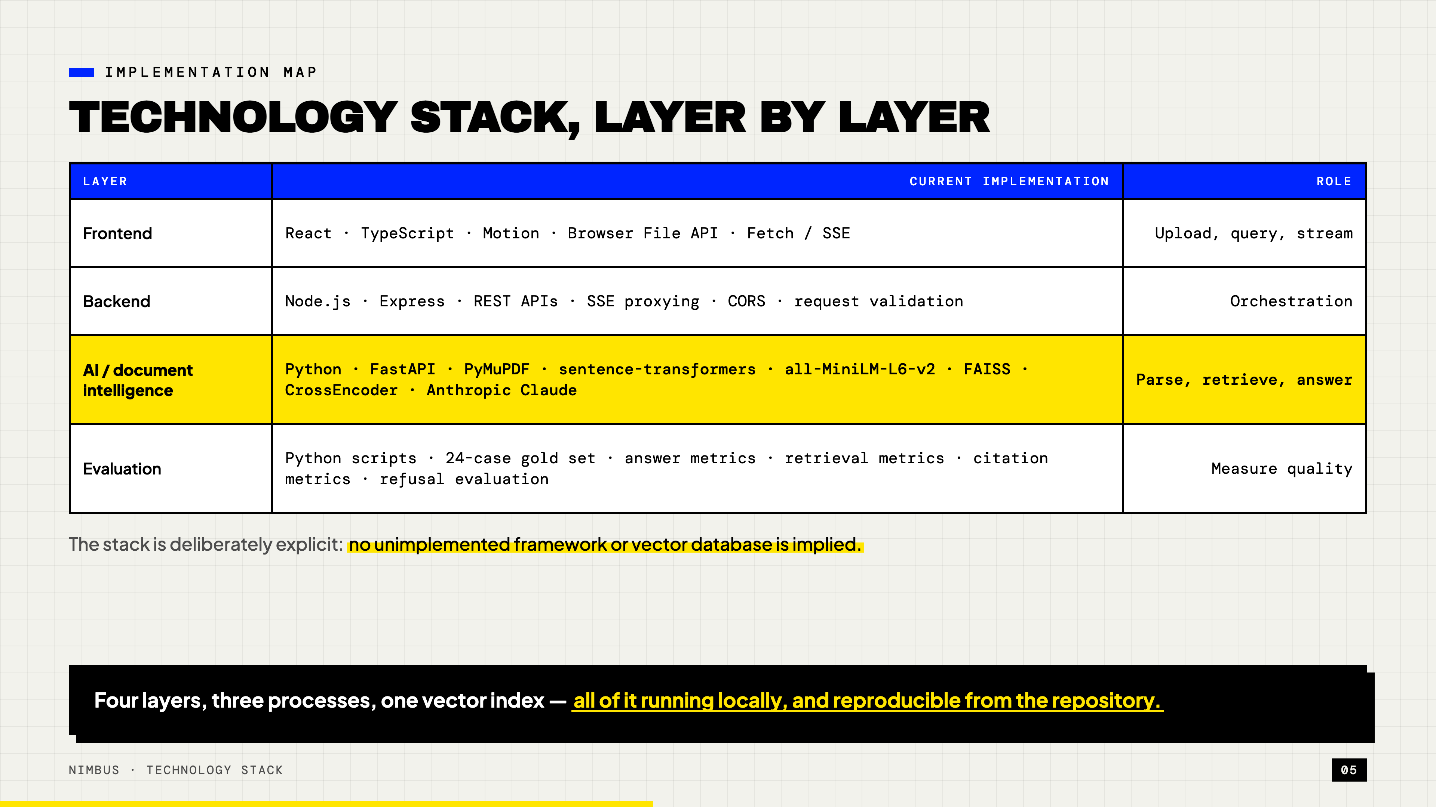
Notes:
Technology stack
Don't read the table. Point at one row and move.
SAY: "Four layers. The one that matters is the third — that's where the document intelligence
actually lives. PyMuPDF reads the PDF, sentence-transformers and MiniLM turn text into vectors,
FAISS searches them, a CrossEncoder re-ranks, and Claude writes the answer.
The line underneath is deliberate. Everything listed here is actually running — there is
nothing on this slide we planned and didn't build."
IF ASKED why no LangChain or LlamaIndex: for a pipeline this size a framework adds indirection
without removing work, and it makes it harder to say exactly what happens between question and
answer. Ours is a handful of explicit Python modules we can test one at a time.
IF ASKED why FAISS rather than Pinecone or pgvector: for one document with 127 chunks an
in-process index is faster than a network call and gives exact matches rather than approximate
ones. A hosted service earns its place at a much larger scale than this.
IF ASKED whether any model was fine-tuned: no, everything is off the shelf. All of the gain
came from how they are combined.

Slide 6
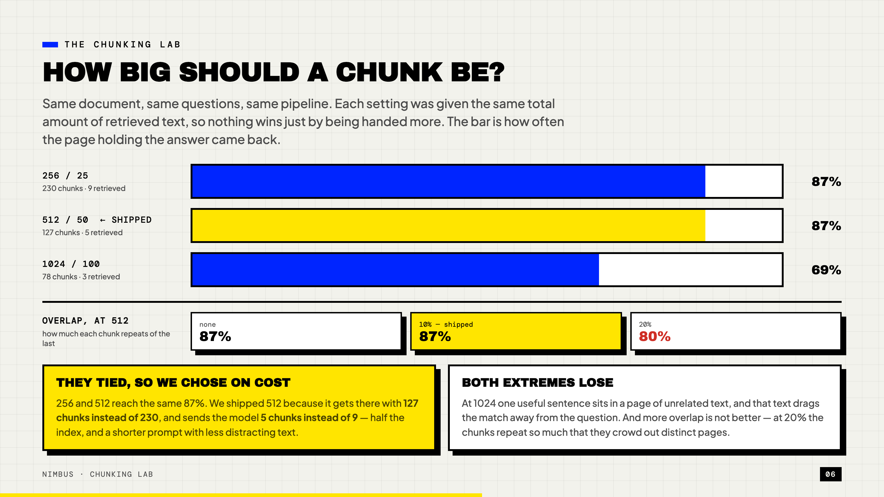
Notes:
The chunking lab
A required deliverable. Be precise, and own the tie — it is a better story than a winner.
SAY: "The brief asked us to compare chunk sizes and overlaps, so we did. Same document, same
questions, and one important control: each setting got the same total amount of retrieved text,
so nothing wins just by being handed more material.
The result is more interesting than a winner. 256 and 512 tie at 87%. Once the full ranking
stack runs, chunk size below 1024 stops mattering. So we chose on cost — 512 reaches the same
number with 127 chunks instead of 230, and sends the model five chunks instead of nine. Half the
index, and a shorter prompt with less distracting text.
1024 loses badly, and that makes sense: one useful sentence sitting in a page of unrelated text,
and the unrelated text drags the match away from the question.
The overlap row surprised us. Twenty percent is worse than ten or none — past a point the chunks
just repeat each other and crowd out distinct pages."
IF ASKED what overlap is for: the end of one chunk repeats at the start of the next, so a
sentence that straddles a boundary still appears whole somewhere.
IF ASKED "so chunk size doesn't matter?": it matters a great deal for raw vector search — there
256 scores 87% and 512 only 73%. The reranker and the fusion absorb the difference. Worth
knowing: a weaker retrieval stack would need the smaller chunks.

Slide 7
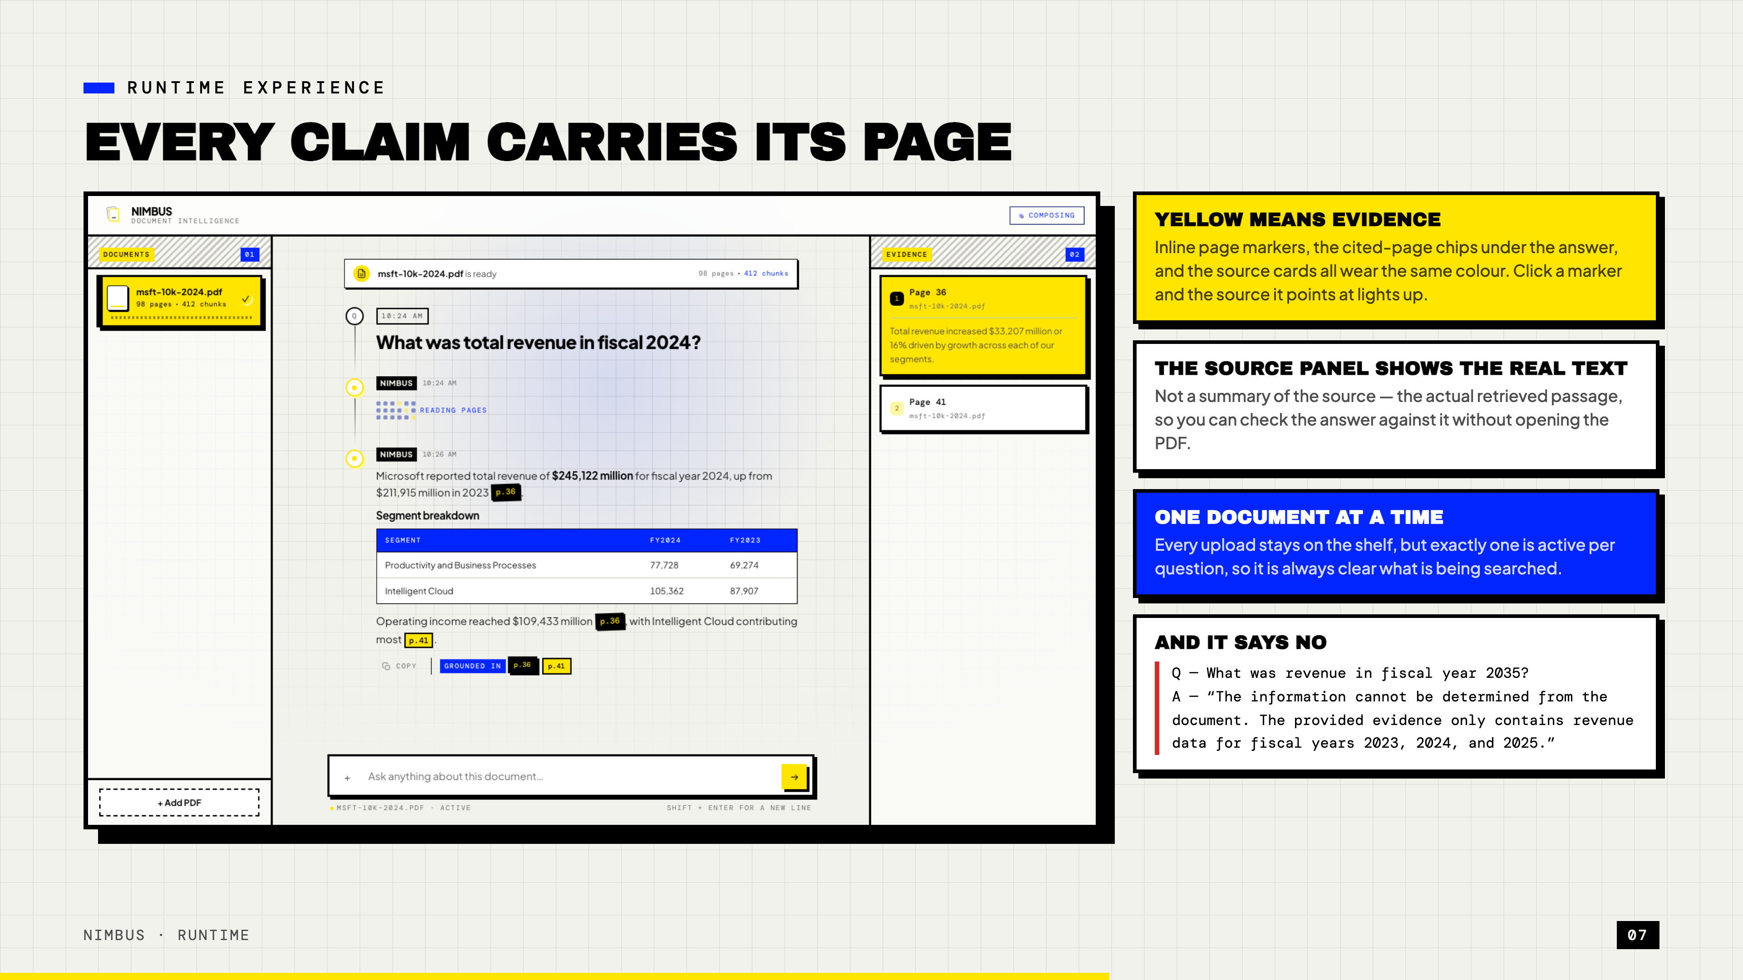
Notes:
Runtime — every claim carries its page
Live demo slot. If the demo is risky, talk over the screenshot.
SAY: "Yellow always means evidence. The page markers inside the answer, the chips under it,
and the source cards on the right all wear the same colour — click a marker and the source it
points at lights up.
The source panel shows the actual retrieved text, not a summary of it, so you can check the
answer without opening the PDF.
And the bottom card is the part we're most pleased with. Ask it about fiscal year 2035 and it
doesn't guess — it tells you the document only covers 2023 to 2025."
DEMO ORDER (safe): one factual question, one broad question, then the refusal.

Slide 8
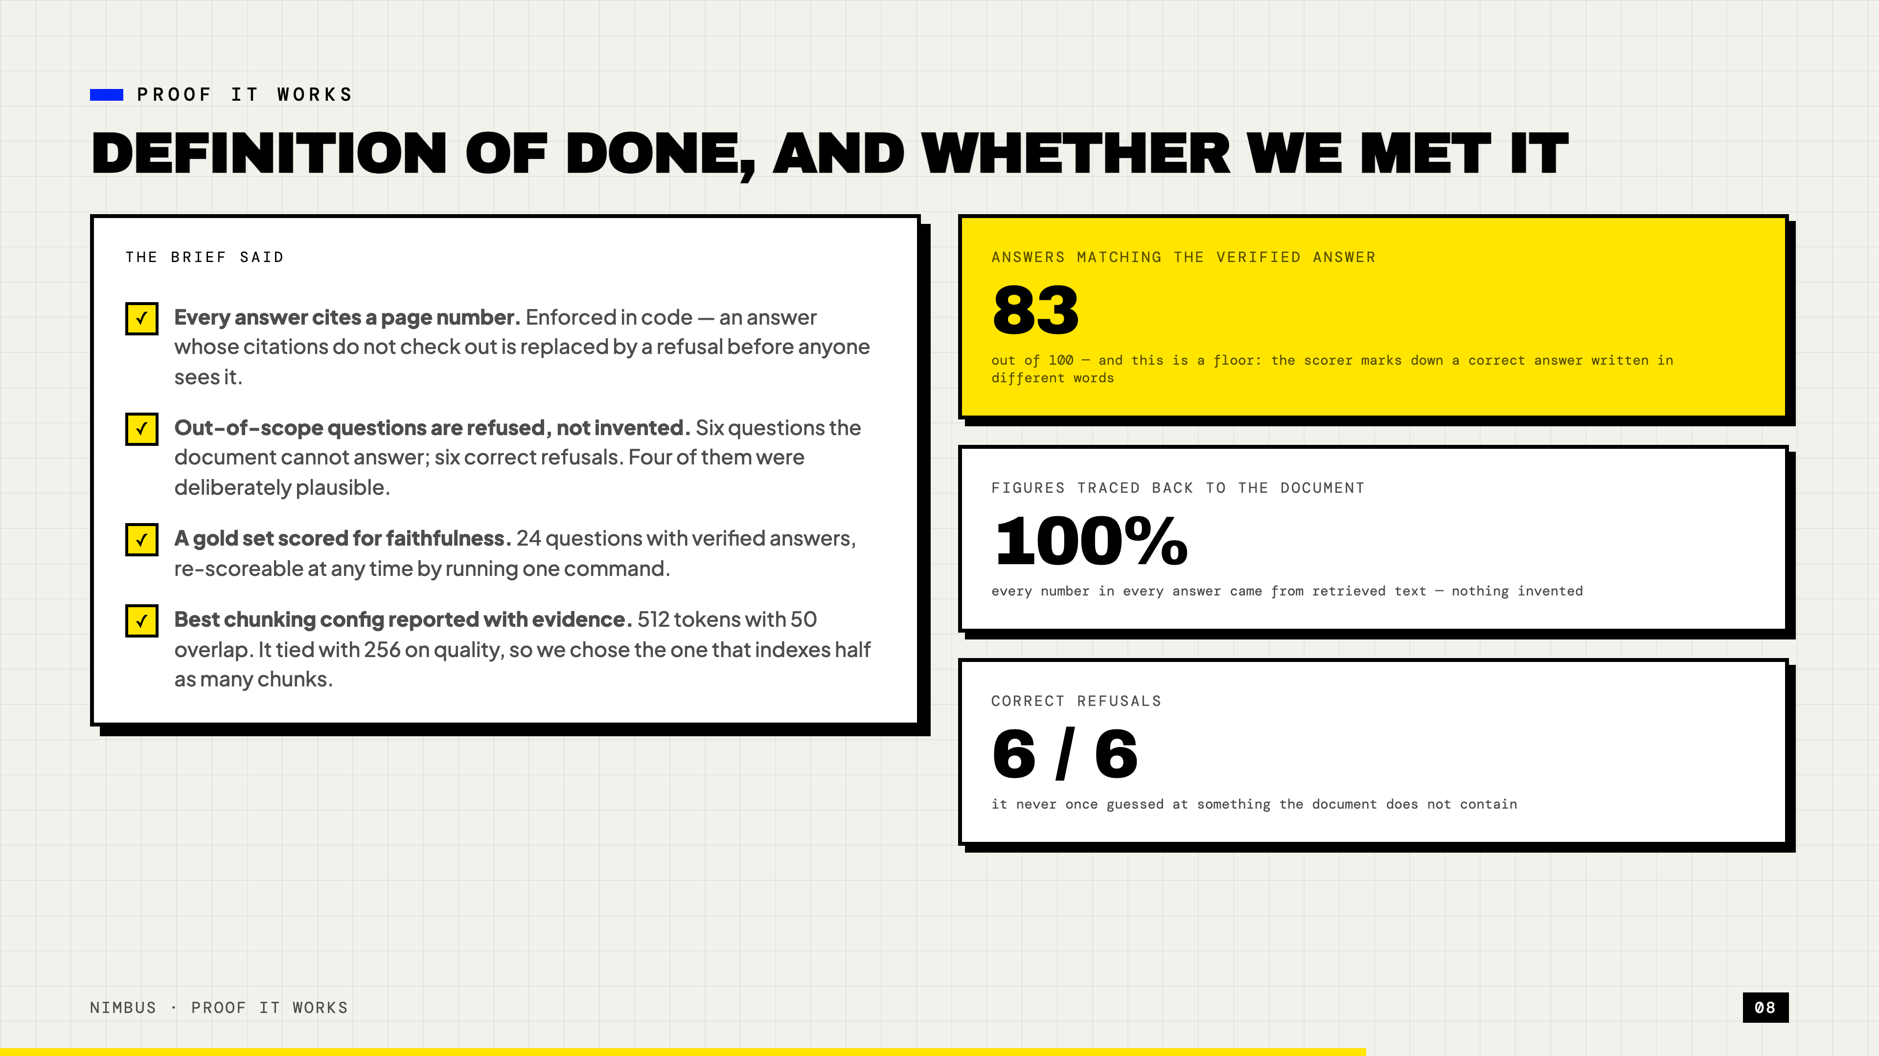
Notes:
Proof it works
SAY: "The brief gave us a definition of done, so here it is answered directly.
Every answer cites a page — that's enforced in code, not hoped for. Out-of-scope questions
refused: six out of six, and four of those six were deliberately plausible, things an annual
report might contain but this one doesn't. Gold set scored. Best chunking config reported
with evidence, which you just saw.
The three numbers on the right: 83 out of 100 on matching the verified answer. 100% of figures
traced back to the document — nothing invented anywhere. And six out of six refusals."
IF ASKED why only 83: our scorer compares wording, so a correct answer phrased differently
gets marked down. It's a floor, not a ceiling.

Slide 9
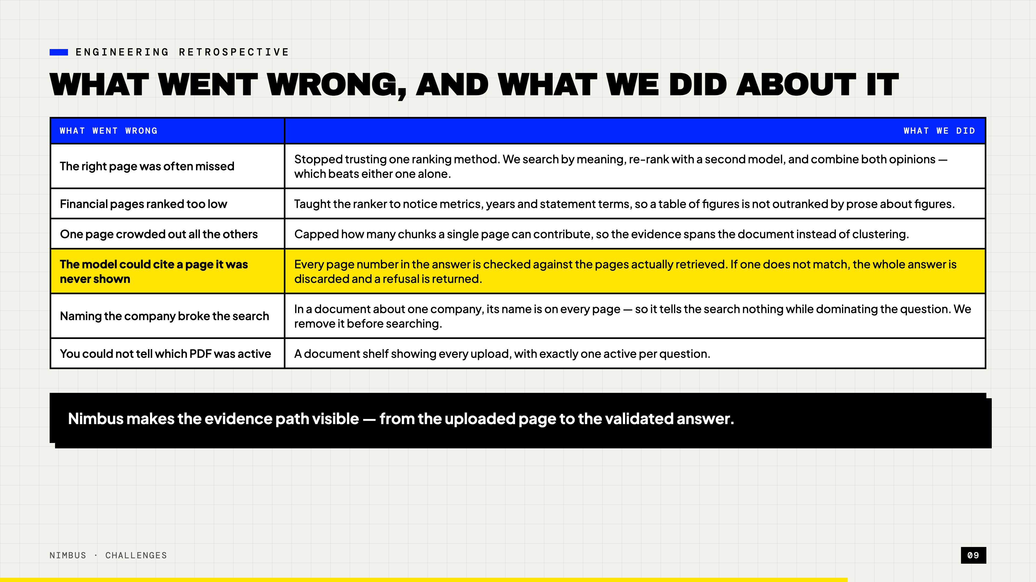
Notes:
Challenges and fixes
The story slide. Pick two rows, don't read the table.
SAY: "Two I'd highlight. The yellow row: early on, the model could cite a page it had never
been shown. Now every page number gets checked against what was actually retrieved, and a
failed check throws the answer away.
And the one below it is my favourite. In a document about one company, that company's name is
on every single page — so it tells the search nothing, but it dominates the question and
crowds out the words that actually matter. We strip it out before searching."
IF ASKED for a number: combining the two ranking methods took recall from 73% to 87%.

Slide 10
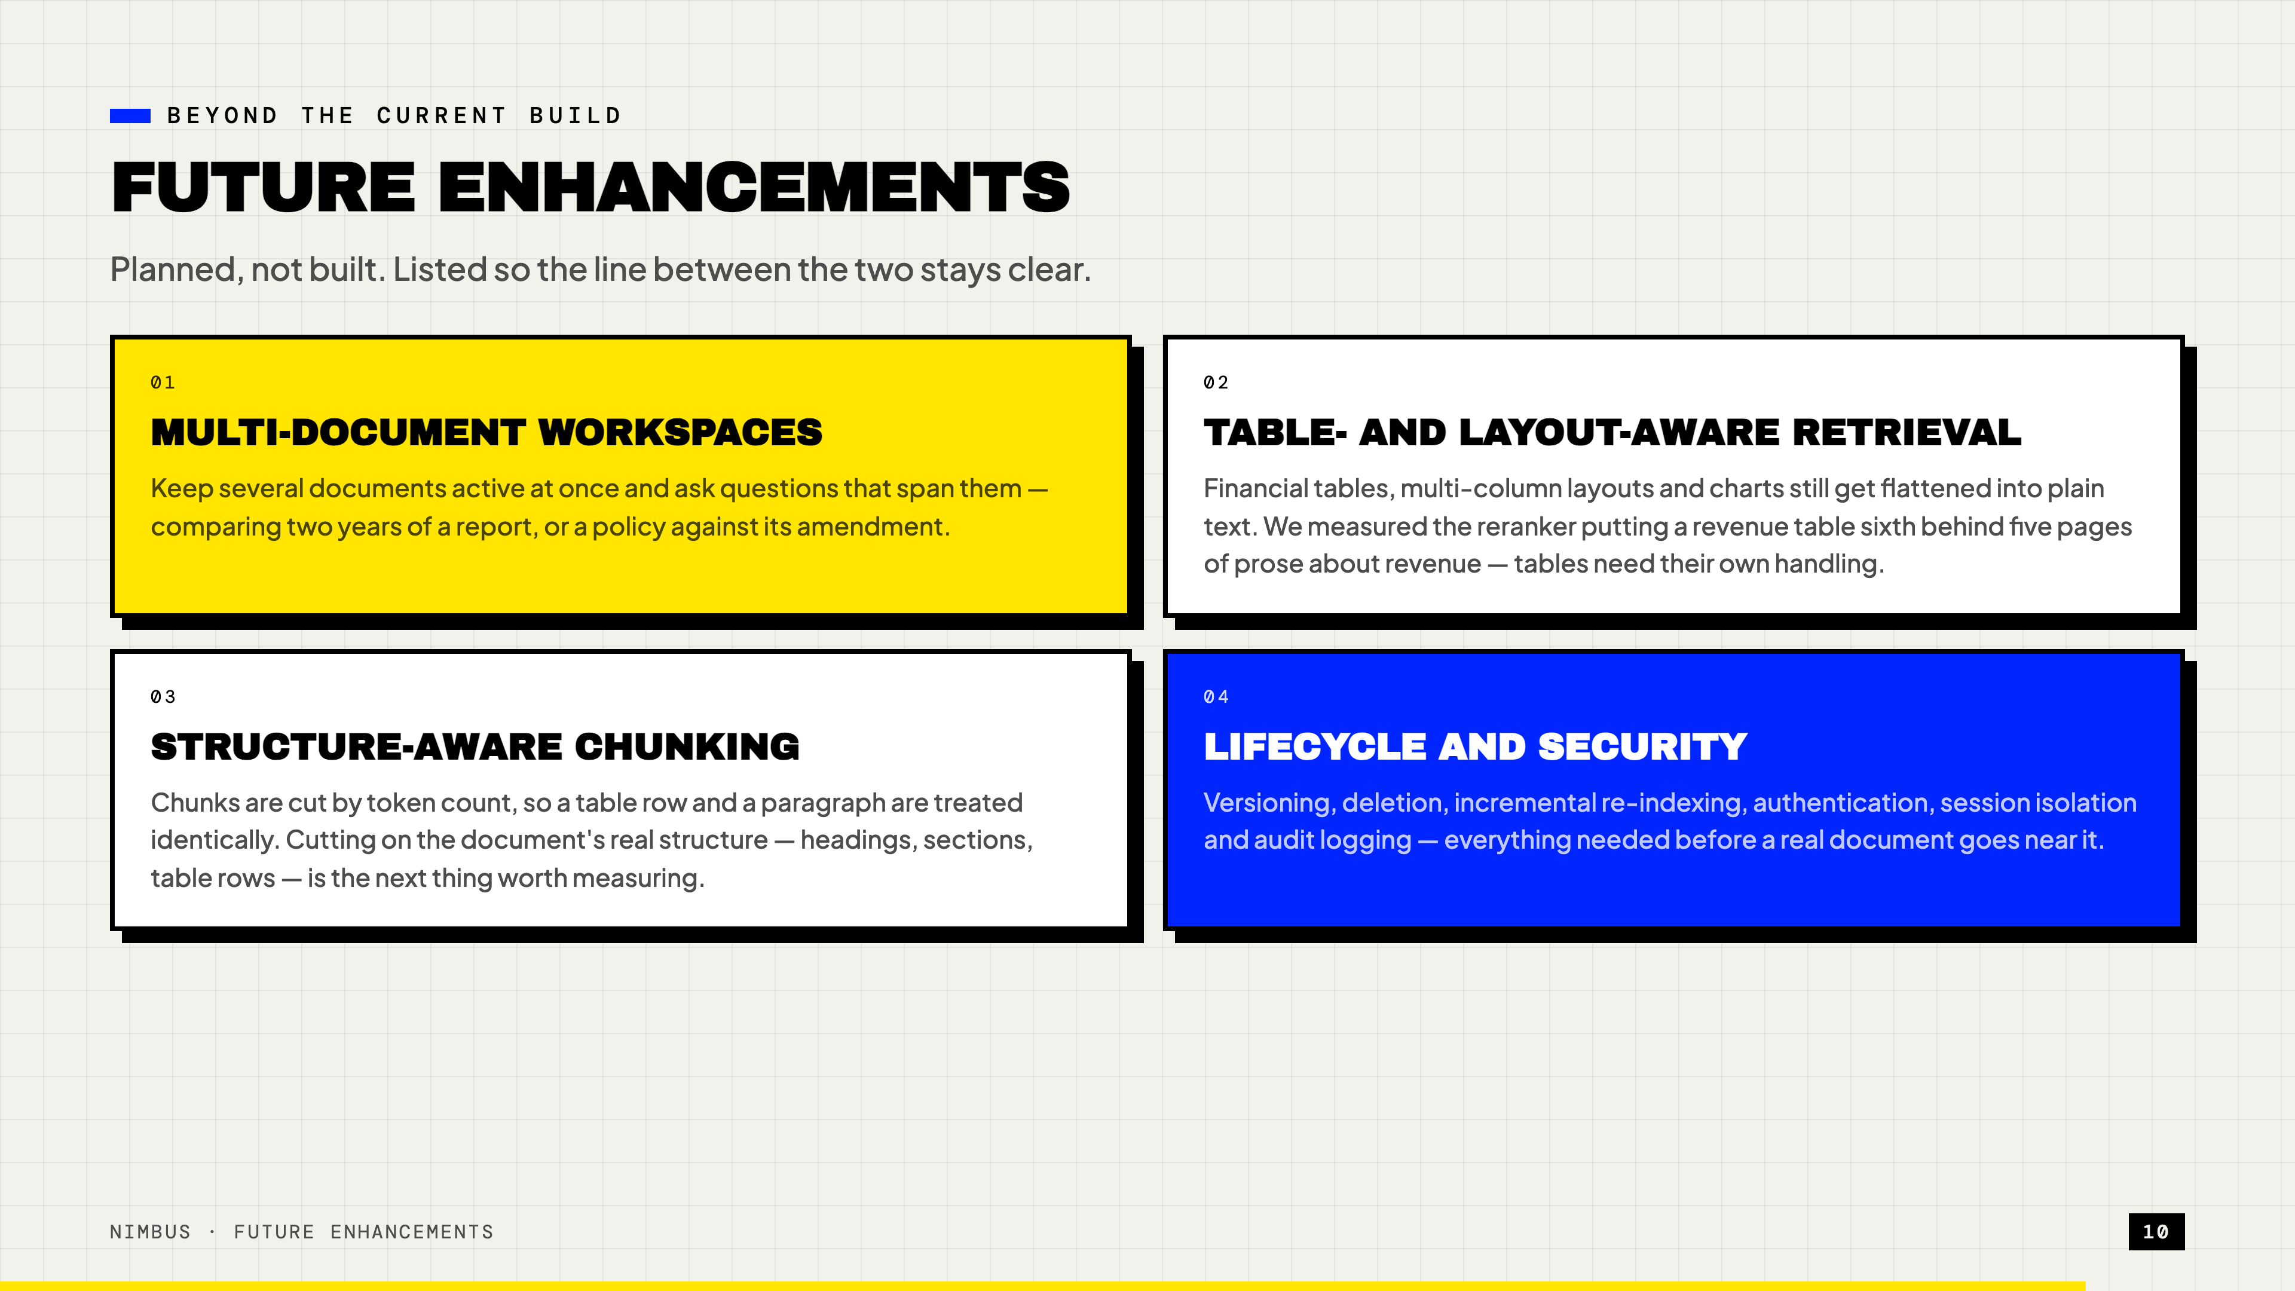
Notes:
Future enhancements
Fast. Twenty seconds.
SAY: "Four things planned, none built — we're keeping that line clear. Multi-document
workspaces, better handling of tables, structure-aware chunking done properly, and everything
security-related before a real document goes near this."
IF ASKED "didn't structure-aware chunking already lose?": yes — splitting on paragraphs lost.
The next attempt has to use real structure, headings and table rows, not just different
break points.

Slide 11
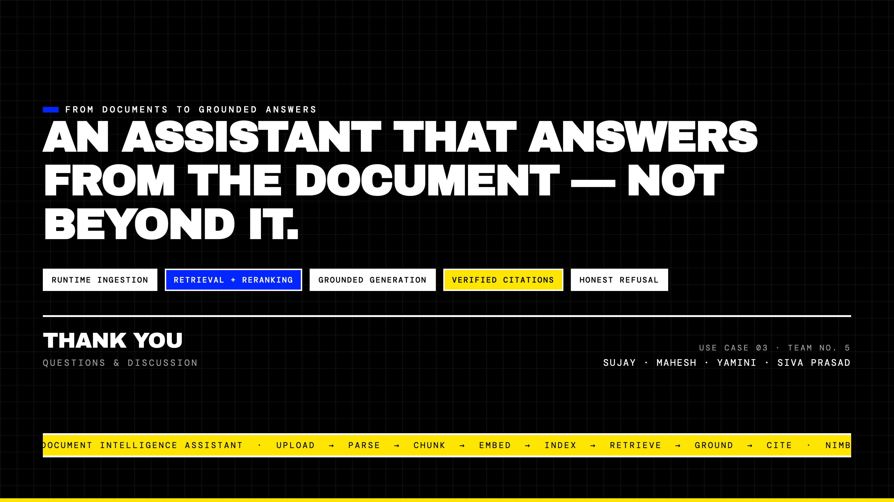
Notes:
Closing
SAY: "So — an assistant that answers from the document, and not beyond it. Thank you.
Happy to take questions."
Then stop talking. Leave this slide up for Q&A.

