Slide 1

LLM Fundamentals
28-day
BOOTCAMP
2026
© Sujeet Banerjee

Slide 2
AGENDA
What’s beneath an LLM?
Tokens, Parameters, …?
What’re their impact
Exercises, Self-Study
© Sujeet Banerjee

Slide 3
Guess the next…
11, 3, 5, 7, _?
11, 4, 9, 16, _?
12, 7, 14, 23, _?

Slide 4
Guess the next, continued…
great
well
my
a
this
fine
ok
it
nothing
“1I am doing
1

Slide 5
Demo…
1Ollama - Autoregressive Token Response…
predicts one token at a time.

Slide 6
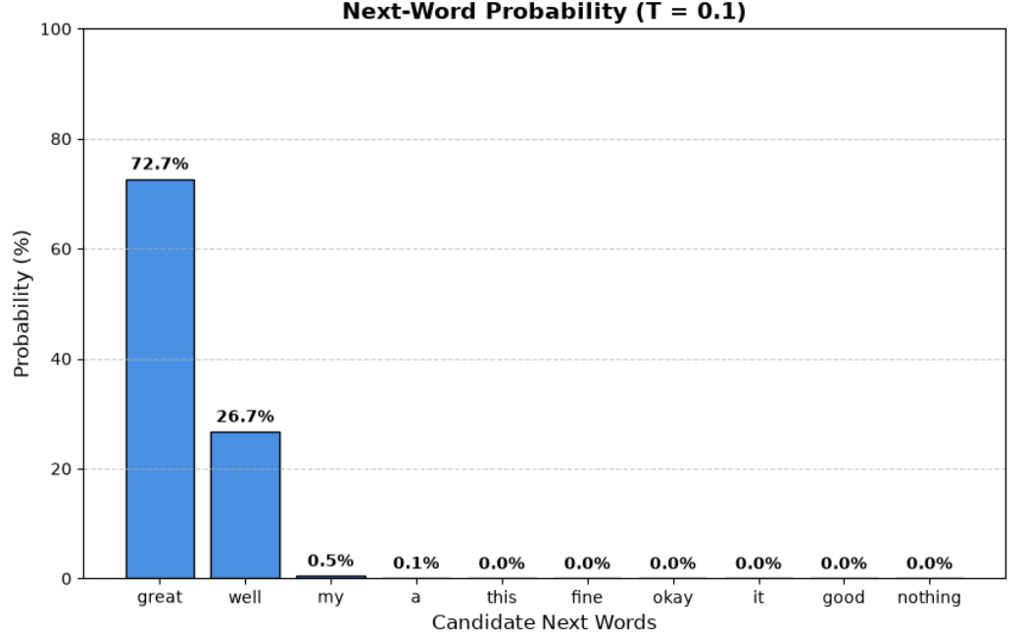
Guess the next, continued…
1I am doing ?
1
Temperature = 0.1

Slide 7
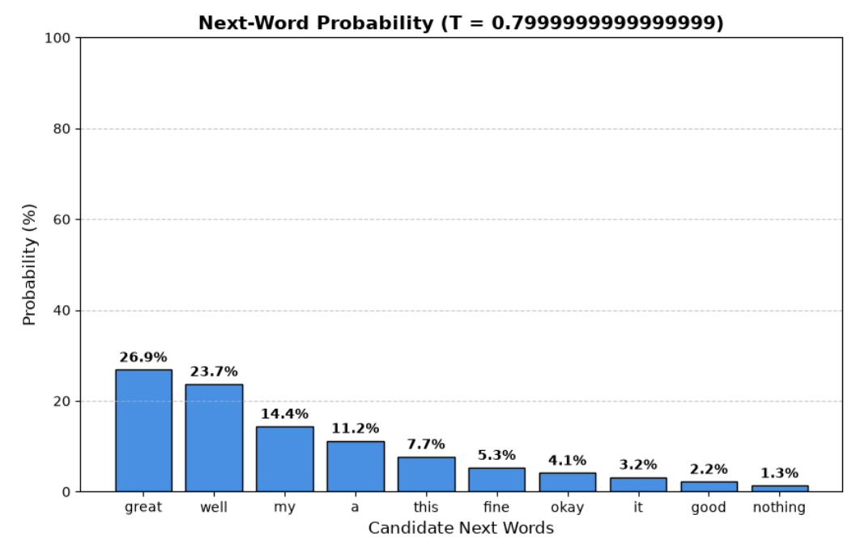
Guess the next, continued…
1I am doing ?
1
Temperature = 0.8

Slide 8
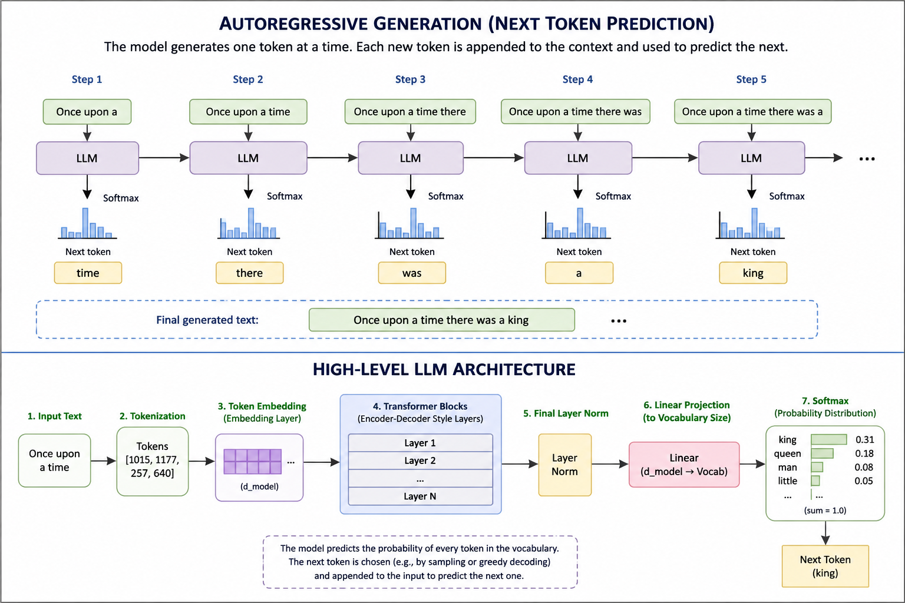
LLM
HIGH LEVEL
ARCH.
One token
at a time…

Slide 9
What are TOKENS…?
Why do we care?
Pricing
Speed
Context Window
“Artificial Intelligence
is amazing”
“Unbelievable”
“Playification”
“Supercalifragilisticexpialidocious“
“こんにちは ”
[‘Artificial’, ‘intelligence’, ‘is’, ‘amazing’]
[‘Un’, ‘believ’, ‘able’]
Ch-tok
Word-tok
Subword
Byte-Pair-Enc.
…

Slide 10
Tokenization
Model | Tokenizer
GPT-2 | Byte Pair Encoding (BPE)
GPT-3 / GPT-4 / GPT-5 family | Byte-level BPE (OpenAI variants)
Llama 2 / 3 / 3.2 | SentencePiece
Gemma | SentencePiece
Mistral | SentencePiece
Qwen | Byte-level BPE variant
DeepSeek | BPE-based tokenize

Slide 11
Context…
The number of tokens that for the current input to the LLM - context
The total capacity (in token terms) of input - context window
The model's fundamental unit of computation - tokens

Slide 12
Summary
✔ AI has evolved dramatically over the past few decades.
✔ LLMs generate text by predicting the next token.
✔ Tokens are the basic units of processing.
✔ Context Window determines how much the model can consider at once.
✔ Temperature affects randomness and creativity.
✔ LLMs are reusable…

Slide 13
Assignment, Self-study
✔ Install Ollama on laptop, and record the effect of temperature.
Instructions to be shared.
✔ Explore the ‘tokenization’ techniques:
WordPiece, SentencePiece, BytePairEncoding
✔ Explore how can you configure the Context Window
In the locally installed Ollama
In your Chat-GPT account.
✔ Explore: Pros and Cons of locally deployed LLM compared to public sites.

Slide 14
Thank
you…

Slide 15
BACKUP
SLIDES

Slide 16
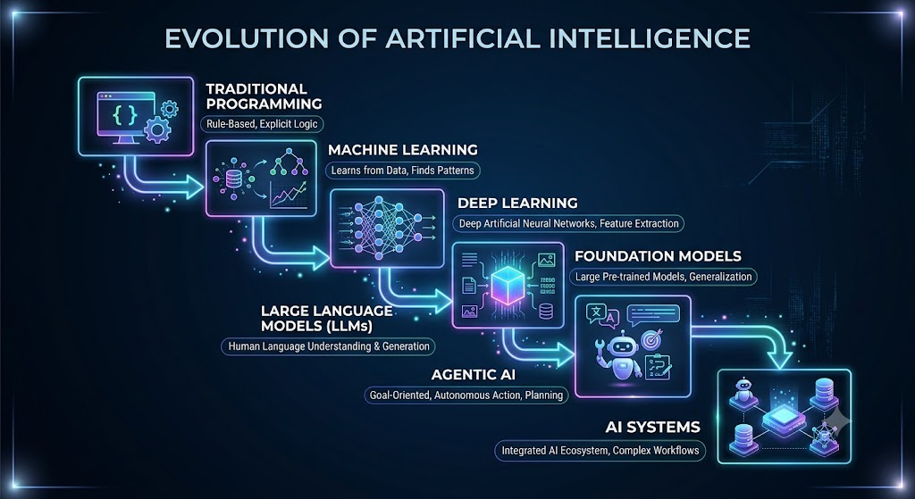

Slide 17
WEEK-WISE SCHEDULE
WEEK-1, 2 AI Fundamentals and Evaluation | LLM fundamentals (evol. From NN / DL) Prompting architectures Agentic Foundation (Agentic Arch. patterns) Metrics: BLEU/ROUGE, Ctx-precision, Recall, Relevance, … Intro to RAGAS
WEEK-2, 3 Agentic AI with N8N | Nodes, Workflows, Triggers, API Calling, Webhooks, LLM Integration, Statelessness, Model abstraction Tool calling, memory (statefulness), Conv. history Agent Routing, Multi-agent arch.
WEEK-4, 5 RAG Architecture (N8N) | RAG, EMbedding Fundamentals, Similarity Search, Vector-DB (Qdrant) Data-Ingestion, Enrichment, Retrieval Strategies
WEEK- 6 LangFuse, LLMOps | Telemetry using LiteLLM Proxy Online and Offline Evals (RAGAS) LangFuse Dashboarding

Slide 18
INFRA
OPTION 1
Local docker-container based setup Requires Laptop(win) / MacBook 16GB RAM 500GB HDD Installation instructions will be shared for self-hosting. No guidance provided for setup/installation in the bootcamp
OPTION 2
Hosted on service provide cloud Use limited-period trial licenses (free period): N8N LangFuse Requires usual laptop No guidance provided for setup/installation in the bootcamp
AI Licenses
OpenAI - $5 token prepaid (optional) Groq / Llama3 Huggingface QDrant

Slide 19
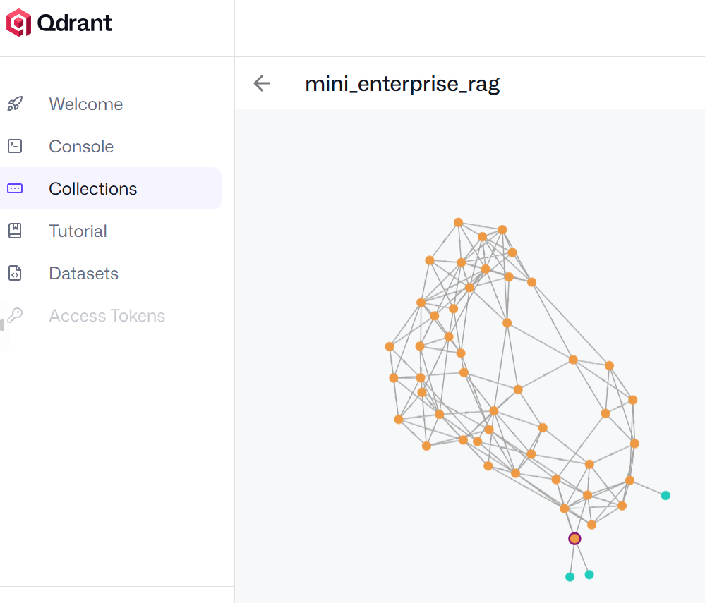
LEARNING OUTCOMES
Understand modern AI architecture
Build Agentic workflows
Evaluate AI
Implement RAG
Understand LLMOps
Sujeet Banerjee

Slide 20
NOT OFFERED
Web Service Development,
Hosting
Data Visualization
Tools
UI Development, Streamlit, Javascript
Build Chatbots
Java
Python
(coding)
(In-depth)
Machine Learning,
Deep Learning,
Neural Networks
Data Science,
Data Engineering
App Development
Mathematics
For AI/ML
Cloud technologies

Slide 21
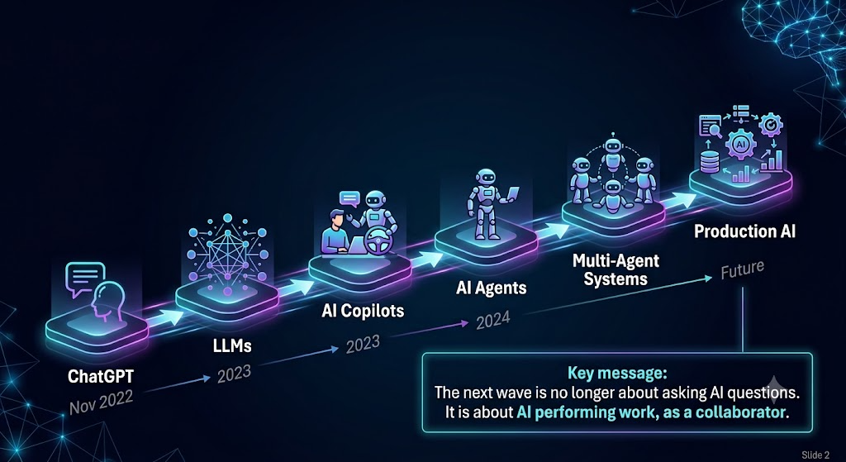
GENERATIVE AI LANDSCAPE
PAST TWO YEARS…

Slide 22
