Slide 1
unGuided
Tyler, Sujeet, Sam, Kevin

Slide 2
Overview
unGuided provides users with the freedom to choose their own tour experience.

Slide 3
Overview
Power in space
Guided tours
Audio tours

Slide 4
Contextual Inquiry
Visitors
Tour guides
Storytellers

Slide 5
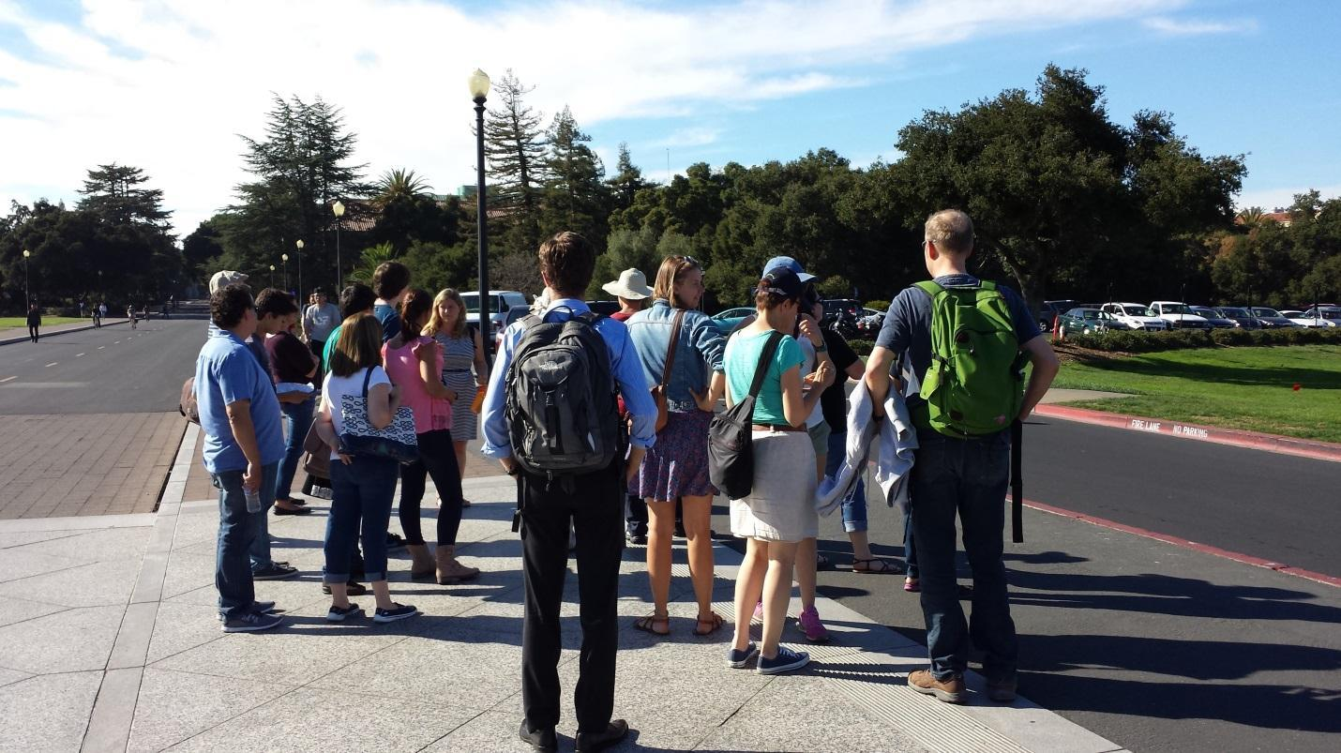
Contextual Inquiry
tour observations
scripted
smooth transitions
questions for engagement
interruptions (sites, traffic)

Slide 6
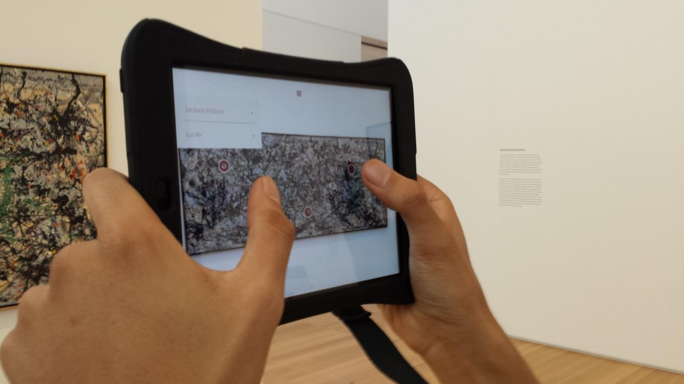
Contextual Inquiry
tour observations
smooth animations
prompts for engagement
no route planning
gorilla arms

Slide 7
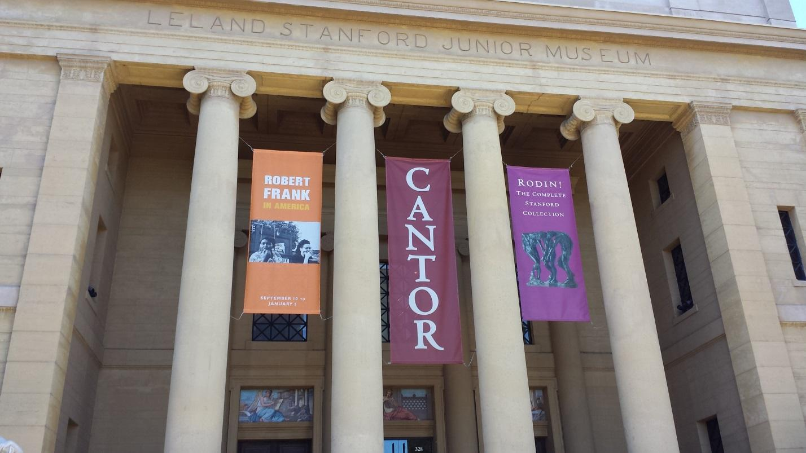
Contextual Inquiry
John and Jane, couple
45-55 years old, North Carolina
Mary, curator
30-40 years old, San Francisco
how & where?

Slide 8
Contextual Inquiry
freely explore
smaller groups
read placards for contextual info
audio tours: mixed opinions

Slide 9
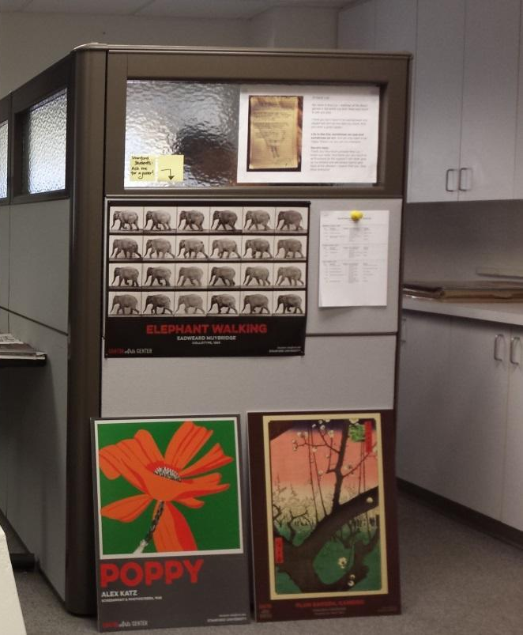
Contextual Inquiry
DJ Dull-Mackenzie
Director of Visitor Relations
50-60 years old
Michelle
Cantor Education Programs Assistant
25-35 years old
how & where?

Slide 10

Contextual Inquiry
Rachel Hamburg
MA in English Literature
former managing editor of Stanford Storytelling Project
how & where?

Slide 11
Task Analysis
Who is going to use the system?
creators & consumers
What tasks to they now perform?
confined vs. disjointed
What tasks are desired?
freely explore, no crowds, useful info

Slide 12
Task Analysis
How are the tasks learned?
professionally trained, binder
Where are the tasks performed?
areas of high interests
What is the relationship between customer and data?
creator vs. consumer

Slide 13
Task Analysis
What other tools does the customer have?
no integrated tools
How do users communicate with each other?
guide makes tour exp. personal + memorable
How often are the tasks performed?
creation + consumption

Slide 14
Task Analysis
What are the time constraints on the tasks?
visitors may be under timecrunch, daytime
What happens when things go wrong?
tours available don’t fit interests
creation process too complex
quality of tour too low

Slide 15
3 Tasks
Creation
user wants to create tour
user-developed content
complex but essential

Slide 16
3 Tasks
Take me on a tour
user doesn’t know where to go
Visitor Center observations
recommendations

Slide 17
3 Tasks
Deliberate planning
user knows where (s)he wants to go
sets own itinerary
adjustable times

Slide 18
Application ideas
GeoBooks
audiobooks set in your location
Steve Jobs
Les Miserables
significance, feasibility, interest

Slide 19
Application ideas
GeoJournal
multimedia
time capsule for revisits
share others’ media from same place
significance, feasibility, interest

Slide 20
Application ideas
unGuided
contextual inquiry
stories
significance, feasibility, interest

Slide 21
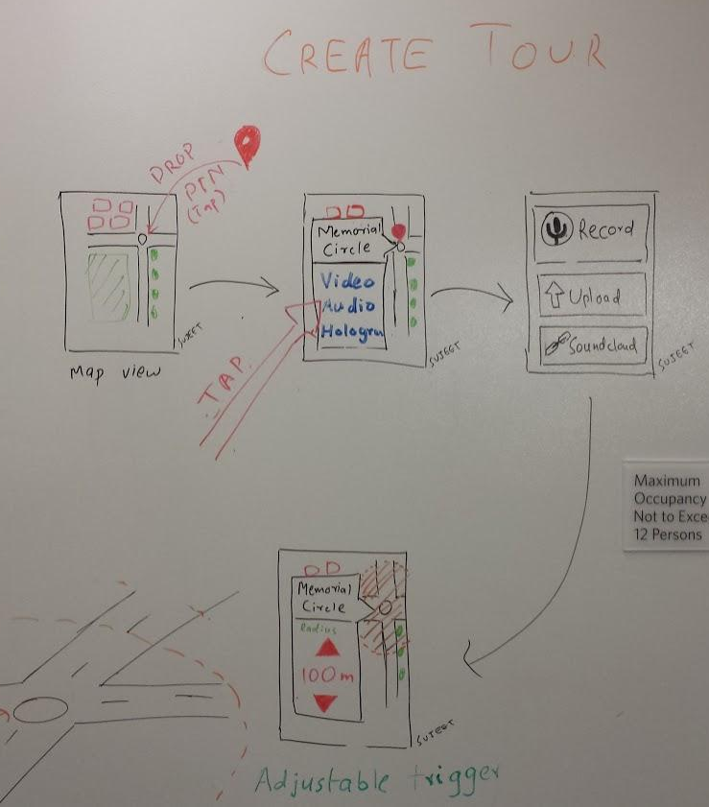
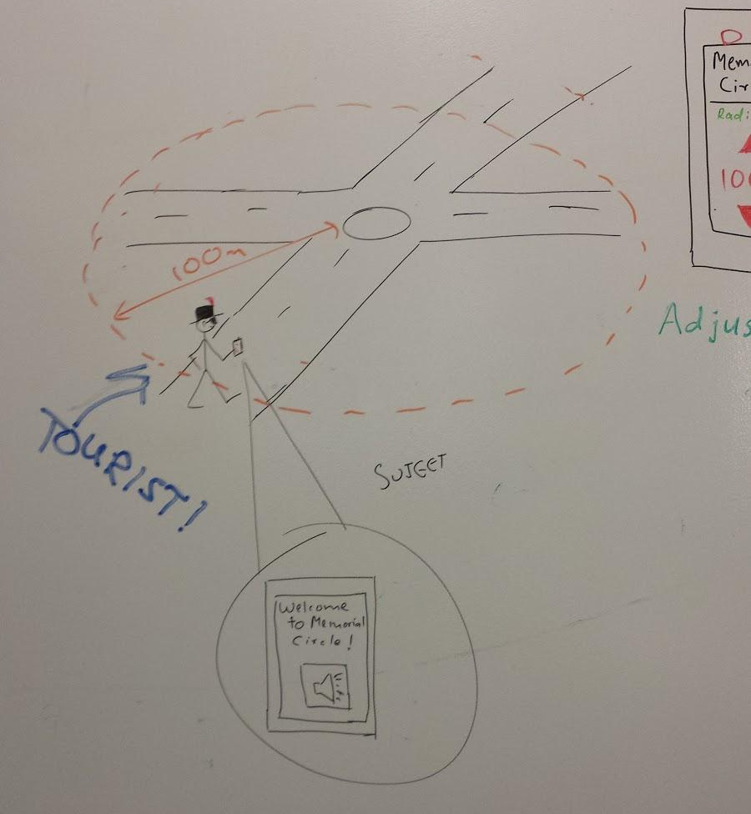
Sketches (mobile)

Slide 22
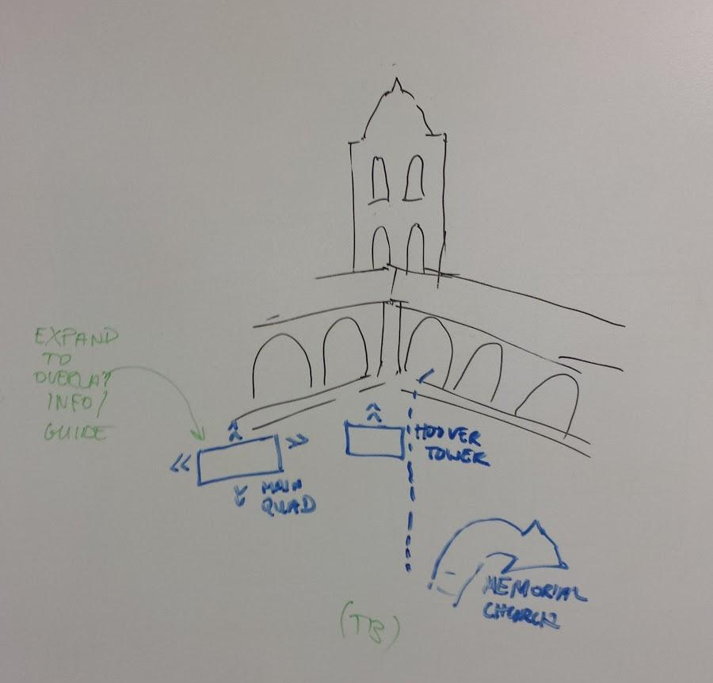
Sketches (augmented reality)

Slide 23
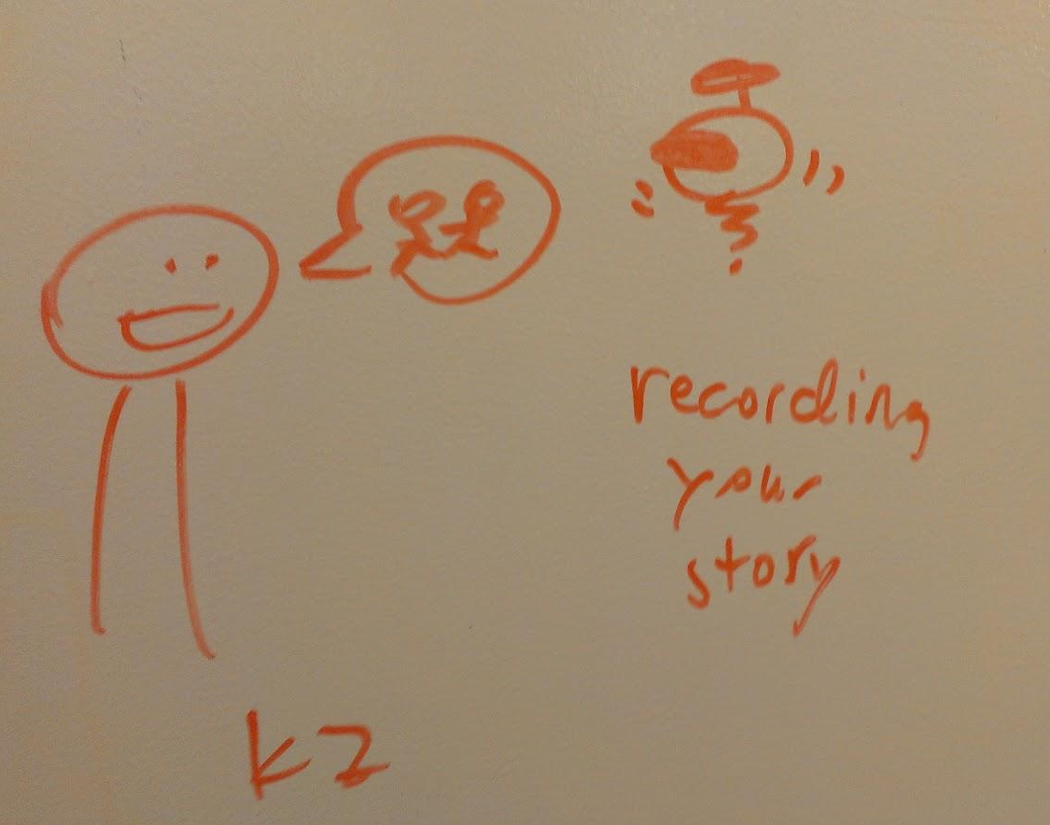
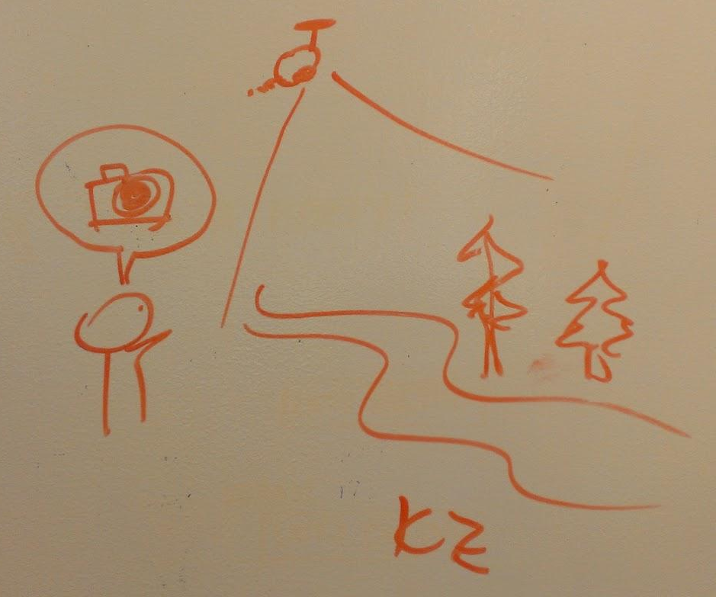
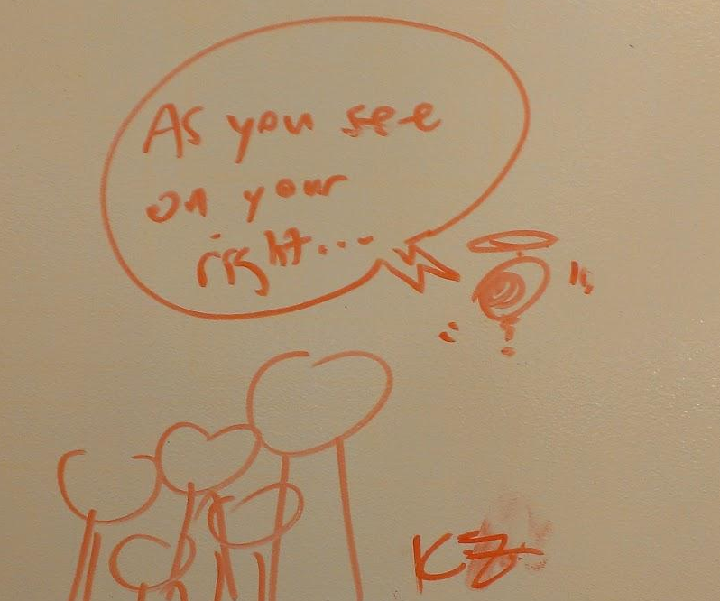
Sketches (drone)

Slide 24
unGuided

