Slide 1
unGuided
Low-fi Prototyping & Pilot Usability Testing
Kevin, Sam, Sujeet, Tyler

Slide 2
Overview
What unGuided can do (the three tasks)
How unGuided does it (the prototype)
unGuided in action!
The grand(?) experiment
So much to learn!
Questions? Shoot!

Slide 3
Mission Statement
Taking the guide out of ‘guided tours’, and keeping the tours still awesome. No, making them more awesome!
Creating engaging tours: because everybody has a story to tell.

Slide 4
Task 1: Let’s take that tour!
At a new place.
No idea what’s around that’s interesting.
Want to walk around and explore the place.
“I don’t like following someone!”
“God, I hate groups!”
“I don’t like to adjust my timings!”

Slide 5
Task 2: Let’s go exploring!
“It's a magical world, Hobbes, ol' buddy ... let's go exploring!”
Find interesting places around you.
Tell unGuided you’re interested.
unGuided guides you there and keeps you engaged.

Slide 6
Task 3: Tell your story, make a tour!
Found something interesting?
Had an out-of-the world experience?
You want others too, to experience it…
Create a tour, tell them your story!

Slide 7
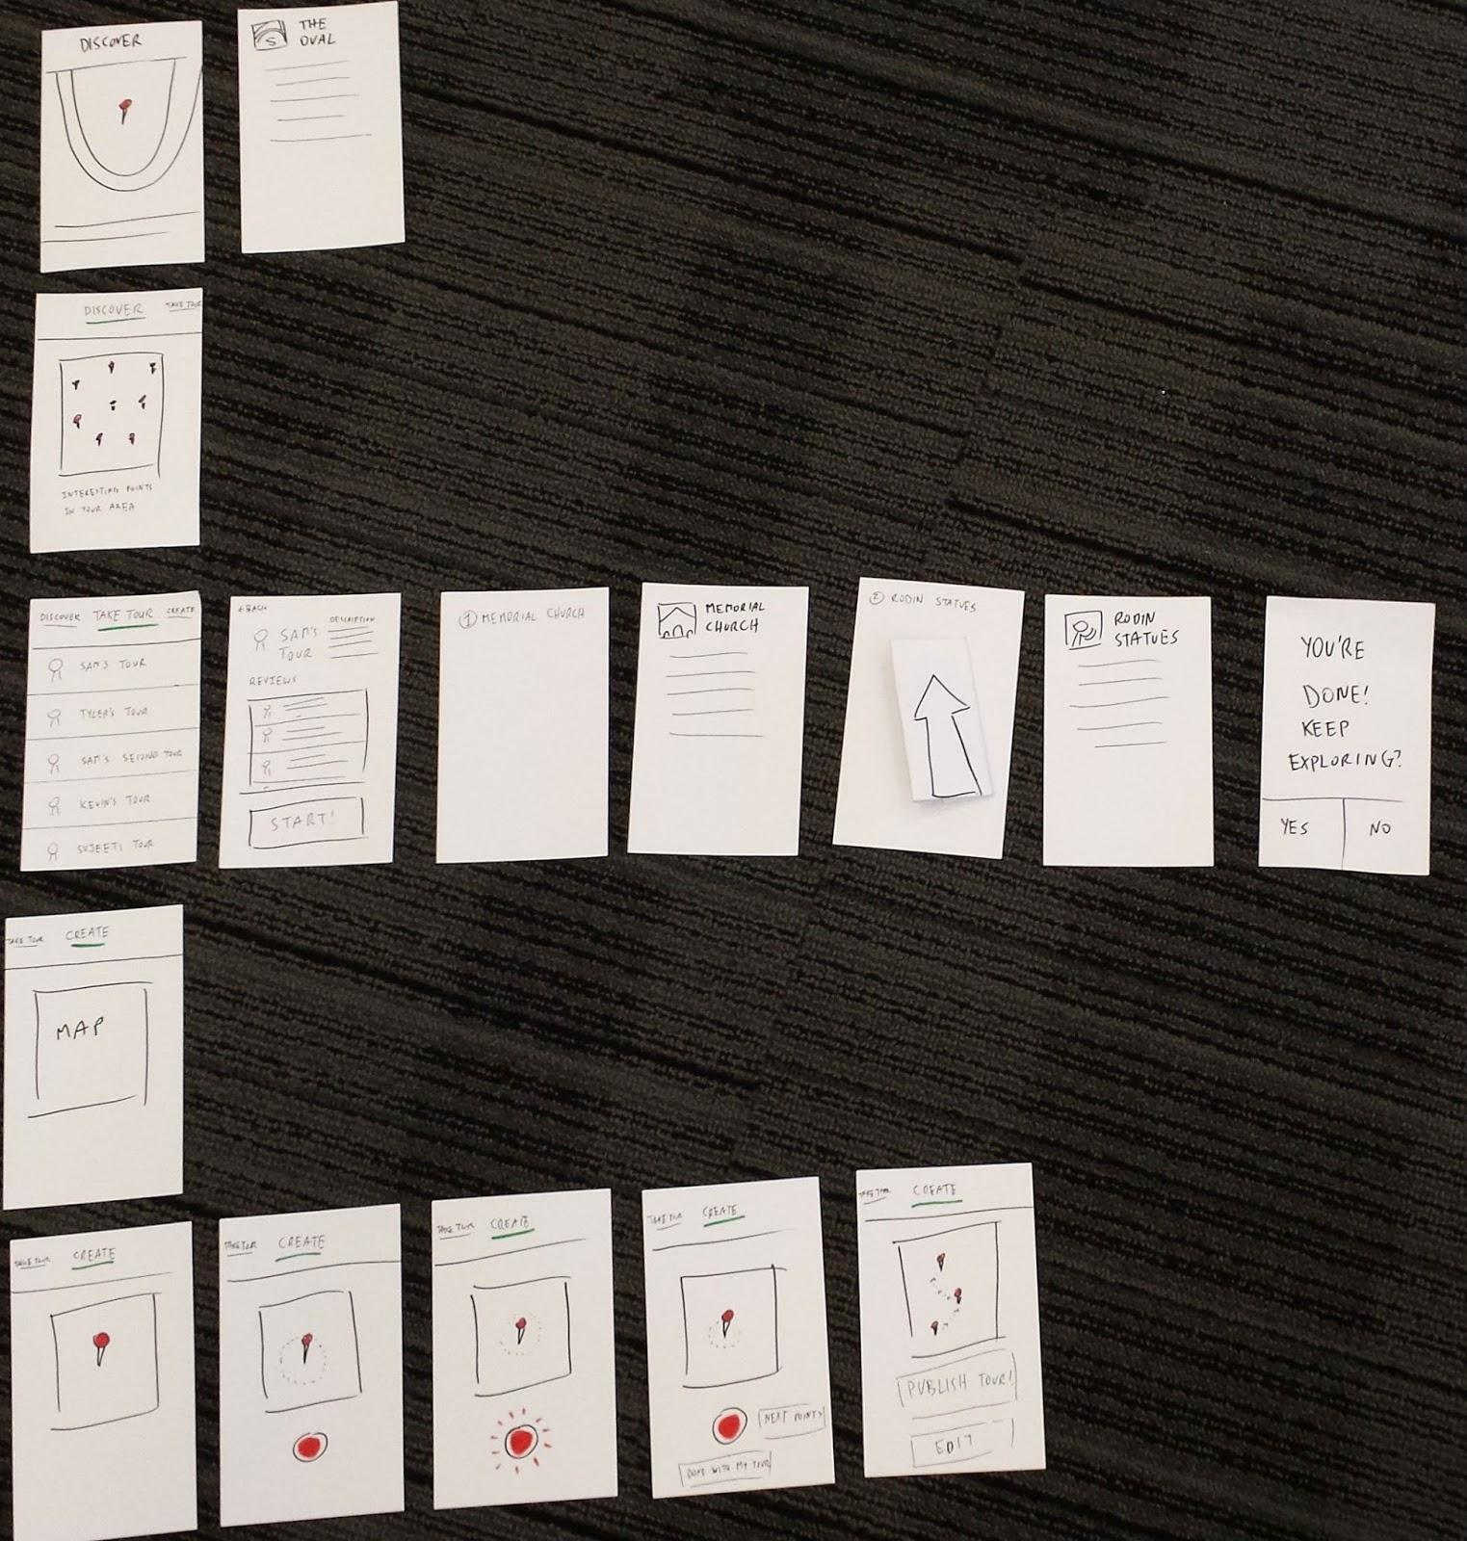
Prototype structure
Lean, minimal
Task oriented
Three way branching
We used POP

Slide 8
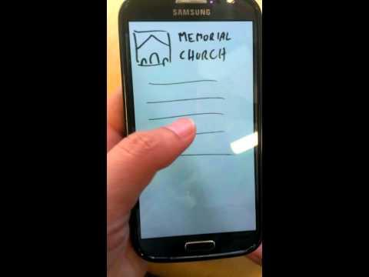
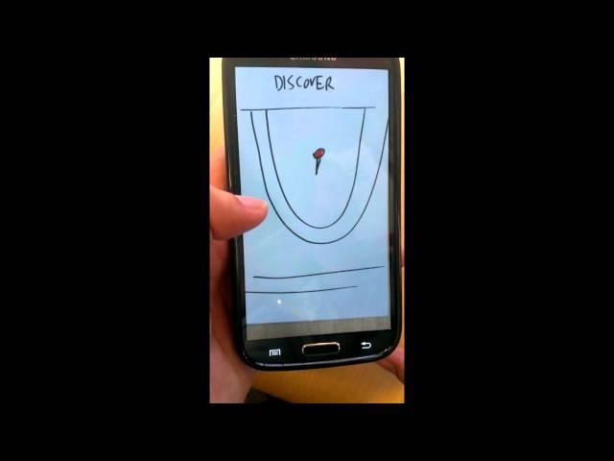
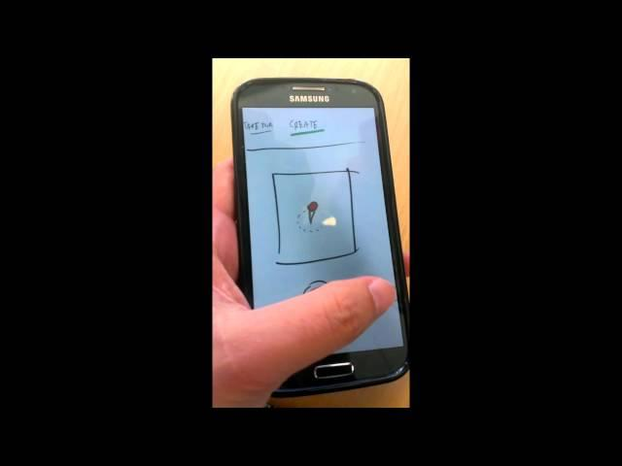
Videos of UI in work
Take a tour Discover Create a tour

Slide 9
How we experimented
Brief
Tell about CS147
Give overall picture of unGuided
Tell the task to be done
Observation
Which buttons do the press?
Facial expressions and exclamations.
Debrief
Ask questions, take direct feedback.

Slide 10
Experiment details
A tour guide, a graduating student, a travel enthusiast.
Tyler: note-ninja
Sam: magic-master
Kevin: fabulous-facilitator
Sujeet: siri

Slide 11
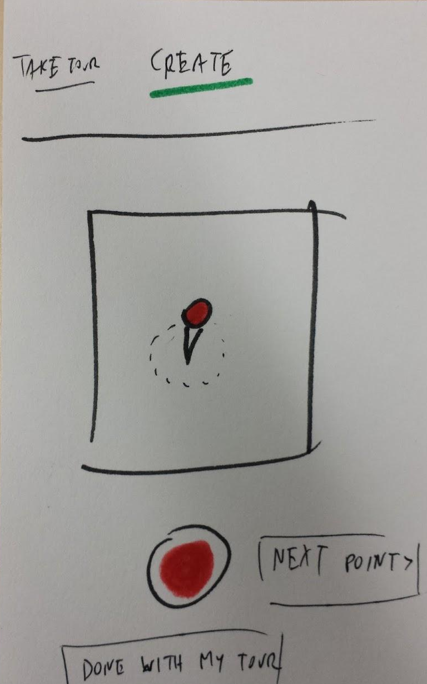
Key observations (user 1)
“Wow! That’s neat!” On seeing “add another location” button after done with adding a point-of-interest in their tour.
“This is too long a walk, I don’t want to just be walking.”
Not comfortable with sharing the tour he created. “Share? Where? How?”

Slide 12
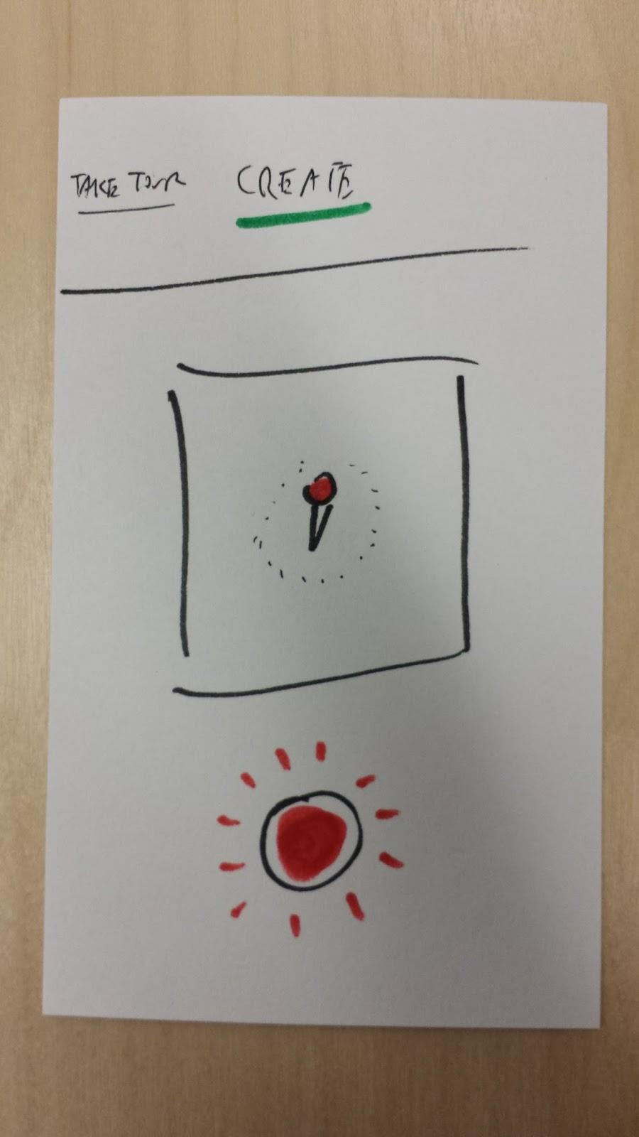
Key observations (user 2)
She’s a tour guide.
Dropped a pin to create a tour and started telling stories about all the points around it.
Sometimes forgot that it was just audio and her gestures aren’t going to be recorded.

Slide 13
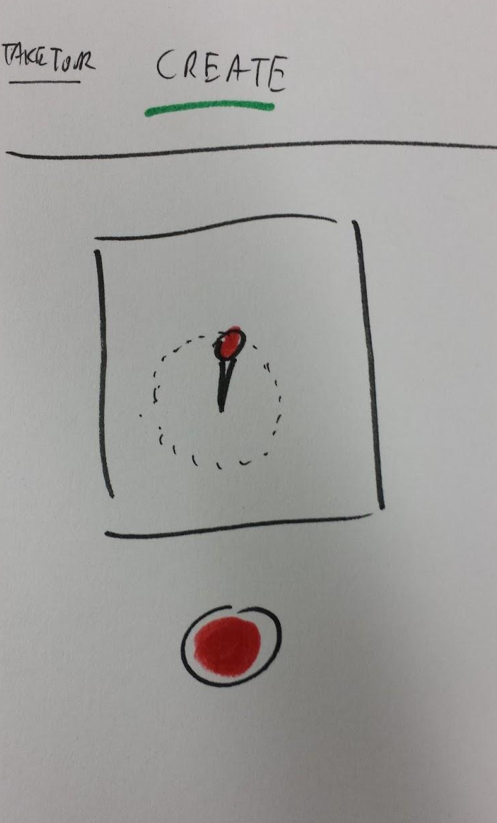
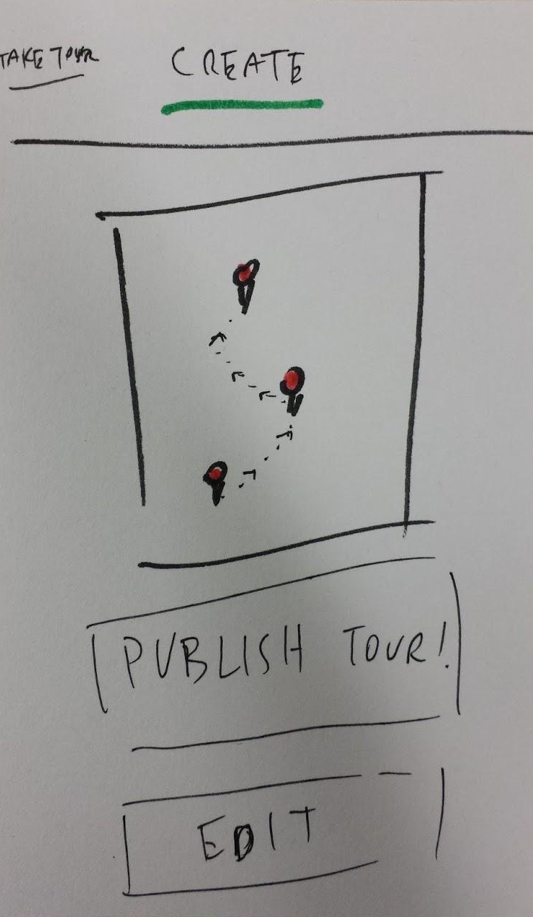
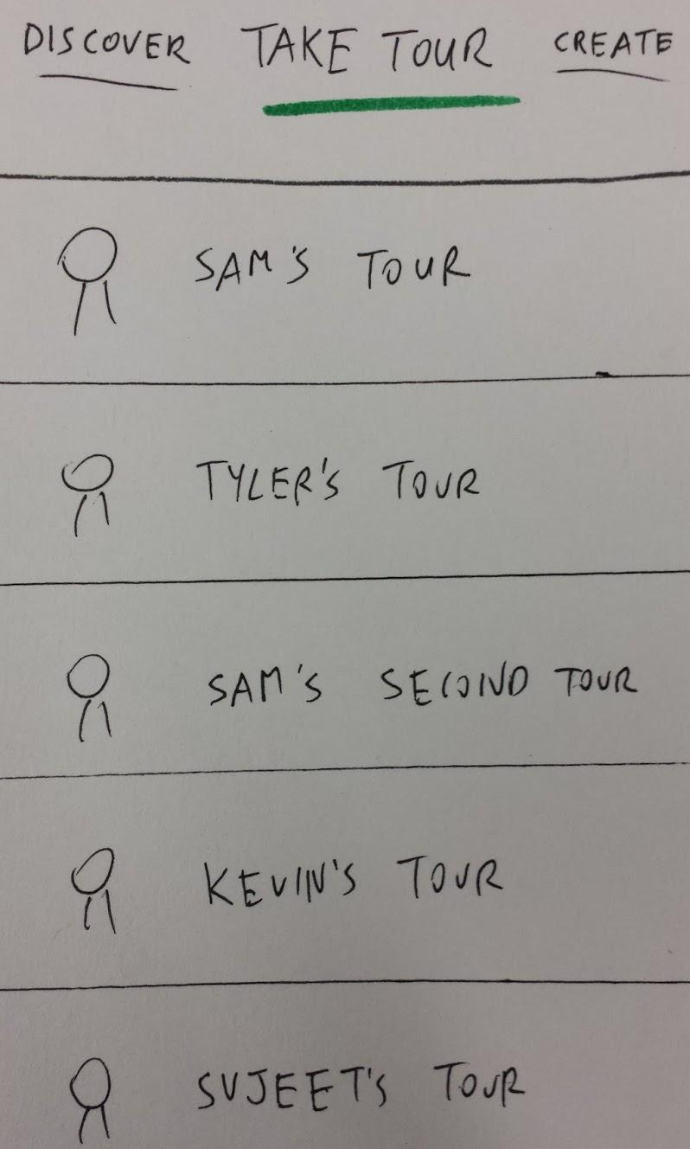
Key observations (user 3)
“Share? Okay.” “Hey! I didn’t get to name it!”
Just tap, tap, tapped the record button without realizing what it was for.

Slide 14
Changes they suggested
There should be more pictures on information page about a point-of-interest.
The share button should somehow suggest what platform it is sharing the tour.
There should be a way of editing the audio clips created.
The direction arrow should also show estimated time and distance.

Slide 15
Some of the things we learnt
People have different ways of narrating tours.
Not everyone is comfortable sharing.
It is important to keep users engaged.
Use traditional symbols wherever possible.

Slide 16
Thanks! :)
?

