Slide 1
unGuided
Medium-Fi Prototype
Kevin Zhai – Manager / Design
Tyler Brown – Documentation
Sujeet Gholap – Development
Samuel Portilla – User Testing

Slide 2
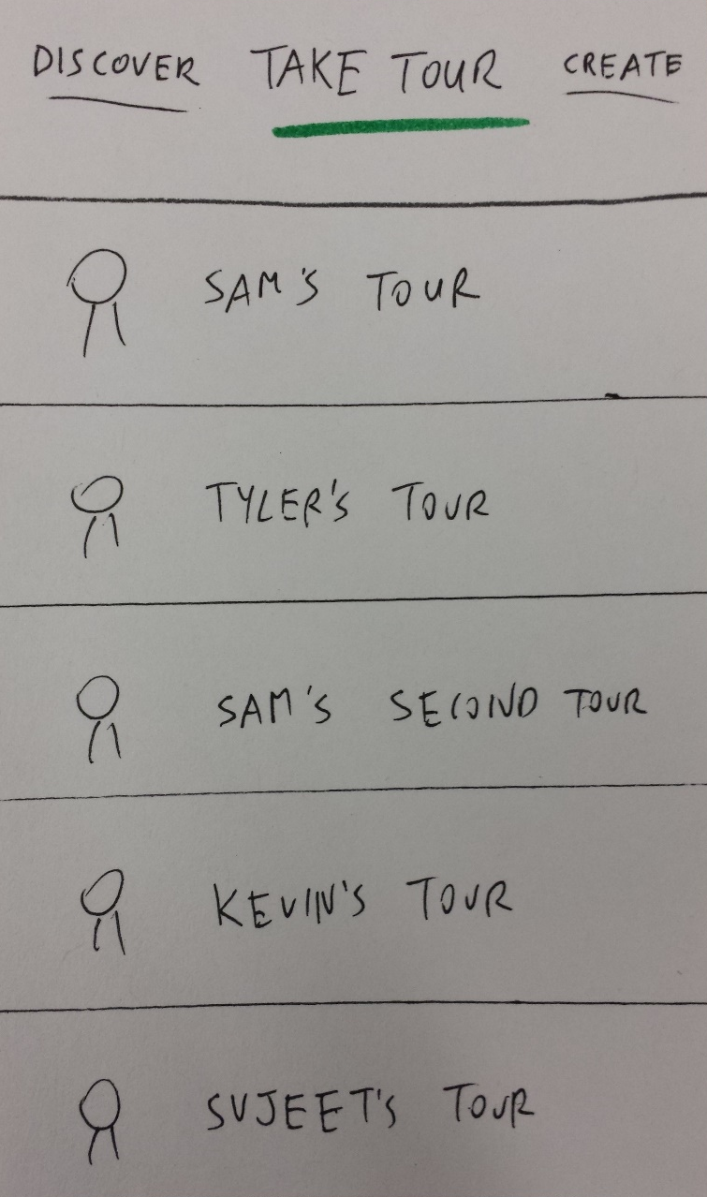
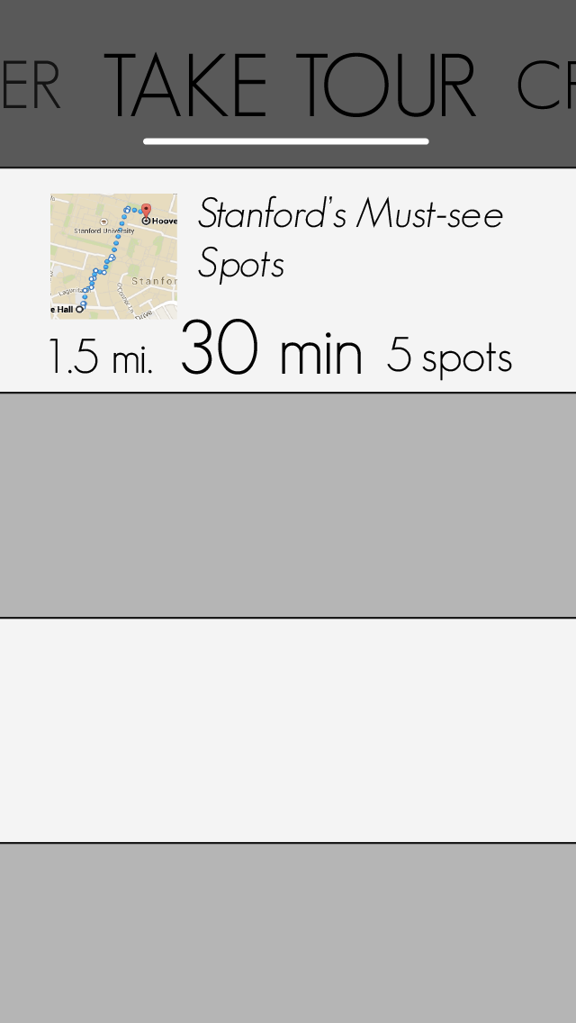
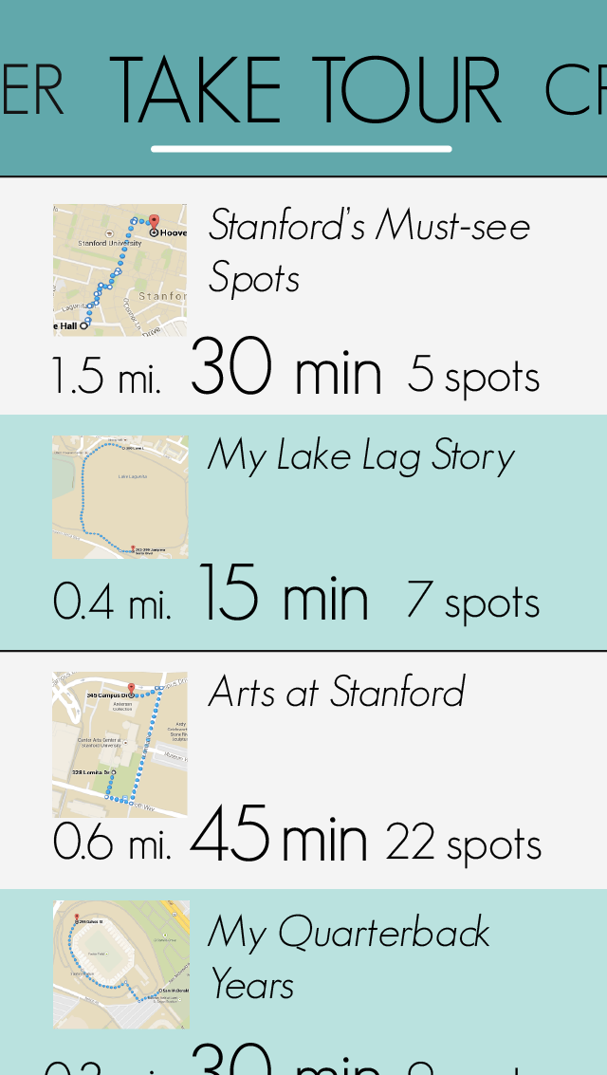
Take Tour

Slide 3
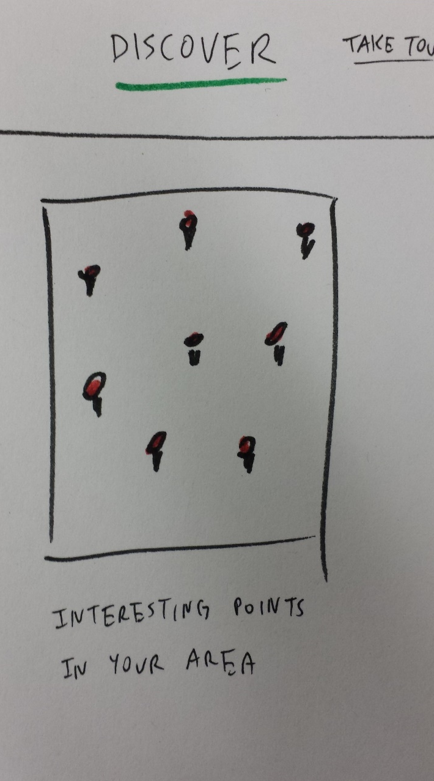
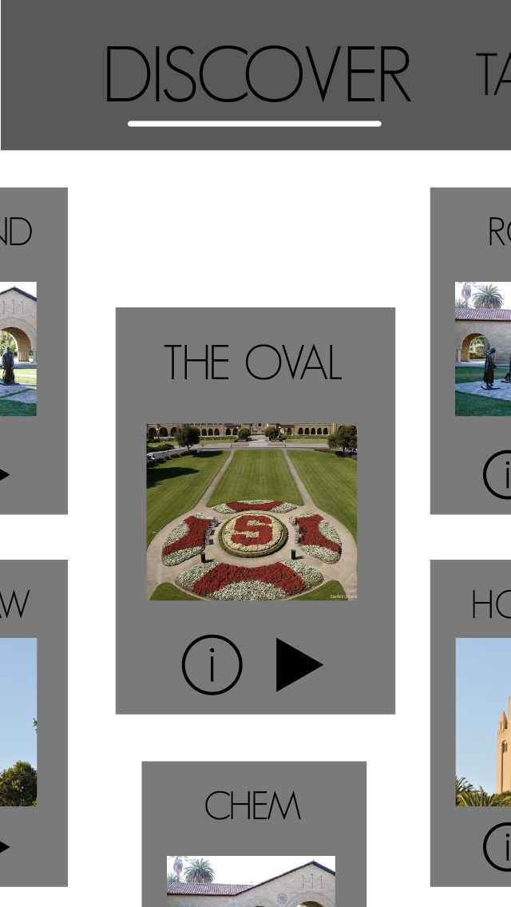
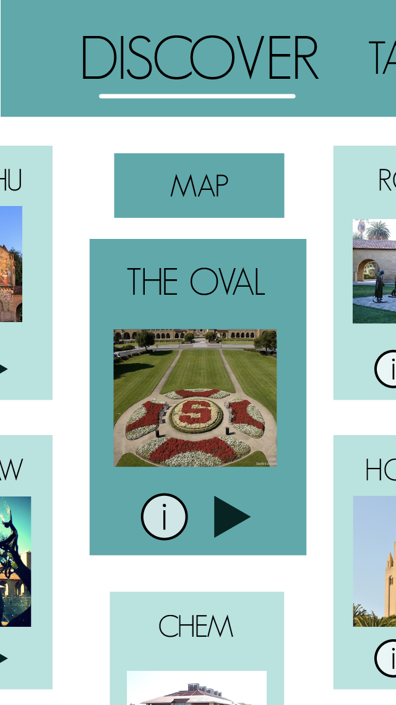
Discover

Slide 4
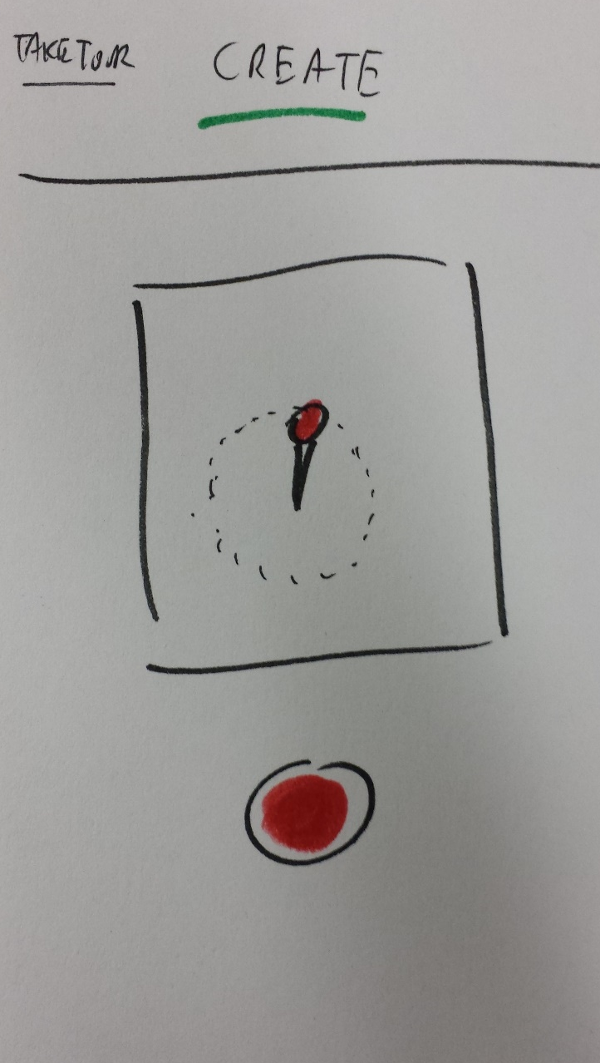
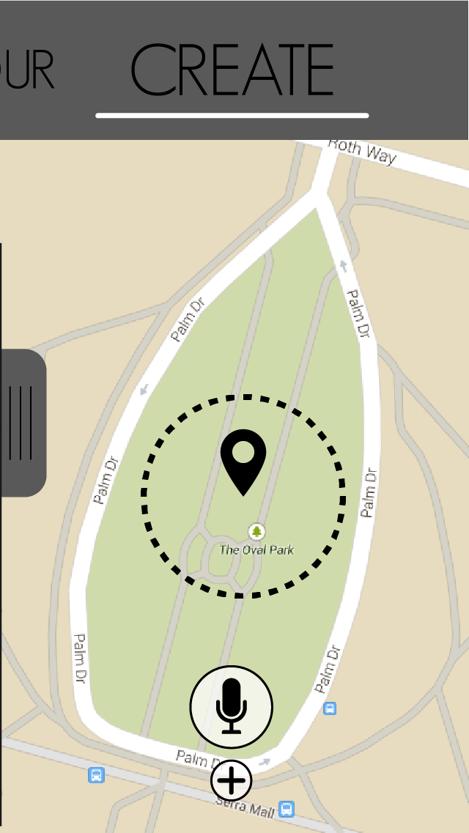
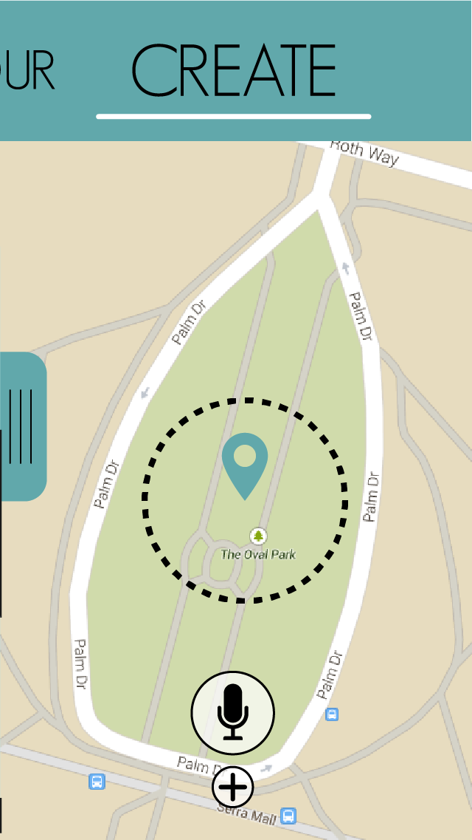
Create

Slide 5
Live Demo
http://invis.io/MX1M2B0SG

Slide 6



Tools Used
proto.io
marvel
invision
Yes. Let’s do this!
Only offered a 15 day trial
We didn’t want to use our Dropbox space

Slide 7
GOOD:
LIMITATIONS:
Plays well with Illustrator
Similar to POP
Smooth animations
Reusable Templates
No scrolling of specific section
Hotspots only map to one gesture

Slide 8
unGuided

