Slide 1
unGuided

Slide 2
Hi-fi Prototype Progress
Kevin Zhai / Project Management & Design
Sujeet Gholap / Development & Design
Samuel Portilla / User Testing
Tyler Brown / Documentation

Slide 3
Let visitors experience tours from many perspectives, in multiple directions, and any pace — and enable people passionate about a place to create and share their unique stories and insights.

Slide 4
Problem
Guided tours are bound by a fixed schedule and often a fixed path
Audio tours are rarely available outside of museums and require unintuitive hardware
Tours are often highly scripted and provide a limited perspective

Slide 5
Solution
Let visitors hear and see tours when, where, and how they want, crowdsourced from people with knowledge and passion for a given space

Slide 6
Heuristic Feedback

Slide 7


Heuristic Feedback

Slide 8
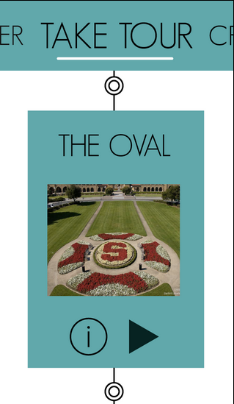
Heuristic Feedback: Tour
No obvious way to exit a tour halfway through (4)

Slide 9
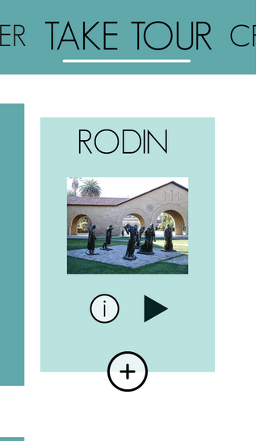
Heuristic Feedback: Tour
No obvious way to exit a tour halfway through (4)
Difficult to recognize significance of nearby POIs (3)

Slide 10
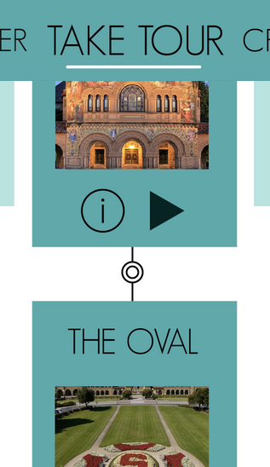
Heuristic Feedback: Tour
No obvious way to exit a tour halfway through (4)
Difficult to recognize significance of nearby POIs (3)
Inability to remove POIs from tour (3)

Slide 11
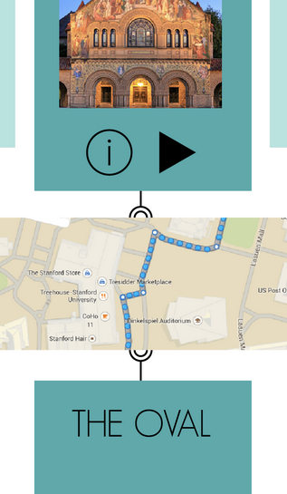
Heuristic Feedback: Tour
No obvious way to exit a tour halfway through (4)
Difficult to recognize significance of nearby POIs (3)
Inability to remove POIs from tour (3)
No directions on how to get to initial POI (2)

Slide 12

Heuristic Feedback: Tour
No obvious way to exit a tour halfway through (4)
Difficult to recognize significance of nearby POIs (3)
Inability to remove POIs from tour (3)
No directions on how to get to initial POI (2)
Tour completion % not documented (1)

Slide 13
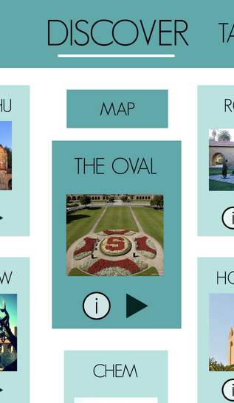
Heuristic Feedback: Discover
No way to filter or do a text search for POIs (0)

Slide 14
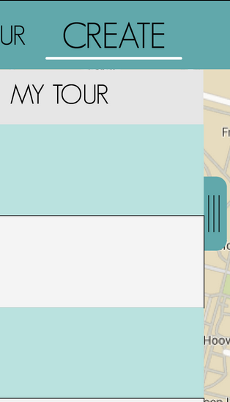
Heuristic Feedback: Create
Pathway for starting ‘create’ task unclear (3)

Slide 15
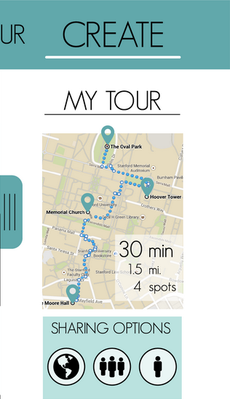
Heuristic Feedback: Create
Pathway for starting ‘create’ task unclear (3)
Conceptual mapping for ‘share tour’ icons was off (1)

Slide 16
Revised Design

Slide 17
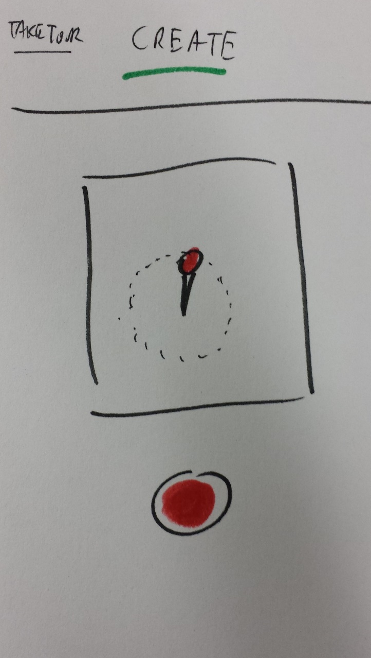
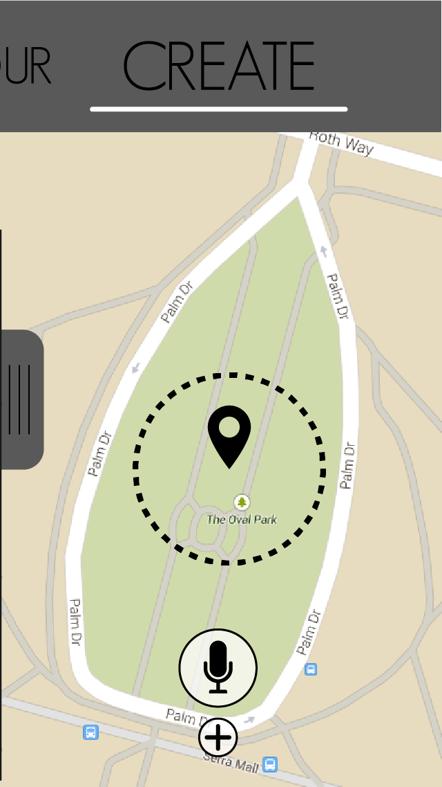
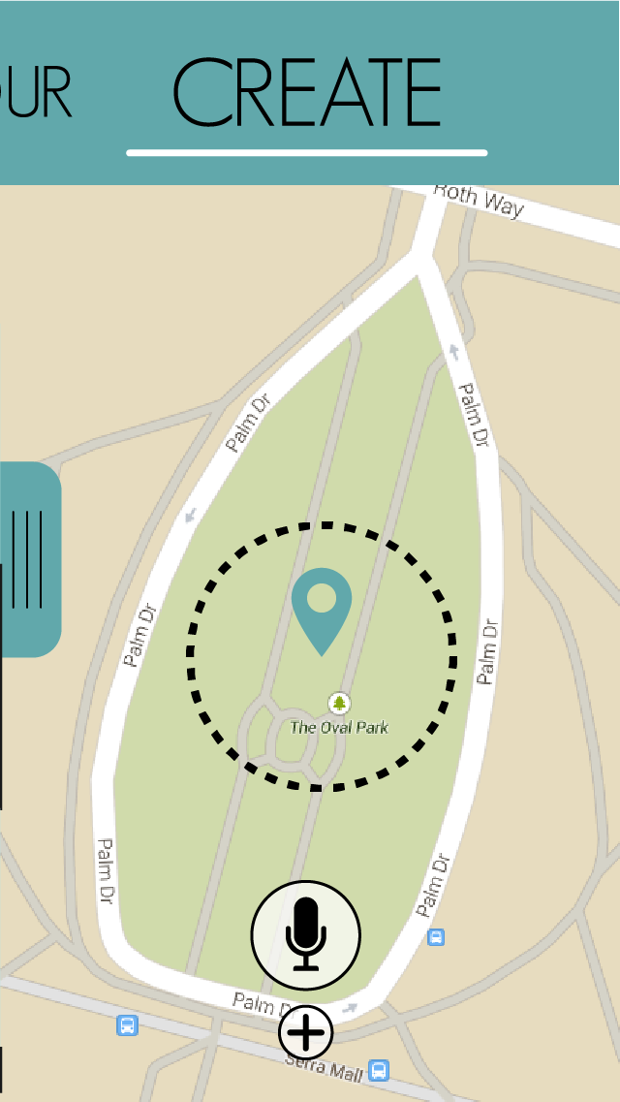
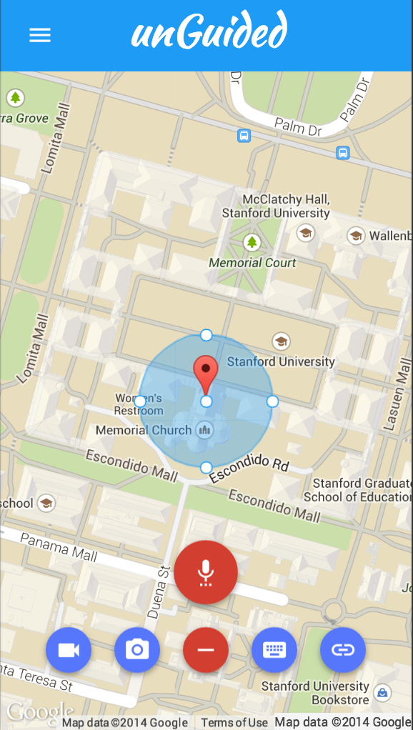
Revised Design

Slide 18
Revised Design
Solved problems highlighted in heuristic evaluation
Pathway for starting ‘create’ task comes with interactivity and more familiar symbols
Implemented standard-practice sharing icons
Brightened color palette
Added functionality relative to medium-fi prototype
More interactive, tasks easily reversible
Now a web app

Slide 19
Implementation Status

Slide 20






Development Tools

Slide 21
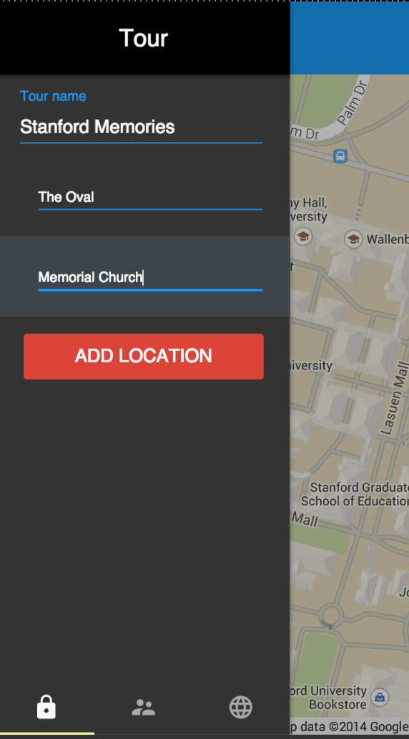
Implemented Features

Slide 22
Unimplemented Features
‘Create’ task works, but is buggy
Additional sub-functions we’d prefer not to dummy
Taking and uploading images
Map interaction and POI creation refinement
‘Discover’ and ‘Take a Tour’ tasks unfinished

Slide 23
The Wizard of Hard Coding
Location (set to a default)
‘Recorded’ audio and other content is not actually stored
We don’t have the time or database for a universe of content to appear
Global sharing is limited; user only has what we create
TBD with other tasks

Slide 24
Outstanding Issues
PhoneGap not playing well with Android APIs
Ground-level functionality (e.g., dummied audio recording) has to be implemented in JS from scratch
Goal: As complete as possible without actual content storage and access

Slide 25
Demo

Slide 26
unGuided

