Slide 1
Face Recognition using Convolutional Neural Network and Simple Logistic Classifier
Hurieh Khalajzadeh
Mohammad Mansouri
Mohammad Teshnehlab

Slide 2
Table of Contents
Convolutional Neural Networks
Proposed CNN structure for face recognition
Logistic Classifier
Result of CNN with winner takes all mechanism
Comparison of using different algorithms for classifying
Results of proposed method
Conclusion

Slide 3
Convolutional Neural Networks
Introduced by Yann LeCun and Yoshua Bengio in 1995
Feed-forward networks with the ability of extracting topological properties from the input image
Invariance to distortions and simple geometric transformations like translation, scaling, rotation and squeezing
Alternate between convolution layers and subsampling layers

Slide 4
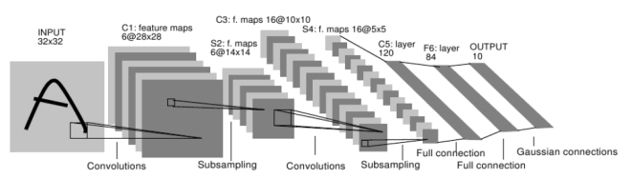
LeNet5 Architecture

Slide 5
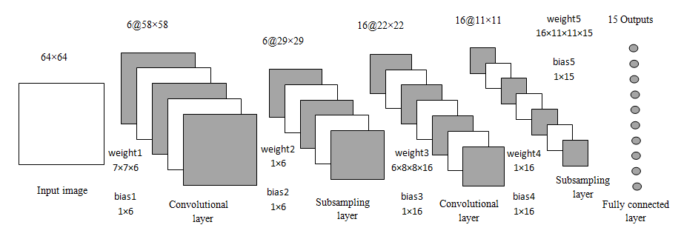
CNN structure used for feature extraction

Slide 6
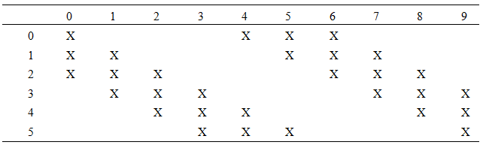
Interconnection of first subsampling layer with the second convolutional layer

Slide 7


Learning Rate

Slide 8
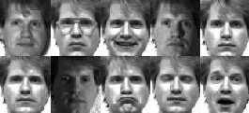

Yale face database
64×64
[-1, 1]

Slide 9
logistic function

Slide 10

Recognition accuracy, training time and number of parameters

Slide 11
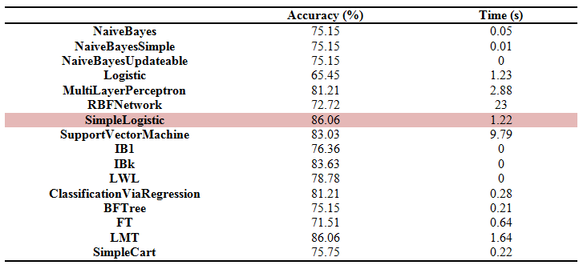
Comparison of different algorithms

Slide 12
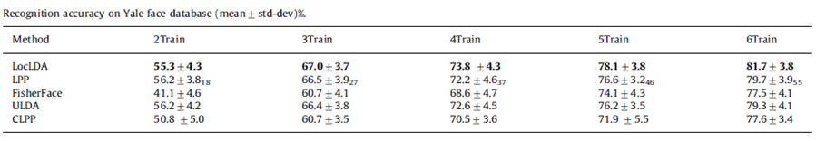
X. Shu et al. / Pattern Recognition 45 (2012) 1892-1898

Slide 13
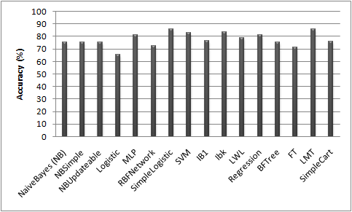
Classification accuracy

Slide 14
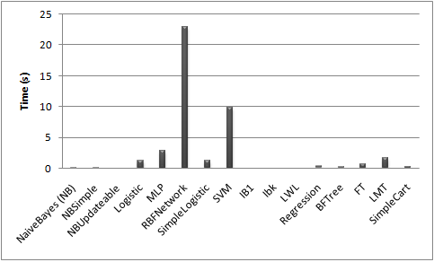
Classification time

Slide 15
Conclusion
Convolutional neural networks and simple logistic regression method are investigated with results on Yale face dataset
Method benefit from all CNN advantages such as feature extracting and robustness to distortions
Simple logistic regression which is a discriminative classifier is more efficient when the normality assumptions are satisfied.
Results show the highest classification accuracy and lowest classification time in compare with other machine learning algorithms

