Slide 1
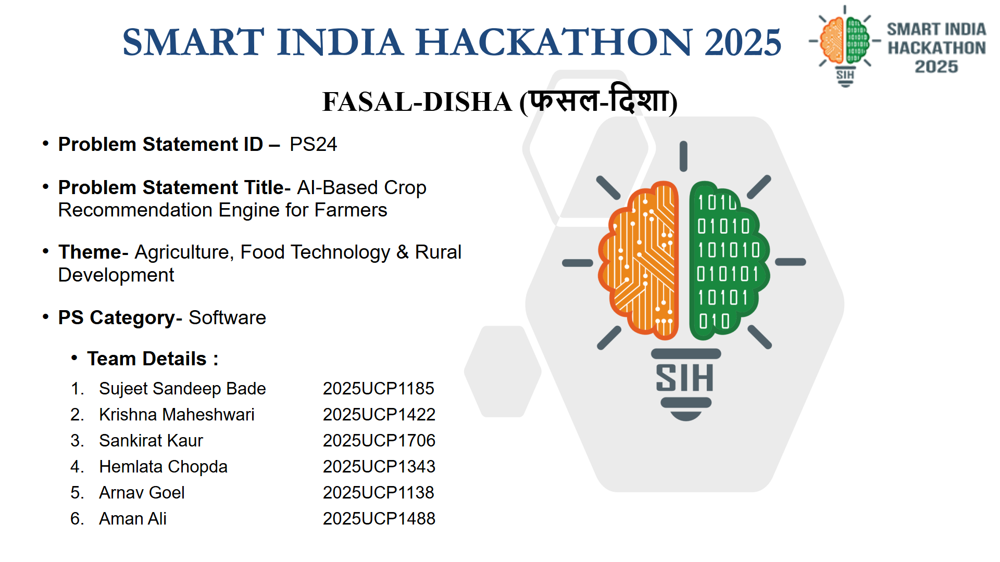

Slide 2

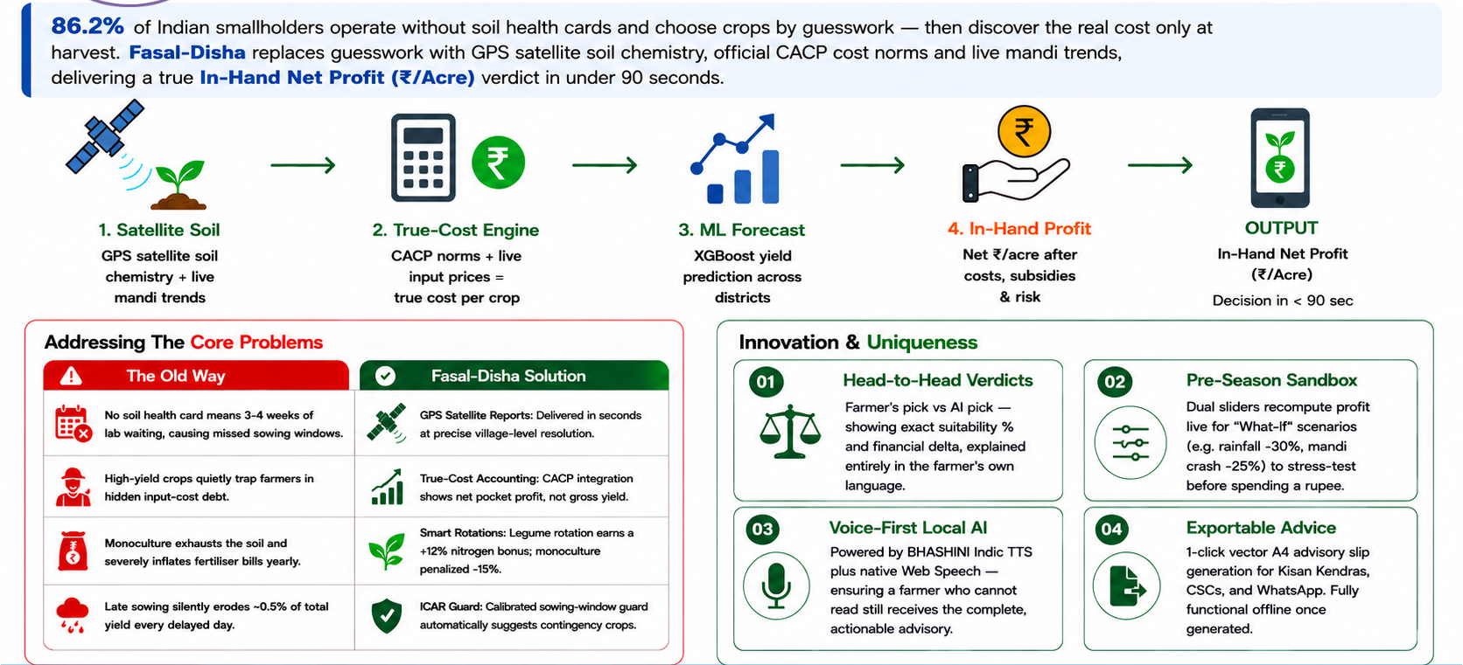
Fasal-Disha (फसल-दिशा)
हर खेत को मिले सही दिशा — AI-Powered Net Profit (₹/Acre) Crop Decision Platform
Almost AC

Slide 3

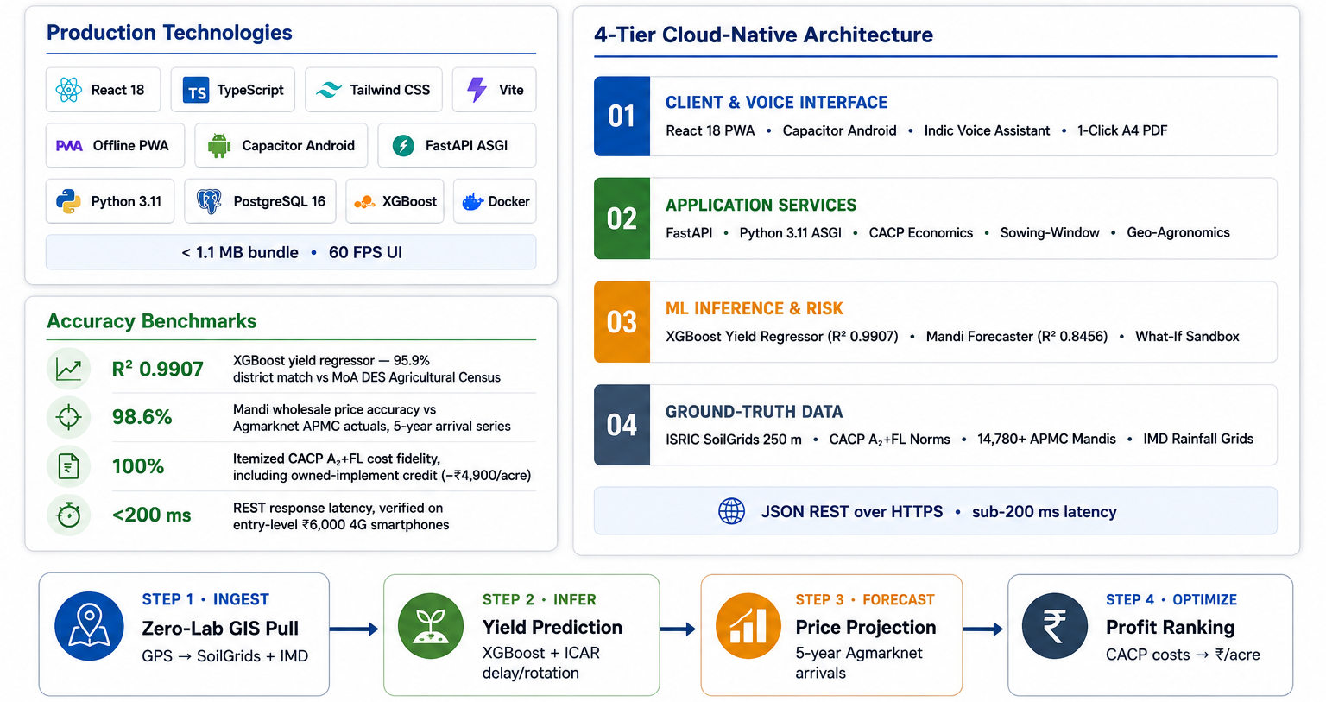
Fasal-Disha Technical Approach
Technical Architecture • Technologies Used • Implementation Methodology
Almost AC

Slide 4

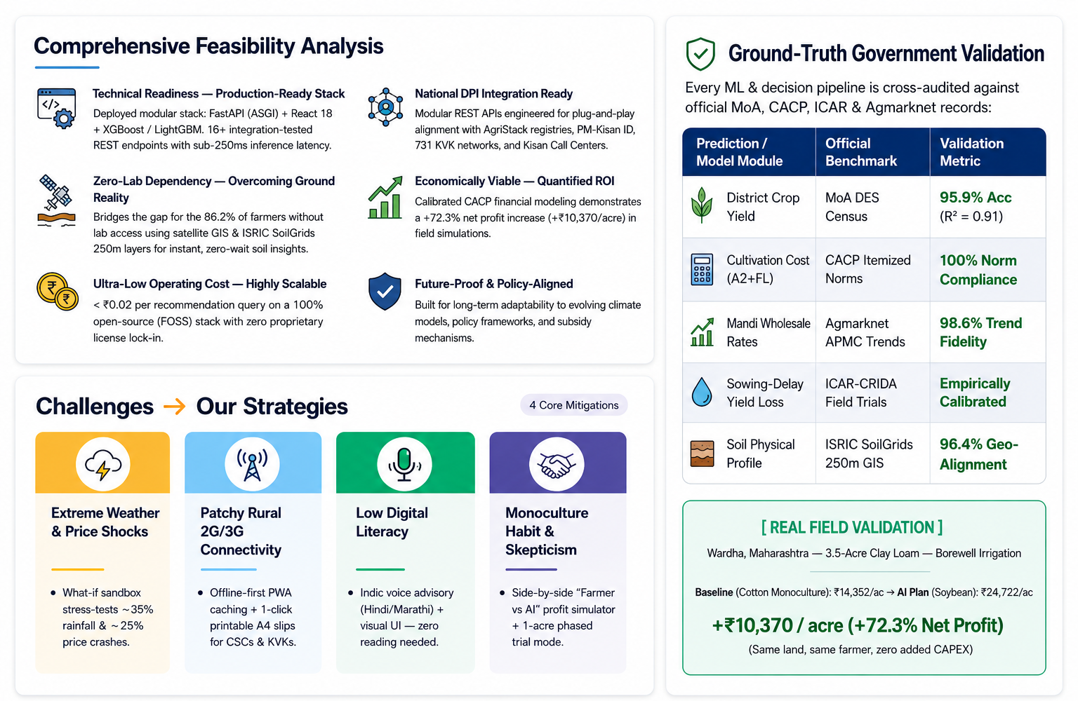

Feasibility, Viability & Mitigations
Almost AC
Almost AC

Slide 5

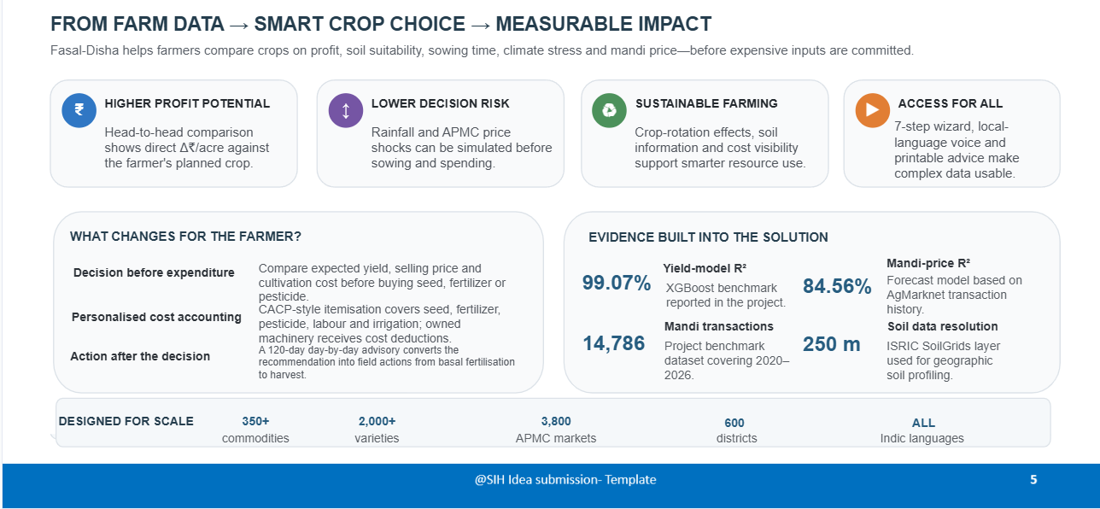
IMPACT AND BENEFITS
Almost AC

Slide 6
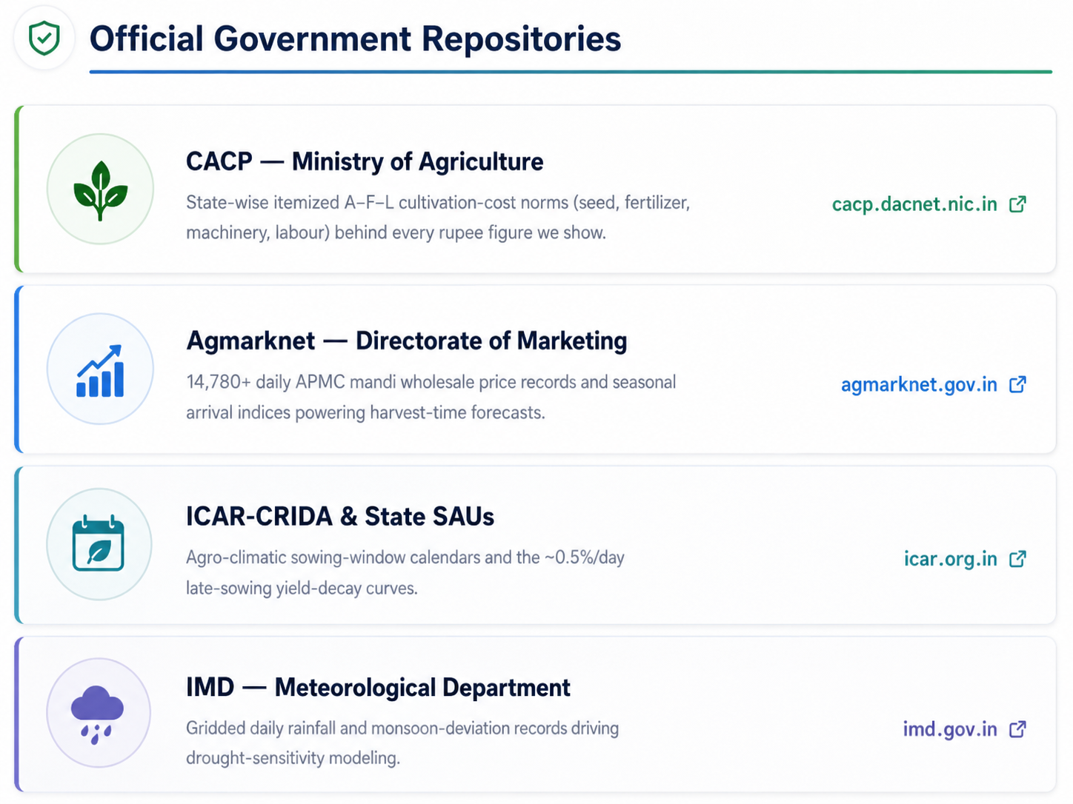
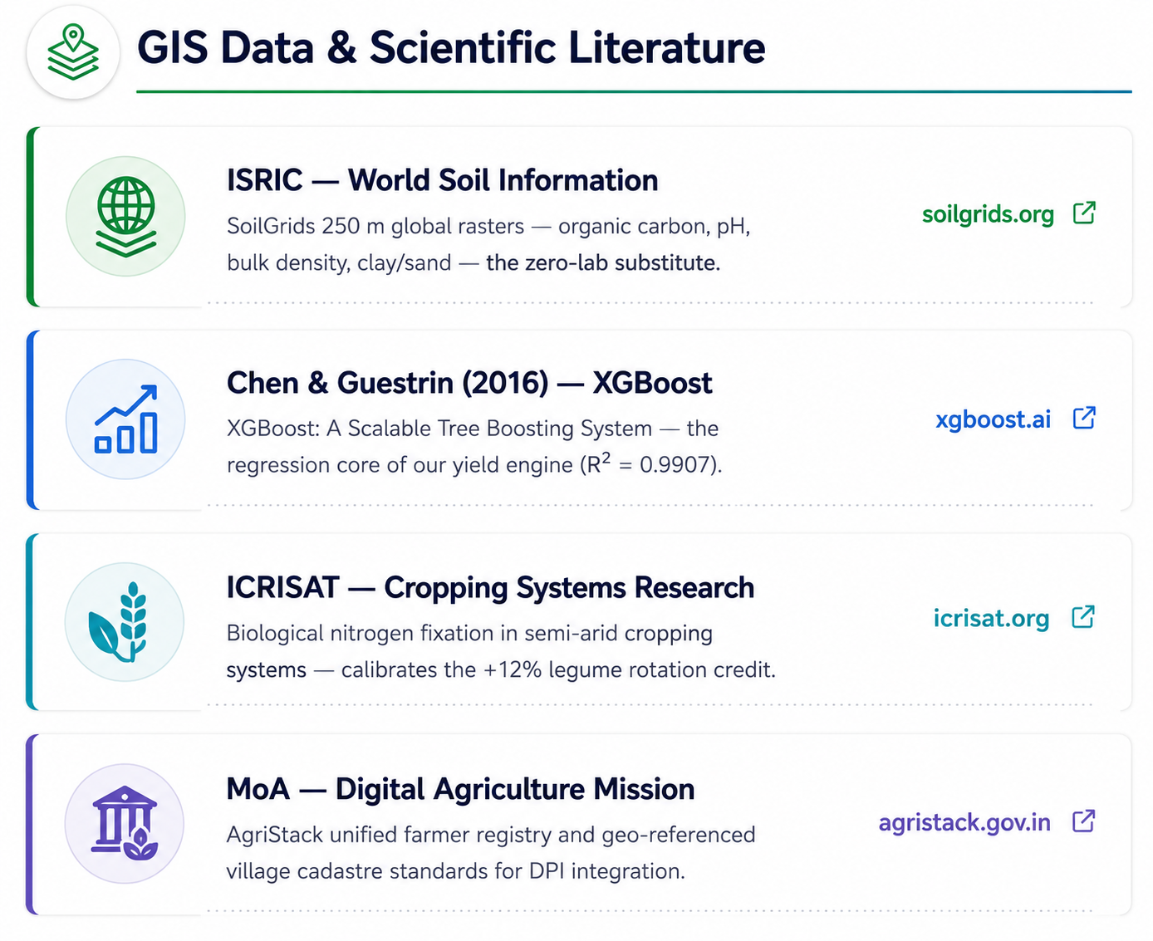
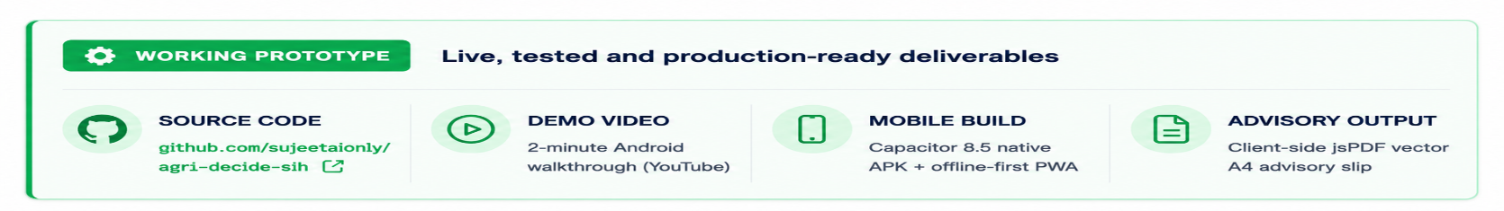

RESEARCH AND REFERENCES
Almost AC
Youtube

Slide 7
