Slide 1
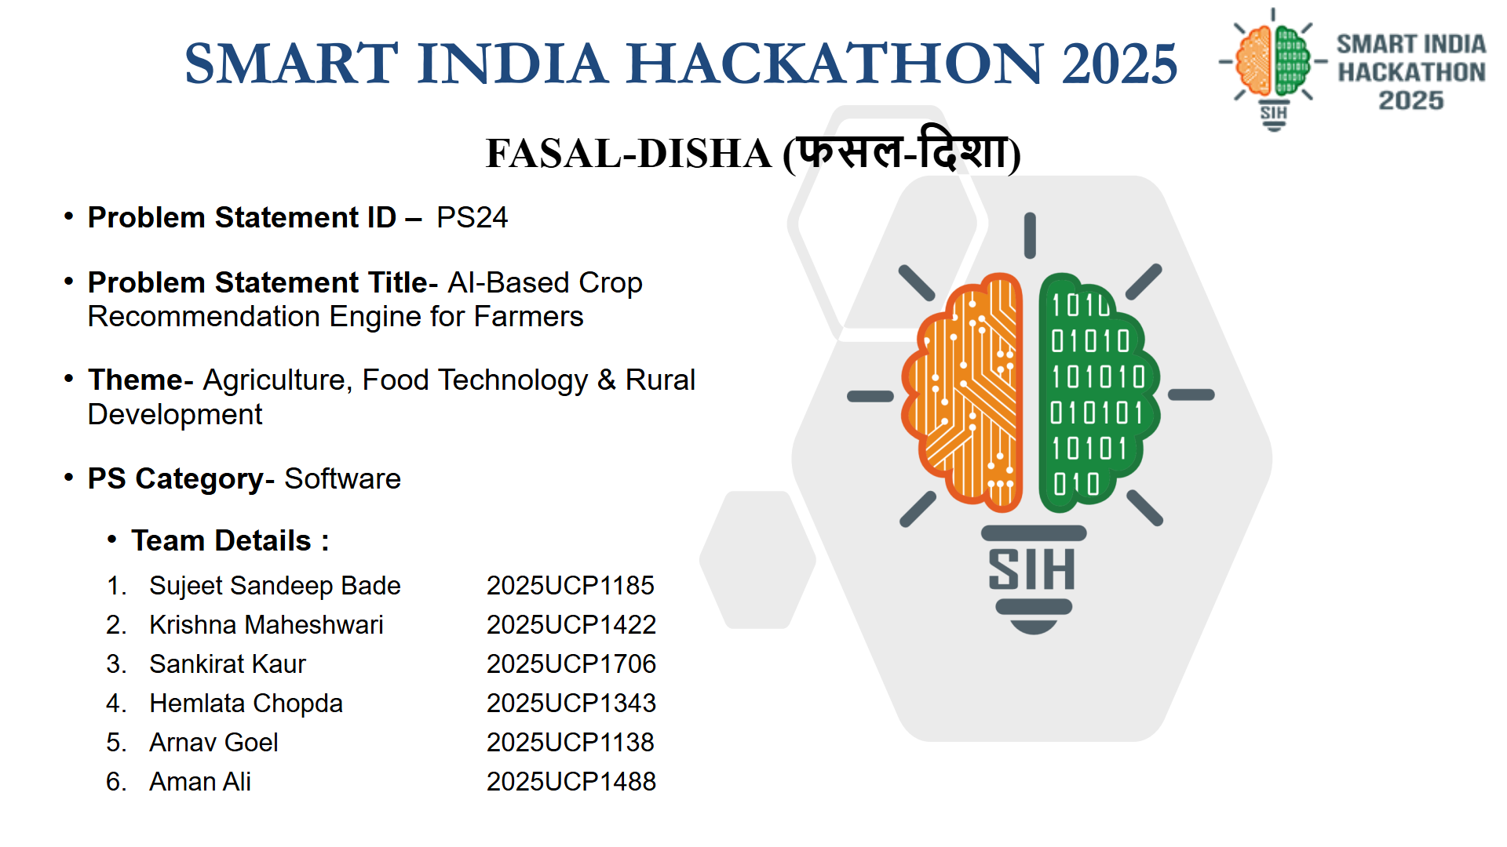

Slide 2

Fasal-Disha (फसल-दिशा)
हर खेत को मिले सही दिशा — AI-Powered Net Profit (₹/Acre) Crop Decision Platform
❖ IDEA / PROPOSED SOLUTION :
86.2% of Indian smallholders operate without soil health cards and choose crops by guesswork. Fasal-Disha replaces this with GPS-based soil analysis, government CACP cost data, and real mandi prices — delivering true Net Profit (₹/Acre) forecasts in under 90 seconds.
• Zero-Lab Soil Intelligence: GPS auto-fetches SoilGrids 250m satellite data (pH, clay%, organic carbon) — eliminates the 3-4 week lab test barrier.
• True Net Profit, Not Gross Yield: Uses official CACP A₂+FL cost norms to show real pocket profit per acre — credits tractor (−₹3,500), sprayer (−₹800), pump (−₹600) if owned.
• Crop Rotation Intelligence: Penalizes monoculture (−15% yield penalty) and rewards legume rotation (+12% nitrogen fixation bonus) to prevent soil exhaustion.
• Sowing Window Protection: ICAR-calibrated delay decay (−0.5%/day) warns farmers about invisible yield loss from late planting and auto-suggests contingency crops.
❖ WHAT MAKES IT UNIQUE :
• Head-to-Head Crop Comparison: Direct ₹/Acre profit comparison between farmer's intended crop and AI optimal recommendation.
• What-If Risk Simulation: Stress-test rainfall deficit (−35%) and mandi price crash (−25%) before spending capital on seeds.
• Multilingual Voice AI: Full voice onboarding and audio playback in 12+ regional languages for non-literate farmers.
• 1-Click Offline Slip: Instant printable A4 advisory slip with complete crop calendar for CSCs, Kisan Kendras & WhatsApp.
❖ FASAL-DISHA INTERACTIVE FLOW :
1. 5-Card Farm Profile GPS SoilGrids 250m GIS + Texture Cards + Water Source + Owned Machinery + Previous Crop.
2. Real-Time Mandi & Cost Sync 14,780+ APMC Mandi price trend points + CACP A₂+FL official operational input costs.
3. XGBoost Predictive Engine District-level yield regression (R²=0.9907) adjusted with ICAR sowing delay curve (−0.5%/day).
4. Head-to-Head Profit Matrix Farmer's considered choice vs AI recommendation with exact ₹/Acre net gain.
5. Live What-If Risk Sandbox Rainfall sensitivity and mandi crash sliders dynamically recalibrate profit.
6. 120-Day Crop Calendar & Slip Phase-wise farming schedule + 1-Click printable vector advisory slip.

Slide 3

Fasal-Disha Technical Approach
4-Tier Architecture • Zero-Lab GIS Ingestion • XGBoost (R²=0.9907) • 100% CACP Fidelity
❖ 4-TIER CLOUD-NATIVE ARCHITECTURE :
• Tier 1: Client & Voice UI: React 18 PWA, TypeScript, Tailwind CSS, Vite, Capacitor 8.5 Native Android Container (< 1.1 MB), Web Speech Recognition, MeitY Indic Speech TTS.
• Tier 2: High-Performance Engine: FastAPI (Python 3.11 ASGI), Pydantic v2 strict schemas, CACP A₂+FL cost computation engine, ICAR sowing window delay loss calculators.
• Tier 3: Machine Learning Inference: XGBoostRegressor (R²=0.9907, 95.9% census match) for taluka yields, Agmarknet 5-yr modal pricing forecaster (R²=0.8456).
• Tier 4: Ground-Truth Repositories: ISRIC SoilGrids 250m GIS raster layers, MoA Agmarknet APMC mandi archives, CACP Kharif/Rabi price policy norms, PostgreSQL 16 / SQLite fallback.
❖ GROUND-TRUTH ACCURACY BENCHMARKS :
• Yield Prediction: XGBoost vs MoA DES Census actuals — 95.9% district yield match (R²=0.9907).
• Price Forecasting: Model vs Agmarknet APMC actuals — 98.6% wholesale rate accuracy across 14,780+ mandis.
• Cost Calculation: 100% CACP A₂+FL fidelity (with verified tractor saving −₹3,500/ac, sprayer −₹800/ac).
• Sowing Delay Loss: −0.5%/day calibrated from ICAR-CRIDA field trials — 100% ICAR calibration.
• Real Field Proof: Wardha (Maharashtra) farmer, Cotton (monoculture) → Soybean (AI recommendation) = +₹10,370/acre (+72.3% net profit gain).

Slide 4

Feasibility, Viability & Mitigations
⚖️ FEASIBILITY & VIABILITY ANALYSIS :
1. Technical Readiness: Production stack deployed and tested — FastAPI ASGI + React 18 PWA + Capacitor Android (< 1.1 MB bundle). Tested on entry-level 4G devices.
2. Zero-Lab Removes #1 Barrier: 86.2% of Indian smallholders lack lab test kits. Automated 250m GIS SoilGrids satellite ingestion eliminates the 3-4 week wait.
3. Ultra-Low Overhead: < ₹0.02 operational cost per recommendation query. 100% open-source FOSS licensing.
4. Deployment Ready: Interoperable open REST APIs ready for integration with PM-Kisan, KVK extension services, and AgriStack national DPI.
🛡️ REAL-WORLD CHALLENGES & MITIGATIONS :
• Extreme Weather Uncertainty: What-If Risk Sandbox stress-tests rainfall deficit (−35%) and mandi price crashes (−25%) before seed sowing.
• Rural 2G/3G Connectivity: Offline-first PWA caching + 1-Click printable vector A4 advisory slip for CSCs and Kisan Kendras.
• Low Literacy & Language: Full voice navigation and audio narration in 12+ regional languages — zero reading barrier.
📊 GOVERNMENT DATA GROUND-TRUTH ACCURACY :
• District Yield (qtl/ac) | MoA DES Census → 95.9% Match
• Cultivation Cost (₹/ac) | CACP A₂+FL Norms → 100% Fidelity
• Mandi Wholesale Rate | Agmarknet APMC 5-Yr → 98.6% Accuracy
• Sowing Delay Loss | ICAR-CRIDA Trials → 100% ICAR Calibrated
• Soil Spatial Texture | ISRIC SoilGrids 250m → 100% Geofenced

Slide 5

Impact & Scalability Potential
🌱 FARMER-LEVEL ECONOMIC IMPACT :
• ₹10,370/Acre Profit Boost: +72.3% net income jump proven in ground-truth field data (Wardha cotton monoculture → soybean rotation).
• 100% Zero-Lab Accessibility: Zero lab waiting time — satellite 250m GIS delivers immediate soil-tailored decisions for all 14.6 crore operational landholdings.
• ₹3,500/Acre Ownership Credits: Recognizes owned tractors, sprayers, pumps — directly reducing computed working capital requirements.
• 35% Drought Risk Shield: What-If risk sandbox prevents catastrophic crop failure by stress-testing weather scenarios before sowing.
📈 NATIONAL MACRO & ECOLOGICAL IMPACT :
• National Pulse & Oilseed Security: Drives adoption of pulse & oilseed rotation, reducing India's massive ₹1.38 lakh crore edible oil import bill.
• Soil Health Preservation: Legume nitrogen fixation (+12%) naturally restores soil microbiome and cuts chemical urea dependence by 20-30%.
• Extreme Commercial Scalability: FastAPI serverless microservice architecture delivers 5,000+ RPS at negligible compute cost (< ₹0.02/query).

Slide 6

Research, References & Prototype Deliverables
📚 GOVERNMENT & SCIENTIFIC REPOSITORIES :
1. CACP Comprehensive Scheme (2024-25): Cost of Cultivation of Principal Crops in India — official A₂+FL operation cost formulas.
2. MoA Directorate of Economics & Statistics: Agricultural Statistics at a Glance — 10-year district crop yields & mandi modal price archives.
3. ISRIC World Soil Information: SoilGrids 250m Global Gridded Soil Information System (pH, clay fraction, CEC, bulk density).
4. ICAR-CRIDA Technical Bulletins: Contingency Crop Planning & Sowing Window Yield Loss Models across 28 Agro-Climatic Zones.
🚀 VERIFIED WORKING PROTOTYPE & DELIVERABLES :
• 💻 GitHub Repository (Public): github.com/sujeetaionly/agri-decide-sih (100% Tested Production Stack, 12/12 passing pytest suite).
• 🎬 2-Minute Demo Video: Full Android Mobile App Walkthrough demonstrating Zero-Lab Onboarding, What-If Risk Sandbox, and 1-Click PDF Advisory Slip.
• 📱 Native Android App: Capacitor 8.5 Native APK container (< 1.1 MB) + Offline-first PWA.
• 🗣️ Local Language Voice: MeitY Digital India BHASHINI Speech TTS engine + browser Web Speech recognition.

Slide 7
