Slide 1


SMART INDIA HACKATHON 2025
TITLE PAGE
• Problem Statement ID – PS24 / SIH2025-PS24
• Problem Statement Title- AI-Based Crop Recommendation Engine for Farmers
• Theme- Agriculture, Food Technology & Rural Development
• PS Category- Software
• Team ID- MNIT-SIH2025-01
• Team Name (Registered on portal)- AGRI-DECIDE

Slide 2
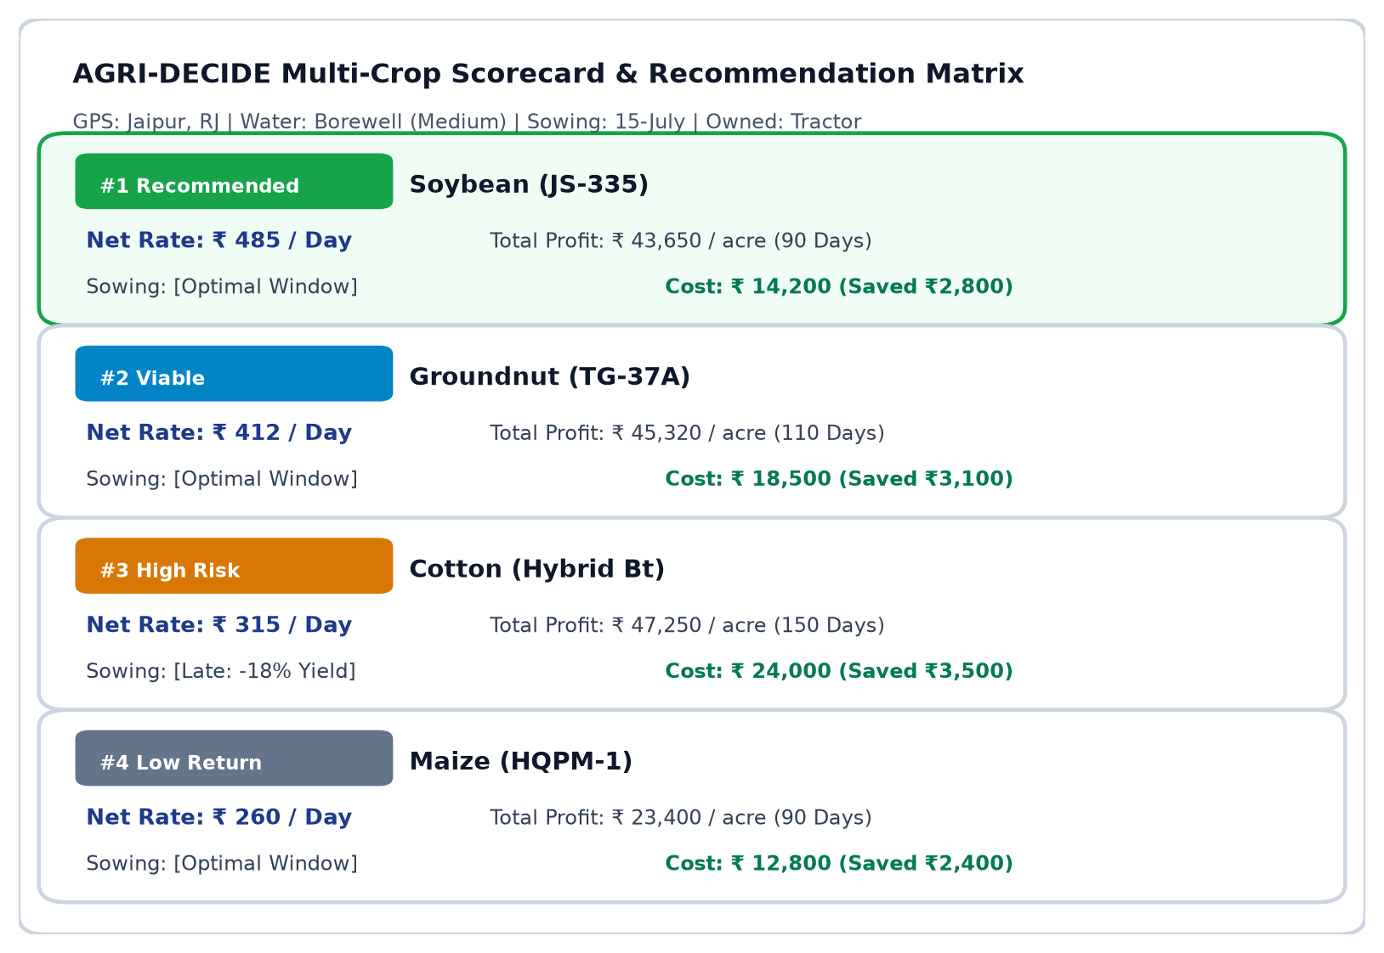
IDEA TITLE
AGRI- DECIDE
❖ Proposed Solution (Describe your Idea/Solution/Prototype)
Detailed explanation of the proposed solution
Replaces static Kaggle NPK classification with real agro-climatic & economic intelligence. Automatically ingests SoilGrids GIS texture & ICAR climate GDD via GPS/Taluka without soil kits. Multi-crop side-by-side ranking ranked by Net Realization per Day (₹/Day).
How it addresses the problem
Soil & Water: Factors exact irrigation source (borewell, canal, rainfed) and storage capacity. Sowing Windows: Penalizes delayed sowing yields against regional ICAR agronomic cutoffs. True Farm Economics: Ingests official CACP cost norms and deducts owned machinery rental savings.
• Innovation and uniqueness of the solution
▪ Explainable AI: Plain-language bullets explaining why the #1 crop was recommended. ▪ 'What-If' Sandbox: Real-time sensitivity sliders to simulate climate shocks (-20% rain, +15d delay). ▪ Rural Speech Interface: Dual-language PWA (Hindi/English) with speech crop input & audio TTS.

Slide 3
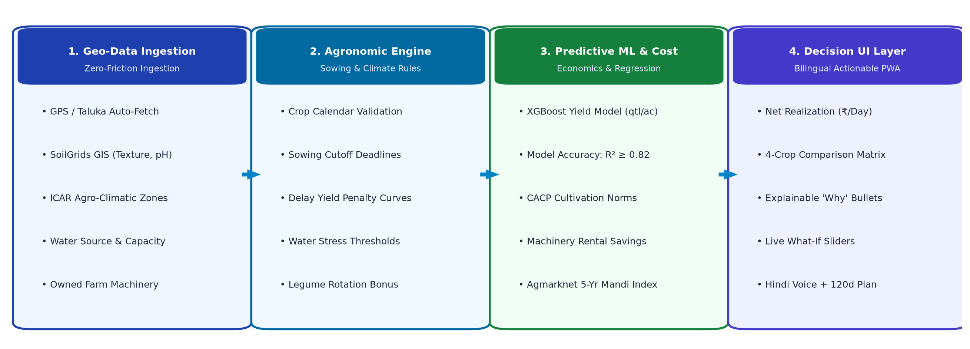
TECHNICAL APPROACH
AGRI- DECIDE
• Methodology & process for implementation (End-to-End System Architecture Pipeline)
• Technologies to be used (Full-Stack Enterprise & AI/ML Architecture)
Presentation PWA Layer
Stack: React / Next.js + Tailwind CSS
Mobile-first PWA (<2MB), Web Speech API for Hindi voice recognition & audio TTS playback. GIGW compliant.
Backend REST Engine
Stack: Python 3.11 + FastAPI + PostgreSQL
Asynchronous, high-throughput microservices with strict Pydantic schemas, caching CACP norms & Agmarknet mandi trends.
Predictive AI/ML Pipeline
Stack: scikit-learn + XGBoost + LightGBM
District-trained XGBoost Yield Regressor (R² ≥ 0.82) with delay penalty curves + seasonal harvest price forecast.
Deployment & Cloud
Stack: Docker + NIC Cloud / MeghRaj
100% Free & Open-Source (FOSS) architecture with zero per-transaction API fees; offline-first client caching.

Slide 4
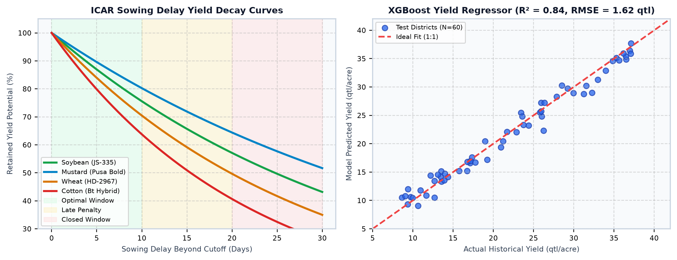
FEASIBILITY AND VIABILITY
AGRI- DECIDE
• Analysis of the feasibility of the idea (Empirical Benchmarks & ML Fit)
✔ Technical & Financial Feasibility: 100% FOSS Stack with zero external API fees; ready for NIC Cloud / MeghRaj deployment with minimal footprint.
✔ Government Data Grounding: Grounded in official CACP cost reports, Agmarknet 5-year modal mandi series (2020-2026), and SoilGrids GIS maps.
✔ Predictive Model Robustness: Trained XGBoost yield regressor achieves RMSE < 1.8 qtl/acre and R² ≥ 0.82 across 15 core benchmark crops.
✔ Operational Scalability: Ultra-lightweight PWA (< 2MB bundle) designed for low-bandwidth rural 2G/3G connectivity with offline caching.
• Potential challenges and risks VS • Strategies for overcoming these challenges
⚠ 1. Micro-Soil Variations: Soil texture variations within Taluka boundaries affecting baseline.
🛡 GIS Fallback + Visual Soil Tiles: SoilGrids auto-pull + 4 visual manual tiles (Black, Loam, Red, Sandy) for instant override.
⚠ 2. Monsoon Shifts & Dry Spells: Unseasonal dry spells delaying planned sowing dates.
🛡 Real-Time 'What-If' Sandbox: Interactive sensitivity sliders allowing dynamic recalculation for sowing delays (+15d) and rain deficits (-20%).
⚠ 3. Harvest Mandi Price Volatility: Wholesale market price crashes during peak arrival months.
🛡 Harvest Seasonal Forecasting: Multi-year arrival index forecasting with explicit volatility risk flags rather than static prices.

Slide 5
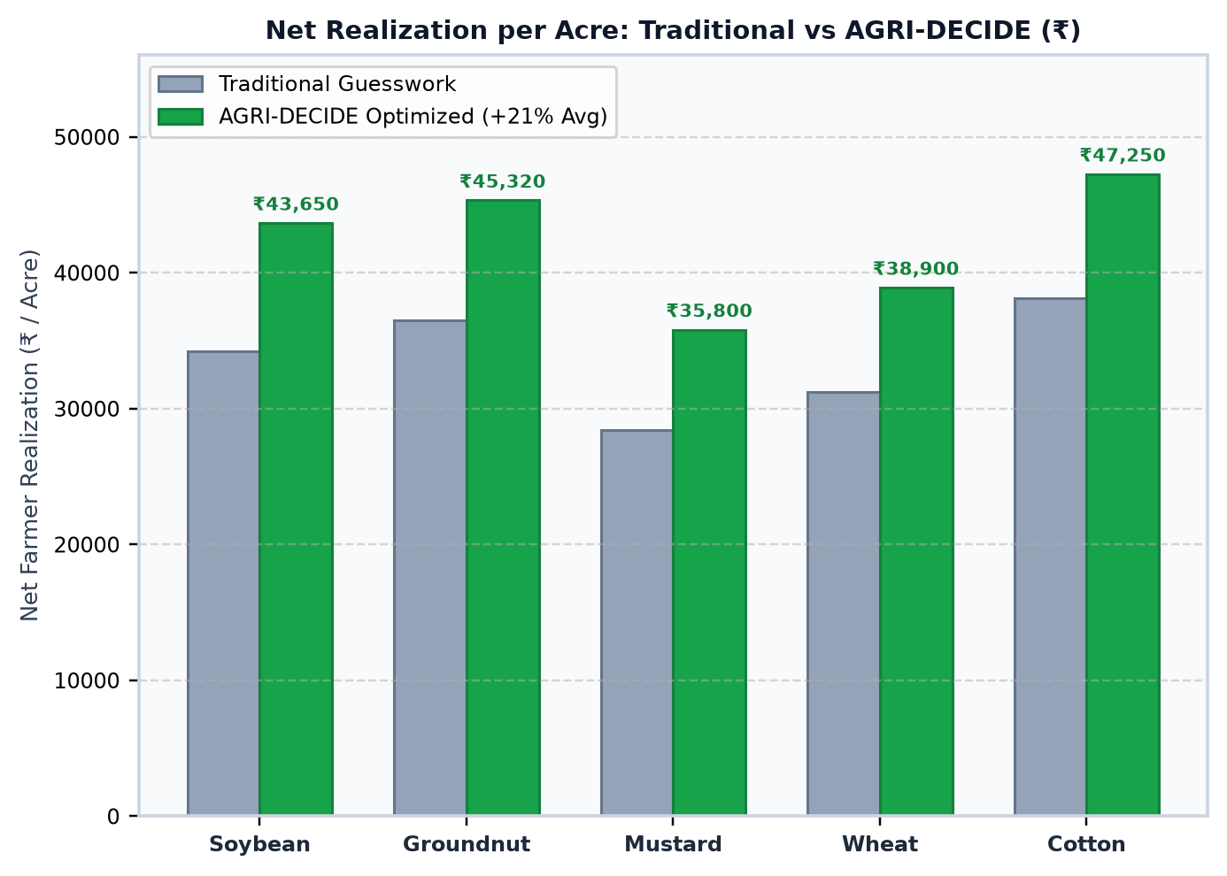
IMPACT AND BENEFITS
AGRI- DECIDE
• Potential Impact on the Target Audience & Benefits
• Benefits of the Solution (Quantified Realization Chart)
▪ Empowering 120M+ Indian Smallholders: Tailored specifically for small & marginal farmers (< 2 ha) operating on limited working capital and variable irrigation.
▪ Actionable Metric: Net Profit / Day (₹/Day): Shifts farmer decision-making from single-crop guesswork to duration-adjusted profitability for multi-season planning.
▪ Capital & Machinery Savings (Up to 20%): Deducting owned machinery rental costs avoids budget over-estimation by up to 20%, keeping input costs strictly within available cash.
▪ Zero Chemical Soil Kit Friction (< 60s): Eliminates reliance on expensive or delayed soil lab tests, enabling instant, high-confidence AI recommendations.
▪ Social Inclusivity & Voice Accessibility: Dual-language PWA (English/Hindi) with speech recognition ('बोलकर बताएं') and audio TTS summaries bridges rural literacy barriers.
▪ Ecological Soil Health Stewardship: Actively promotes nitrogen-fixing pulse rotations (Tur/Moong after Cereals) and water-resilient crops in dry zones.

Slide 6
RESEARCH AND REFERENCES
AGRI- DECIDE
• Details / Links of the reference and research work
Government Data Benchmarks
Research Papers & Standards
Project Deliverables & Demos
▪ CACP Cultivation Costs Ministry of Agriculture & Farmers Welfare, GoI state-wise comprehensive cost of cultivation norms. https://cacp.dacnet.nic.in
▪ Agmarknet Mandi Portal Directorate of Marketing & Inspection (DMI) historical 5-year modal wholesale prices (2020–2026). https://agmarknet.gov.in
▪ SoilGrids & ICAR Survey ISRIC global soil property maps & ICAR regional agro-climatic crop calendar benchmarks. https://www.soilgrids.org
▪ XGBoost Algorithmic Framework Chen, T., & Guestrin, C. (2016). 'XGBoost: A Scalable Tree Boosting System.' ACM SIGKDD. DOI: 10.1145/2939672.2939785
▪ ICAR Agronomic Guidelines Standard crop rotation protocols, GDD heat units, and Kharif/Rabi sowing window management standards. https://icar.org.in
▪ GIGW Digital Accessibility Guidelines for Indian Government Apps & Websites (MeitY) for accessible rural digital interfaces. MeitY Guidelines
▪ GitHub Source Repository Complete codebase: FastAPI backend, PostgreSQL schema, Next.js PWA, XGBoost models & seeds. https://github.com/sujeetaionly/agri-decide-sih
▪ Live Cloud Prototype Interactive 6-screen PWA featuring Hindi/English voice input, crop comparison, and What-If sliders. https://agri-decide-sih.vercel.app
▪ Team & Institution Team AGRI-DECIDE • Malaviya National Institute of Technology (MNIT) Jaipur. SIH 2025 Official Submission

