Slide 1

Encryption, Decryption and Cracking of Vigenère Cipher
By Sujeet Sanjay Amberkar

Slide 2
Encryption
E_{i}(x_{i}) = (x_{i}+ ki) mod 26
THIS IS A INPUT TEXT
K
E
Y

Slide 3
Encryption
E_{i}(x_{i}) = (x_{i}+ ki) mod 26
THIS IS A INPUT TEXT
K
E
Y
K
E
Y
K
E
Y

Slide 4
DLGC MQ K MLZYR DIVD"
Encrypted Text is:

Slide 5
Decryption
E_{i}(x_{i}) = (x_{i}i-ki) mod 26
DLGC MQ K MLZYR DIVD
THIS IS A INPUT TEXT
K
E
Y
K
E
Y

Slide 6
Cracking of Cipher
Determining Length by Kaiski Algorithm

Slide 7
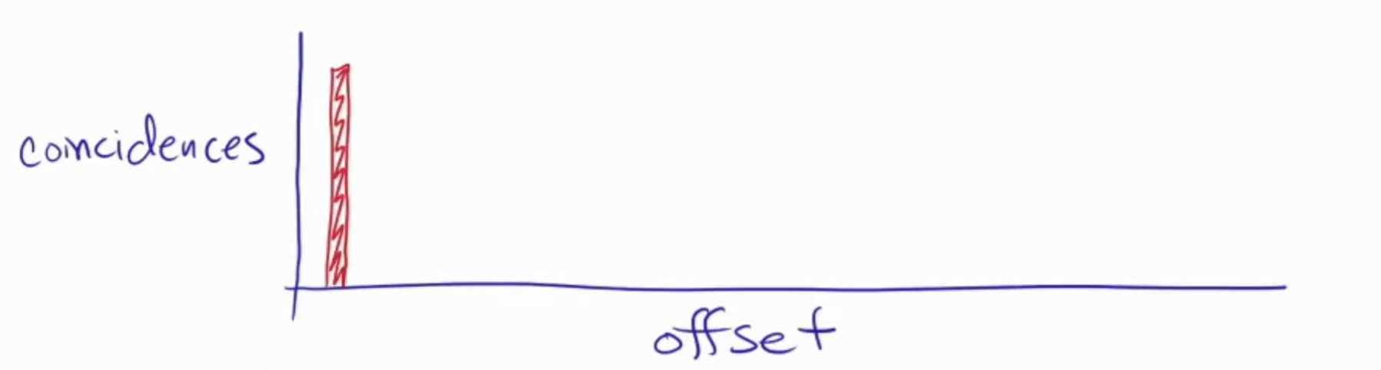

Slide 8
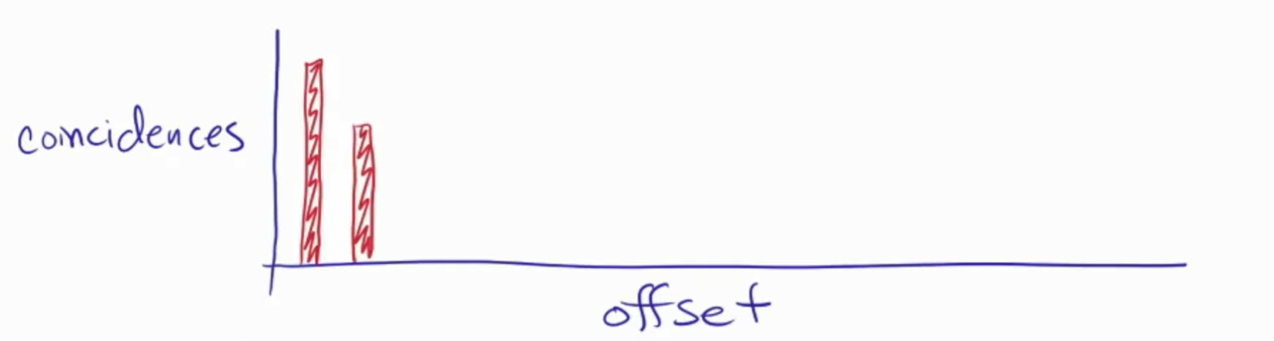

Slide 9
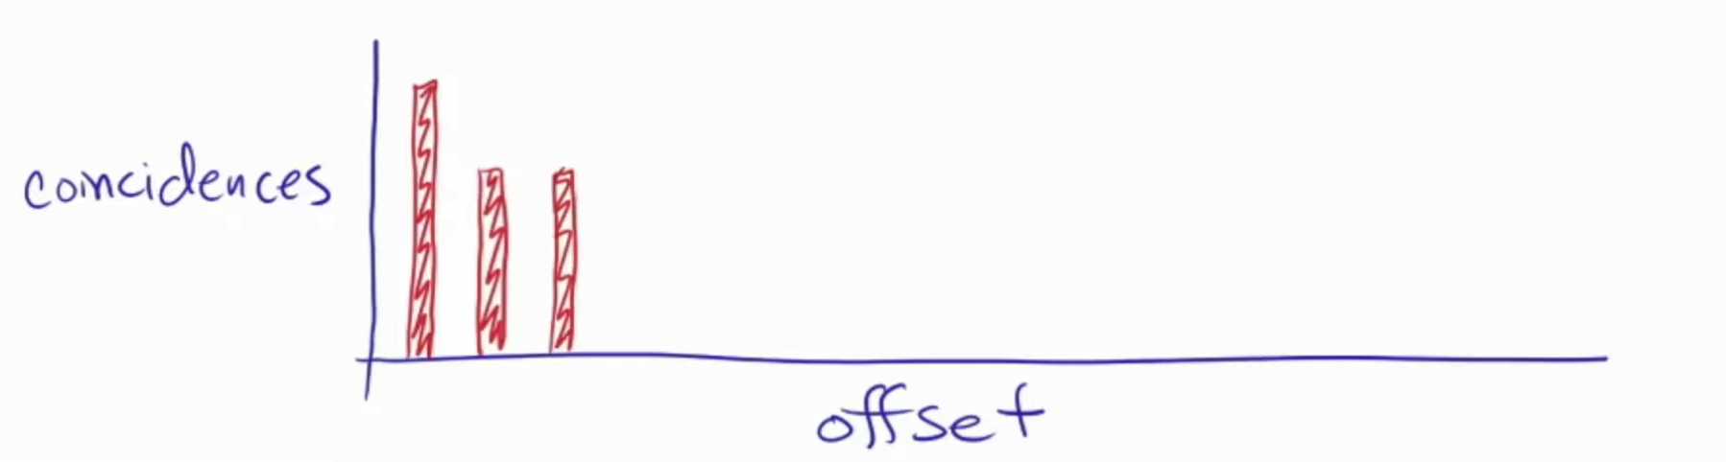

Slide 10
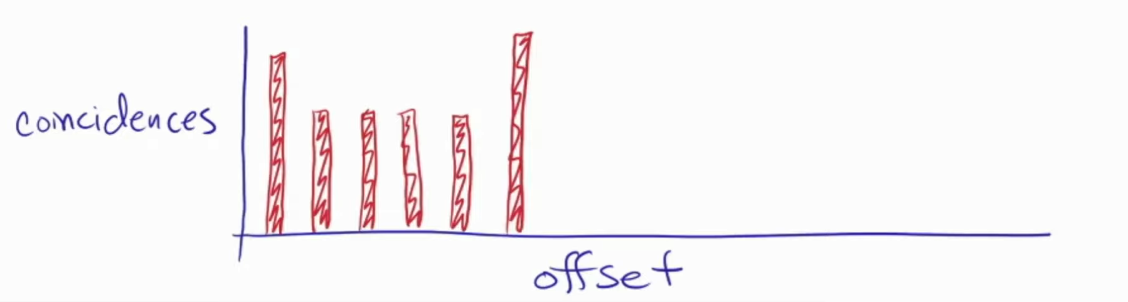

Slide 11
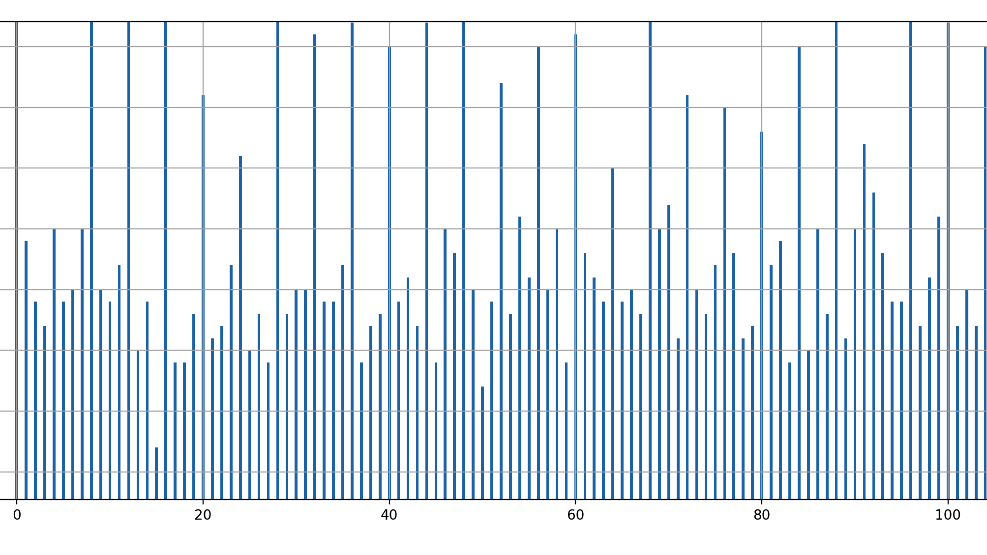

Slide 12
Length of Key = mode (values)

Slide 13
1
1
1
2
2
2
3
3
3
4
4
4
5
1
1
1
2
2
2
3
3
3
4
4
4
5
If Length = n, Divide the encrypted text into n Caesar cipher

Slide 14
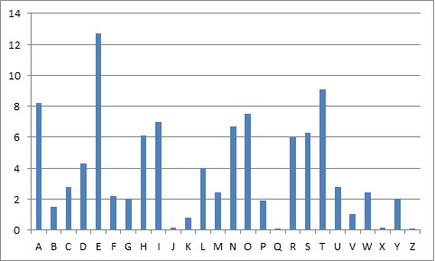

Slide 15
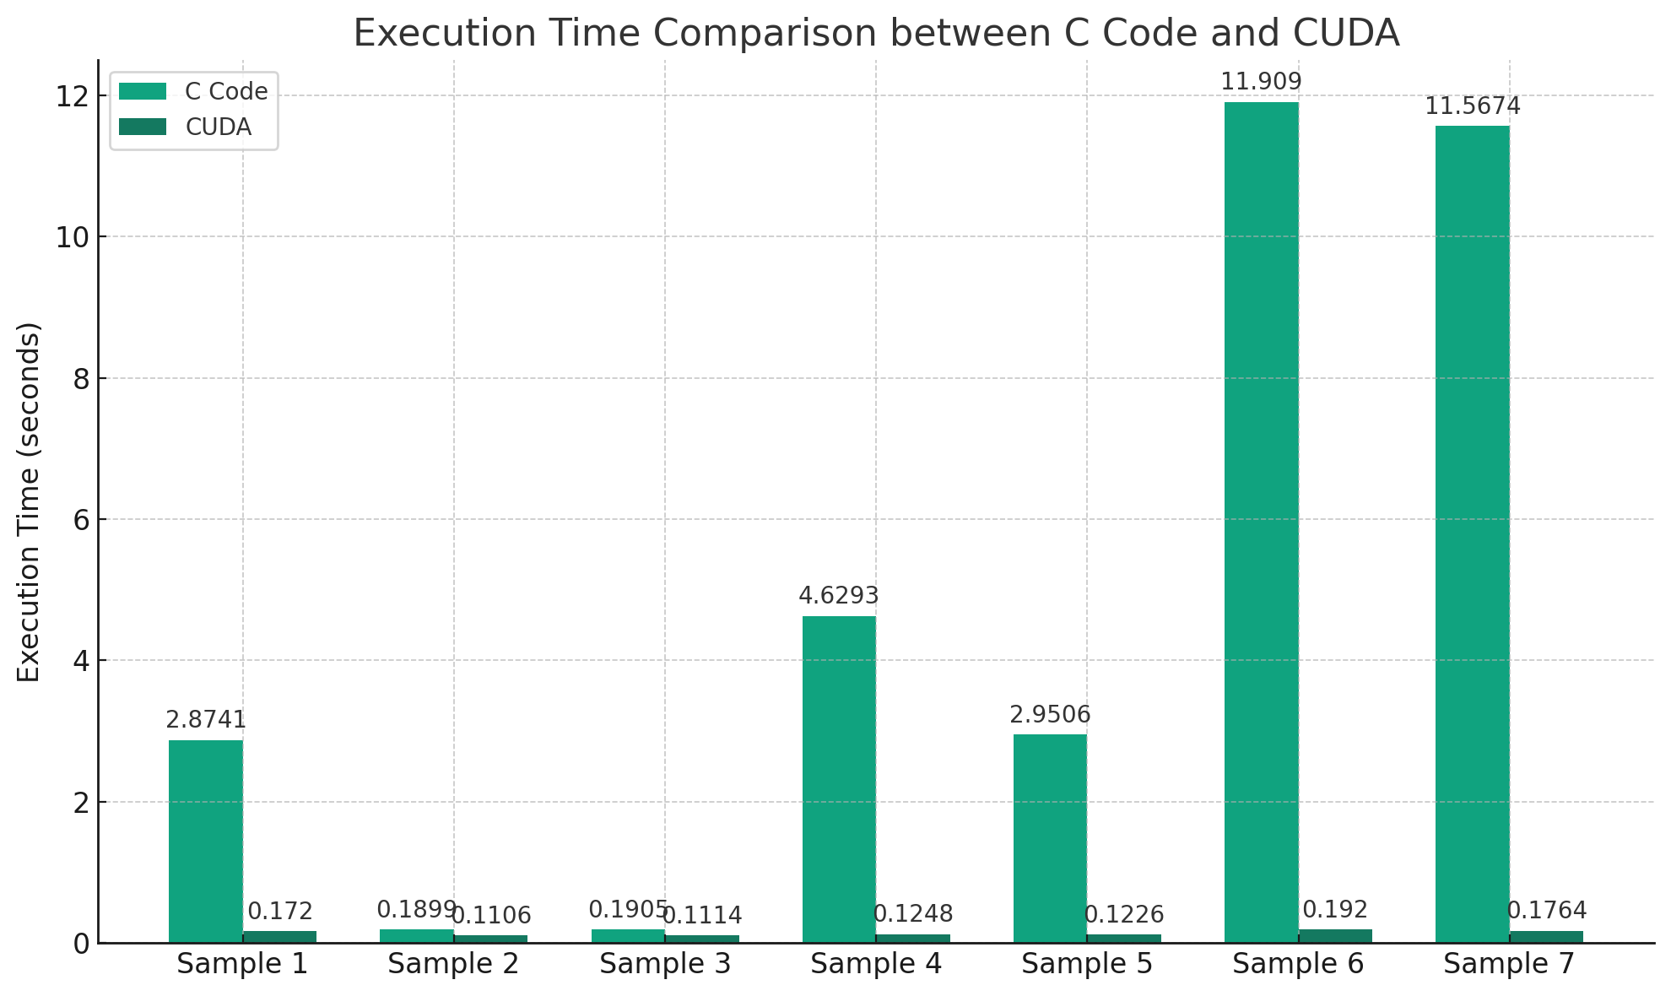
Results
C Code | Nvidia | Key | Length of Sample Text
2.874124 | 0.171985 | SUJEET | 3059
0.189914 | 0.110613 | SUJEETAM | 745
0.190495 | 0.111438 | SUJEET | 745
4.629269 | 0.124841 | SUJEET | 3737
2.950582 | 0.122647 | SUJEET | 2983
11.909002 | 0.191981 | SUJEET | 5971
11.567394 | 0.176444 | SUJEETAM | 5971

Slide 16
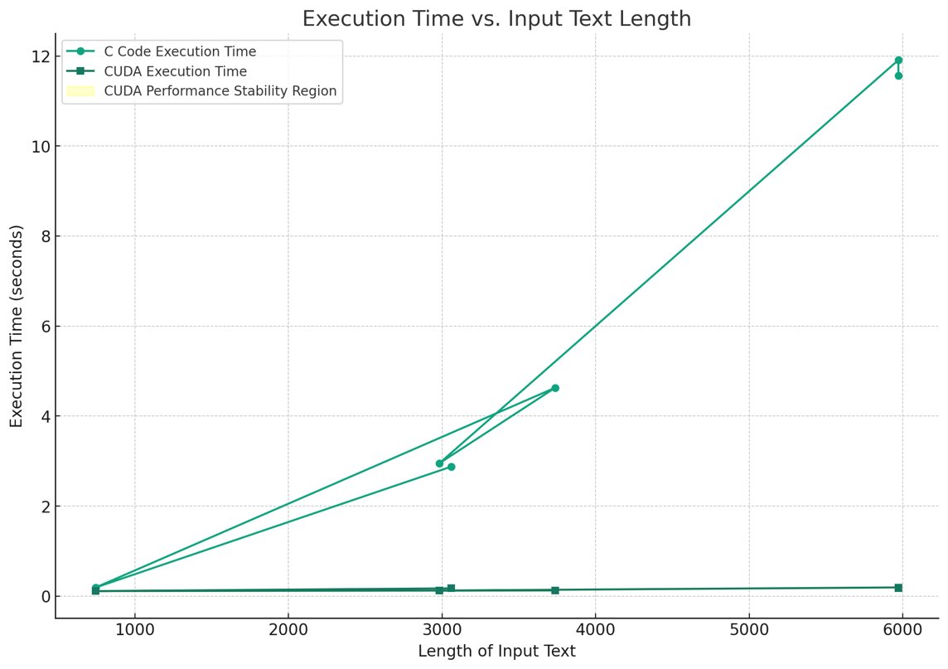

Slide 17
Thank You

