Slide 1
Group-13
Phase-III project.
Presentation
214363009 SUJEET KUMAR SINGH
216103015 JOHNSON B LAKRA

Slide 2
Constrained Optimisation
Using
Bracket Penalty Method.

Slide 3
Descriptions of the Methods Used
Bounding Phase
Bisection
Powell Conjugate
Bracket Penalty

Slide 4
Descriptions of the Method Used
1. Bounding Phase
It starts with an initial guess.
Finds search direction based on two function evaluations with respect to the initial guess
New value is found by adding or subtracting a exponential value ( delta)
The value is found is giving larger function value than the previous then last value is the minimum value.

Slide 5
Descriptions of the Method Used
2. Bisection
It uses first derivative value and it sign to eliminate certain regions.
We choose two points a and b in a manner such f’(a)<0 and f’(b)>0
The function value of the average of a and b is considered mid point
If the first derivative average function value is -ve then region between mid point to a is eliminated.
If the first derivative average function value is +ve then region between mid point to b is eliminated.

Slide 6
Descriptions of the Method Used
3. Powell Conjugate
It’s a direct search method that uses previous solutions to create new search direction.
It creates N linearly independent search direction and performs a series of unidirectional searches starting each time from previous best point.
New conjugate direction is found using extended parallel subspace property.
In general thereafter one final unidirectional search is conducted to obtain a minimum point.

Slide 7
Descriptions of the Method Used
4. Bracket Penalty
$$Ω=R<g\left(x\right)>^{2}$$
where ⟨α⟩ = α, when α is negative, zero otherwise.
This term also handles inequality constraints.
Since the bracket operator assigns a positive value to the infeasible points, this is an exterior penalty term.
The first sequence begins with a small value of the penalty parameter R and is increased in subsequent sequences.
This operator is mostly used in handling inequality constraints.

Slide 8
Descriptions of the Programme
Constrained function is converted to Unconstrained function using Bracket operator penalty.
The converted unconstrained multivariable uses powell- conjugate to find the optimised value.
The powell conjugate uses bracketing method 1. Bounding Phase 2. Bisection method to reduce the range within which the optimum value lies.

Slide 9
Flow-Chart of the Programme

Slide 10
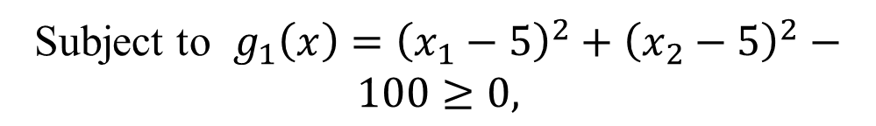

Prob. 1:
Min $f\left(x\right)={\left(x_{1}−10\right)}^{3}+{\left(x_{2}−20\right)}^{3}$
Subject to $g_{1}\left(x\right)={\left(x_{1}−5\right)}^{2}+{\left(x_{2}−5\right)}^{2}−100≥0,$
$$g_{2}\left(x\right)={\left(x_{1}−6\right)}^{2}+{\left(x_{2}−5\right)}^{2}−82.81≤0$$
$$13≤x_{1}≤20,0≤x_{2}≤4$$
Number of variables: 2 variables.

Slide 11
Prob. 1:
Number of Variables. | Initial points | Resultant Points. | Function Value | No of iterations
2 | 1,2 | 14.0999,0.8526 | -0.6951 | 8

Slide 12
Prob. 1:
Number of Variables. | Initial points | Resultant Points. | Function Value | No of iterations
2 | 2,3 | 14.0999,0.8526 | -0.6951 | 8
2

Slide 13
Prob. 1:
Number of Variables. | Initial points | Resultant Points. | Function Value | No of iterations
2 | 3,4 | 14.0999,0.8526 | -0.6951 | 8

Slide 14
Prob. 1:
Number of Variables. | Initial points | Resultant Points. | Function Value | No of iterations
2 | 4,5 | 14.0999,0.8526 | -0.6951 | 8

Slide 15
Prob. 1:
Number of Variables. | Initial points | Resultant Points. | Function Value | No of iterations
2 | -1,-2 | 14.0999,0.8526 | -0.6951 | 8

Slide 16
Prob. 1:
Number of Variables. | Initial points | Resultant Points. | Function Value | No of iterations
2 | -2,-3 | 14.0999,0.8526 | -0.6951 | 8

Slide 17
Prob. 1:
Number of Variables. | Initial points | Resultant Points. | Function Value | No of iterations
2 | -3,-4 | 14.0999,0.8526 | -0.6951 | 8

Slide 18
Prob. 1:
Number of Variables. | Initial points | Resultant Points. | Function Value | No of iterations
2 | -4,-5 | 14.0999,0.8526 | -0.6951 | 8

Slide 19
Prob. 1:
Number of Variables. | Initial points | Resultant Points. | Function Value | No of iterations
2 | 1,1 | 14.0999,0.8526 | -0.6951 | 8

Slide 20
Prob. 1:
Number of Variables. | Initial points | Resultant Points. | Function Value | No of iterations
2 | -1,1 | 14.0999,0.8526 | -0.6951 | 8

Slide 21
Problem:1
Number of Variables. | Initial points | Resultant Points. | Function Value | Function Value(Best) | Function Value(worst) | Function Value(mean) | Function Value(median) | Function Value(Standard Deviation)
2 | 1,2 | 4.0999,0.8526 | -0.6951 | -0.6951 | -0.6951 | -0.695100 | -0.695100 | 0.0000
 | 2,3 | 4.0999,0.8526 | -0.6951
 | 3,4 | 4.0999,0.8526 | -0.6951
 | 4,5 | 4.0999,0.8526 | -0.6951
 | -1,-2 | 4.0999,0.8526 | -0.6951
 | -2,-3 | 4.0999,0.8526 | -0.6951
 | -3,-4 | 4.0999,0.8526 | -0.6951
 | -4,-5 | 4.0999,0.8526 | -0.6951
 | 1,1 | 4.0999,0.8526 | -0.6951
 | -1,1 | 4.0999,0.8526 | -0.6951

Slide 22
Prob. 1:(Observations)
Irrespective of the change in the starting point , the point has the same optimum value with same number of iteration. Hence the standard deviation is zero
The convergence plot remains same.

Slide 23
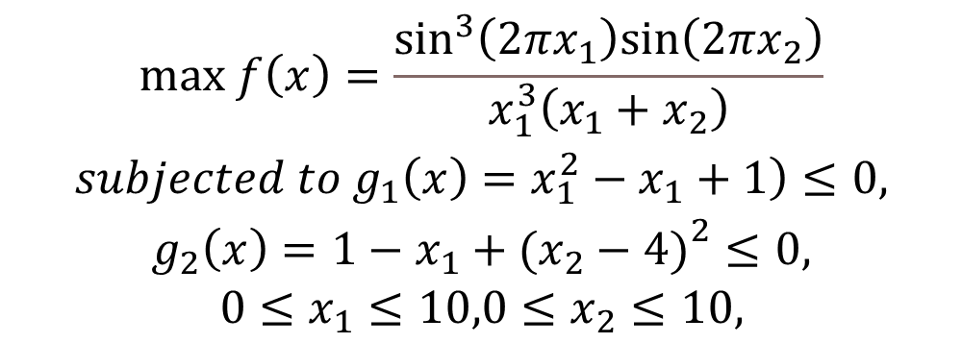
Prob. 2:
$$\begin{matrix}max f\left(x\right)=\frac{\sin^{3}\left(2πx_{1}\right)sin\left(2πx_{2}\right)}{x_{1}^{3}\left(x_{1}+x_{2}\right)} \\ \left.subjected to{ g}_{1}\left(x\right)=x_{1}^{2}−x_{1}+1\right)≤0, \\ g_{2}\left(x\right)=1−x_{1}+{\left.\left.(\right.x_{2}−4)\right.}^{2}≤0, \\ 0≤x_{1}≤10,0≤x_{2}≤10,\end{matrix}$$
•Number of variables: 2 variables.

Slide 24
Prob. 2:
Number of Variables. | Initial points | Resultant Points. | Function Value | No of iterations
2 | 1,2 | 1.2280,4.2454 | -0.0958 | 4

Slide 25
Prob. 2:
Number of Variables. | Initial points | Resultant Points. | Function Value | No of iterations
2 | 2,3 | 1.2280,4.2454 | -0.0958 | 4

Slide 26
Prob. 2:
Number of Variables. | Initial points | Resultant Points. | Function Value | No of iterations
2 | 3,4 | Un able to give point | Un able to give value | --------------

Slide 27
Prob. 2:
Number of Variables. | Initial points | Resultant Points. | Function Value | No of iterations
2 | 4,5 | No value | No value | ------------

Slide 28
Prob. 2:
Number of Variables. | Initial points | Resultant Points. | Function Value | No of iterations
2 | -1,-2 | 2.0006,5.0006 | 3.3968e-06 | 1

Slide 29
Prob. 2:
Number of Variables. | Initial points | Resultant Points. | Function Value | No of iterations
2 | -2,-3 | 2.001.,5.0010 | 1.0261e-05 | 1

Slide 30
Prob. 2:
Number of Variables. | Initial points | Resultant Points. | Function Value | No of iterations
2 | -3,-4 | 2.0005,5.0006 | 2.9836e-06 | 1

Slide 31
Prob. 2:
Number of Variables. | Initial points | Resultant Points. | Function Value | No of iterations
2 | -4,-5 | 2.0007,5.0007 | 4.5940e-06 | 1

Slide 32
Prob. 2:
Number of Variables. | Initial points | Resultant Points. | Function Value | No of iterations
2 | 1,1 | 1.7341,4.7461 | -0.0291 | 2

Slide 33
Prob. 2:
Number of Variables. | Initial points | Resultant Points. | Function Value | No of iterations
2 | -1,1 | 1.7341,4.7461 | -0.0291 | 2

Slide 34
Problem:2
Number of Variables. | Initial points | Resultant Points. | Function Value | Function Value(Best) | Function Value(worst) | Function Value(mean) | Function Value(median) | Function Value(Standard Deviation)
2 | 1,2 | 1.2280,4.2454 | -0.0958 | -0.095800 | 0.000010 | -0.031222 | -0.014549 | 0.041833
 | 2,3 | 1.2280,4.2454 | -0.0958
 | 3,4 | unable | unable
 | 4,5 | unable | unable
 | -1,-2 | 2.0006,5.0006 | 3.3968e-06
 | -2,-3 | 2.001.,5.0010 | 1.0261e-05
 | -3,-4 | 2.0005,5.0006 | 2.9836e-06
 | -4,-5 | 2.0007,5.0007 | 4.5940e-06
 | 1,1 | 1.7341,4.7461 | -0.0291
 | -1,1 | 1.7341,4.7461 | -0.0291

Slide 35
Prob. 2:(Observations)
The value converges for smaller value of the initial guess, but for higher value the programme is unable to terminate.
For negative value the values of the function varies due to the accuracy of the function value is effected
For negative value the slope is negative in nature.

Slide 36
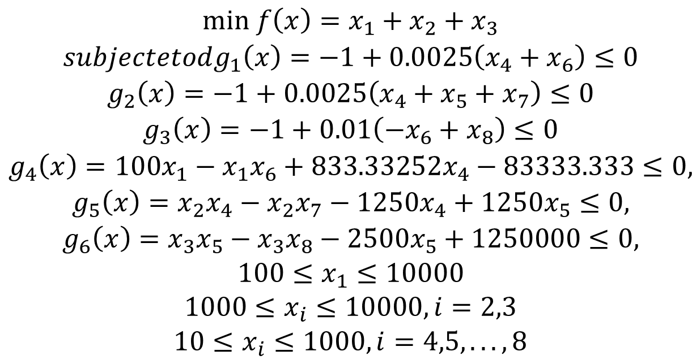
Prob. 3:
$$\begin{matrix}min f\left(x\right)=x_{1}+x_{2}+x_{3} \\ subjectetodg_{1}\left(x\right)=−1+0.0025\left(x_{4}+x_{6}\right)≤0 \\ g_{2}\left(x\right)=−1+0.0025\left(x_{4}+x_{5}+x_{7}\right)≤0 \\ g_{3}\left(x\right)=−1+0.01\left(−x_{6}+x_{8}\right)≤0 \\ g_{4}\left(x\right)=100x_{1}−x_{1}x_{6}+833.33252x_{4}−83333.333≤0, \\ g_{5}\left(x\right)=x_{2}x_{4}−x_{2}x_{7}−1250x_{4}+1250x_{5}≤0, \\ g_{6}\left(x\right)=x_{3}x_{5}−x_{3}x_{8}−2500x_{5}+1250000≤0, \\ 100≤x_{1}≤10000 \\ 1000≤x_{i}≤10000,i=2,3 \\ 10≤x_{i}≤1000,i=4,5,...,8\end{matrix}$$
Number of variables: 8 variables.

Slide 37
Prob. 3:
Number of Variables. | Initial points | Resultant Points. | Function Value | No of iterations
8 | 1,2,1,2,1,2,1,2 | Un-able

Slide 38
Prob. 3:
Number of Variables. | Initial points | Resultant Points. | Function Value | No of iterations
8 | 2,1,2,1,2,1,2,1 | unable

Slide 39
Prob. 3:
Number of Variables. | Initial points | Resultant Points. | Function Value | No of iterations
8 | 2,3,2,3,2,3,2,3 | unable

Slide 40
Prob. 3:
Number of Variables. | Initial points | Resultant Points. | Function Value | No of iterations
8 | 3,2,3,2,3,2,3,2 | unable

Slide 41
Prob. 3:
Number of Variables. | Initial points | Resultant Points. | Function Value | No of iterations
8 | 3,4,3,4,3,4,3,4 | unable

Slide 42
Prob. 3:
Number of Variables. | Initial points | Resultant Points. | Function Value | No of iterations
8 | -1,-2,-1,-2,-1,-2,-1,-2 | unable

Slide 43
Prob. 3:
Number of Variables. | Initial points | Resultant Points. | Function Value | No of iterations
8 | -2,-3,-2,-3,-2,-3,-2,-3 | unable

Slide 44
Prob. 3:
Number of Variables. | Initial points | Resultant Points. | Function Value | No of iterations
8 | -3,-4,-3,-4,-3,-4,-3,-4 | unable

Slide 45
Prob. 3:
Number of Variables. | Initial points | Resultant Points. | Function Value | No of iterations
8 | 1,1,1,1,1,1,1,1 | unable

Slide 46
Prob. 3:
Number of Variables. | Initial points | Resultant Points. | Function Value | No of iterations
 | 1,-1,1,-1,1,-1,1,-1 | unable

Slide 47
Problem:3
Number of Variables. | Initial points | Resultant Points. | Function Value | Function Value(Best) | Function Value(worst) | Function Value(mean) | Function Value(median) | Function Value(Standard Deviation)
5

Slide 48
Prob. 3:(Observations)

