Slide 1

Predicting Patient Admission and Length of Stay in Emergency Departments Using Machine Learning
Author: Sujeeth Reddy Sithagari
Professor: Dr. Chaoji(Jay) Wang
Semester: Fall-2024, UMBC

Slide 2
Introduction and Background
Objective:
This project applies machine learning to predict critical emergency department (ED) outcomes:Patient Admission (whether a patient will be admitted or discharged) and Length of Stay (estimated time in ED).
Models utilize triage data (collected on arrival) and vital signs data to predict these outcomes.
Why does it matter?
Accurate predictions improve resource allocation (e.g., beds, staffing), reduce ED congestion, improve patient care, and shorten wait times.

Slide 3
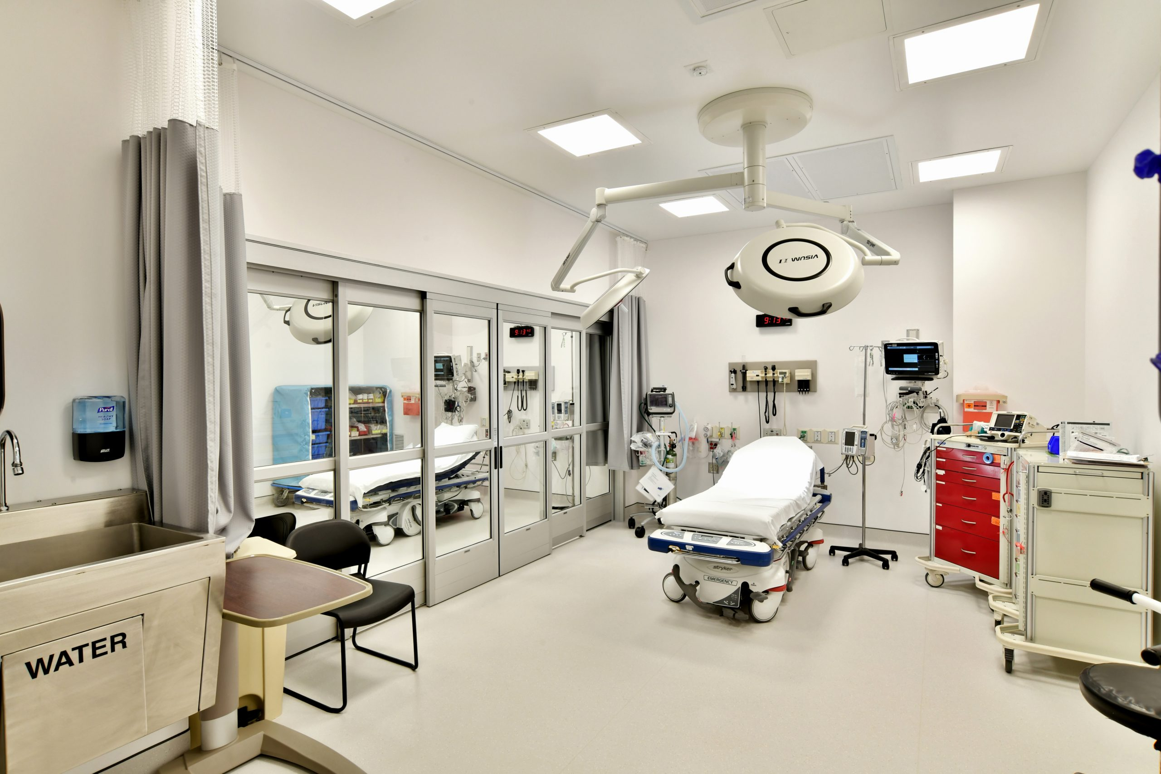
Research Questions
Admission Prediction: Can ML models predict patient admission based on triage and vital signs data?.
Length of Stay Prediction: Can the models estimate the time a patient will stay in the ED?
Enhanced Understanding through Visualization: How can interactive visualizations improve insights into the data and model results?

Slide 4
Dataset Overview
The datasets were used from the database called MIMIC (Medical Information Mart for Intensive Care)(https://physionet.org/content/mimic-iv-ed-demo/2.2/):
ED Stays: Records of patient visits to the emergency department.
Triage: Data collected at the time of the patient's initial assessment.
Vitalsign: Continuous recordings of patient vital signs during their stay.
Data Size
The dataset size is 5 MB.
Data Shape
ED Stays: 222 rows, 9 columns
Triage: 222 rows, 11 columns
Vitalsign: 1,038 rows, 11 columns
Time Period:
The data spans from 2010 to 2020.

Slide 5
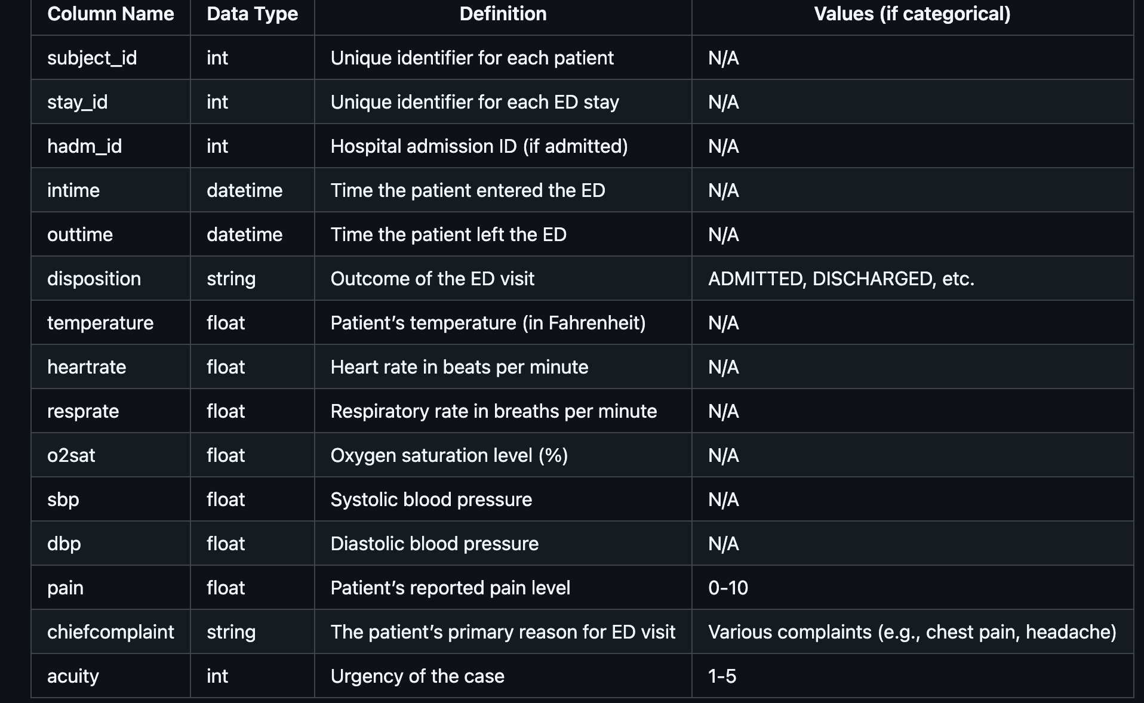
Data Dictionary

Slide 6
Target/Label Variables
Classification: Admission status.
Regression: Length_of_stay (time in hours).
Features/Predictors
Triage Data: temperature, heartrate, resprate, o2sat, sbp, dbp, pain, chiefcomplaint, acuity.
Demographics: gender, race, arrival_transport.

Slide 7
Data Preprocessing
Data Cleaning:
Handling Missing Values: Removed rows and columns with missing data to maintain integrity.
Duplicate Removal: Deleted duplicate rows to ensure data uniqueness.
Data Type Conversion:
Datetime Conversion: Converted 'intime' and 'outtime' to datetime format for time-based analysis..
Categorical Conversion: Changed columns like 'disposition' and 'chiefcomplaint' to categorical types for processing.

Slide 8
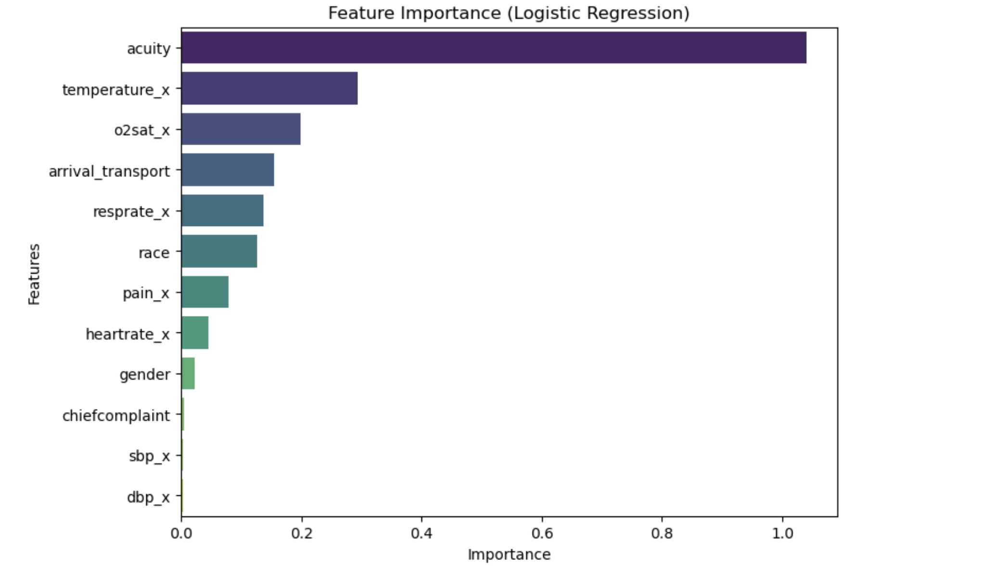
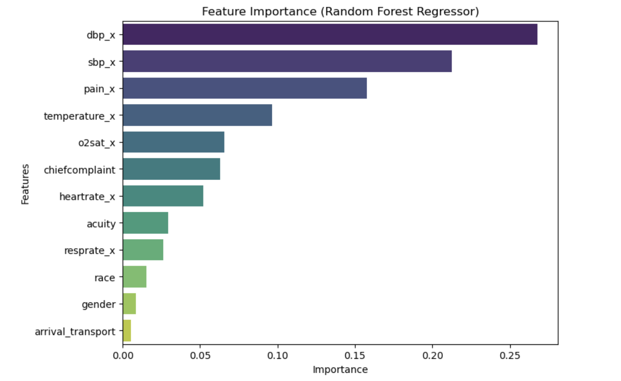
Feature Selection and Importance
Feature Selection & Importance: Optimized model performance by selecting key features and visualizing their predictive impact through importance rankings.

Slide 9
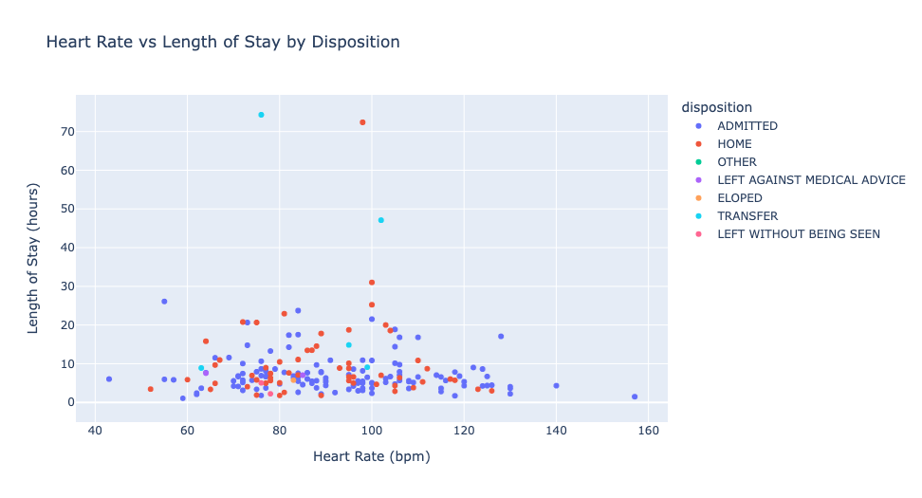
EDA
Heart Rate vs Length of Stay - Shows the link between heart rate and ED stay time, with colors for admitted or discharged patients.

Slide 10
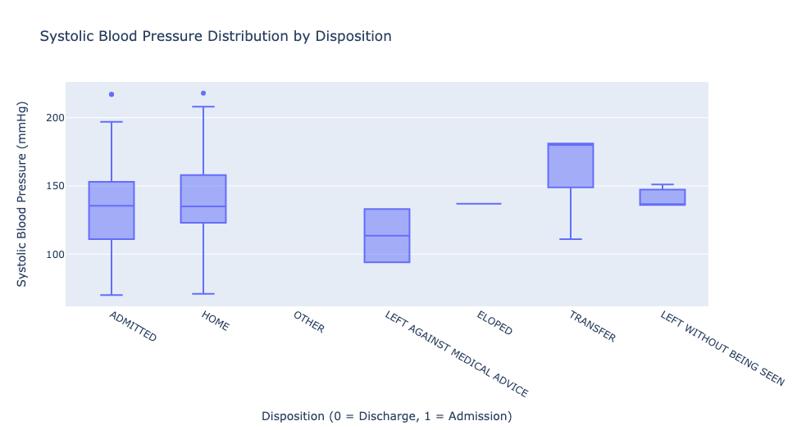
Systolic Blood Pressure by Disposition - Compares blood pressure for admitted vs. discharged patients, highlighting differences.

Slide 11
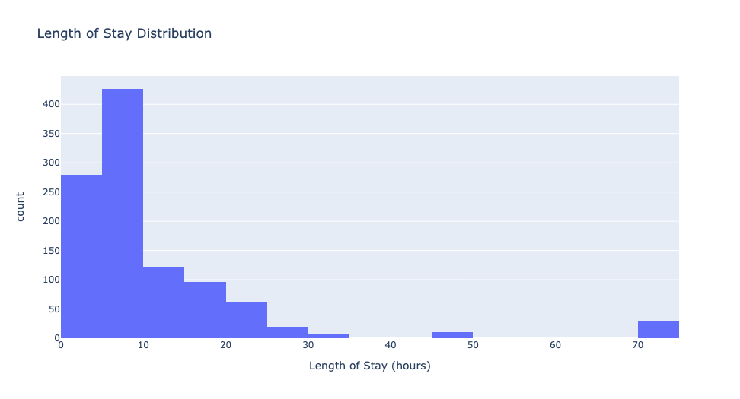
Length of Stay Distribution - Displays how often different stay durations occur in the ED.

Slide 12
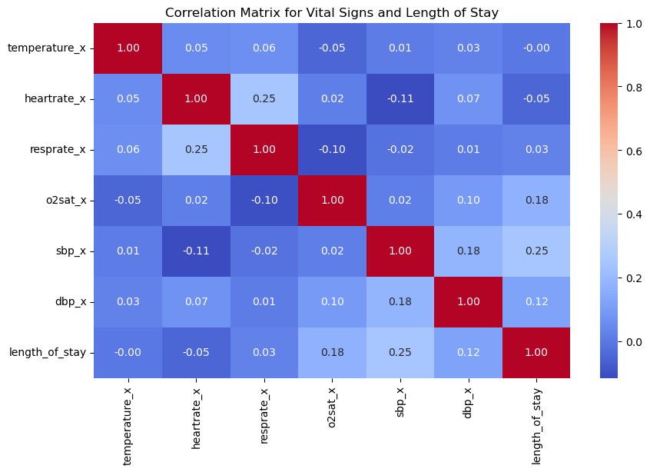
Correlation Heatmap - Shows relationships between vital signs and stay duration to identify key connections.

Slide 13
Model Training and Evaluation
Dataset Split: 80% training, 20% testing to ensure sufficient learning and unbiased evaluation.
Model Selection: Models used are
Random Forest Classifier(for classification of patient admission),
Random Forest Regressor (for predicting length of stay).

Slide 14
Model Evaluation
Performance Scores :
METRIC | MODEL | VALUE
Classification Accuracy(Training) | Random Forest Classifier | 97.9
Classification Accuracy(Testing) | Random Forest Classifier | 96.5
R-squared (R²)(Training) | Random Forest Regressor | 0.94
R-squared (R²)(Testing) | Random Forest Regressor | 0.91

Slide 15
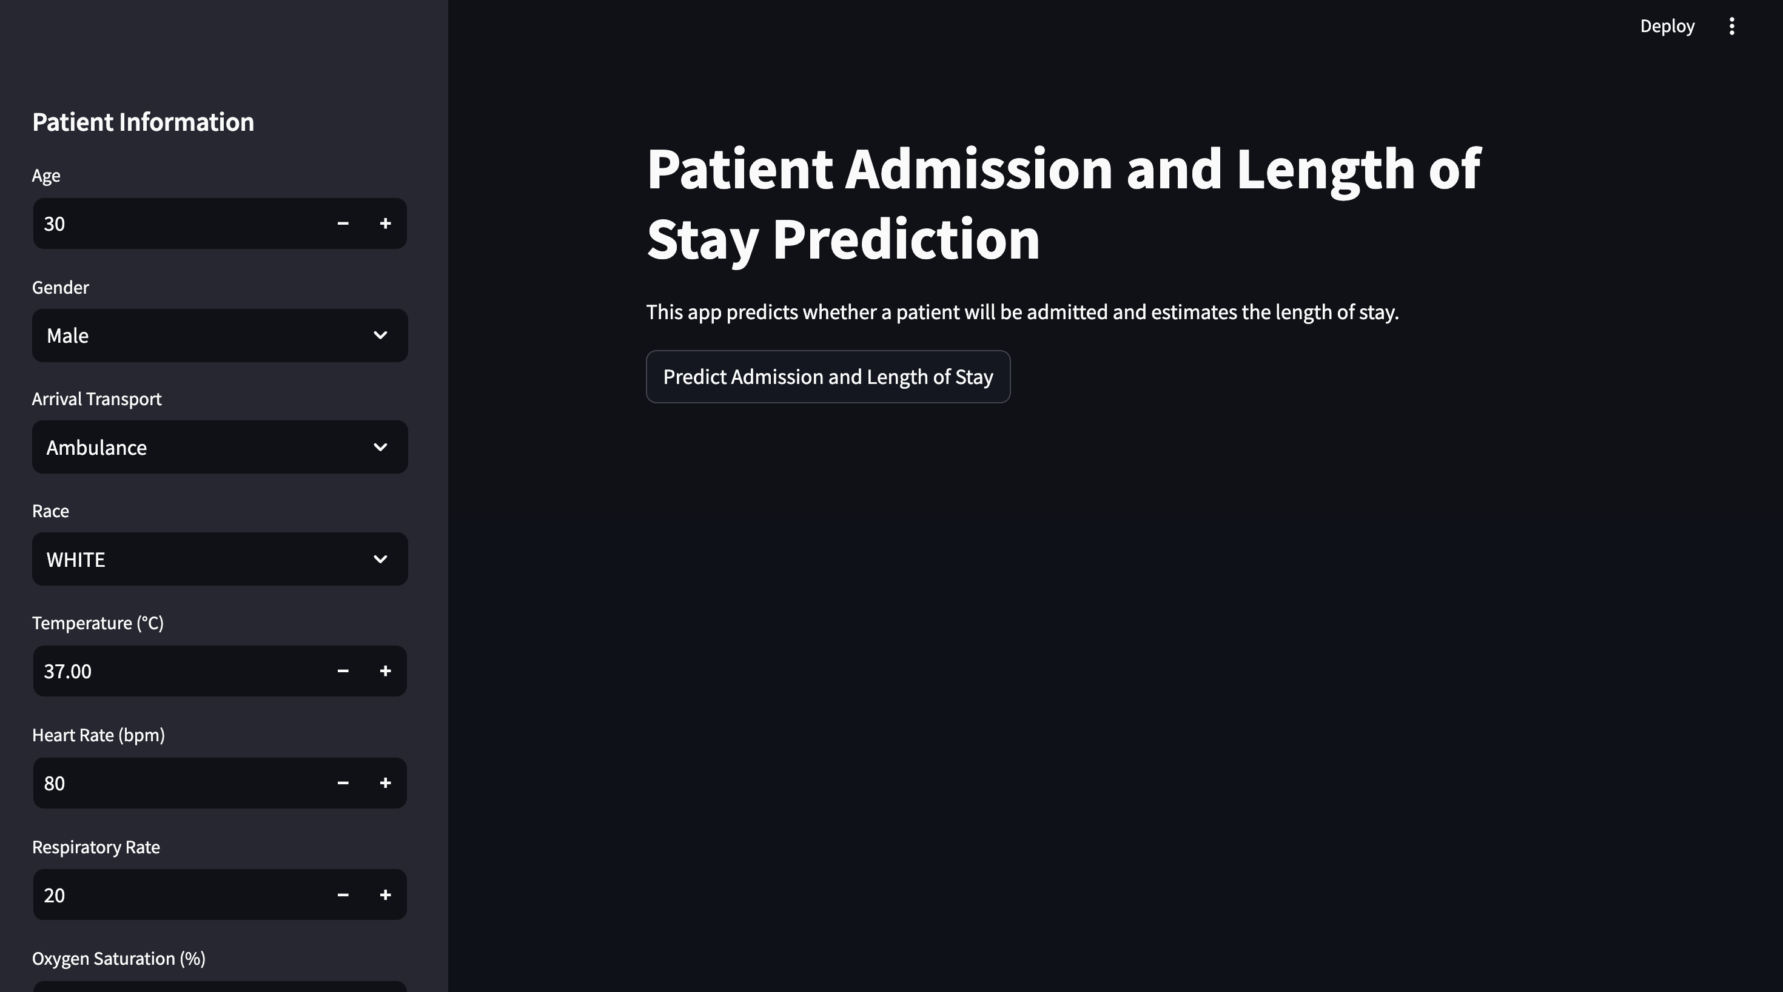

Slide 16
Web Application Overview: A Streamlit app designed to predict patient admission status and length of stay in emergency departments using trained machine learning models.
Interactive Features: Input fields allow users to enter patient information such as triage data (e.g., heart rate, respiratory rate) and demographics for real-time predictions.
Real-Time Predictions: The application loads machine learning models (Logistic Regression for admission prediction and Random Forest for length of stay estimation) to provide immediate predictions based on user inputs.
User-Friendly Design: Clean, intuitive interface with interactive elements for easy data entry and seamless navigation.
Application Impact: Highlights the practical application of machine learning in healthcare, aiming to improve hospital resource allocation and patient care in emergency departments.

Slide 17
Conclusion
Data Insights: Visualizations highlighted key factors influencing patient admission and length of stay.
High Accuracy: Models like Random Forest and Logistic Regression showed strong predictive accuracy.
Balanced Data: Data balancing improved fairness and accuracy in predictions.
User-Friendly App: Streamlit app enables easy access to predictions for healthcare providers.
Impact: Demonstrates ML’s potential to improve hospital efficiency and patient care in emergency departments.

Slide 18
Lessons Learned
Effective Cleaning and Data Preparation: Rigorous cleaning and data preparation steps improved model accuracy and reliability.
Visualizations for Key Insights: Data visualizations reveal critical patterns in patient admission and length of stay, aiding better understanding and communication.
Feature Engineering Enhancements: Including vital signs and triage information strengthened model predictive capabilities.
Streamlit App Accessibility: Streamlit’s design ensures that predictive insights on patient admission and length of stay are easily accessible to healthcare providers.

Slide 19
References
Streamlit Documentation:
Streamlit. (n.d.). Streamlit Documentation. Streamlit. Retrieved from https://docs.streamlit.io/
Plotly Documentation:
Plotly. (n.d.). Plotly Python Open Source Graphing Library. Plotly. Retrieved from https://plotly.com/python/
Holden, R. J., & Karsh, B. T. (2010). The Technology Acceptance Model: Its past and its future in health care. Journal of Biomedical Informatics, 43(1), 159–172. doi: 10.1016/j.jbi.2009.07.002

