Slide 1
Project :High Level deployment
-Sujeet Subhash rahate

Slide 2
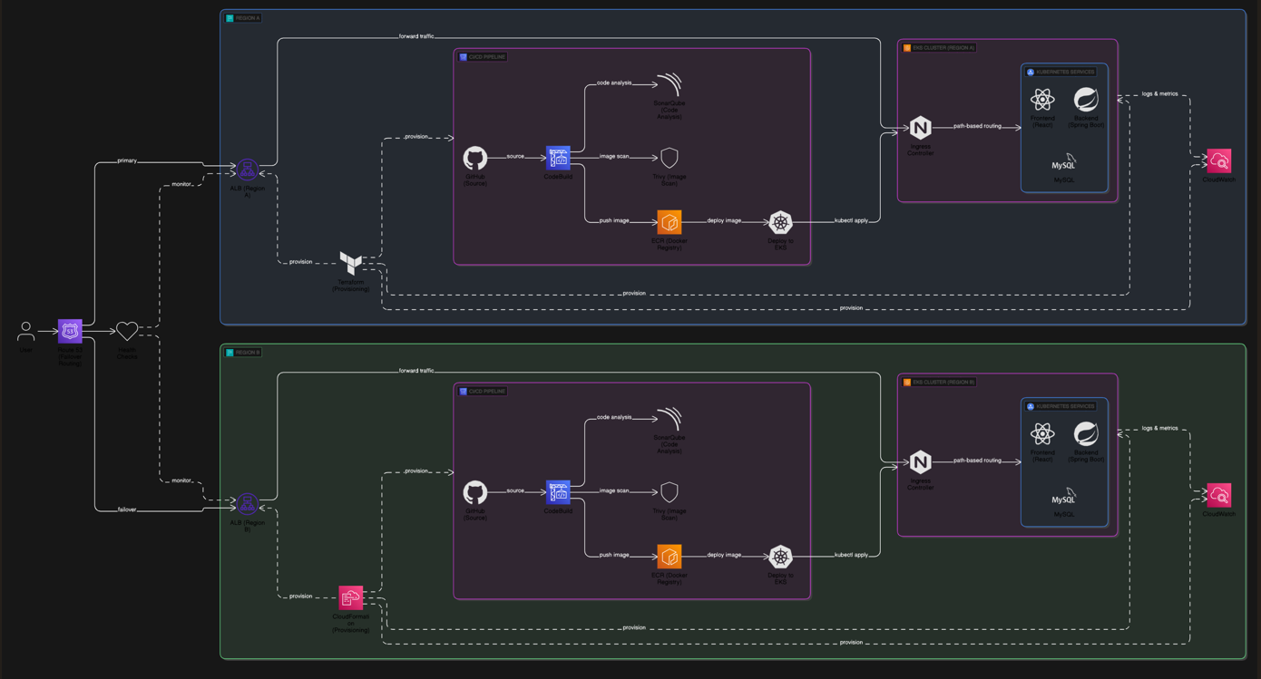

Slide 3
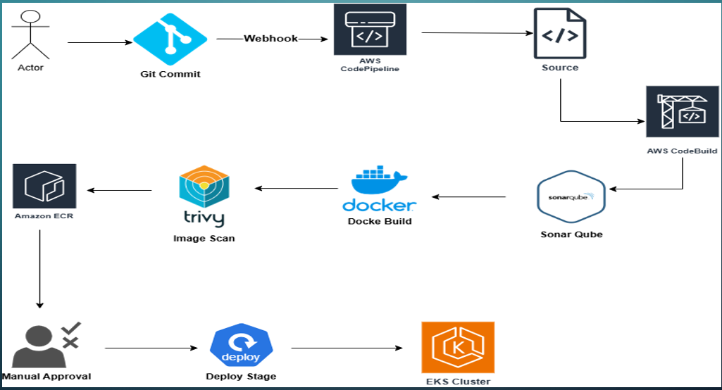
Flow of the project:

Slide 4
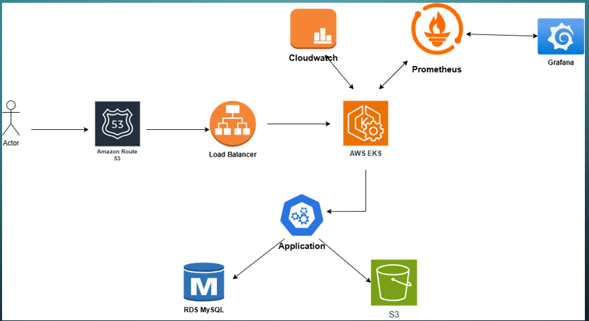
Application

Slide 5
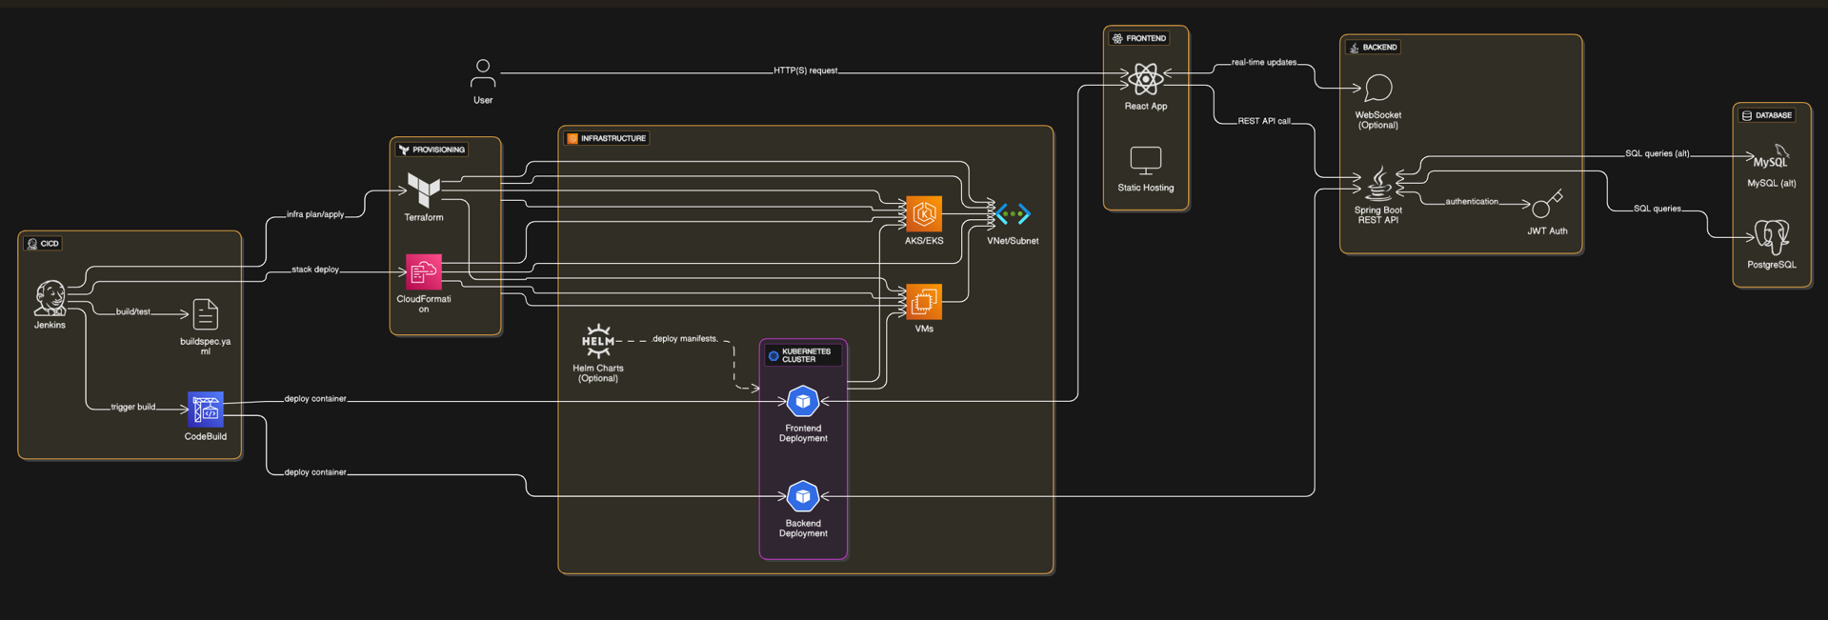
Architecture:

Slide 6
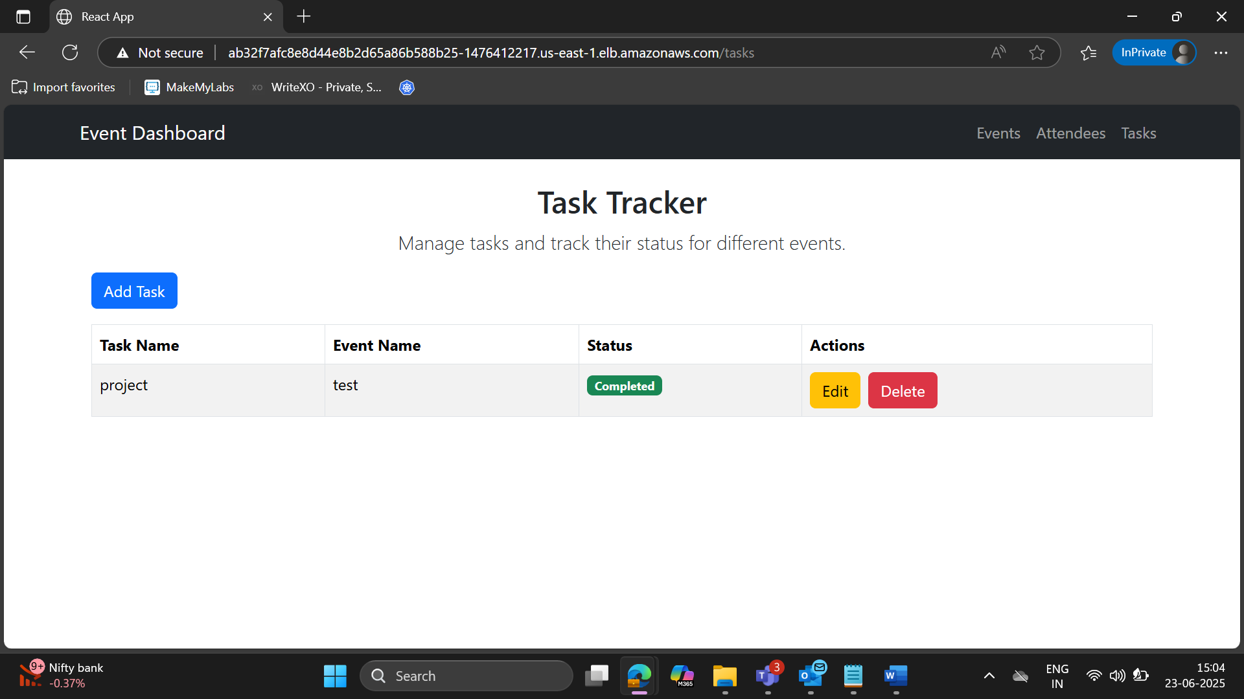
User Interphase

Slide 7
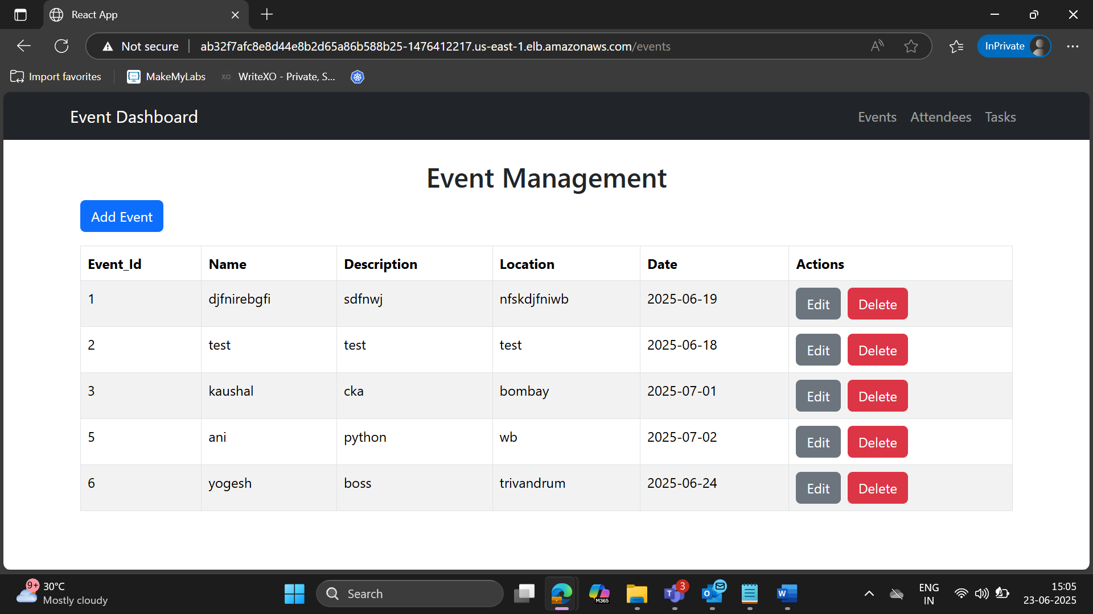
Adding Data to check Backend

Slide 8
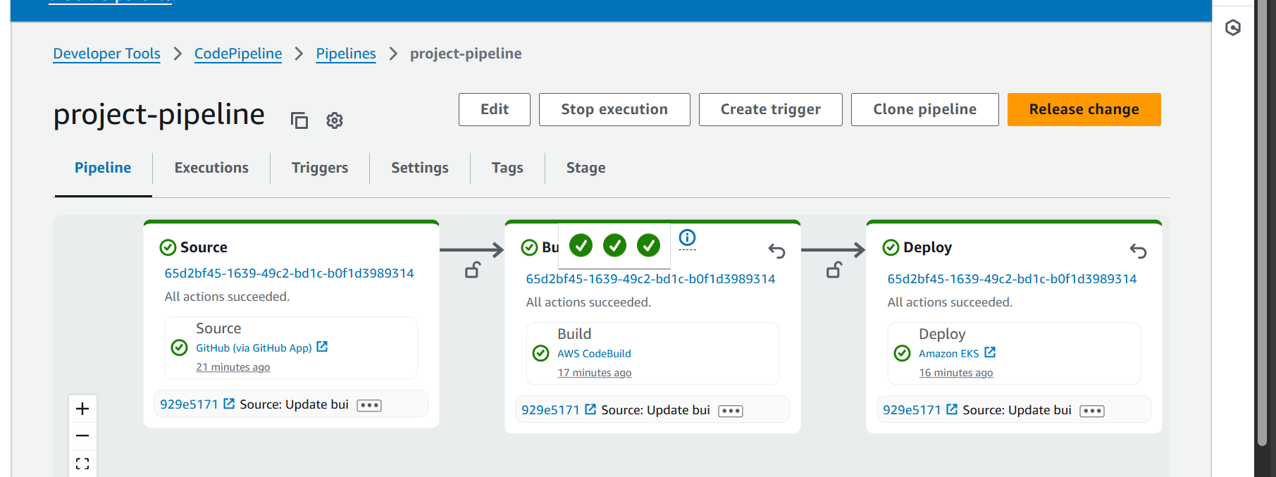
Phase 2: deploy Application Through pipeline Git Repo(buildspec.yaml): Capstone-Final-z/buildspec.yaml at main · sujeetsrahate/Capstone-Final-z

Slide 9
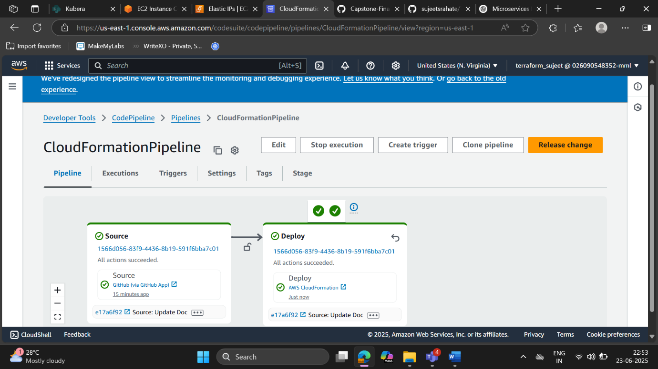
3: Use AWS Auto pipeline Multi Region of infrastructure with CFT and Terraform.

Slide 10
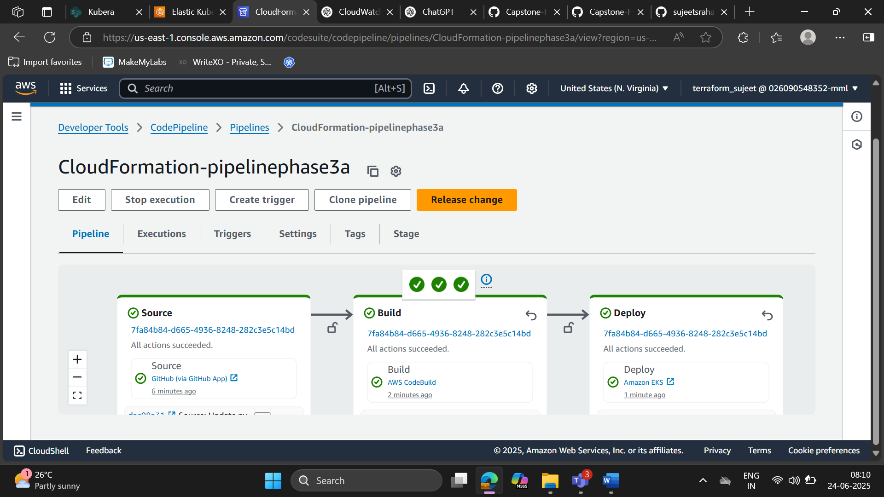
Deploy pipeline on Cft-Infra

Slide 11
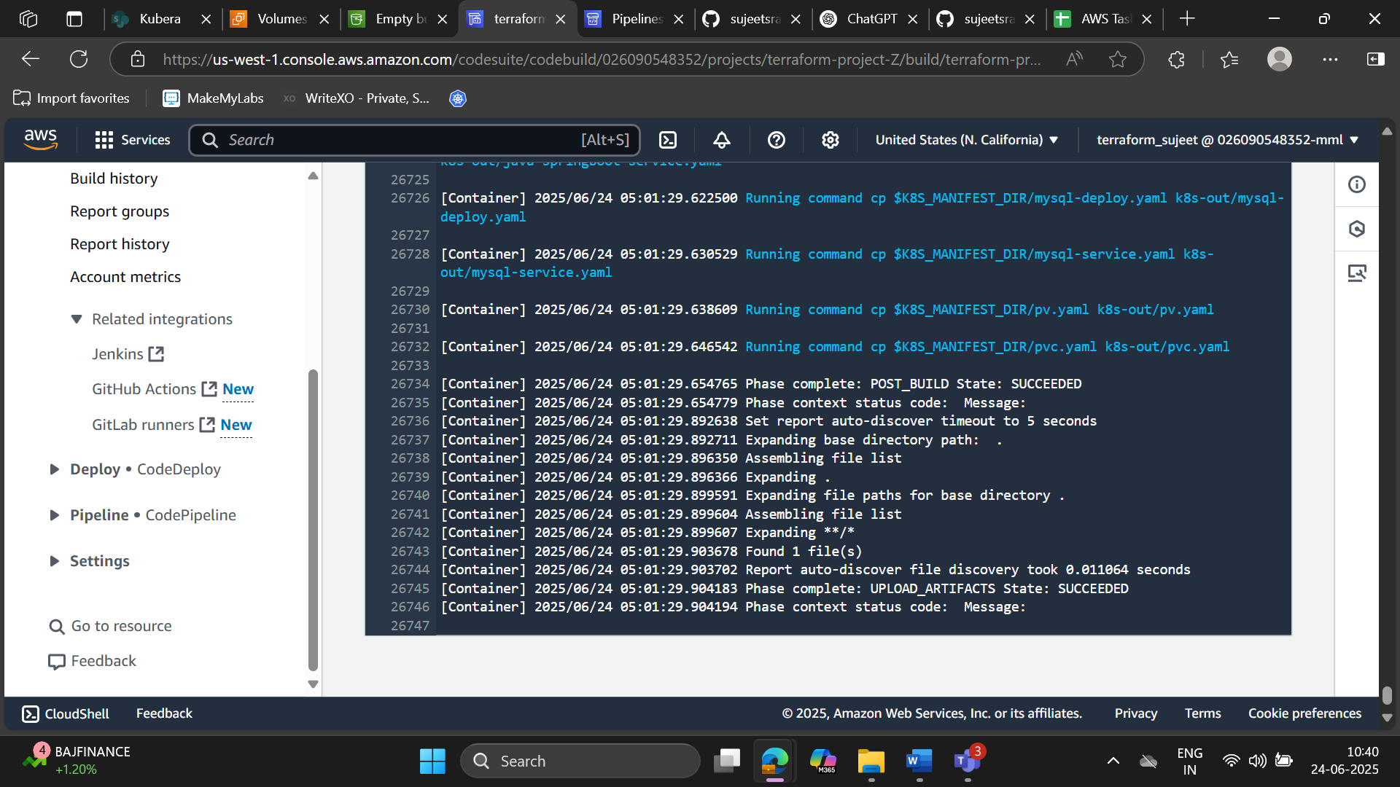
3B: creating Infra Structure through Terraform

Slide 12
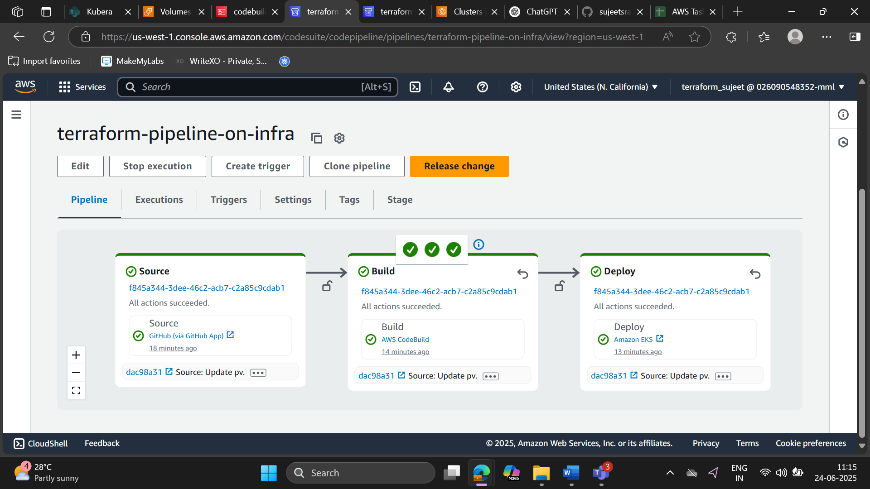
Deployment of application on other region using terraform infra:

Slide 13
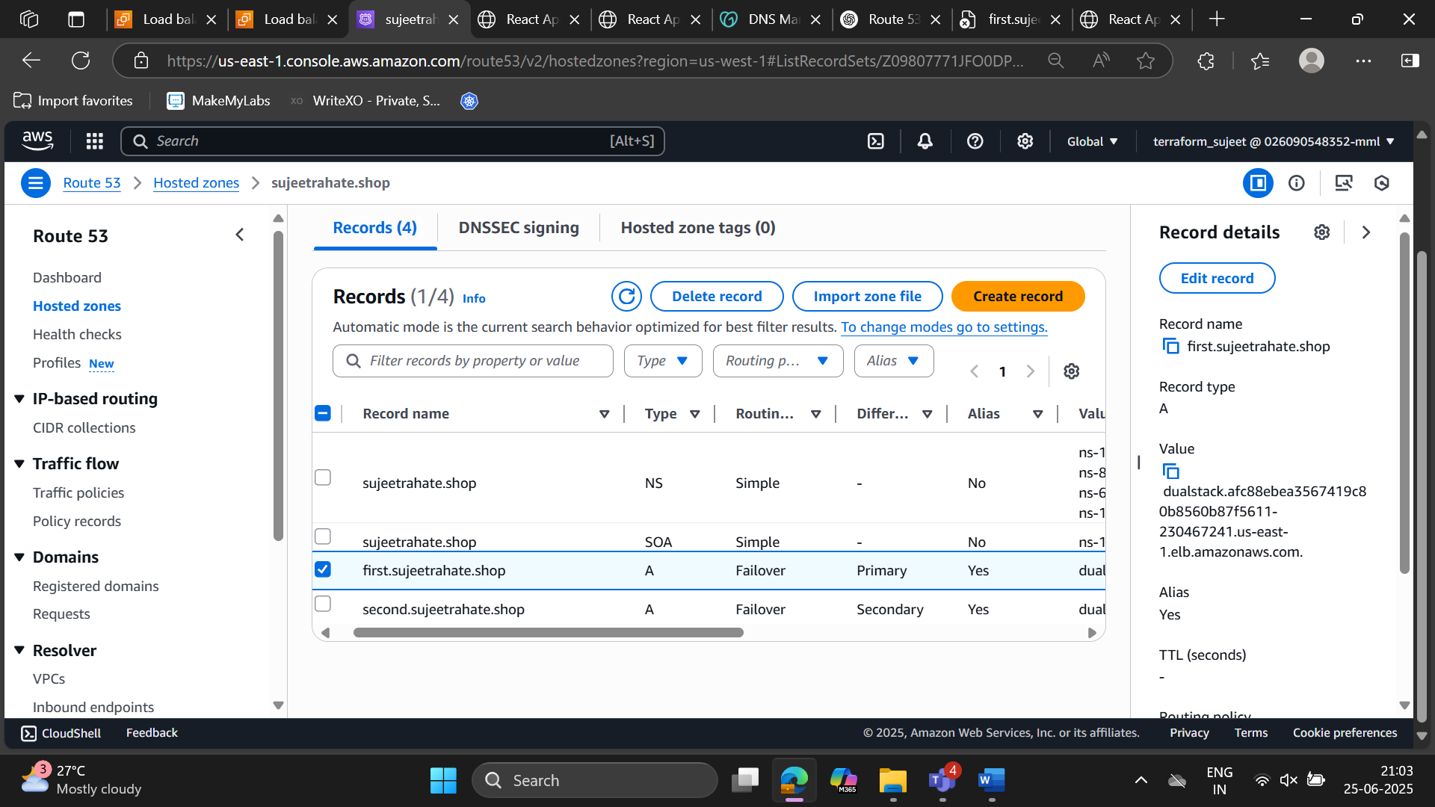
Make Route 53 Restructure. (make disaster strategy)

Slide 14
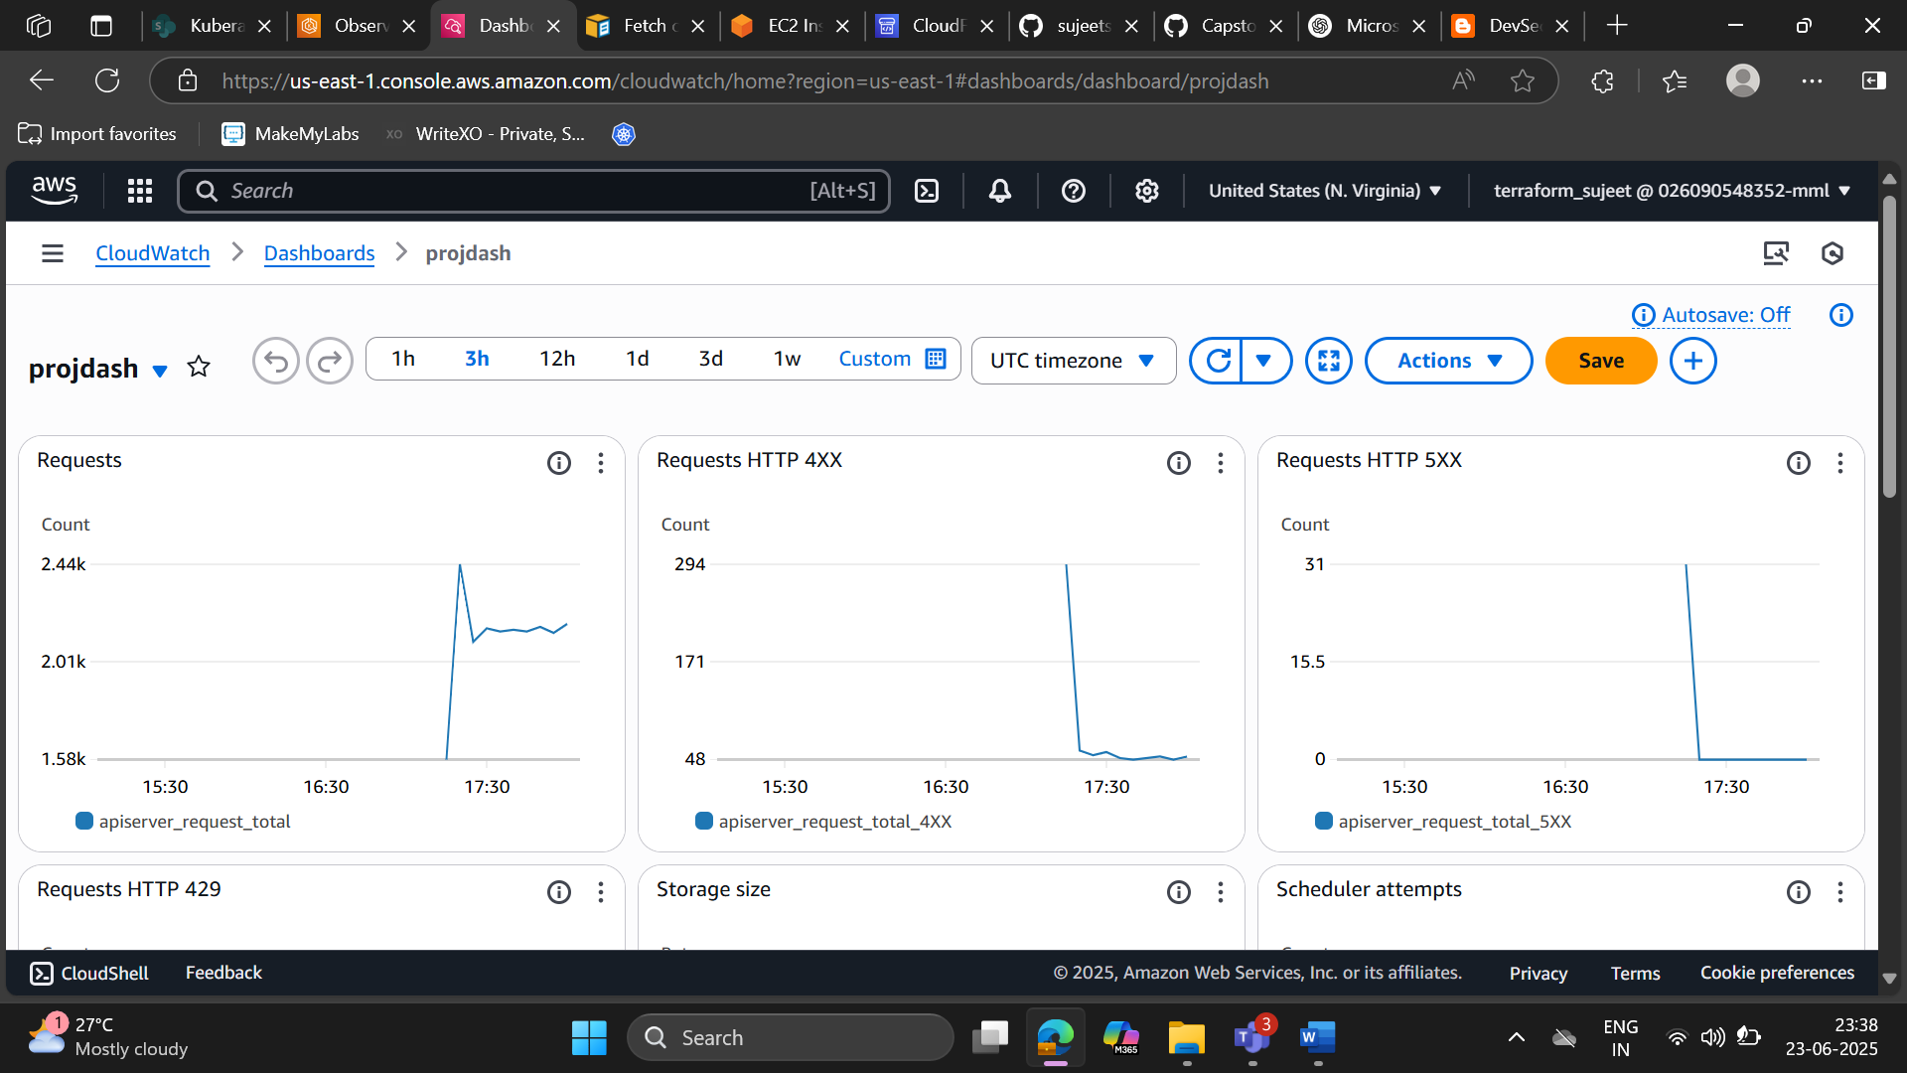
Phase 5: Cloud Watch:

Slide 15
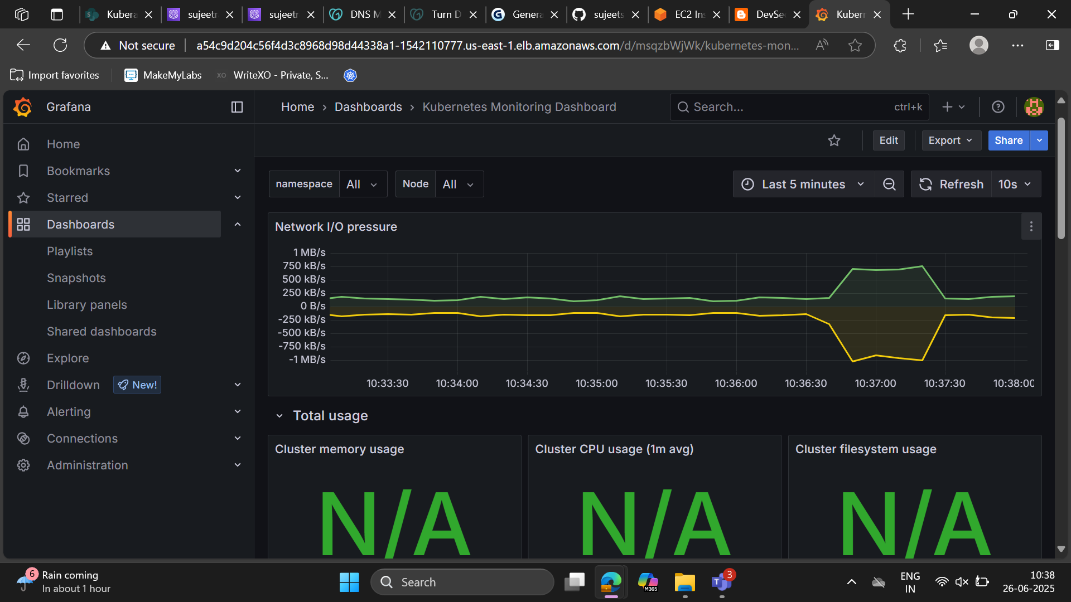
Technical Analysis through Promothis

Slide 16
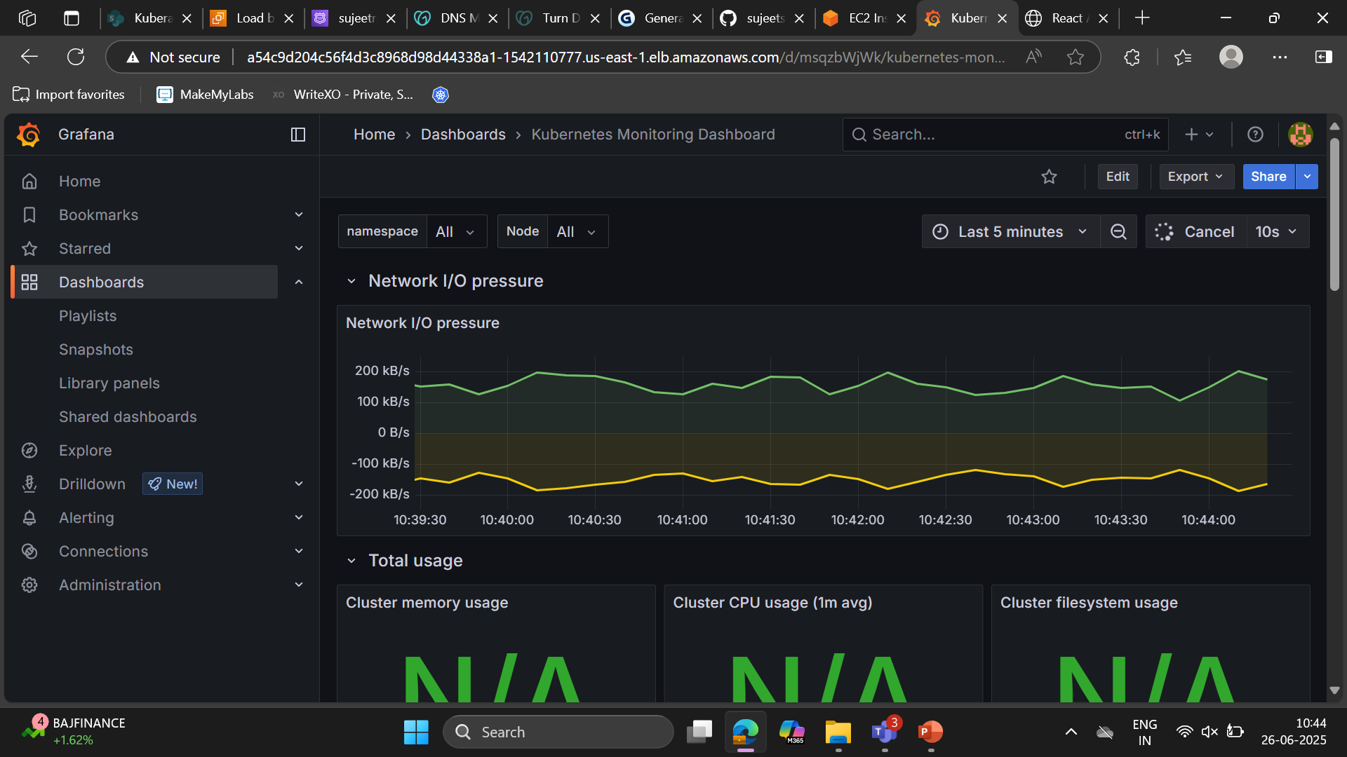
Update record:

Slide 17
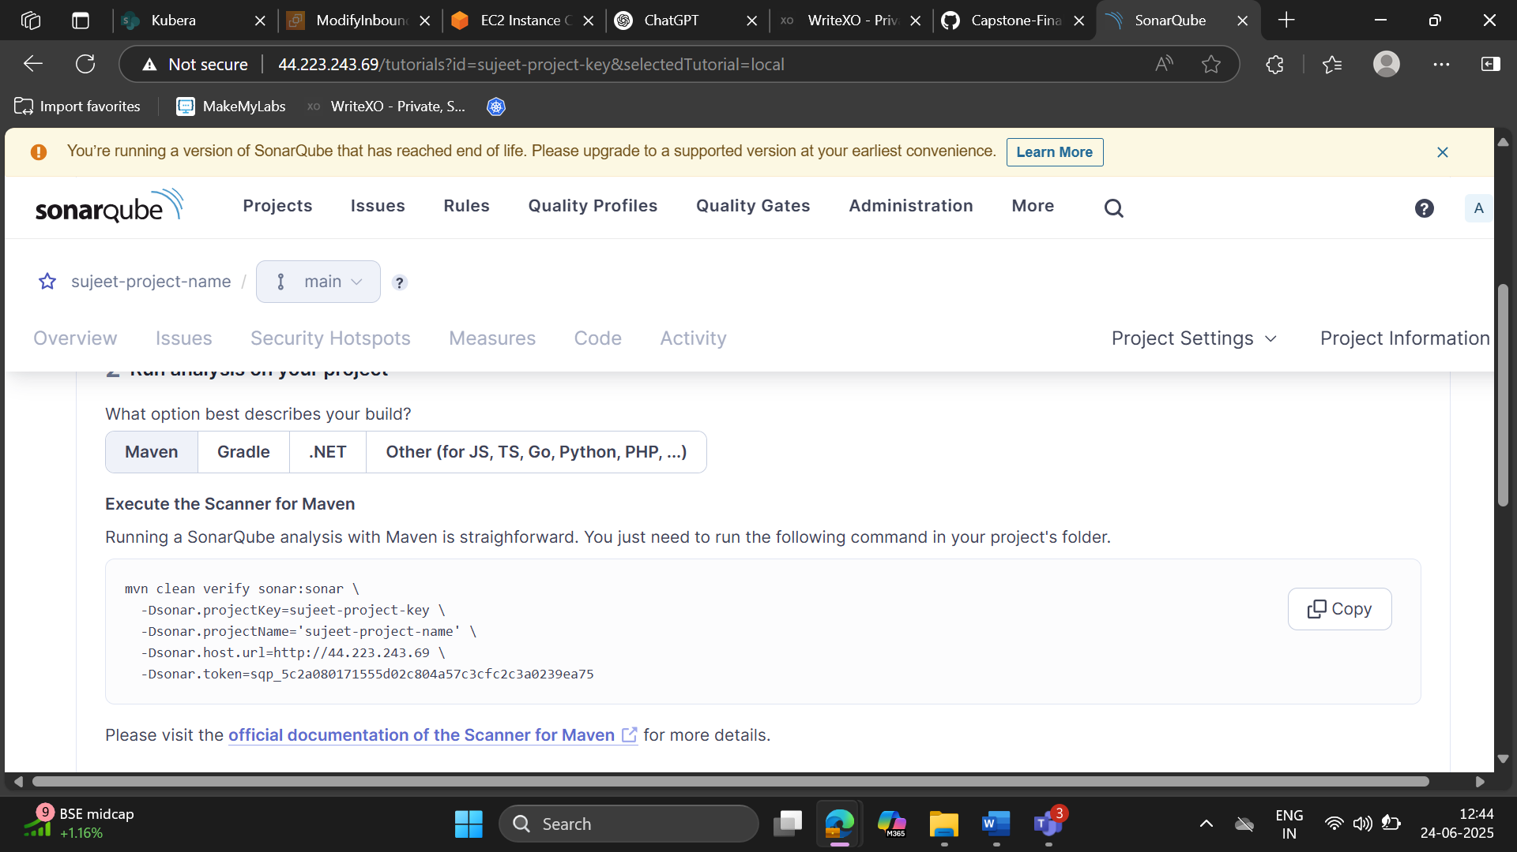
Sonar Qube Configuration for project:

Slide 18


Thank you

