Slide 1
Quiz Master
By,
Sujeet Kumar
2110991846
G5-3rd Year

Slide 2
Title
Title: "Quiz Game Website: Engaging Learning Experience"
This title emphasizes the primary focus of your website, which is to provide an engaging and educational experience through quizzes.
Subtitle: "An Overview of Our Project"
The subtitle sets the context that this presentation will provide an overview of your website project.
Your name and any relevant affiliations or contact information.
Include your name and any organizational or contact information to establish credibility.
A visually appealing image or logo representing your website.
Use an image or logo that represents your website's branding and purpose. Visuals can capture the audience's attention and set the tone for your presentation.

Slide 3
Introduction
Title: "Introduction"
The title sets the stage for introducing your project.
Briefly introduce the purpose and goals of your quiz game website.
Explain why you created the website and what you aim to achieve. For example, if it's for educational purposes, state how it can aid learning.
Mention the target audience or user group (e.g., students, trivia enthusiasts).
Identify the primary users who would benefit from your website.
Provide a brief overview of the content and features of the website.
Mention what type of quizzes are available, how users can access them, and what they can expect in terms of content.

Slide 4
Key Features
Title: "Key Features"
This slide is designed to showcase the website's main functionalities.
Highlight the main features and functionalities of your quiz game website:
Quiz creation and customization.
Explain how users can create their own quizzes or customize existing ones.
User registration and profiles.
Describe the process for users to register and how profiles enhance their experience.
Leaderboards and scoring.
Discuss how users can track their performance and compare it with others.
Categories or topics available.
List the categories or topics covered by the quizzes.
Any unique or standout features.
If your website offers distinctive features that set it apart from competitors, highlight them.

Slide 5
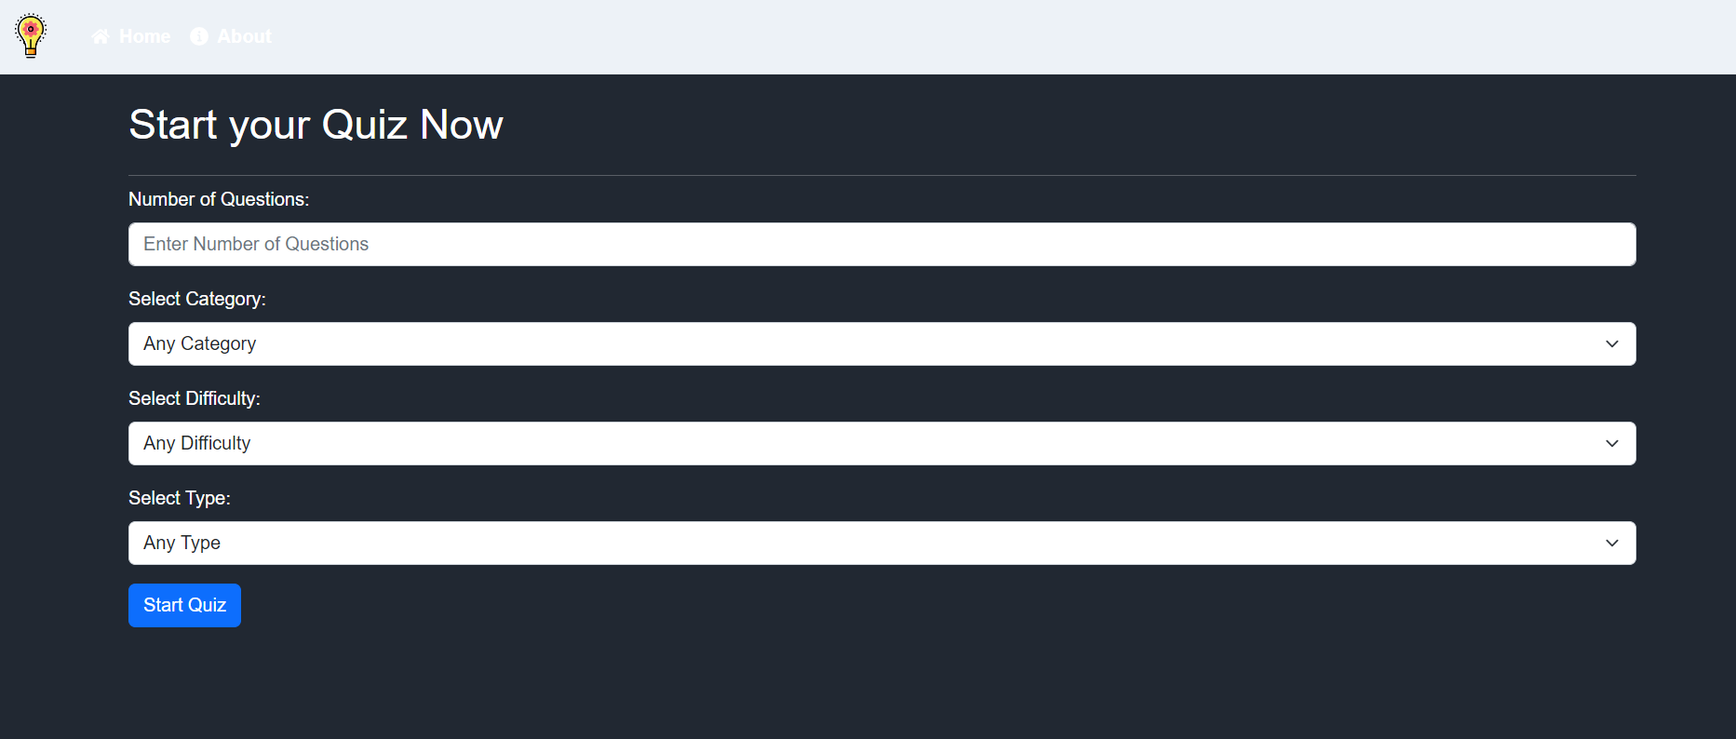

Slide 6
User Experience
Title: "User Experience"
This slide delves into the aspect of user interaction with your website.
Discuss how your website ensures a positive user experience:
User-friendly interface and navigation.
Explain how your website is designed to be intuitive, making it easy for users to find and take quizzes.
How quizzes are organized and presented.
Describe how users can browse and access quizzes, as well as the presentation of questions.
Any gamification elements or interactive features.
If you incorporate gamification (e.g., badges, rewards), explain how it enhances the user experience.
Responsive design for mobile and desktop users.
Emphasize that your website is accessible and usable on various devices.
Include user testimonials or feedback if available.
Share positive feedback from users, which can boost credibility and trust.

Slide 7
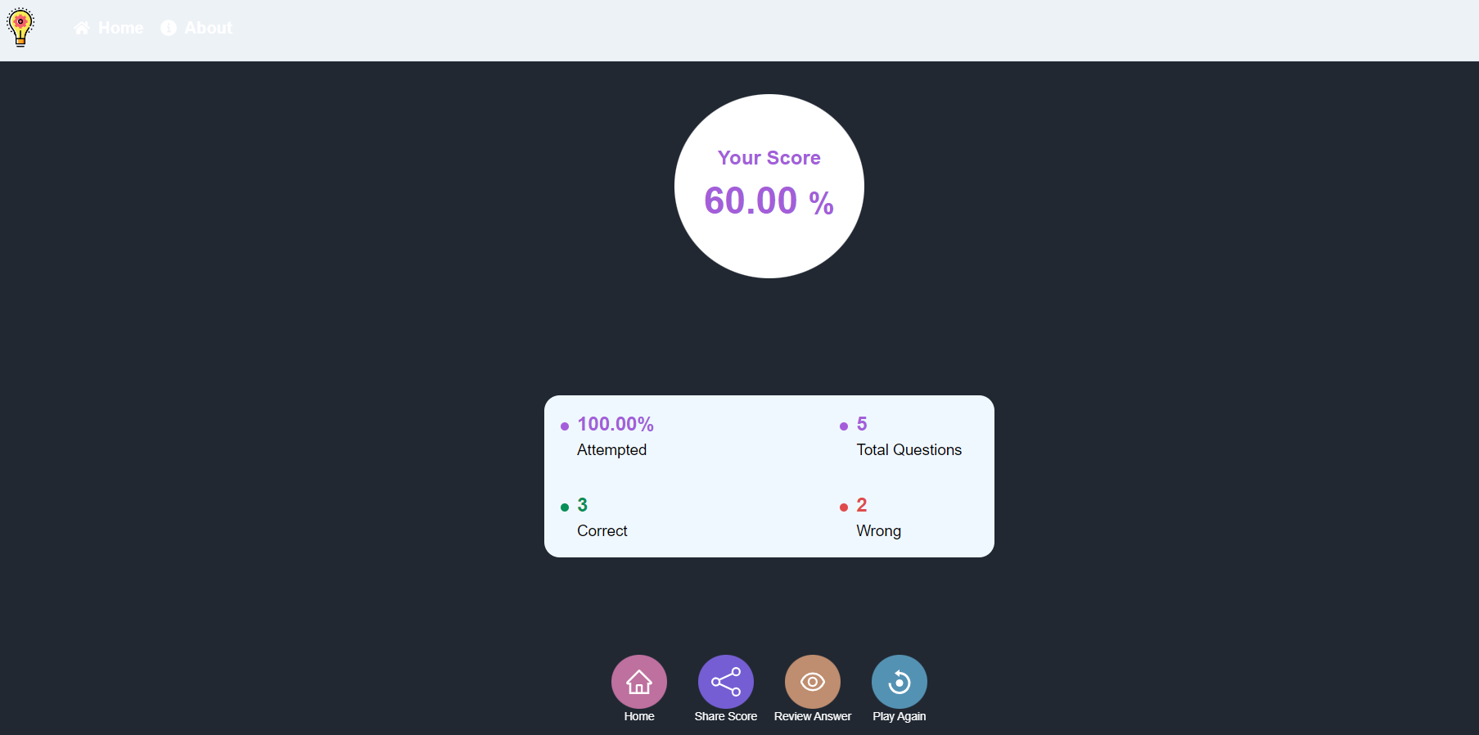
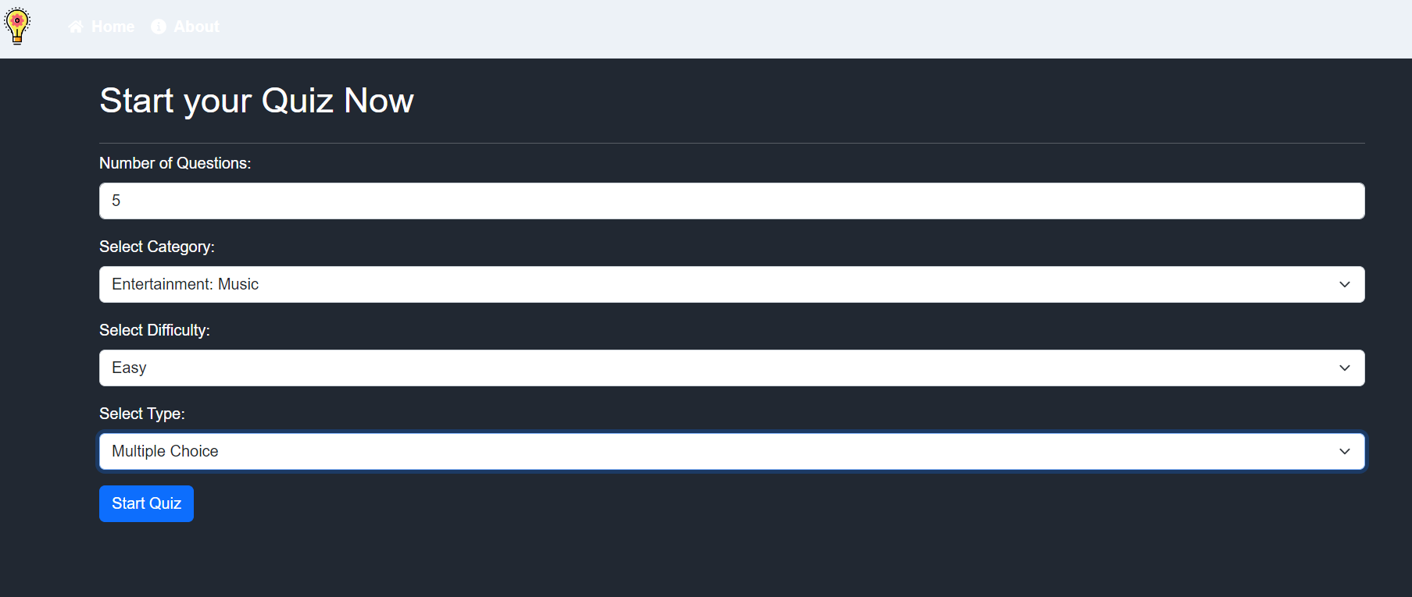

Slide 8
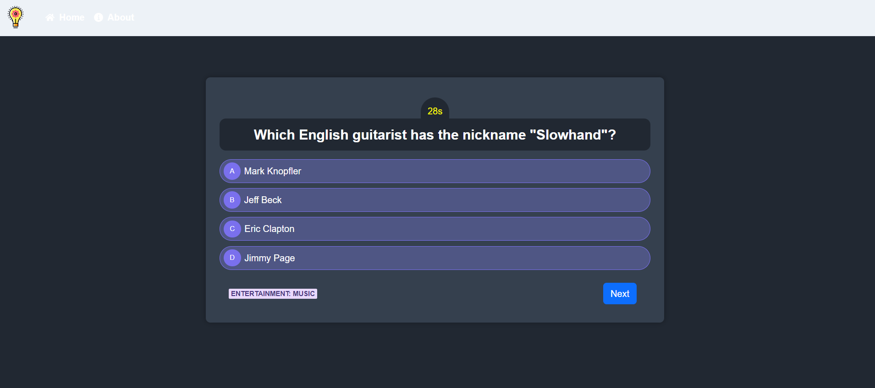

Slide 9
Conclusion
Title: "Future Plans and Conclusion"
This slide discusses what lies ahead for your project and summarizes your presentation.
Discuss your future plans for the project, such as:
Upcoming features and improvements.
Share what enhancements you plan to make to further improve the website.
Expanding the quiz library.
If you plan to add more quizzes or topics, mention them.
Community engagement or user feedback incorporation.
Explain how users can provide feedback and how it will shape the website's future.
Conclude by summarizing the key takeaways from your presentation and inviting questions or feedback from your audience.
Recap the main points of your presentation and open the floor for questions or comments.

