Slide 1
SHOOTER
AUGMENTED REALITY GAME

Slide 2

164004E A.M.S.K.Abeysinghe

Slide 3
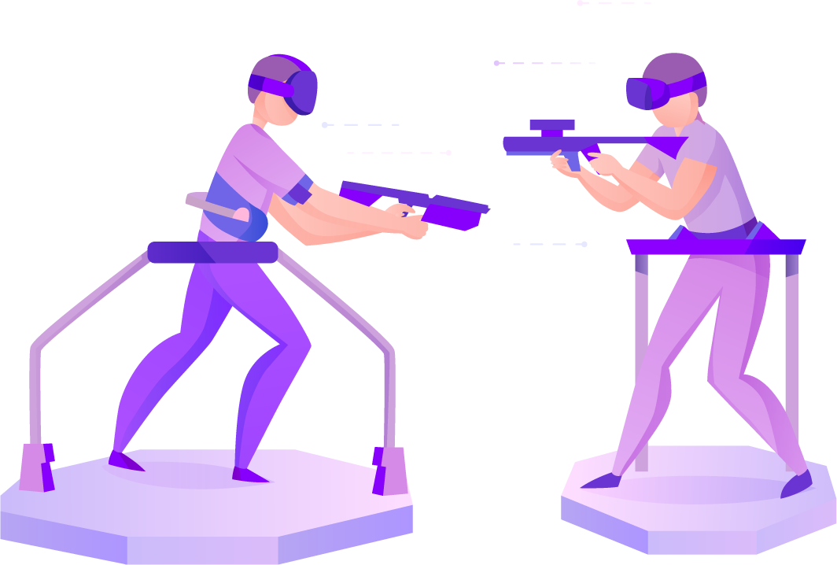
ENTERTAINMENT
SHOOTER
TINY AR GAME

Slide 4
FEATURES
Shooting
Sound Effects
Scores for kills

Slide 5
TECHNOLOGIES
Java
Android

Slide 6
BENIFIT
Fun

Slide 7
THANK YOU..!

