Slide 1
SHOOTER
AUGMENTED REALITY GAME

Slide 2

164004E A.M.S.K.Abeysinghe

Slide 3
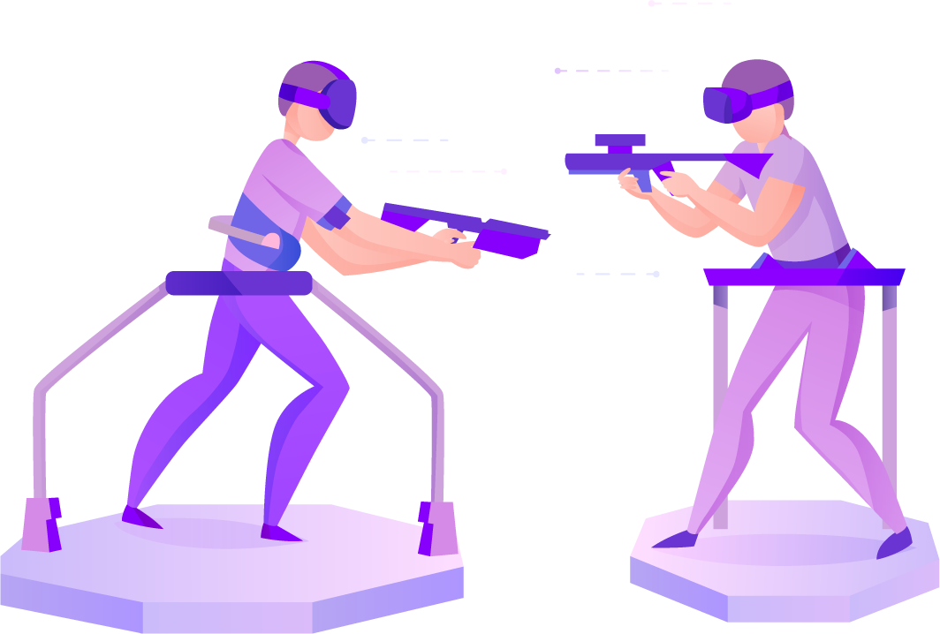
ENTERTAINMENT
SHOOTER
TINY AR GAME

Slide 4
ROUGH PREVIEW
Score : 3
Time : 00.35

Slide 5
FEATURES
Shooting
Sound Effects
Score & Time

Slide 6
TECHNOLOGIES
Java or C Sharp
Android or Unity

Slide 7
BENIFIT
Fun

Slide 8
THANK YOU..!

