Slide 1

Exploratory Data Analysis
G2M Insight For Cab Investment Firm
July 20, 2022
By Jeffery Su

Slide 2

Agenda
Executive Summary
Problem Statement
Approach
EDA
EDA Summary
Recommendations

Slide 3

Summary
The Client
XYZ is a private firm in US. Due to remarkable growth in the Cab Industry in last few years and multiple key players in the market, it is planning for an investment in Cab industry and as per their Go-to-Market(G2M) strategy they want to understand the market before taking final decision.
OR

Slide 4
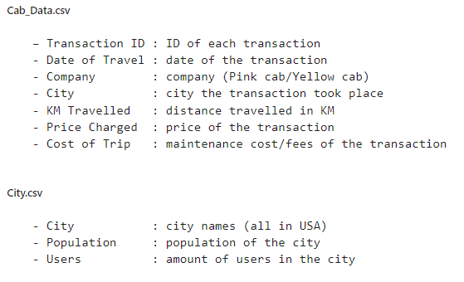
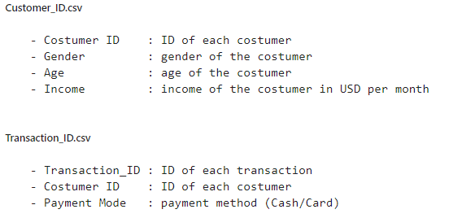
The Datasets
There is 4 individual data sets.
Time period of data is from 31/01/2016 to 31/12/2018.
Added a Profit column in Cab_Data.csv to store the profit made for that transaction.

Slide 5
Exploratory
Data
Analysis

Slide 6
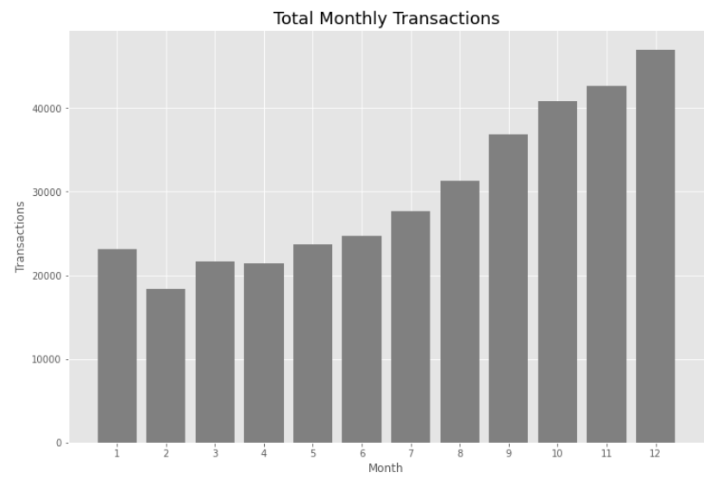
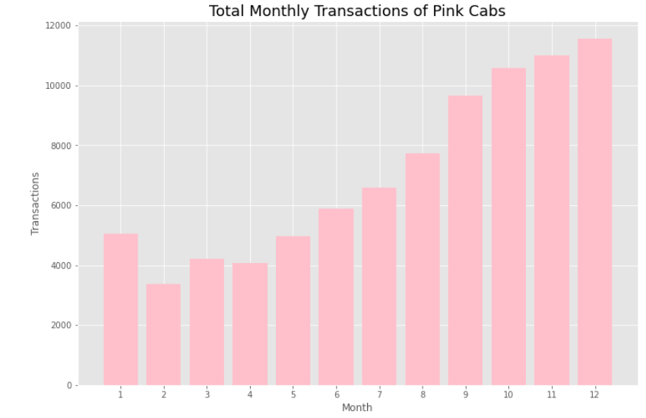
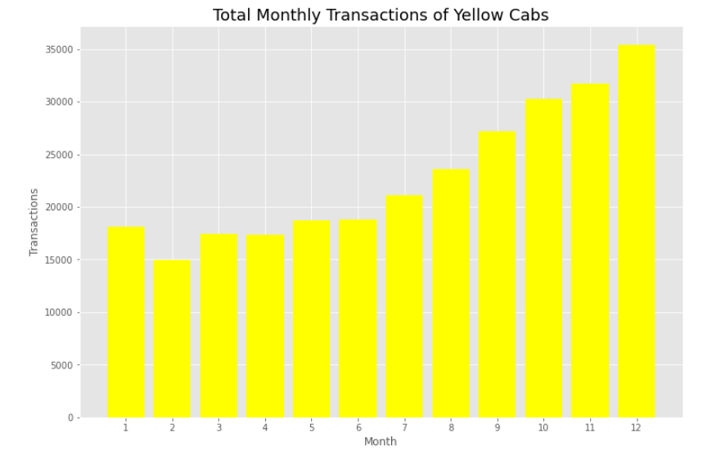
Transactions Per Month
February has the least transactions while December has the highest transactions.
There is a trend of increasing transactions from February and peaks in December
January has a lot less transactions.
Yellow Cab has noticeably many more transaction in all the months

Slide 7
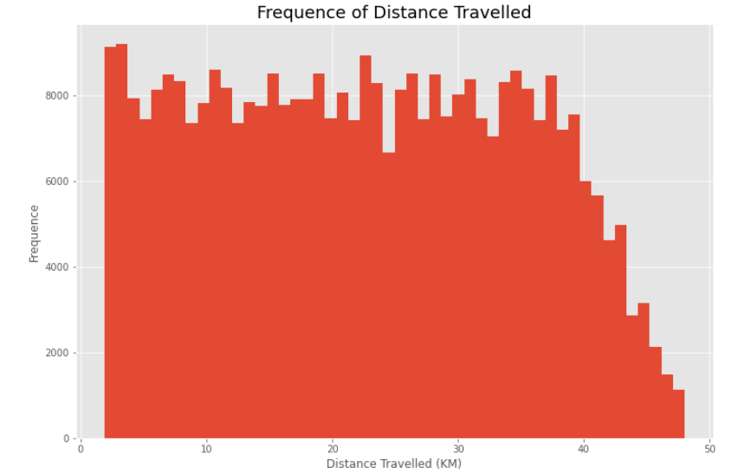
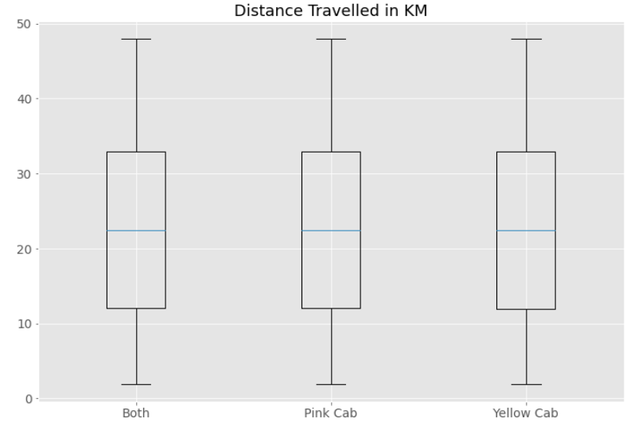
Frequency of Distance Travelled
Travel distance is range from 2 KM to 48 KM
Majority of the distance are from 12 KM to 33 KM

Slide 8
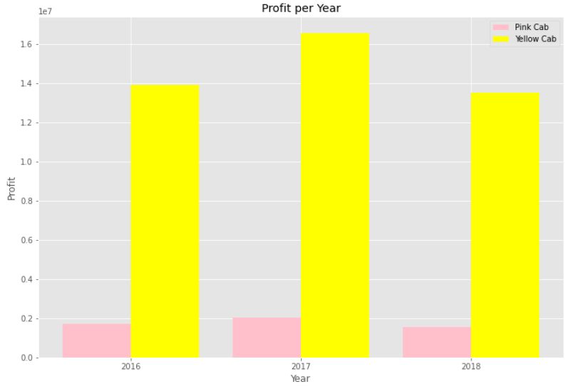
Profit Per Year
The graph above, shows the profit of both Cab company and the Yellow Cab is more profitable. The profit is the highest in 2017 followed by 2016 and 2018.

Slide 9
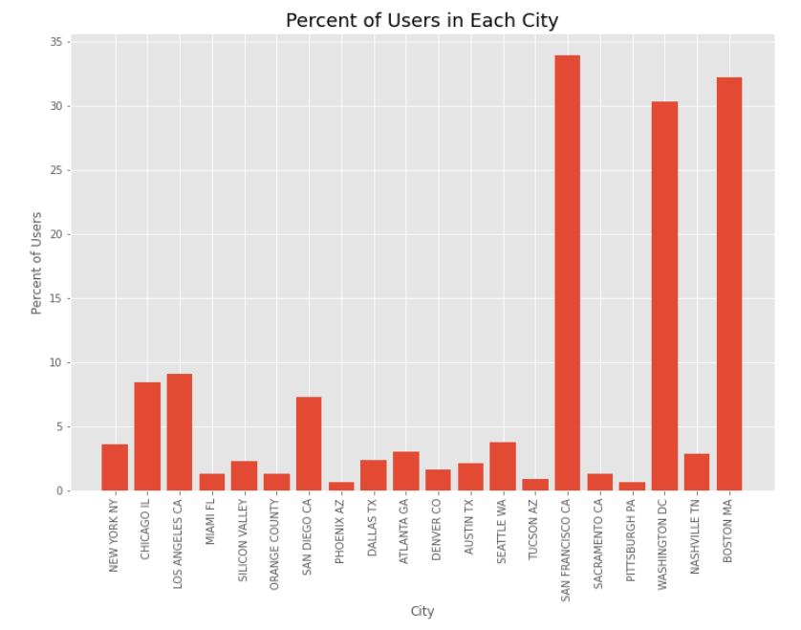
Percentage of Population in City
The percentage of population that uses the cab services are highest in San Francisco, Washington and Boston is the highest.

Slide 10
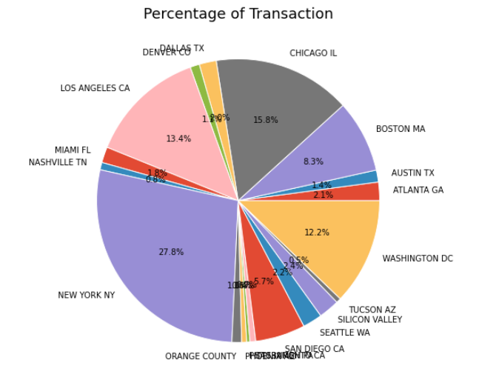
Percentage of Total Transaction
New York has the highest over all percentage of transaction at 27.8%
Followed by Chicago (15.8%), Los Angeles (13.4%) and Washington (12.2%).

Slide 11
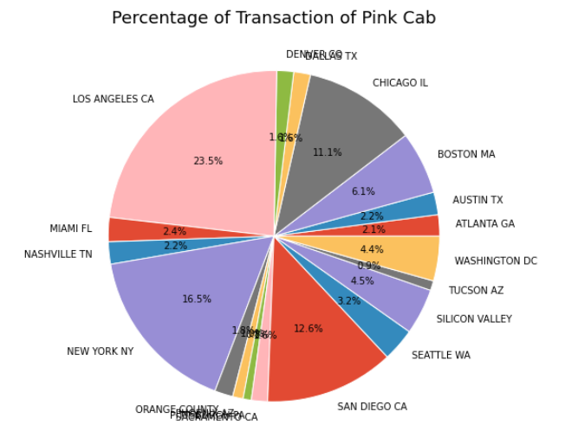
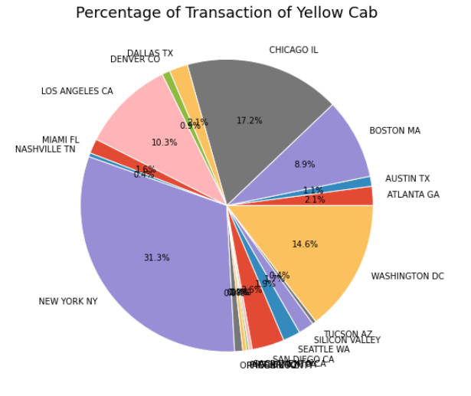
Percent of Total Transaction
Pink Cab have more transactions in Los Angeles and San Diego
Yellow Cab have more transactions in New York, Chicago and Washington.

Slide 12
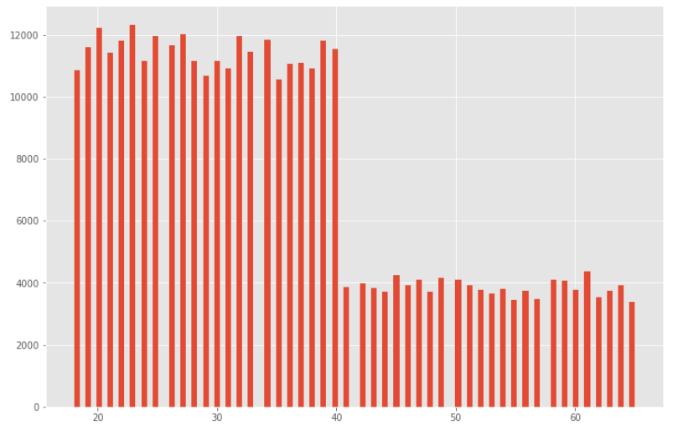
Costumer Age
Customer age range from 18 to 65 years old.
The majority of costumer is from age 18 to 40 years old.

Slide 13
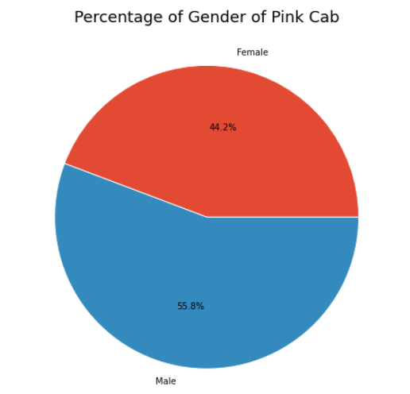
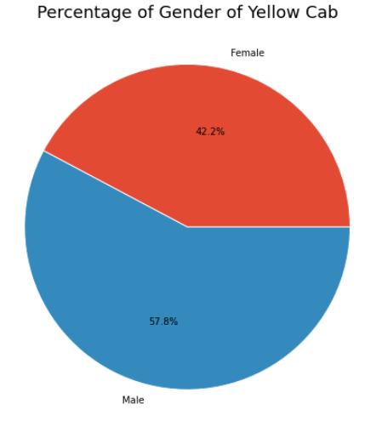
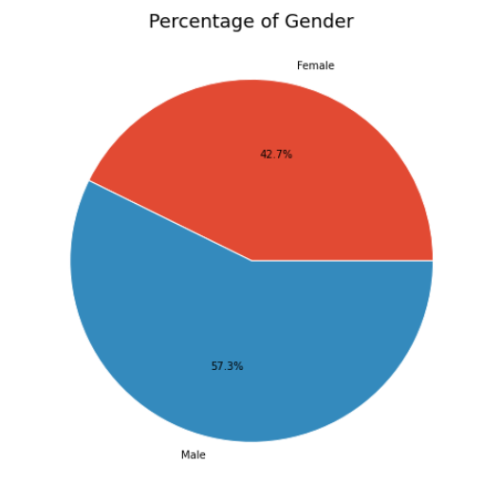
Gender
More males uses the cab then females.

Slide 14
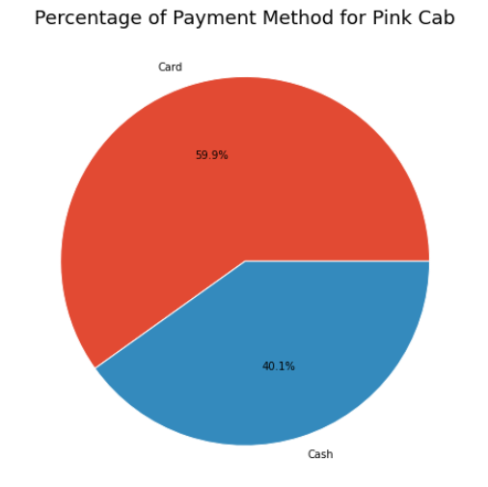
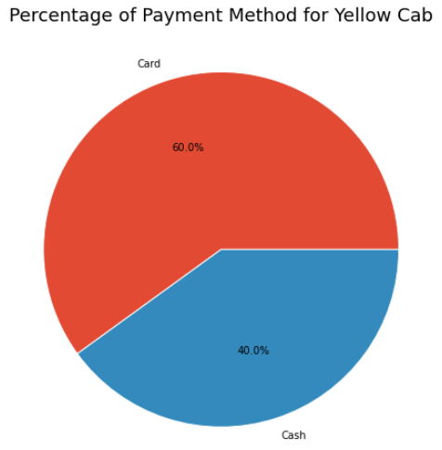
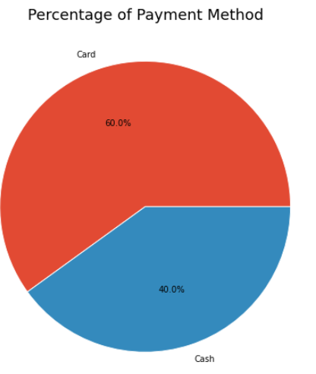
Payment Method
60% of the transactions are through card and 40% is with cash.

Slide 15
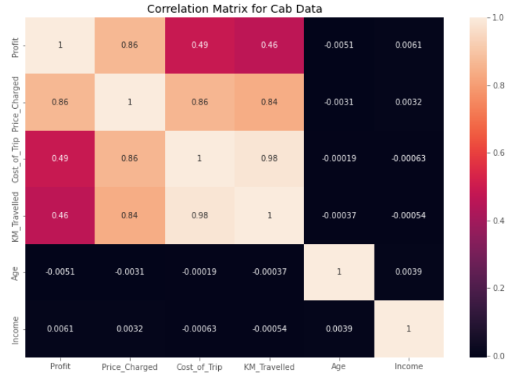
Correlations
From the above heatmap, there is a big correlation between profit & price charged. There are also good correlation between Profit & Cost of Trip and Profit & KM Travelled

Slide 16
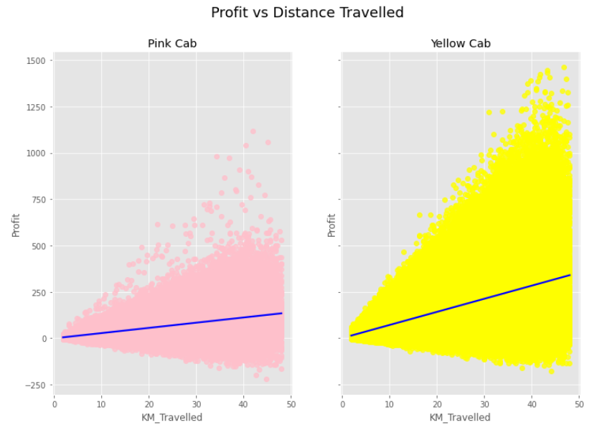
Profit per Distance Travelled
There is increase profit when increase in distance travelled for both company, but Yellow Cab have a higher correlation.

Slide 17
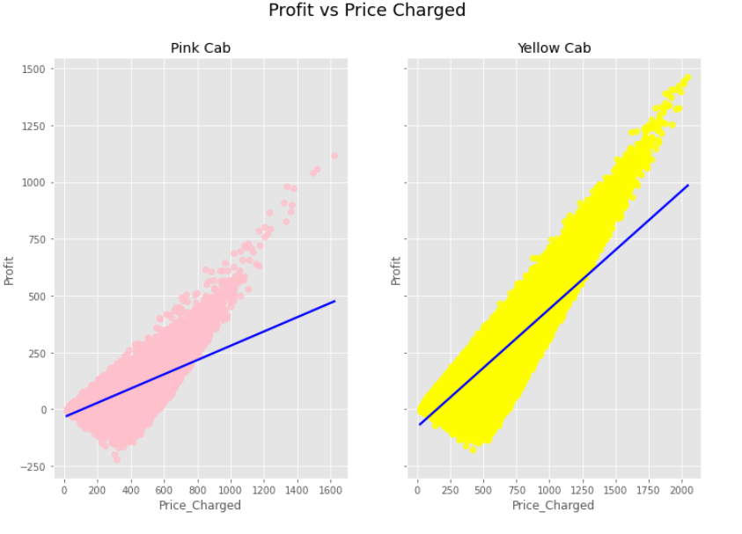
Profit vs Price Charged
There is increase profit when increase in price charged for both company, but Yellow Cab have a higher correlation.

Slide 18
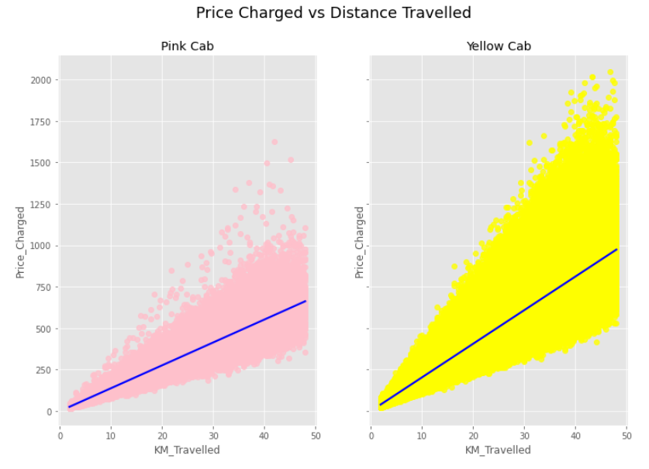
Price Charged for Distance Travelled
Yellow Cab charges more for distance travelled then Pink Cab

Slide 19
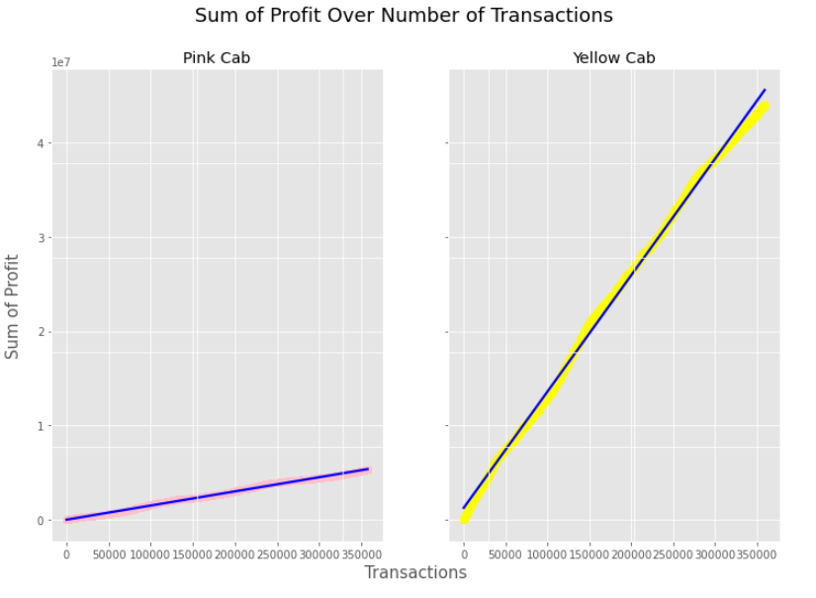
Profit Over Transactions
From the graph above, the profit of the Yellow Cab increase more with increasing transactions then Pink Cab.

Slide 20
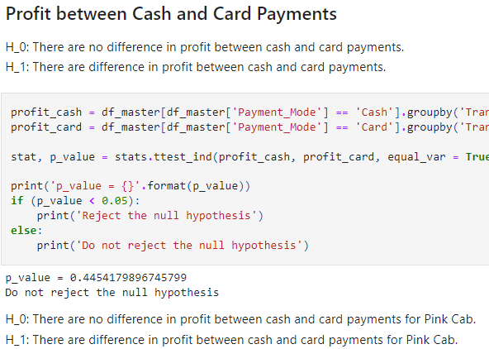
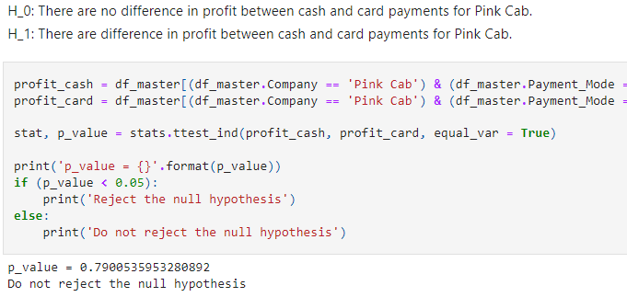
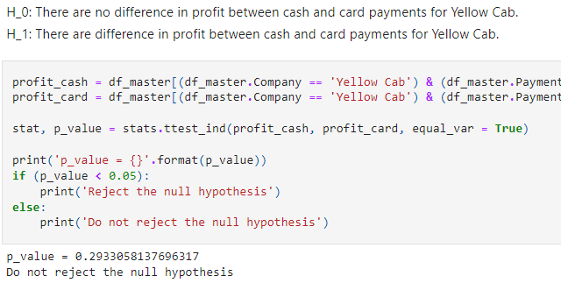
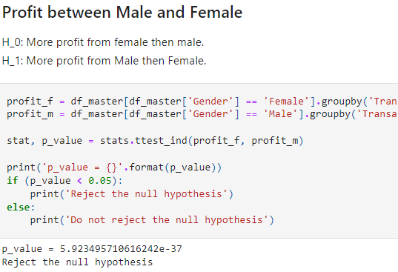
Hypothesis Testing

Slide 21
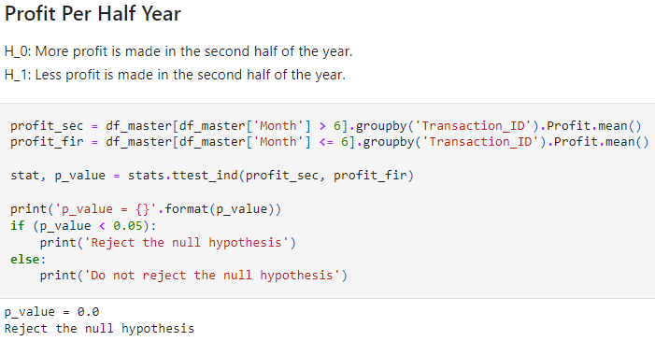
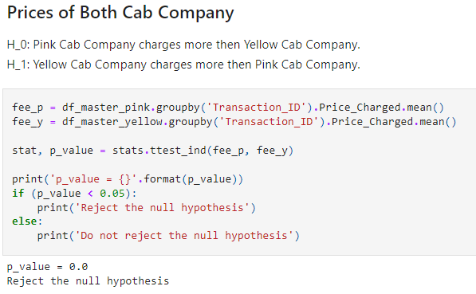
Hypothesis Testing

Slide 22
EDA Summary
VS
Monthly transaction range from 3,000 to 12,000.
Majority of distance travelled are the same for both company (range from 12 KM to 33 KM)
Yearly profit of around 2 Million
More transactions in Los Angeles, New York, and San Diego
Age group range from 18 to 65 year old, majority from 18 to 40
Around 44.2% female and 55.8% male
Monthly transaction range from 15,000 to 35,000.
Majority of distance travelled are the same for both company (range from 12 KM to 33 KM)
Yearly profit of 14 to 16.5 Million
More transactions in New York, Chicago and Washington
Age group range from 18 to 65 year old, majority from 18 to 40
Around 42.2% female and 57.8% male

Slide 23
EDA Summary
VS
Around 59.9% uses card and 40.1% uses cash to pay
Less profit per distance then Yellow Cab
Less profit per price charged then Yellow Cab
Charge less per distance then Yellow Cab
1/8 times the total profit of Yellow Cab
Around 60% uses card and 40% uses cash to pay
More profit per distance then Pink Cab
More profit per price charged then Pink Cab (almost double)
Charge more per distance then Pink Cab
8 times the total profit of Pink Cab

Slide 24
Conclusion
In conclusion, based on the EDA and hypothesis testing, Yellow Cab company has 7 – 8 times the profit of Pink Cab company per year. The Yellow Cab company also has 3 – 5 times the about of transactions of Pink Cab. Yellow Cab makes more profit per distance, more profit per price charged, and more profit per distance. Therefore, XYZ should invest into Yellow Cab then Pink Cab.

Slide 25
Thank You

