Slide 1
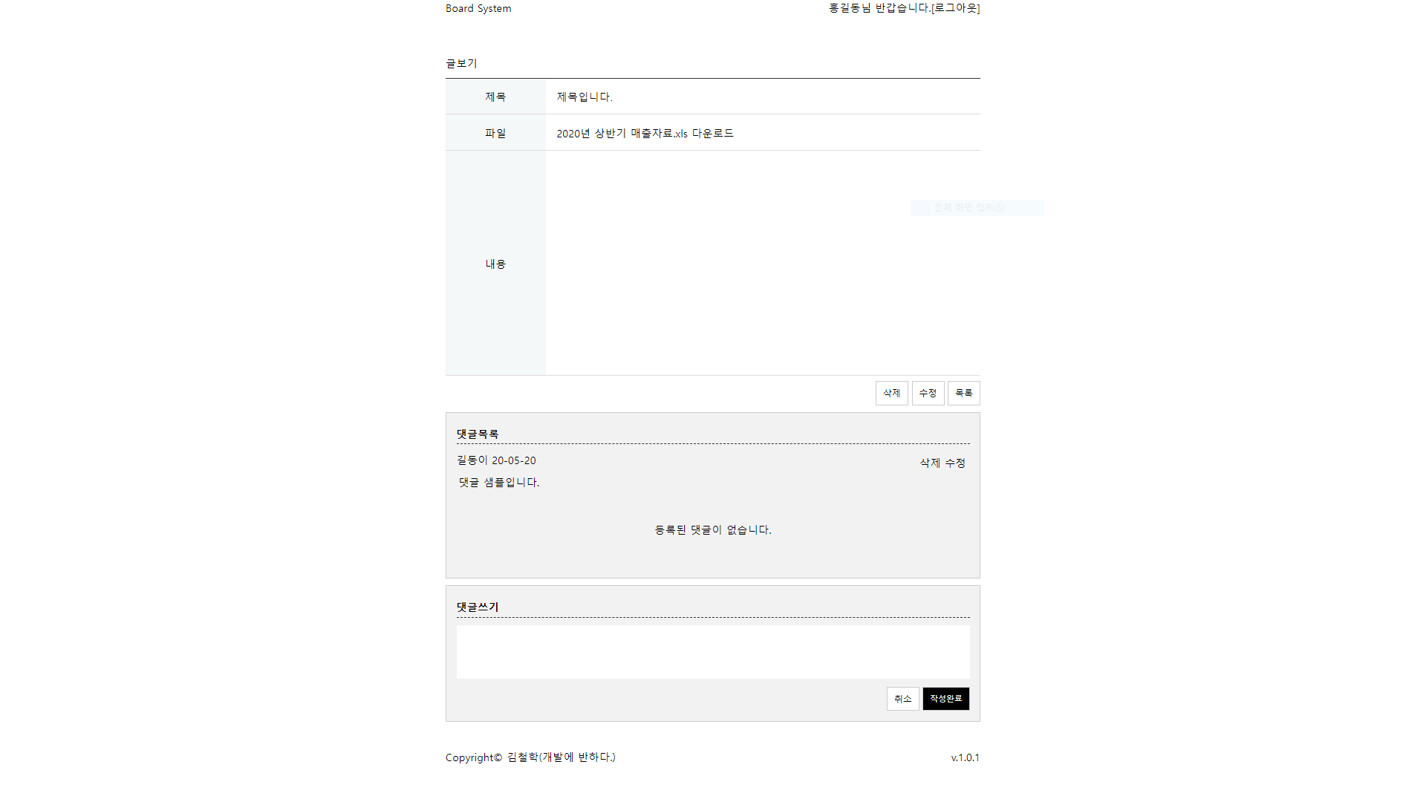
Span ->
main
header
info ^
info
L User_name : 홍길동
L A : [로그아웃]
Board_title ->
Board_box
board
< Container
: box
Board_sub_title
Board_content
:textarea
Button wrap
: board_btn
wrap
: Comm_name
: Comm_date
Item_title
item
Link_wrap ->
Comm_content ->
None ->
Item_title ->
Item_content ->
item
Comm_txt
Button_wrap
Cancle: board_btn
작성완료:Comm_btn
Footer_wrap
<span>
Footer_wrap
<p>
footer

