Slide 1

RailAhead
NJ Metro Rail Delay Prediction App
Notes:
Hello everyone, we are here to day to represent our company “RAILAHEAD”. We will be introducing a new train delay prediction app that predicts the NJ Metro rail delay time in New Jersey

Slide 2

Use Cases
Forecast potential Metro train delays
Suggest alternative traveling options
Capture and update real-time delays
Display real-time weather conditions
Notes:
The goal of our app includes…

Slide 3



Targeted Users
Passengers who…
Commutes to work/school
Takes public transportation frequently
Runs on a tight schedule
Notes:
The users of the app will be primarily passengers who
The primary users of the app will be passengers who:
Commute to work or school.
Frequently use public transportation.
Operate on tight schedules and rely on accurate timing.

Slide 4
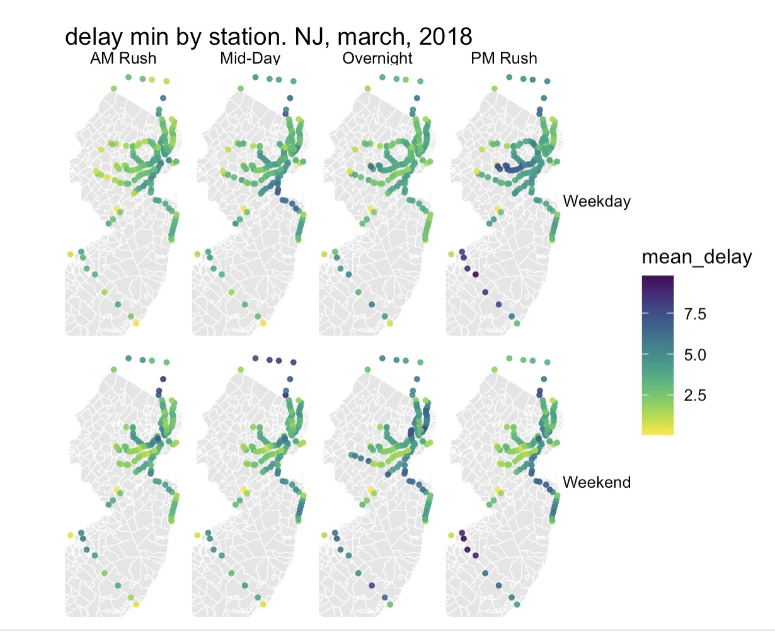
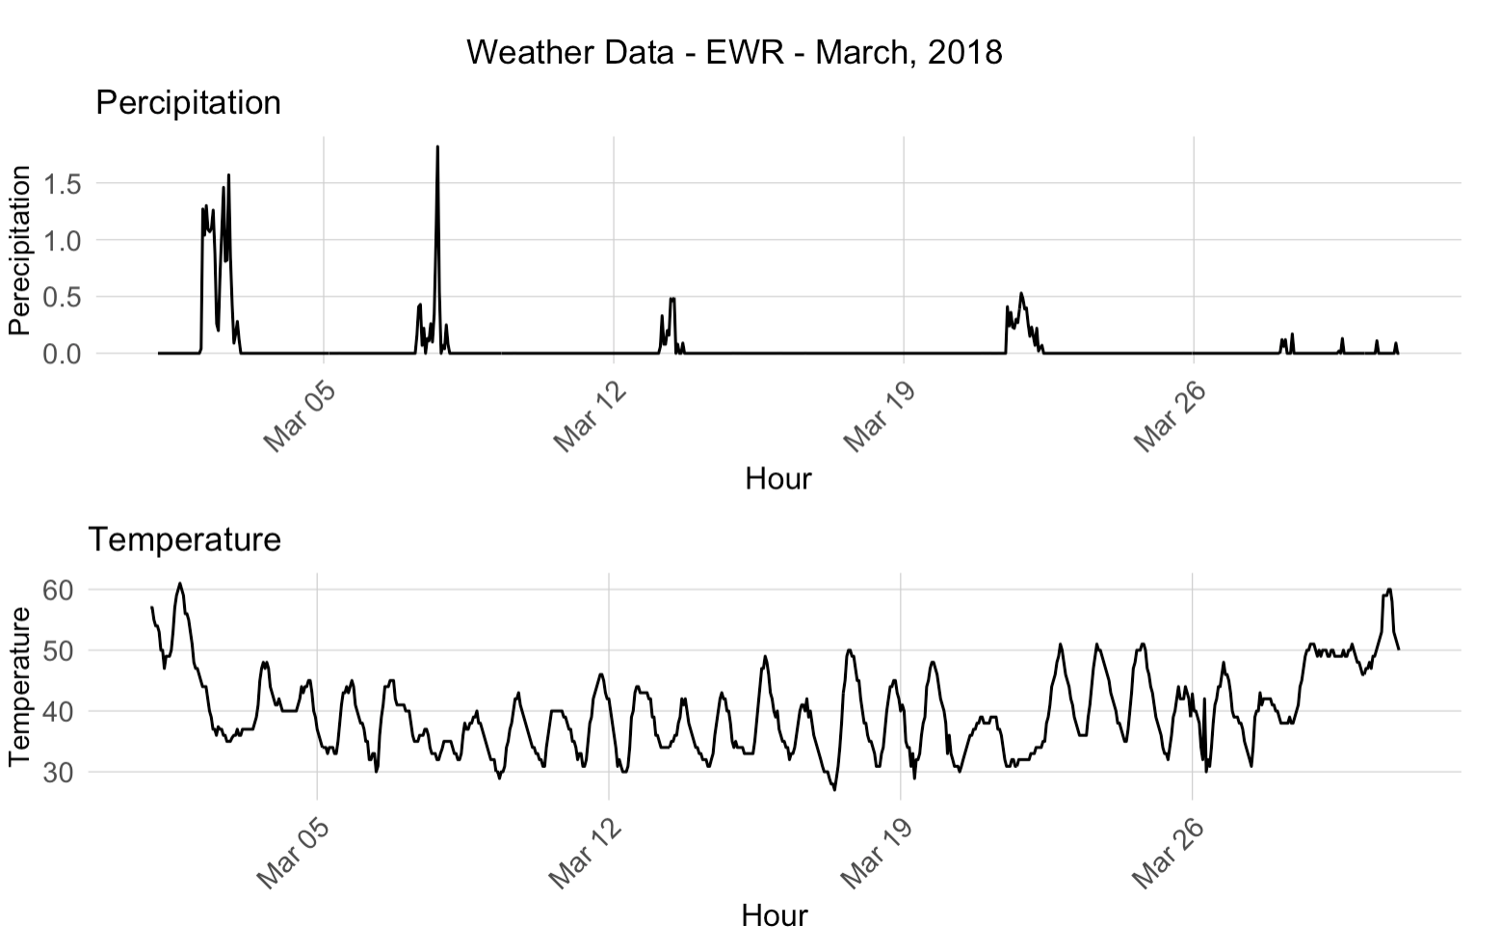
Relevant Features
Notes:
We collected data which we thought will have impacts on the delay time as potential variables we would use to create our models, these includes factors such as day of week, weather, and location of NJ transit stations.

Slide 5
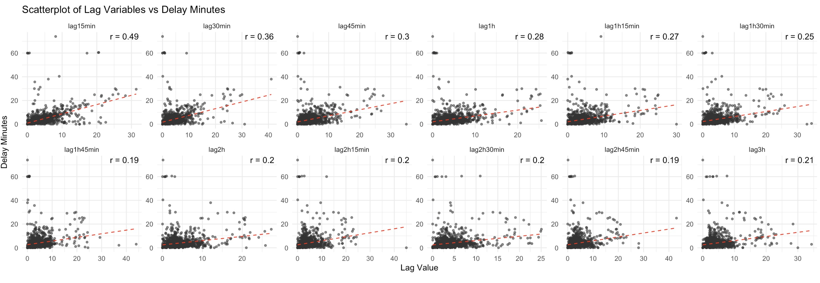
Exploratory Analysis – Temporal Lag
Notes:
We created time lag variables which did not result in strong correlations with the delay time.
However, these variables can help us better understand the dynamic nature of delay and external infulences.
Short time lags (such as lag15min and lag30min) have a greater impact on current delays, and Long-term lags (e.g., lag2h and lag3h) are less relevant but still capture long-term delay trends.
As the lag time increases, the correlation between it and the delay time variable decreases…

Slide 6
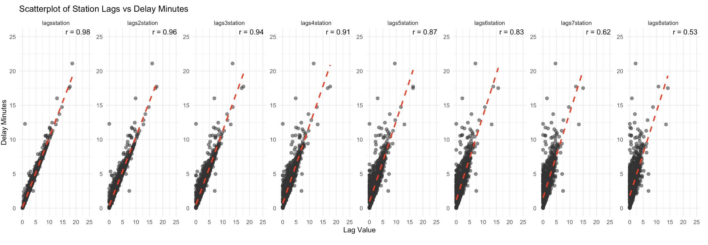
Exploratory Analysis – Spatial Lag
Notes:
On the other hand, twe create the spatial lag variable (we created) which resulted in much stronger relationships with the delay time variable
However, the correlation are decreasing with each additional lag stations, but the predictive power are stronger in overall.
When station lag is under or equal 3 stations is when the correlations are the strongest.

Slide 7
Model Methodology
Variables
Starting Point, Destination, Day of Week, Temperature, Precipitation, Stop Sequence, Time Lag, Spatial Lag
Regression Models
30-Minute Model: time lag 45mins ago, spatial lag 3 stations ago
60-Minute Model: time lag 60mins ago, spatial lag 5 stations ago
90-Minute Model: time lag 90mins ago, spatial lag 6 stations ago
Notes:
We used starting point, destination, DoW, Temperature, Precipitation, Stop sequence, time lag and spatial lag variables (we created using the 2018 data) to make the three models:
(The 30-, 60-, and 90-Minute model using different time and spatial lags)
We create three models, which use to Forecasting delay within 30, 60, and 90 min delay for NJ Metro rail. these three model use different time and spatial lag variables in different delay time period

Slide 8
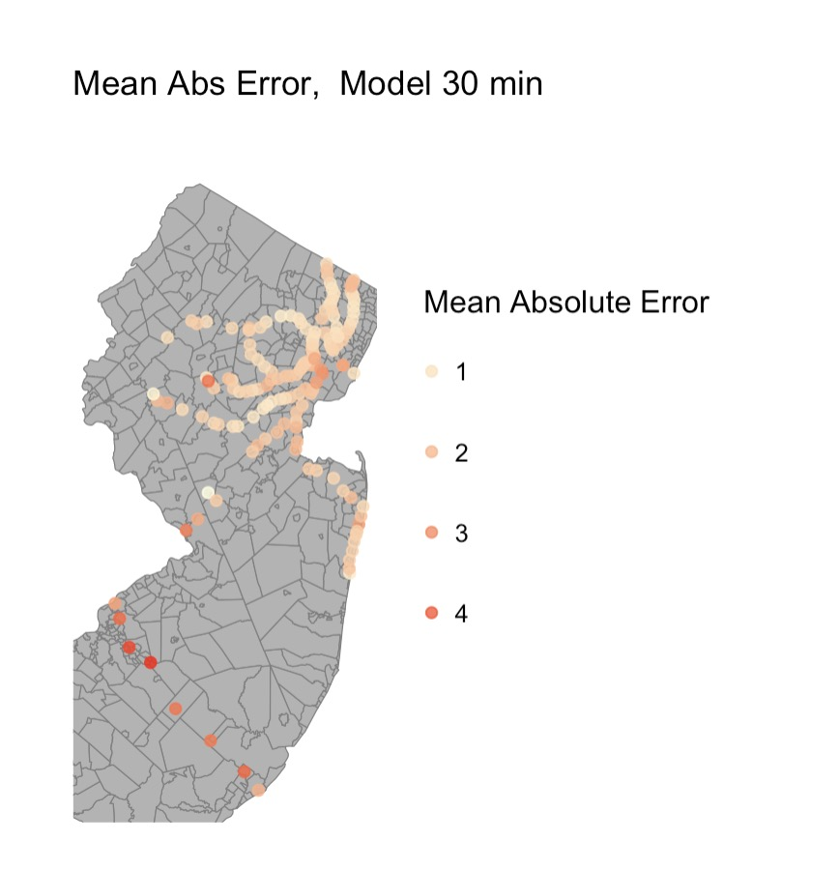
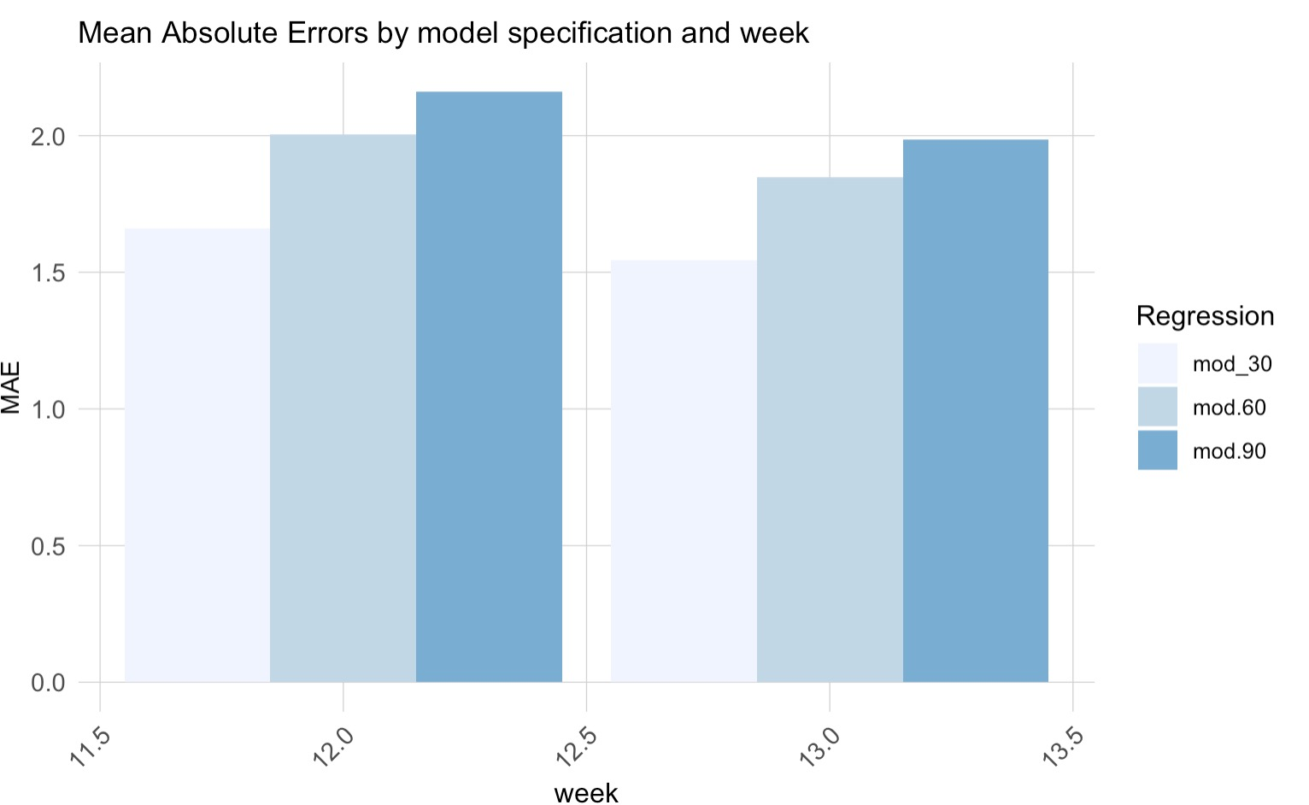
Model Performance
Notes:
To display the performance of our model, we calculated the Mean Absolute Error for all three models.
As you can see on the left of the screen, (the 30 Min Model ) represented by the lightest blue indicates that this model has the least Mean Absolute Error out of the three we have created.
left: 30 minuntes delay forecast model has the smallest MAE value, indicating the most accurate model prediction.
on the right side, it display the distribution map of MAE value for 30 min delay model.

Slide 9
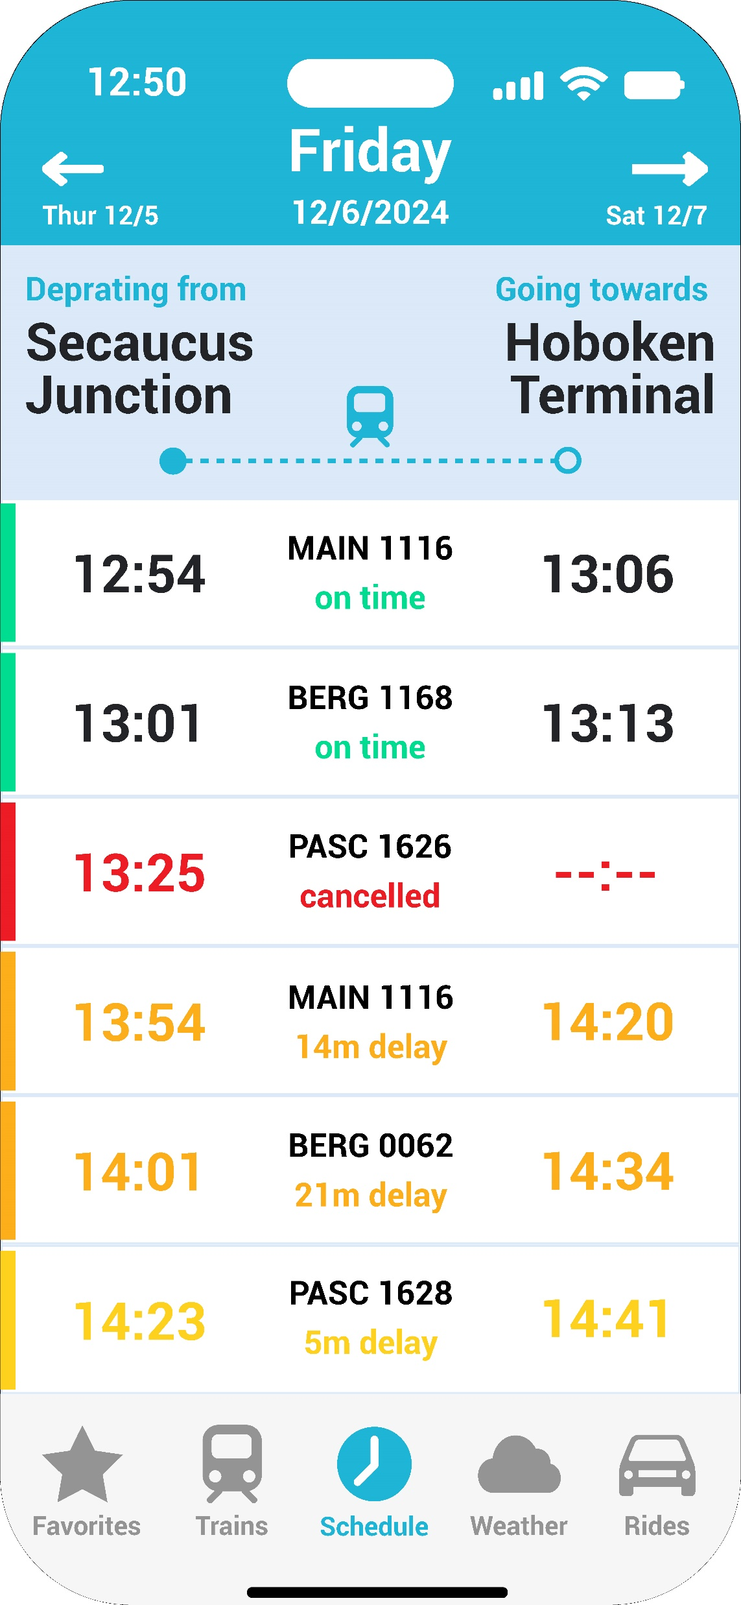
User Interface
Change View Date
Station Information
Scheduled Departure Time
Train Number
Arrive Time (with delay)
Delay Time
Book Rides (alternative traveling option)
Notes:
Here is a mock up of our user interface, as shown on the graph, the features we have includes…

Slide 10
Accessibility Features
Customizable display setting
Supports multiple languages
Regular maintenance and updates
Alerts and notifications
Notes:
To increase the accessibility of our app, we will be including features that allow for:

Slide 11
App Creation
Product Team
Data Analytics Team
Development Team
Design Team
Marketing Team
Defines the vision and sets the goals
Predicts delays using algorithms and machine learning
Builds the frontend and backend of the app
Designs the user interface
Promotes the app and seek potential partnerships
Notes:
Here is a break down of the teams…

Slide 12



Next Steps - Partnerships
Notes:
Lastly, we will be seeking partnerships with bikeshare company such as citi bike and ride hailing companies such as Uber and Lyft in the state of NJ since a main feature of our app include providing alternative traveling options.

