Slide 1

ATTENTION TRACE
Submitted To:
Dr.(Prof.) R.K SINGH
Prof. SONAM ARYA
Submitted By:
SAURABH KUMAR(24764)
SUJAN CHAURASIA(24768)
KARTIK YADAV(24735)
KAMLA NEHRU INSTITUTE OF TECHNOLOGY SULTANPUR (U.P.)
MASTER OF COMPUTER APPLICATIONS

Slide 2
ATTENTION TRACE
AI-Powered Real-Time Advertising Analytics Platform
Leveraging Computer Vision, Emotion AI & Behavioral Tracking for Next-Gen Ad Intelligence
Final Year Project Presentation | May 2026
Guided by: Dr. (Prof.) R. K. Singh & Prof. Sonam Arya
Presented by: Saurabh Kumar | Sujan Chaurasia | Kartik Yadav

Slide 3
01
Introduction
Attention Trace is a SaaS-based advertising analytics platform that uses Artificial Intelligence to measure how users truly engage with online advertisements. Unlike traditional ad tracking that only counts impressions and clicks, our platform leverages real-time computer vision and behavioral analysis to deliver a comprehensive Engagement Score.
Emotion Detection
Gaze Tracking
Behavioral Analytics
Real-time facial expression analysis using FER deep learning model
Google MediaPipe Face Mesh with 478 facial landmarks
Mouse movement heatmaps, velocity tracking, hover zone analysis
Tracks 7 emotions: Happy, Sad, Angry, Surprise, Fear, Disgust, Neutral
Iris position mapping for precise on-screen gaze coordinates
Click tracking, idle time vs active time measurement
Emotion timeline and distribution charts generated per session
On-ad / Off-ad detection to measure visual attention percentage
Tab visibility monitoring with keepalive data persistence

Slide 4
02
Problem Statement
Traditional ad metrics (impressions, CTR) only measure surface-level interactions -- they cannot tell if a user actually looked at, understood, or emotionally responded to an advertisement.
Advertisers spend billions annually on digital ads with no reliable way to measure genuine human attention, leading to wasted budgets and ineffective campaigns.
No existing lightweight, browser-based solution combines facial emotion recognition, eye-gaze tracking, and behavioral analytics into a single embeddable script.
Current solutions require expensive hardware (eye-tracking glasses, EEG headsets) or controlled lab environments, making them impractical for real-world ad tracking.
Privacy concerns around webcam-based tracking remain unaddressed -- existing tools often store raw video data, creating significant security and compliance risks.

Slide 5
03
Objectives
Build a real-time ad analytics engine using browser-based AI (MediaPipe + FER) that processes webcam data without storing any raw video frames.
Develop a lightweight, embeddable JavaScript tracking script (trace.js) that can be integrated into any website with a single <script> tag.
Create a comprehensive SaaS dashboard (React + FastAPI) providing advertisers with engagement scores, emotion distribution, attention heatmaps, and gaze overlays.
Implement a complete subscription management system with UPI-based payment processing, admin verification workflows, and campaign limit enforcement.
Design a privacy-first architecture where facial data is processed in real-time and only computed analytics (emotion labels, gaze coordinates) are retained.

Slide 6
04
System Flowchart
1
2
3
4
5
6
7
8
User Visits Website
>>
trace.js Loads
>>
Ad Overlay Displayed
>>
Webcam + Mouse Capture
>>
WebSocket AI Engine
>>
Emotion + Gaze Analysis
>>
Session Data MongoDB
>>
Dashboard Visualization
Frontend Layer
Backend Layer
AI + Data Layer
React 18 + Vite for SPA dashboard
FastAPI (Python) REST API
Google MediaPipe Face Mesh (478 landmarks)
Tailwind CSS responsive styling
WebSocket for real-time AI streaming
FER deep learning emotion classifier
trace.js (Vanilla JS) tracking engine
JWT authentication with Google OAuth
OpenCV for frame preprocessing
Recharts for analytics visualization
SMTP email service for OTP verification
MongoDB Atlas cloud database

Slide 7
05
Technologies Used
Python / FastAPI
React 18 + Vite
MongoDB Atlas
Tailwind CSS
High-performance async backend REST framework
Modern SPA frontend with hot-module reload
Cloud-hosted NoSQL document database
Utility-first CSS for rapid premium UI
Google MediaPipe
FER Library
WebSocket
Google OAuth 2.0
Face Mesh with 478 landmark iris tracking
CNN-based facial expression recognition
Real-time bidirectional AI data streaming
Secure third-party authentication system

Slide 8
06
Major Modules
Authentication Module
Campaign Management
Email/Password signup with OTP verification via SMTP, Google OAuth 2.0 integration, JWT token-based session management, and password reset flow.
Create, upload, and manage ad campaigns with media files (image/video), target URL configuration, and auto-generated embed scripts.
AI Tracking Engine (trace.js)
Real-Time AI Processing
Autonomous JavaScript injected into publisher sites. Handles webcam streaming, WebSocket AI communication, and keepalive data persistence on tab close.
WebSocket endpoint processes webcam frames for emotion detection (FER) and gaze tracking (MediaPipe) simultaneously, returning JSON results in < 500ms.
Analytics Dashboard
Subscription & Payment
Interactive React dashboard with engagement scores, emotion pie charts, attention heatmaps, gaze timelines, and downloadable CSV reports.
SaaS model with dynamic UPI QR payments, admin verification workflow, campaign limits, plan management, and billing records.

Slide 9
07
Result Comparison
How Attention Trace outperforms existing advertising analytics platforms:
Feature / Metric
Traditional Platforms
Attention Trace (Ours)
Engagement Metric
Clicks + Impressions only
Emotion + Gaze + Behavior Score (0-100)
Emotion Detection
Not available
Real-time 7-emotion FER via webcam
Eye Tracking
$15,000+ hardware required
Free browser-based MediaPipe iris tracking
Integration Effort
Complex SDKs, weeks of setup
Single <script> tag, 30 seconds
Privacy & Storage
Raw video stored on server
Zero video stored; analytics only
Cost
$500-5,000+/month enterprise
Free tier + Rs. 500/month Pro
Processing Speed
Post-session batch analysis
Live WebSocket AI, < 500ms/frame
Attention Trace delivers enterprise-grade analytics at a fraction of the cost with zero hardware requirements.

Slide 10
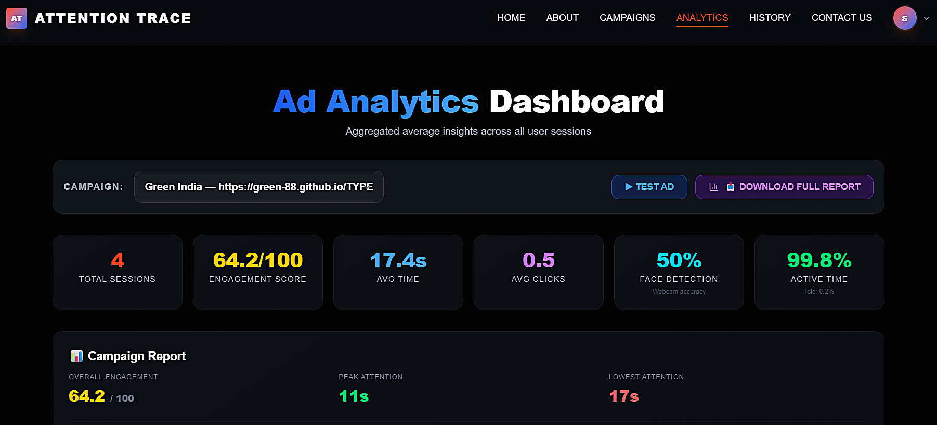
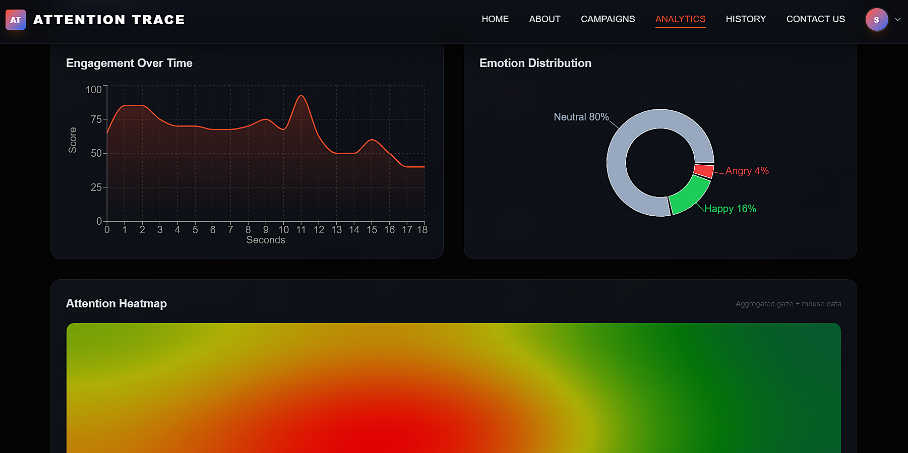
08
UI INTERFACES

Slide 11
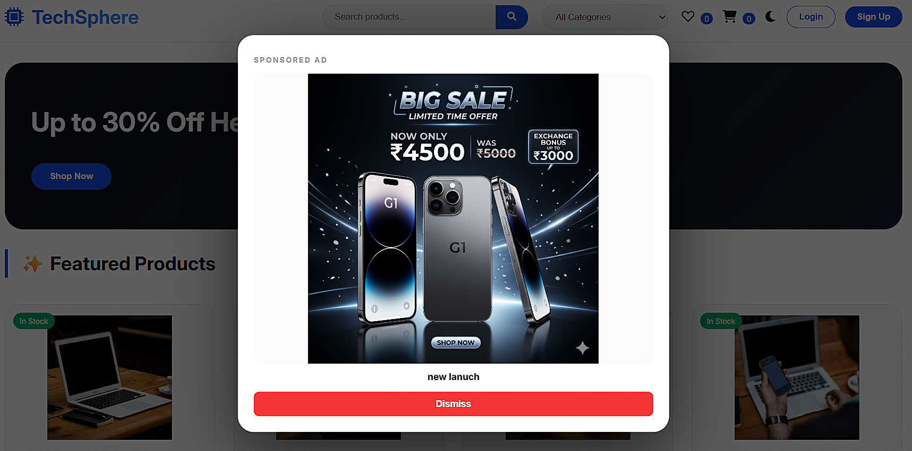

08
UI INTERFACES

Slide 12
09
Conclusion
Attention Trace successfully demonstrates that real-time, browser-based AI can transform how advertisers measure genuine human engagement. By combining facial emotion recognition, iris-based gaze tracking, and behavioral heatmapping into a single embeddable script, we have built a practical, privacy-respecting platform that goes far beyond traditional click-through metrics.
Privacy-First Design
Real-Time AI Engine
Single Script Integration
SaaS Production Ready
No raw video frames are ever stored or transmitted
< 500ms processing per webcam frame via WebSocket
One <script> tag deploys full tracking on any website
Complete auth, payments, admin panel, and analytics
The platform is production-ready with full authentication (Google OAuth + Email OTP), admin controls, CSV report generation, and a responsive React dashboard.

Slide 13
10
Future Scope
Automated Payment Gateway
Demographic Estimation
Replace manual UPI verification with Razorpay or Stripe for instant subscription activation.
Add age and gender estimation using deep learning to provide audience demographic insights.
Frame-by-Frame Gaze Heatmaps
A/B Testing Engine
Generate pixel-level attention heatmaps overlaid directly on the advertisement creative.
Allow advertisers to run split tests between different ad creatives and compare engagement.
Multi-Language Support
Mobile SDK
Internationalize the dashboard UI to support Hindi, Spanish, and other regional languages.
Develop native Android/iOS SDKs for in-app ad tracking beyond browser environments.

Slide 14
11
References
[1] Google MediaPipe -- Face Mesh & Iris Tracking https://developers.google.com/mediapipe
[2] FER -- Facial Expression Recognition Library (CNN) https://github.com/justinshenk/fer
[3] FastAPI -- Modern High-Performance Python Web Framework https://fastapi.tiangolo.com
[4] React.js -- Declarative Frontend JavaScript Library https://react.dev
[5] MongoDB Atlas -- Fully Managed Cloud Database Service https://www.mongodb.com/atlas
[6] Tailwind CSS -- Utility-First CSS Framework https://tailwindcss.com
[7] OpenCV -- Open Source Computer Vision Library https://opencv.org
[8] python-jose -- JSON Web Token (JWT) Implementation https://github.com/mpdavis/python-jose
[9] Vite -- Next-Generation Frontend Build Tool https://vitejs.dev
[10] Recharts -- React Charting Library https://recharts.org

Slide 15
Thank You!
Questions & Discussion
ATTENTION TRACE | AI-Powered Advertising Analytics | 2026

