Slide 1
Food Price Outlook Matthew MacLachlan USDA - Economic Research Service 2022 USDA Agricultural Outlook Forum February 24th – 25th, 2022

Slide 2
Outline
Overview of consumer spending on food
Food price trends over time
Food prices in 2021
2022 food price forecasts in (recent) historical context
Next Food Price Outlook release: Friday, Feb. 25th
Additional ERS Publications

Slide 3
Most of the information in this presentation can be found on ERS’s website
Food Price Outlook Monthly Report
ERS Food Price Environment: Interactive Visualizations
Charting the Essentials
Charts of Note

Slide 4
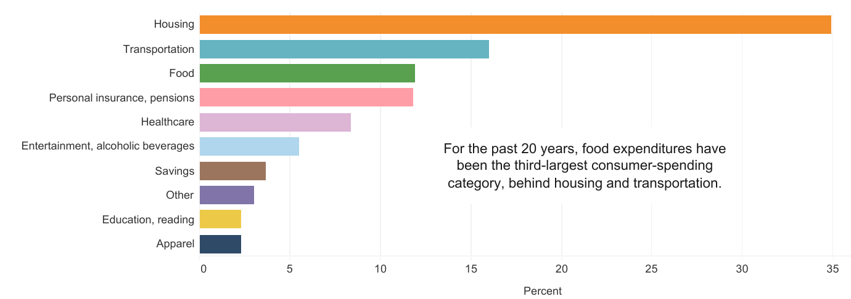
On average, U.S. consumers spent 12 percent of expenditures on food in 2020
Share of U.S. household consumer expenditures by major categories
Source: USDA - ERS using BLS Consumer Expenditure Survey Data

Slide 5
On average, U.S. consumers spent 12 percent of expenditures on food in 2020
Share of U.S. household consumer expenditures by major categories
Fraction of expenditures spent on food in 2020 similar to historical average
Source: USDA - ERS using BLS Consumer Expenditure Survey Data

Slide 6
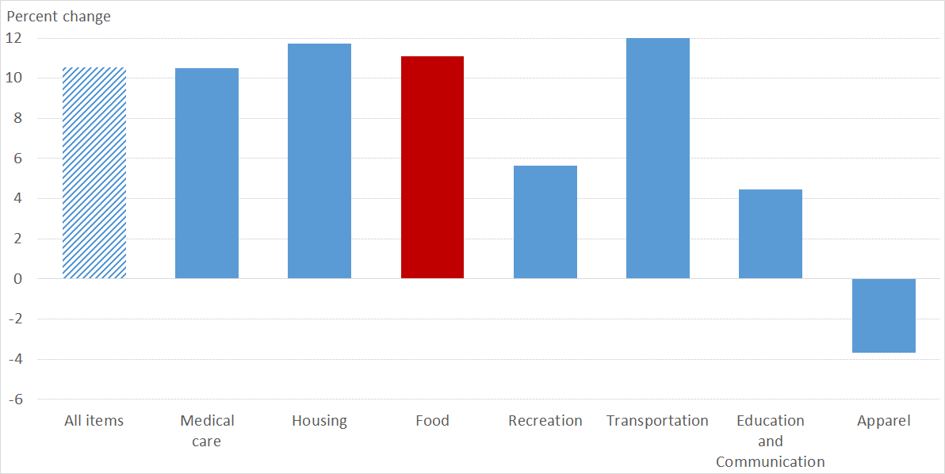
Food price inflation was below housing and transportation over the past 5 years and slightly above the 5-year inflation rate of all items
Source: USDA - ERS using BLS Consumer Expenditure Survey Data

Slide 7
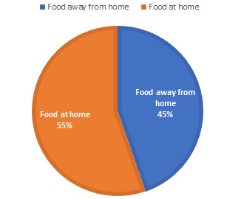
Consumers spent different amounts on food categories—weighting within CPIs accounts for these differences
Source: USDA - ERS using BLS Consumer Expenditure Survey Data

Slide 8
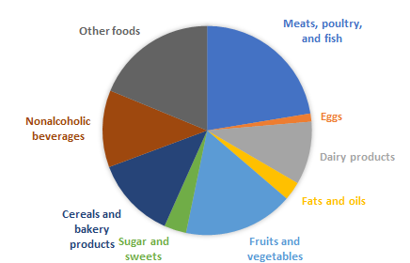
ERS also reports subcategories of food
Source: USDA - ERS using BLS Consumer Expenditure Survey Data

Slide 9
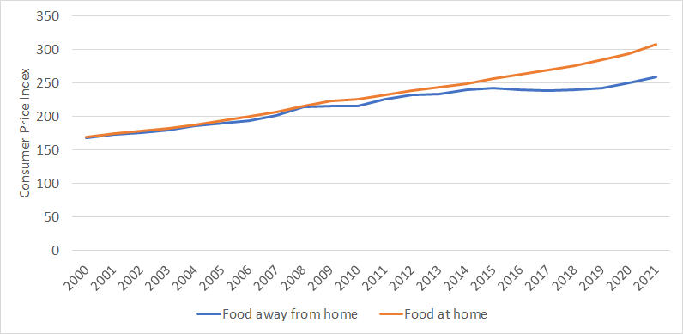
Price growth differs for food consumed at home versus away from home; more similar during the pandemic
Source: USDA - ERS using BLS Consumer Expenditure Survey Data

Slide 10
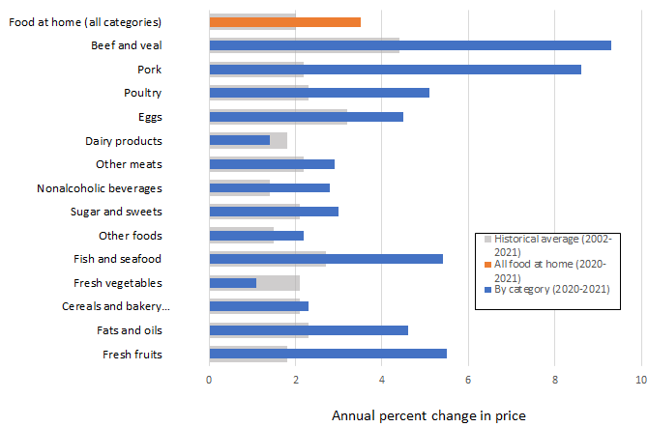
Annual percent changes in retail prices, 2021
Source: USDA - ERS using BLS Consumer Expenditure Survey Data

Slide 11
Annual percent changes in retail prices, 2021
9.3%
8.6%
Source: USDA - ERS using BLS Consumer Expenditure Survey Data

Slide 12
Annual percent changes in retail prices, 2021
1.1%
Source: USDA - ERS using BLS Consumer Expenditure Survey Data

Slide 13
What to watch for in 2022?
Pandemic-related changes
Variants
Vaccination
Disease mitigation
Additional factors
International trade
Supply chains
U.S. economy

Slide 14
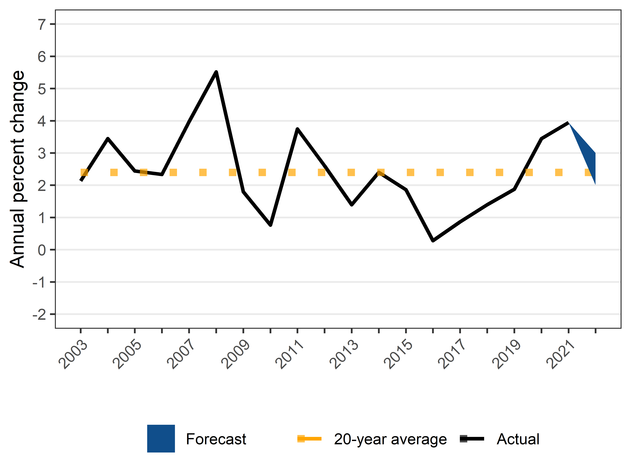
2022 food price inflation forecasted between 2 and 3%
Source: USDA - ERS using BLS Consumer Expenditure Survey Data

Slide 15
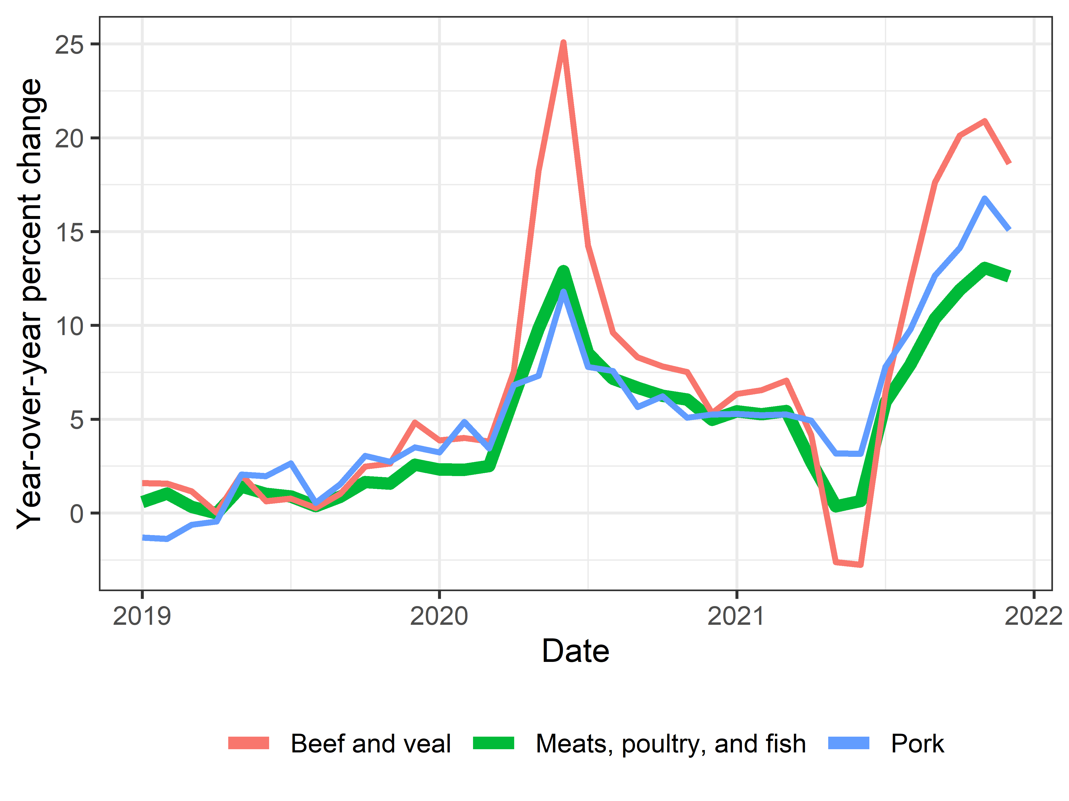
Meat prices increased near the onset of the pandemic and again in late 2021
Source: USDA - ERS using BLS Consumer Expenditure Survey Data

Slide 16
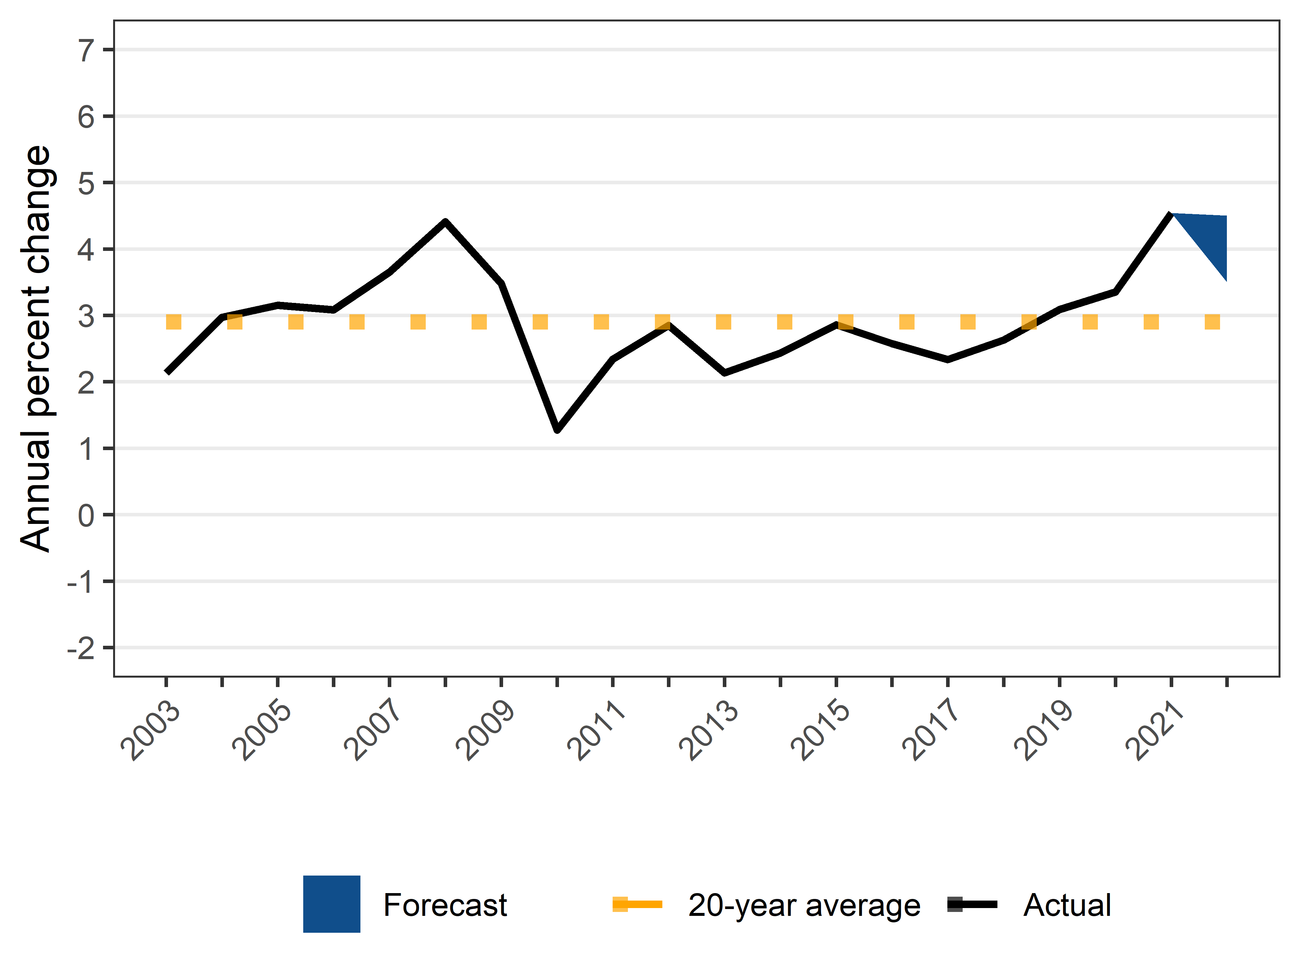
Food away from home prices increased more rapidly than in recent history; expected price inflation between 3.5 and 4.5% in 2022
Source: USDA - ERS using BLS Consumer Expenditure Survey Data

Slide 17
Takeaways
Last year (2021)
High food price inflation
Meat prices increased more than other categories
Prices did not decrease for any category; vegetables had the smallest price increase
Next year (2022)
Pandemic-related factors will continue to present uncertainty
Food prices predicted to increase 2-3%; food-away-from-home prices predicted to increase 3.5-4.5%

Slide 18
What’s next?
Food Price Outlook updated: Friday, Feb. 25th
Forecasts cover the current calendar year, and the succeeding calendar year, starting in July
Forecast 7 farm, 6 wholesale, and 22 retail food categories
Available at www.ers.usda.gov/data-products/food-price-outlook
Additional research addressing forecasting methods used in the Food Price Outlook

Slide 19
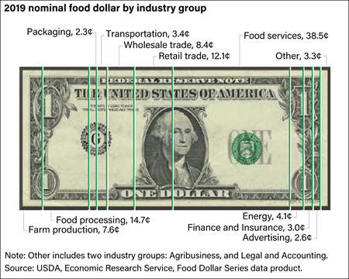
Other work from ERS Food Markets Branch
USDA Food Dollar Series: Measures annual expenditures on food. www.ers.usda.gov/data-products/food-dollar-series
Food Expenditure Series: Comprehensive data on the U.S. food systems, quantifying the value of food acquired in the United States by type of product, outlet, and purchaser. www.ers.usda.gov/data-products/food-expenditure-series
Price Spreads from Farm to Consumer: Comparisons or prices paid by consumers with prices received by farmers for corresponding commodities. www.ers.usda.gov/data-products/price-spreads-from-farm-to-consumer

Slide 20

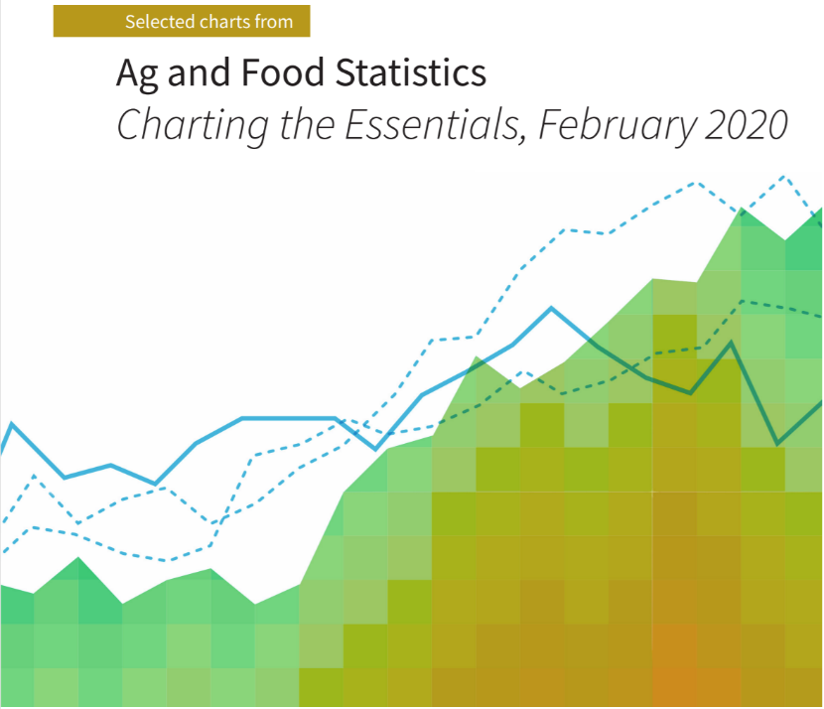
Additional ERS resources
Amber Waves: Current ERS economic and policy research on agriculture, food, rural America, and the environment for policymakers, academics, and the public.
Charts of Note: Highlights from ERS current and past research. A version of the 2022 food-at-home forecast slide is a Chart of Note.
Charting the Essentials: 70 charts and maps covering key information about agricultural markets and trade, farm income, food prices and consumption, food security, rural economies, and the interaction of agriculture and natural resources.
Subscribe online for email notifications on updates to these and more.

Slide 21
Thank you!
Matthew MacLachlan Food Markets Branch, Food Economics Division USDA - Economic Research Service Matthew.MacLachlan@usda.gov

