Slide 1


GLOBAL COMPACT
ON EDUCATION
BUILDING CONSTELLATIONS
OF HOPE
JUBILEE OF THE WORLD OF EDUCATION - 27/10 | 1/11/2025
International Congress «Educational Constellations - A pact with the future»

Slide 2

GLOBAL COMPACT ON EDUCATION
THE IMPACT OF THE GLOBAL COMPACT ON EDUCATION AROUND THE WORLD
2.

Slide 3
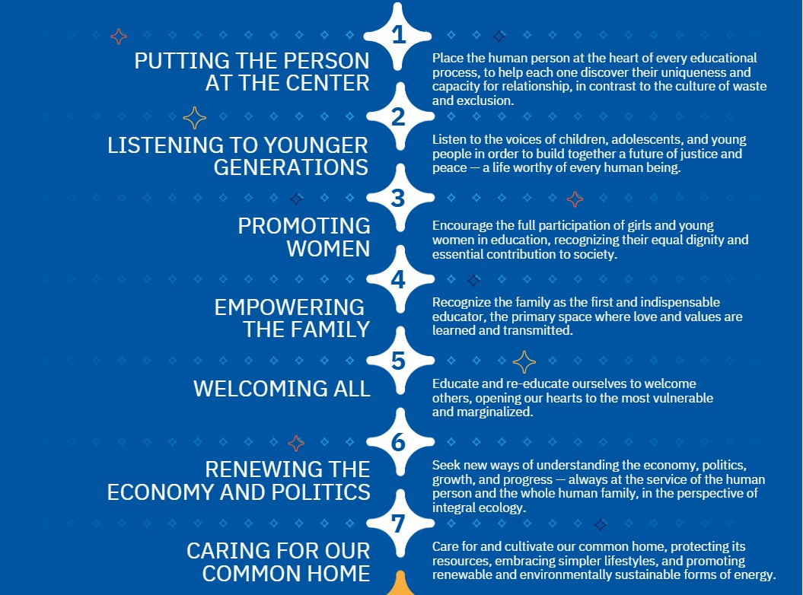
GLOBAL COMPACT ON EDUCATION
THE FIRST 7 GOALS OF THE GLOBAL COMPACT ON EDUCATION
3.

Slide 4

GLOBAL COMPACT ON EDUCATION
THE 3 NEW GOALS OF THE GLOBAL COMPACT ON EDUCATION
4.

Slide 5

GLOBAL COMPACT ON EDUCATION
BUILDING CONSTELLATIONS OF HOPE
5.
2.0

