Slide 1
Being An Older Adult in an Ageist Society
Patricia M. Schwirian, PhD,RN
Professor Emeritus, OSU College of Nursing
Senior Research Scholar,
OSU Primary Care Research Institute
Senior Faculty Affiliate,
OSU Office of Geriatrics & Gerontology

Slide 2
JUST REMEMBER:
Getting old is not for sissies
How old would you be if you didn’t know how old you were? ( S. Paige, date unknown)

Slide 3
AGEISM
What is ageism?
How is ageism manifested?
What is the theoretical basis for ageism?
What is the process by which ageism persists?

Slide 4
AGEISM: What Is It?
…a term coined by Butler (1969)
“Ageism reflects a deep-seated uneasiness on the part of young and middle-aged--a personal revulsion and distaste for growing old, disease, disability, and fear of powerlessness, “uselessness”, and death”
THUS:

Slide 5
In a society that highly values and has great regard for youth and vitality it is no surprise that ageism exists.
Ageism is a form of bigotry, just like racism and sexism

Slide 6
Ageism can be seen as a process of systematic stereotyping of and discrimination against people because they are old, just as racism and sexism accomplish this with skin color and gender

Slide 7
“
“Ageism” became part of the popular consciousness in the 70’s
Kalish (1979) introduced the concept, a “New Ageism”

Slide 8
Characteristics of the “New Ageism”
Stereotypes ‘the elderly’ in terms of those OA’s who are the least capable, the least healthy, and the least alert
Perceive older persons as relatively helpless, dependent individuals requiring support services of agencies and other organizations

Slide 9
Moreover...
Encourages the development of services with little concern as to whether the outcome contributes to reduction in freedom and decision-making power
Produces a stream of criticism against society in general for its mistreatment of the elderly

Slide 10
Kalish says:
“The message of the new ageism seems to be that we understand how badly your are being treated….You are poor, lonely, weak, incompetent, ineffectual, and no longer terribly bright…we are going to relieve your suffering from ageism”.

Slide 11
Ageism Revisited (Bytheway & Johnson, 1990)
Ageism: A set of beliefs originating in the biological variation between people and relating to the aging process
Ageism is made manifest in the actions of corporate bodies--what is said and done by their representatives and the resulting views that are held by ordinary aging people

Slide 12
Moreover, ageism:
Generates & reinforces fear & denigration of the aging process, stereotyping assumptions regarding competence, and the need for protection
Consequences range from well-meaning patronage to unambiguous villification

Slide 13
Ageists:
Avoid older persons on an individual level
Discriminate in terms of jobs and utilization of social institutions
Deride older people through hostile humor
Complain that older people are a drain on society--that they are just taking, not giving

Slide 14
MANIFESTATIONS of AGEISM
In the workplace, OA’s may
Be “downsized” first
Be passed over for promotions/raises
Find their suggestions/observations ignored and/or denigrated
Find it very difficult to get a new job

Slide 15
In the health care system, OA’s may:
Be treated as “crocks”
Be underdiagnosed
Be overmedicated/undermedicated
Be patronized
Be automatically ordered as a DNR
Be excluded from decisions made about their own care

Slide 16
On television, OA’s:
Are largely absent from Saturday AM cartoons (unless they are witches)
Show up primarily in ads for health-problem-oriented products
Are depicted in stereotypical fashions

Slide 17
THEORETICAL FOUNDATIONS FOR AGEISM
Fear of death in Western society; death & old age are considered synonymous in American society
Unrelenting emphasis on the youth culture
American emphasis on productivity (usually narrowly defined in terms of economic potential
The manner in which aging was originally researched

Slide 18
How does the ageism “process” work and intensify?
The Cycle of Structurally Induced Dependence (Kuypers & Bengston, 1984)
Why is it so toxic?

Slide 19
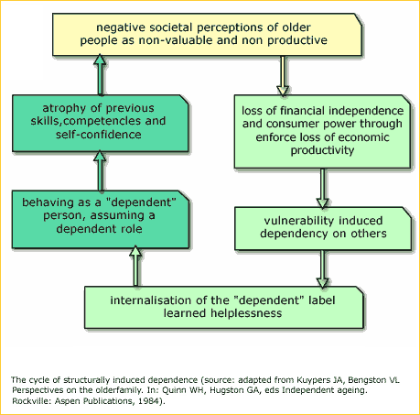

Slide 20
Combatting the Downward Spiral
Realize that older people are part of the cycle of life; they should not be compartmentalized into an undiffereniated “blob”
Focus on HEALTH PROMOTION goals as part of healthy aging

Slide 21
Give importance to the settings in which individuals age--these help determine their health status in old age
Emphasize strategies that maintain bonding between generations

Slide 22
And Finally: Deal With the Myths of Aging as They Exist
Source: Rowe, J.W. & Kahn, R.L. (1998). Successful Aging: The MacArthur Foiundation Study. New York: Dell Publishing Company.
(available through Amazon.com)

Slide 23
Myth #1
To be old is to be sick
FACTS based on Research
People are much more likely to age well than become decrepit & dependent
Age-related disabilities declining; of those 65-74 in 1994, a full 89% reported no disability whatever

Slide 24
Myth #2
You can’t teach an old dog new tricks
FACTS
Wrong, wrong, wrong, wrong!
Older people learn differently,but they learn
Flexibility & adaptability are actually hall marks of successful aging/agers

Slide 25
Key Features Predicting Strong Mental Function in OA’s
Regular physical activity
Strong social support system
Belief in one’s ability to handle what life has to offer

Slide 26
Myth # 3
The Horse is Out of the Barn
FACTS
“Nature is remarkably forgiving”
“Research shows that it is almost never too late to begin healthy habits, such as smoking cessation, sensible diet, exercise, & the like.”

Slide 27
Myth #4
The secret is choose your parents wisely
FACT
Swedish Twins Study: only 30% of physical aging can be blamed on genes, & about half the changes in mental function
“We are, in large part, responsible for our old age.”

Slide 28
Myth #5
Older adults don’t pull their own weight
FACTS
Wrong measures: Only paid work counts as “productive”
Ageism in the workplace

Slide 29
Thank You For Coming!

