Slide 1


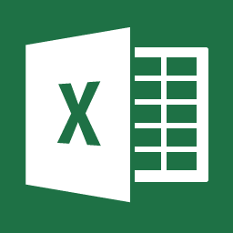

Google Play store Apps – Analysis and Visualization
Ginu Varghese
Sujil Kumar
Ravichandra Reddy

Slide 2





Introduction
Research Questions
Which are the popular apps in Play Store?
Do people prefer free or paid apps?
1
2
Which category has most apps & which are the top rated apps
Which are the highest paid apps?
3
4
Notes:
Introduction:
Android is an operating system created by Google for smartphones and tablets.
It is available on devices by different manufactures with different choices.
Here we are analysing the google playstore apps.
This analysis is to help android developers to know what the motivating factor for people is to download an app.
It will also help to find out the factors that affect someone’s decision to download an app.
Here we are analysing google playstore apps using different visualization tools like Microsoft excel, Tableau and power bi.

Slide 3

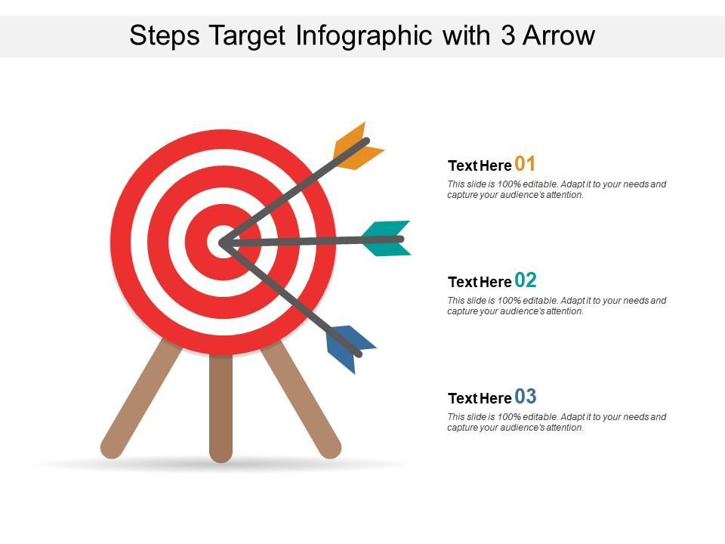


Research Questions:
Which are the popular apps in the play store?
Do people prefer free apps or paid apps?
Which category has the most apps, and which are the most rated apps?
Which are the highest paid apps?
Data:
Data is downloaded from Kaggle website.
Dataset consists information about Applications and Its Features.
Features: Name, Category, Rating, Reviews, Size, Installs, Type, Price, Content Rating, Genre, Last Updated, Android Version, and Current Version.

Slide 4

Data Cleaning:
Duplicates are checked.
Uneven names and typos are replaced.
Size column data is set to Megabytes.
Primary Genre is selected.
Unique Application name is selected.
Price is set to quantitative.
Correct data type is set to all the columns.
Null values are kept so information is used for other graphs.

Slide 5








CHANGED DATE FORMAT
DUPLICATES
UNEVEN NAMES
CHECKED NULL VALUES
Data Cleaning
SET DATA TYPES
SIZE TO MB
UNIQUE APP NAME
PRIMARY GENRE
Notes:
After cleaning 10841 rows are reduced to 9660 rows.

Slide 6

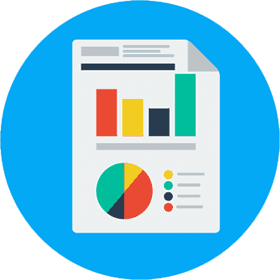



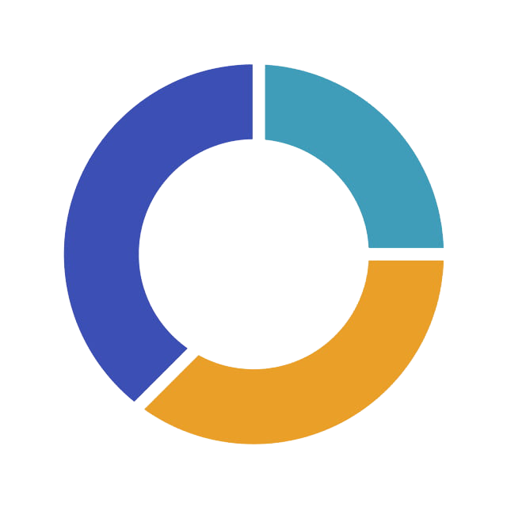
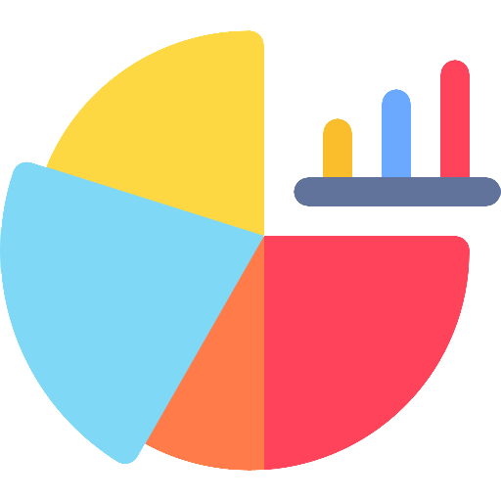


Reviews & Recommendations
Logos and Buttons
Dashboard switching
Tree map colors are odd
Added clear filters
Relevant information stand out
Interactive graphs
Pie chart not recommended
Added clear filters
Interactive dashboard tabs
Description icon
Tree map needs to be scrolled
Consistent color tone

Slide 7
Pros and cons :
Microsoft Excel Dashboard Strengths:
Logo and buttons are implemented correctly.
Switching between different dashboards to show more visualizations.
Select all and clear filters are given for all the slicers.
Future recommendation:
Tree map colors are odd with the dashboard.
B. Power Bi Dashboard Strengths:
Main relevant information stands out on home
All graphs are interacting each other
Single clear filter option is very useful
Future Recommendation:
We do not normally recommend using Pie Chart. It’s better to use some other graphs.

Slide 8
C. Tableau Dashboard Strengths:
Attractive & interactive header bar.
It's a useful idea to have a "bulb" icon providing a short info about the dashboard.
A color tone consistently used throughout the dashboard graphs Disadvantage
Future Recommendation:
Genre based on installs need to be scrolled to see whole heatmap so it’s better to improve it.

Slide 9


Conclusion
Used in most organizations.
Can produce interactive and efficient dashboards.
Notes:
From our analysis we found which are the most popular apps, its ratings, and reviews.
Every technology has its own benefits and disadvantages.
Based on the dashboard we can recommend tableau for visualizations using more data.
Although it has some disadvantages it is used in most organizations and preferred by most people for visualizations.
It is a tool which we can depend for producing interactive and efficient dashboards

Slide 10
Thank you!
Notes:
From our analysis we found which are the most popular apps, its ratings, and reviews.
Every technology has its own benefits and disadvantages.
Based on the dashboard we can recommend tableau for visualizations using more data.
Although it has some disadvantages it is used in most organizations and preferred by most people for visualizations.
It is a tool which we can depend for producing interactive and efficient dashboards

