Slide 1


Research Project 2022
Suicide Analysis
Sujil Kumar K.M, DKIT

Slide 2

Why Suicide Analysis ?
Dundalk Institute of Technology
Notes:
When conducting research, it is easy to go to one source: Wikipedia. However, you need to include a variety of sources in your research. Consider the following sources:
Who can I interview to get more information on the topic?
Is the topic current and will it be relevant to my audience?
What articles, blogs, and magazines may have something related to my topic?
Is there a YouTube video on the topic? If so, what is it about?
What images can I find related to the topic?

Slide 3

Introduction
Enter Your
Screenshot Here
1. Area & topic of research
2. Relevance of Visualisation
3. Previous studies
4. Social Impact on study

Slide 4

Ethical concepts
01
Data Storage
02
Data Privacy
03
Data Security
04
Ethical Responsibility

Slide 5
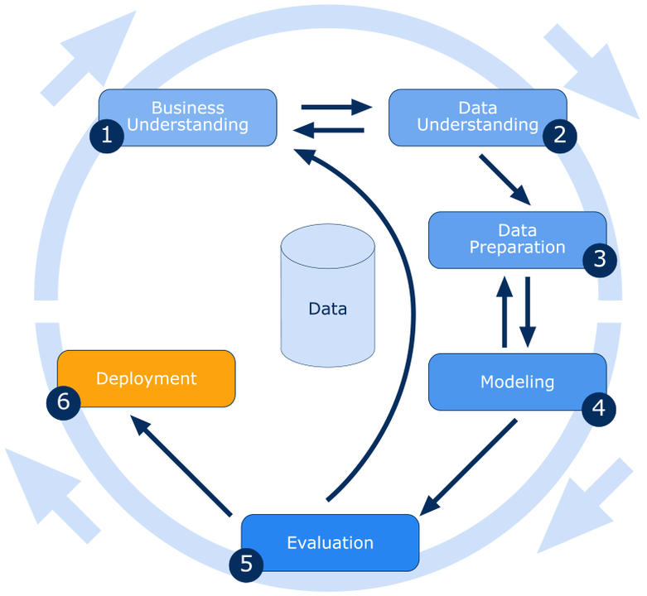
Technologies and Methods
1. Time Series and ML Suicide Forecast Models
2. MySQL Database Architecture
3. PHP Laravel Admin Control Panel for CRUD op.
4. Python Dash with CSS for Dashboard design
5. Git Repos and hosting on Remote Server
6. SSH Configurations for server updates
7. CRISP-DM Methodology
Notes:
When conducting research, it is easy to go to one source: Wikipedia. However, you need to include a variety of sources in your research. Consider the following sources:
Who can I interview to get more information on the topic?
Is the topic current and will it be relevant to my audience?
What articles, blogs, and magazines may have something related to my topic?
Is there a YouTube video on the topic? If so, what is it about?
What images can I find related to the topic?

Slide 6



The overall process
Raw data
Laravel Admin Panel
Feedback Collection Page In Laravel
MySQL DB
Load csv with SSH Interface
output.csv
Data maker
Program
Data Preparation
Manually run
Cron Jobs
country_wise.csv
Forecasted
Data Modeling
Program
Exploratory Data Analysis and Modeling
outliers.csv
Outlier detected
Error of models
error.csv
Initial Analysis in Jupyter Notebook in Local
Python Dashboard
Mochahost VPS Server
Dundalk Institute of Technology

Slide 7
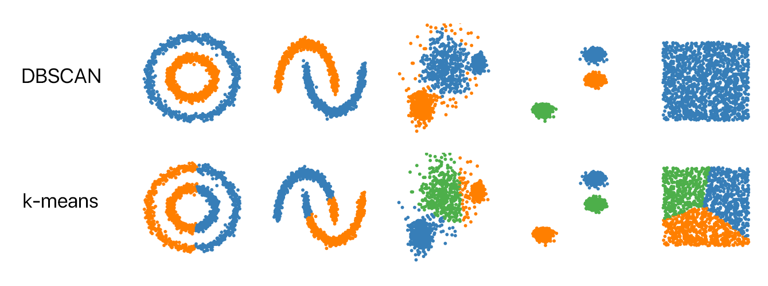
Density-based spatial clustering of applications with noise (DBSCAN)
Unsupervised Machine Learning Algorithms
Methods that identify distinctive groups/clusters
base algorithm for density-based clustering
minPts: The minimum number of points (a threshold) clustered together for a region to be considered dense.
eps (ε): A measurement of distance that will be used to find the points neighborhood any given location.
Dundalk Institute of Technology

Slide 8
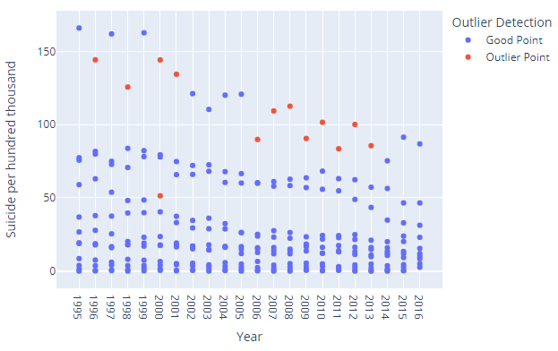
Dundalk Institute of Technology

Slide 9
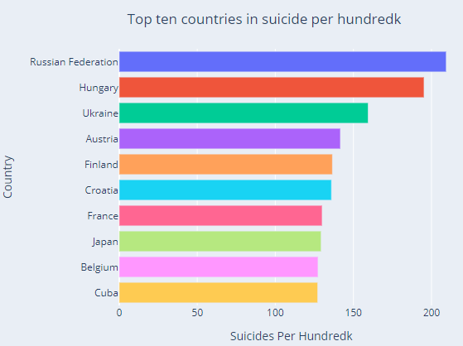
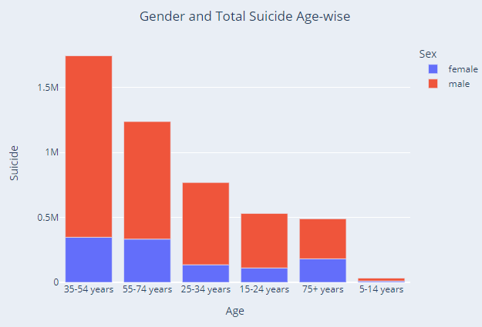
Dundalk Institute of Technology

Slide 10
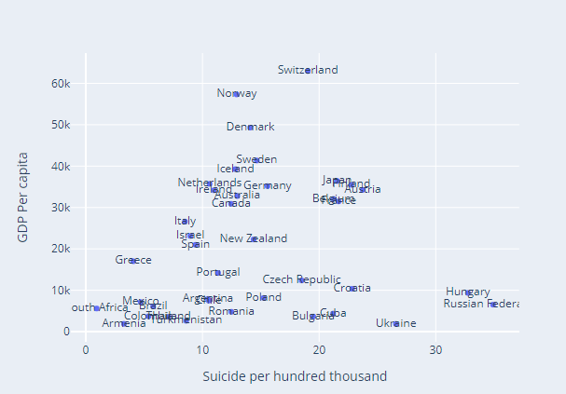
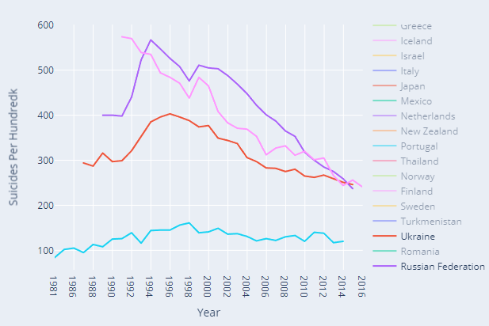
Dundalk Institute of Technology

Slide 11
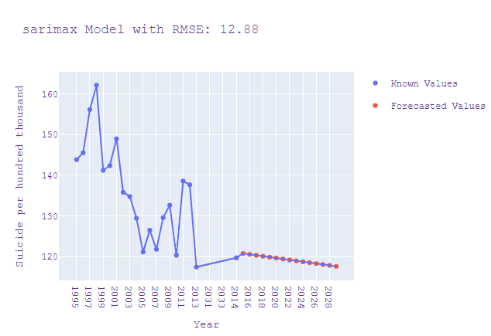
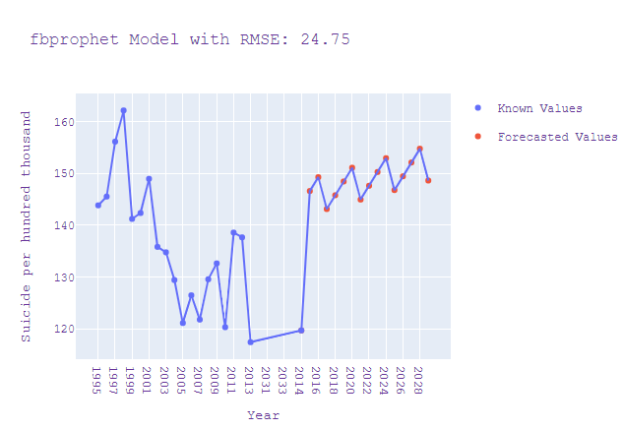
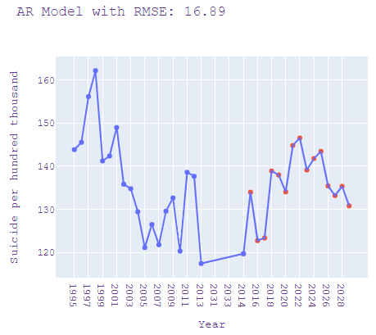
Predictions for Ireland using three models
Dundalk Institute of Technology

Slide 12

Conclusion
SARIMAX outperformed other models such as FB Prophet and Custom AR
Russia, Ukraine, and Hungary have the highest suicide rate.
Low and moderate GDP Per capita countries have more suicide
By the year 2025 Ireland will have 118.49 suicides as per SARIMAX forecast
People with Age 35-54 are the most vulnerable age group
Men are more likely to commit to suicide compared to women
Notes:
You can use this slide as your opening or closing slide. Should you choose to use it as a closing, make sure you review the main points of your presentation. One creative way to do that is by adding animations to the various graphics on a slide. This slide has 4 different graphics, and, when you view the slideshow, you will see that you can click to reveal the next graphic. Similarly, as you review the main topics in your presentation, you may want each point to show up when you are addressing that topic.
Add animation to images and graphics:
Select your image or graphic.
Click on the Animations tab.
Choose from the options. The animation for this slide is “Split”. The drop-down menu in the Animation section gives even more animations you can use.
If you have multiple graphics or images, you will see a number appear next to it that notes the order of the animations.
Note: You will want to choose the animations carefully. You do not want to make your audience dizzy from your presentation.

Slide 13
References
https://online.sbu.edu/news/importance-of-business-ethics - ethics image
Brendan Artley. (2022). Time Series Forecasting with ARIMA , SARIMA and SARIMAX | by Brendan Artley | Towards Data Science. https://towardsdatascience.com/time-series-forecasting-with-arima-sarima-and-sarimax-ee61099e78f6
Elias Dabbas. (2019). Build a Ploty Dash App - Poverty Data Dashboard. https://povertydata.org/
Exploratory Data Analysis (EDA) using Python and Jupyter Notebooks - YouTube. (n.d.). IGeek. Retrieved August 27, 2022, from https://www.youtube.com/watch?v=iZ2MwVWKwr4
Nagesh Singh Chauhan. (2022). DBSCAN Clustering Algorithm in Machine Learning - KDnuggets.
https://www.kdnuggets.com/2020/04/dbscan-clustering-algorithm-machine-learning.html

Slide 14


Dundalk Institute Of Technology

