Slide 1


Research Project 2022
Suicide Analysis
Sujil Kumar K.M, DKIT

Slide 2
Why Suicide Analysis ?
Notes:
When conducting research, it is easy to go to one source: Wikipedia. However, you need to include a variety of sources in your research. Consider the following sources:
Who can I interview to get more information on the topic?
Is the topic current and will it be relevant to my audience?
What articles, blogs, and magazines may have something related to my topic?
Is there a YouTube video on the topic? If so, what is it about?
What images can I find related to the topic?

Slide 3
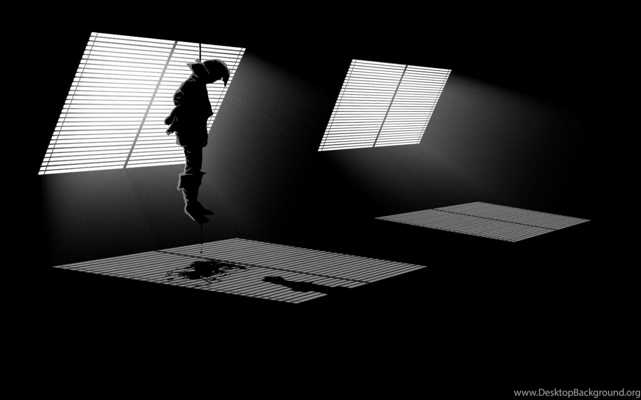

Introduction
Enter Your
Screenshot Here
1. Area & topic of research
2. Relevance of ethics in study
3. Previous studies
4. Social Impact on study

Slide 4

Ethical concepts
01
Data Storage
02
Data Privacy
03
Data Security
04
Results and web

Slide 5
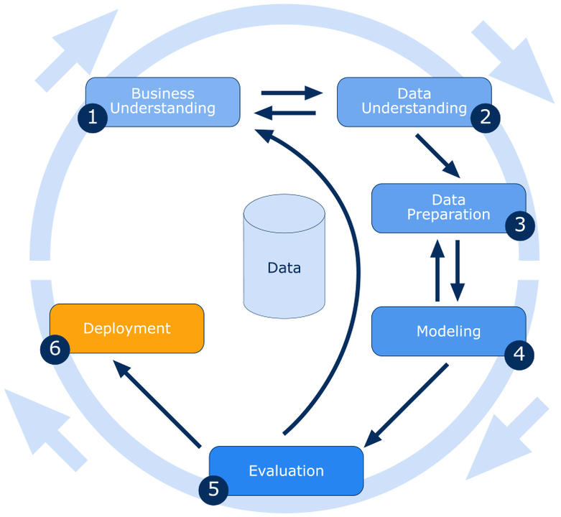
Technologies and Methods
1. Time Series and ML Suicide Forecast Models
2. MySQL Database Architecture
3. PHP Laravel Admin Control Panel for CRUD op.
4. Python Dash with CSS for Dashboard design
5. Git Repos and hosting on Remote Server
6. SSH Configurations for server updates
7. CRISP-DM Methodology
Notes:
When conducting research, it is easy to go to one source: Wikipedia. However, you need to include a variety of sources in your research. Consider the following sources:
Who can I interview to get more information on the topic?
Is the topic current and will it be relevant to my audience?
What articles, blogs, and magazines may have something related to my topic?
Is there a YouTube video on the topic? If so, what is it about?
What images can I find related to the topic?

Slide 6
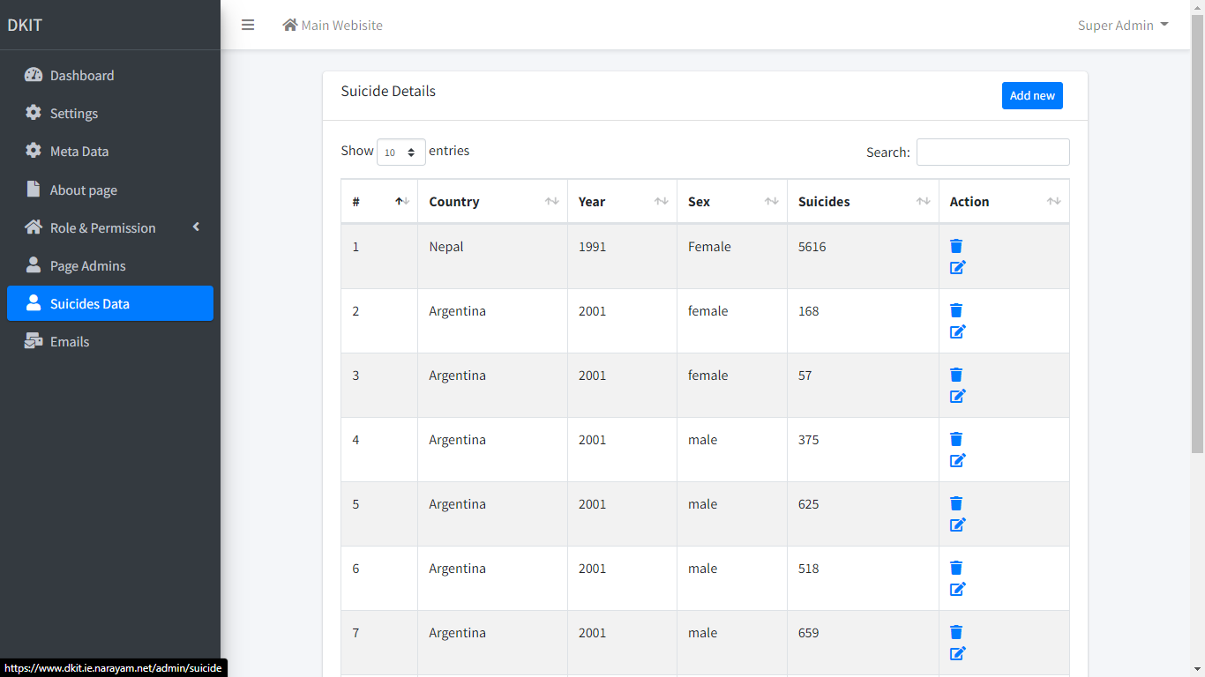

Slide 7
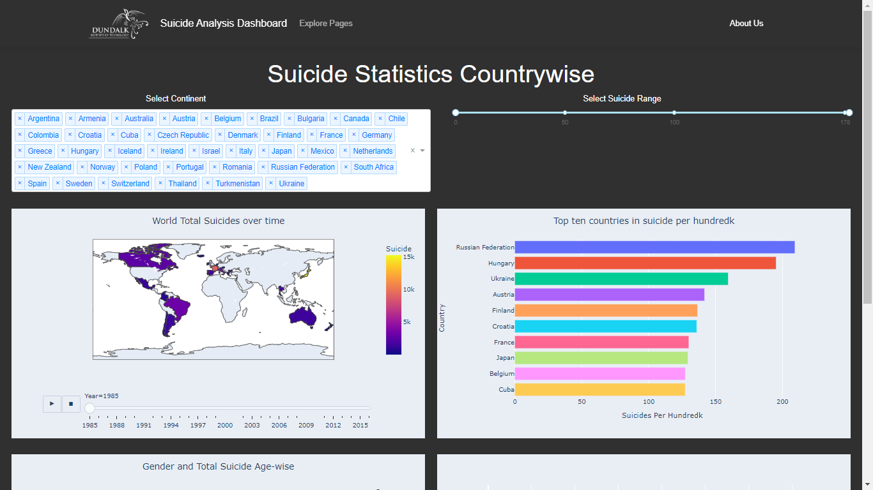

Slide 8
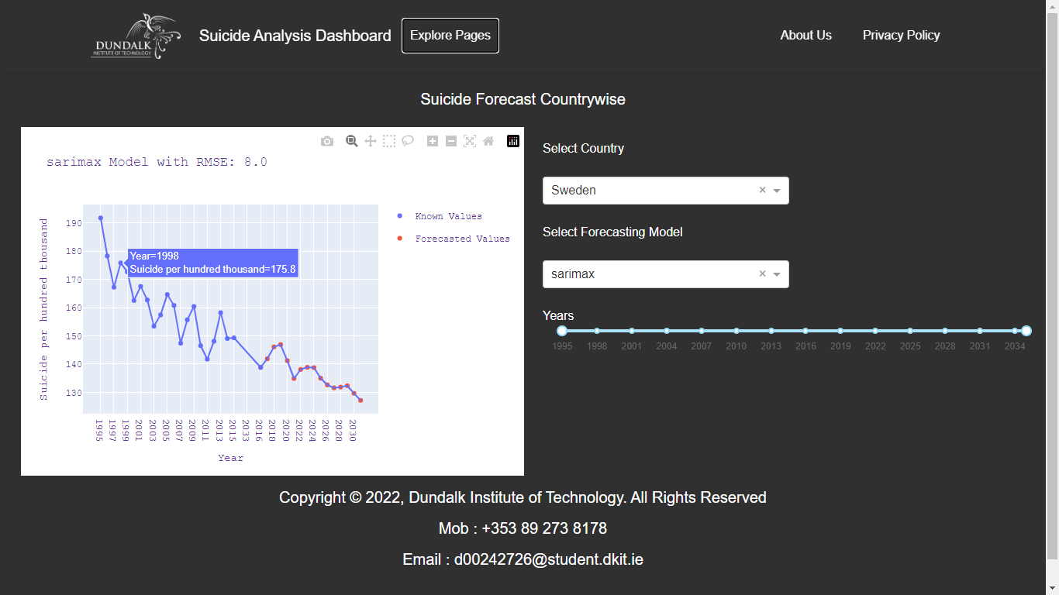

Slide 9
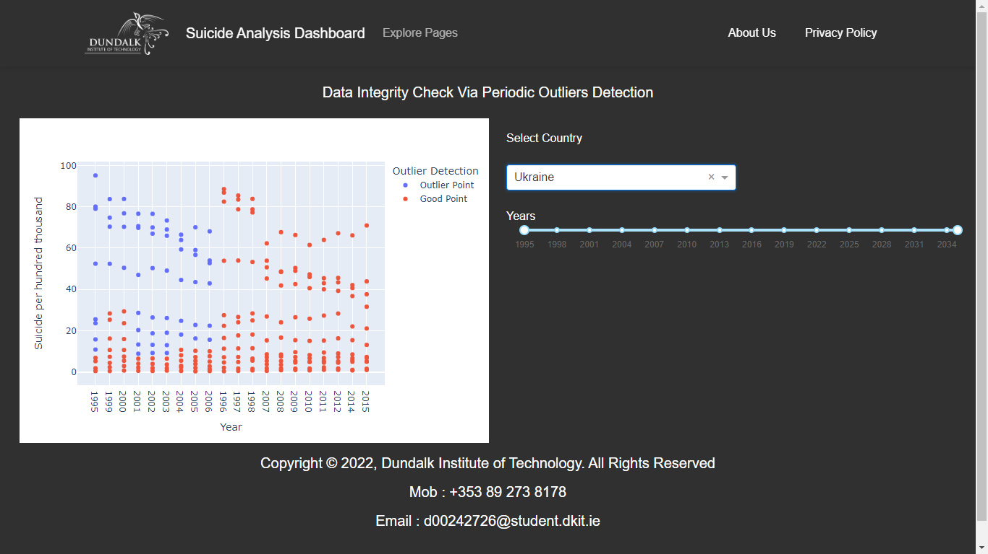

Slide 10

Conclusion
SARIMAX outperformed other models
Moderate results from FB Prophet and AR
Cron Jobs made the app real-time
Effective Visualisations for general audience
Most affected People Age , Gender
Admin Backend effective management of data
Notes:
You can use this slide as your opening or closing slide. Should you choose to use it as a closing, make sure you review the main points of your presentation. One creative way to do that is by adding animations to the various graphics on a slide. This slide has 4 different graphics, and, when you view the slideshow, you will see that you can click to reveal the next graphic. Similarly, as you review the main topics in your presentation, you may want each point to show up when you are addressing that topic.
Add animation to images and graphics:
Select your image or graphic.
Click on the Animations tab.
Choose from the options. The animation for this slide is “Split”. The drop-down menu in the Animation section gives even more animations you can use.
If you have multiple graphics or images, you will see a number appear next to it that notes the order of the animations.
Note: You will want to choose the animations carefully. You do not want to make your audience dizzy from your presentation.

Slide 11
References
Suicide Statistics 2011 - CSO - Central Statistics Office. (n.d.). Retrieved August 28, 2022, from https://www.cso.ie/en/releasesandpublications/er/ss/suicidestatistics2011/
The Economist. (2018). Why the global suicide rate is falling | The Economist. https://www.economist.com/the-economist-explains/2018/11/30/why-the-global-suicide-rate-is-falling
Time Series Analysis: Definition, Types & Techniques | Tableau. (n.d.). Retrieved August 24, 2022, from https://www.tableau.com/learn/articles/time-series-analysis

Slide 12


Dundalk Institute Of Technology

