Slide 1
Git Hub
➔ GitHub is a cloud platform which is used to store the source code of all the developers
at one place, by hosting a repository.
➔ GitHub allows you to Store repositories online and Collaborate with teams.
➔ You can think Git Hub as a Google Drive for projects.
➔ To communicate with GitHub repositories, you have to install 'git' as client software.
➔ A Project team members installs git as client software and through this connects to
the Git Hub repository for code integration.
➔ version control system like SVN (before GIT dis- not distributed repo local repo not created),CVS
➔GitHub allows to monitor/track the code changes.
-- who modified
-- when modified
-- what modified
-- why modified.

Slide 2
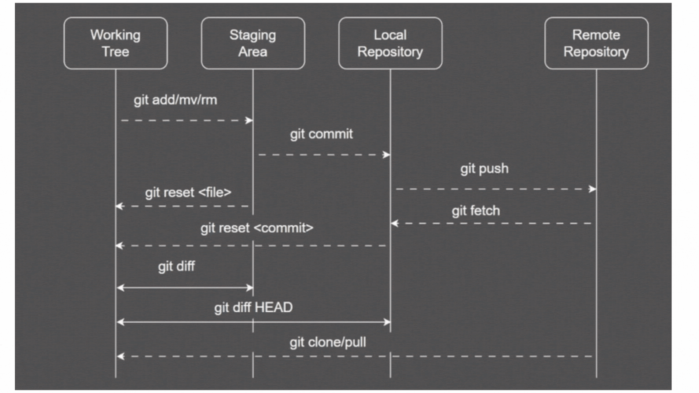
Environment Setup:
Git Architecture
Create an account in www.github.com
Download & Install git client software
https://git-scm.com/install/windows
Open Git bash and configure your username and email using the below commands.
$ git config --global user.name "your-name"
$ git config --global user.email "your-email"
Note: Configuring the username and email is a one-time process.
For every project one GitHub repository will be created.
The Repository is a place where we can store project source code/files.
Mostly project name and repo name same
2 types repositories in the GitHub.
  1. Public (Anyone one can see & you choose who can commit)
  2. Private (You choose who can see & who can commit)
Note: In real-time DevOps team is responsible for creating a github repository for a project.
When a repository is created, its URL is generated. This URL will be used by the Team members to connect with the GitHub repository.
Working Tree: This is your current workspace(project) where you are creating the files, editing the files or deleting the files.
Staging Area: A middle layer between Working Tree and Local Repository. This area is added with the files that are eligible to commit.
Local Repo: It is a place where your commits are permanently stored on the Local Machine. For each commit a unique commit id will be generated.
All this will be created when we clone the project
Central Repo: It exists on github.com, it stores the source code of all the developers at one place.

Slide 3
Git bash commands
1.git clone : It creates a copy of a central repository into local machine.
$ git clone <central_repo_url>
ex: $ git clone https://github.com/javabyshekher/Our-Bank-App.git
2. git status : Displays Working Tree status (staged & un-staged)
$ git status

Slide 4
Environment Setup:

