Slide 1
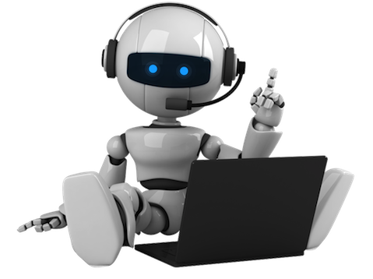

NIXZY
Virtual personal assistant
Under the Guidance of
Presented by…
Sujin .T(963519104043)
Sabin .M(963519104036)
Mrs. G . Santhiya M.E
Assistant Prof . department of CSE
Stella Mary’s College of Engineering
Aron Herso.S(963519104301)

Slide 2
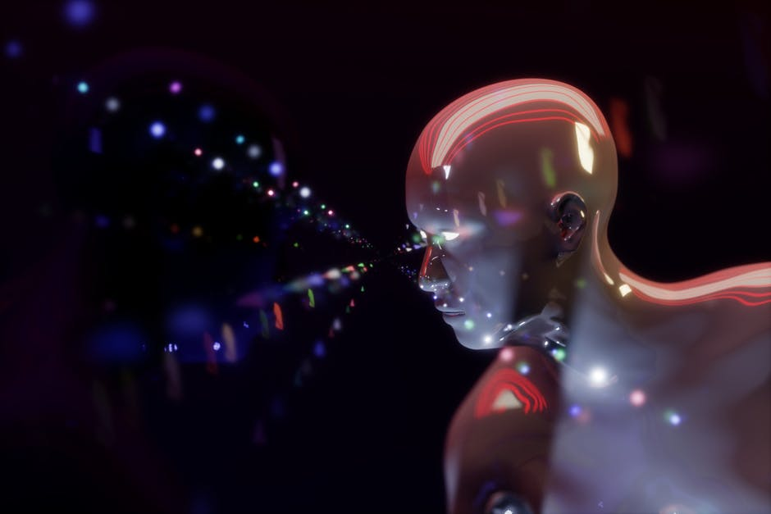
AGENDA
INTRODUCTION
EXISTING SYSTEM
PROPOSED SYSTEM
SCREENSHOTS
FUTURE ENHANCEMENT
CONCLUSION

Slide 3
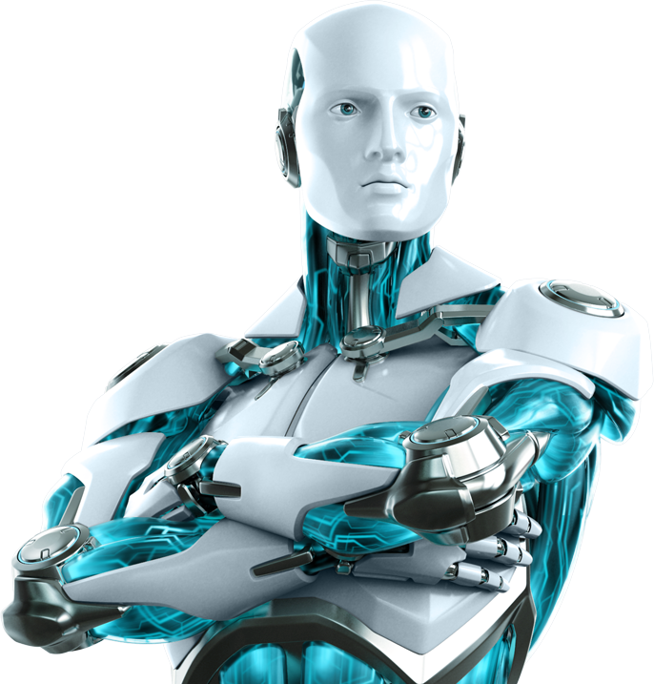
INTRODUCTION
Our world is becoming more digital, Personal assistants using advanced Artificial Intelligence are forming the bridge between the digital and human world. Offering consumers and businesses support with a wide range of tasks.
Intelligent personal assistants are an important achievement, which have become an indispensable part of the ubiquitous digitalization process.
A virtual assistant is an intelligent application that can perform tasks or provide services for a person responding to orders or inquiries .

Slide 4

EXISTING SYSTEM
There are existing Virtual assistants available on most smartphones and tablets, traditional computers, and even standalone devices like the Amazon Echo and Google Home.
Alexa is also available on more third-party speakers than Google Assistant, including the excellent Sonos one.

Slide 5
DISADVANTAGE
Cost – One of the greatest hindrances of a PDA is the expense. ...
Interruption – PDAs may likewise turn into an interruption when they're not satisfying an authentic need. ...
Restricted in Scope – PDAs are restricted in degree.

Slide 6
PROPOSED SYSTEM
NIXZY is an application that understands voice commands and completes tasks for a user.
NIXZY it still involves human relationships, emotions, values and all the complexity which this implies.
Hey Nixzy . . .

Slide 7
ADVANTAGES
Most people hire a personal assistant to gain time. We can all agree time is a limit resource,
and we never seem to have enough!
General assistants will manage all manner of day-to-day duties, such as:
Scheduling meetings
Filing paperwork
Sending emails
Running errands

Slide 8
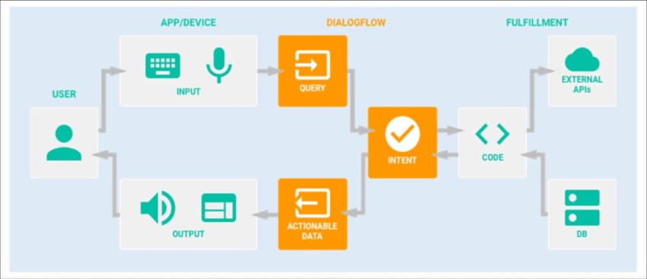
ARCHITECTURE DIAGRAM

Slide 9
SCREEN SHOTS

Slide 10

NIXZY
Listening…

Slide 11
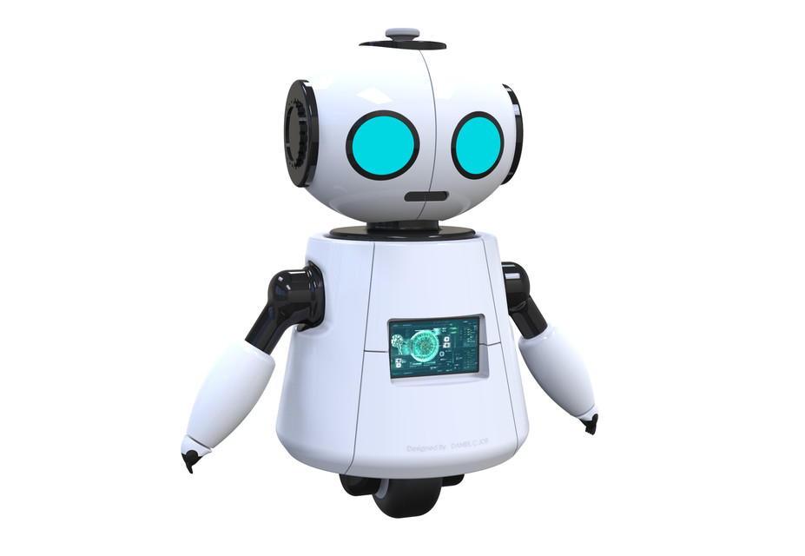

COMMUNICATION WITH NIXZY
Hai… dude
Hello... nice to meet you NIXZY

Slide 12

REQUEST AND RESPONSE FROM NIXZY
NIXZY search Something about Android mobiles
Searching…

Slide 13
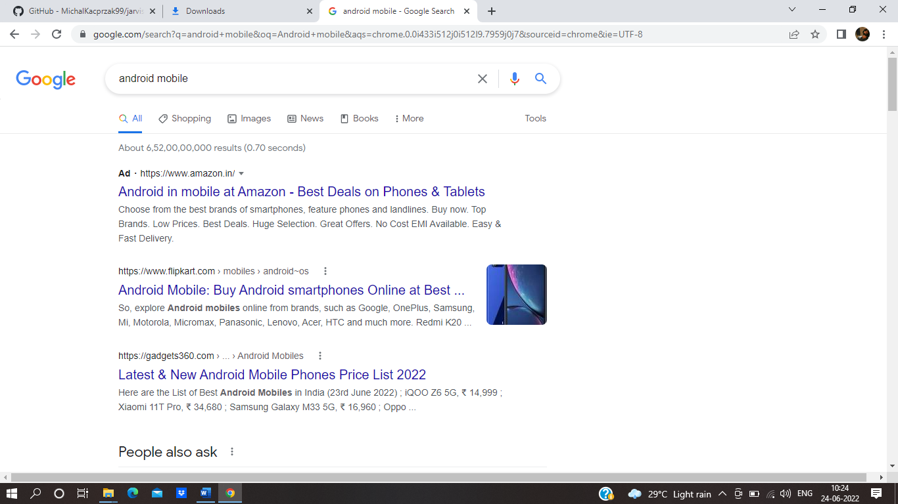
RESPONSING FROM NIXZY

Slide 14
FUTURE ENHANCEMENT
This new project is making interacting with these assistants more natural for users—not to mention much more convenient. Such devices are also expected to get better at understanding contextual factors that make conversations more efficient.
NIXZY will save time and money by doing the small tasks for you and doing them accurately and with high quality.
There are different kinds of personal assistance relationships, and neither in our research nor in any other literature can we find a single, ideal, perfect way of handling the relationship.

Slide 15
Conclusion
NIXZY will save time and money by doing the small tasks for you and doing them accurately and with high quality.
There are different kinds of personal assistance relationships, and neither in our research nor in any other literature can we find a single, ideal, perfect way of handling the relationship.
Personal assistance can be difficult, particularly if you are employing somebody for the first time but having a personal assistant like NIXZY it helps in all field.
The disabled person will be learning all sorts of new skills, as an administrator, but also as a manager of another human being.
Make this world a better place to live.

Slide 16
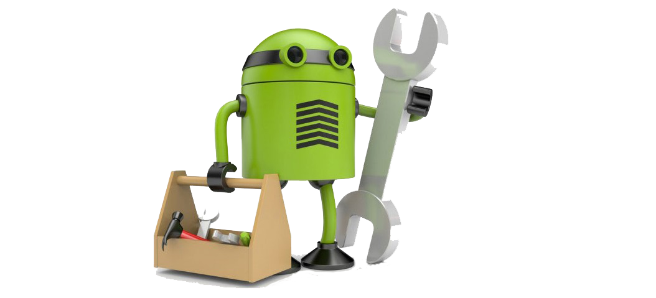
New update
Coming soon . . .
Nixzy tool parts

