Slide 1

Photodissociation Dynamics of CH₄ Using PySpawn/OpenMolcas
Deokgi Hong
Department of Materials Science and Engineering
University of Texas at Dallas

Slide 2
Contents
Photodissociation reactions of CH₄
Ab initio multiple spawning method for nonadiabatic molecular dynamics simulations
Results
Observed reactions
Electronic state population change
Branching ratio
Summary

Slide 3
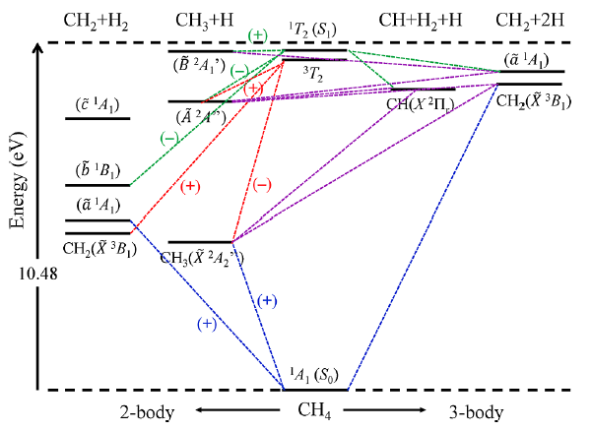
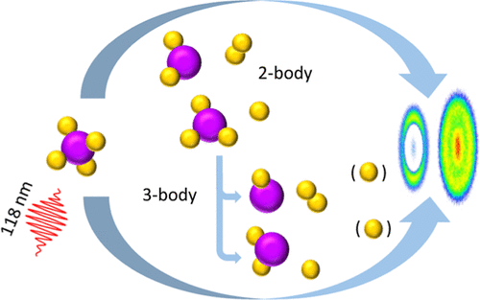
Reaction pathways of CH₄ photodissociation
J. Phys. Chem. A 128, 5273−5284 (2024)
Reaction pathways of CH₄ photodissociation have been studied.
The pathways include major 2-body reactions and minor 3-body reactions.

Slide 4
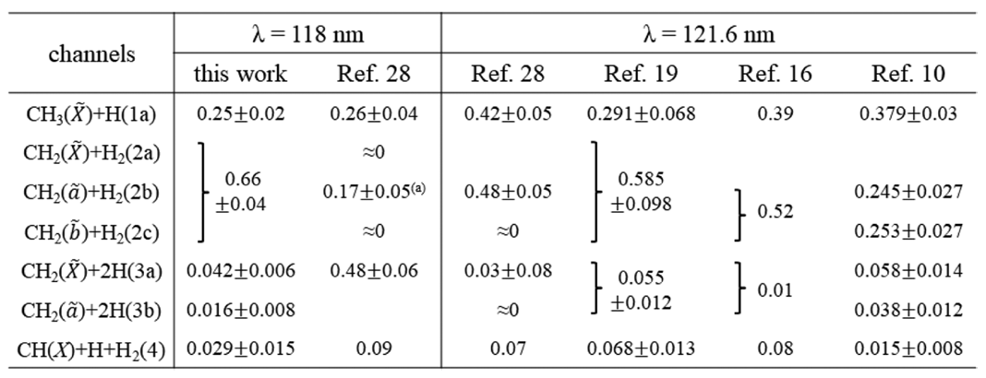
Branching ratio of CH₄ photodissociation
Two body
Three body
J. Phys. Chem. A 128, 5273−5284 (2024)
The branching ratio of CH₄ photodissociation was reported in previous experimental and computational studies.

Slide 5
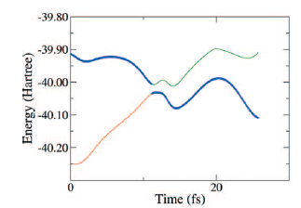
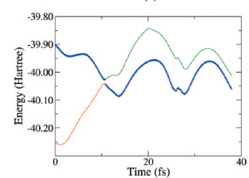
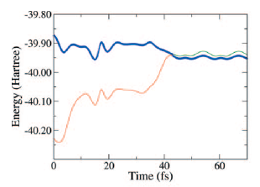
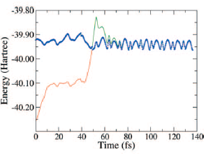
Timescale of CH₄ photodissociation
Potential energy change in NAMD with TSH (FSSH) method
CH₄ photodissociation reactions take place within tens of femtoseconds.
They do not require long simulation times.
Hence, this system is an efficient testbed for NAMD methods.
CH₃ + H
CH₂ + H₂
CH₂ + 2H
CH + H₂ + H
J. Chem. Phys. 131, 224320 (2009)

Slide 6
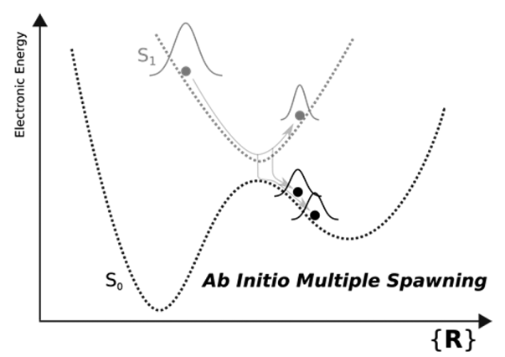
Ab initio multiple spawning (AIMS) method
Chem.Rev. 118, 3305−3336 (2018)
Multiple trajectories are spawned during a simulation.
When applying AIMS to the CH₄ photodissociation case, we can confirm that AIMS generates different reaction pathways within a single simulation.

Slide 7
Workflow
Optimize structure of CH₄ molecule using OpenMolcas
geometry.xyz, *.RasOrb
Generate hessian file
*.h5 file
Generate 40 initial conditions
geometry.xyz, INPORB, hessian.hdf5
Run NAMD simulations with PySpawn

Slide 8
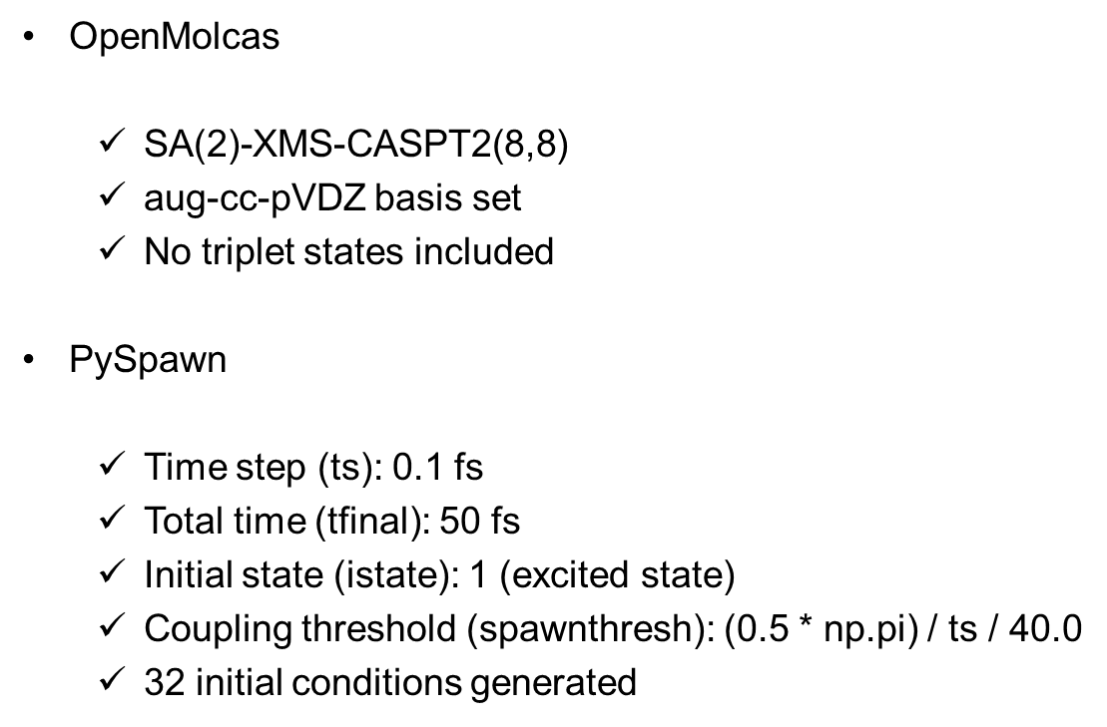
Simulation settings
OpenMolcas
$\text{SA}\text{(2)−}\text{XMS}\text{−}\text{CASPT}\text{2(8,8)}$
aug-cc-pVDZ basis set
No triplet states included
PySpawn
Time step (ts): 0.1 fs
Total time (tfinal): 50 fs
Initial state (istate): 1 (excited state)
Coupling threshold (spawnthresh): (0.5 * np.pi) / ts / 40.0
32 initial conditions generated

Slide 9
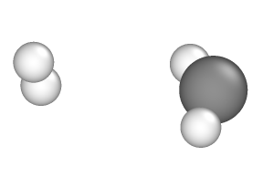
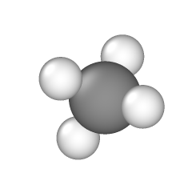
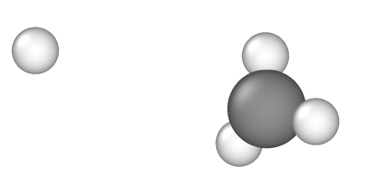
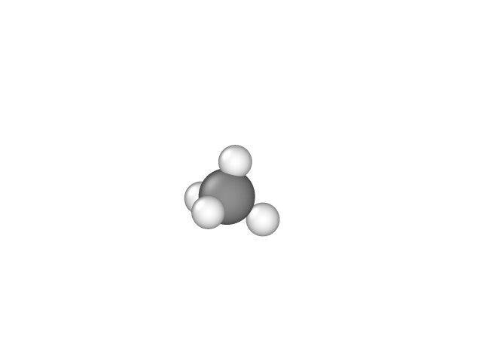
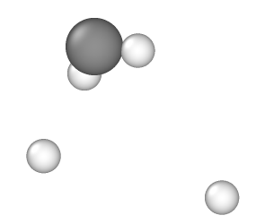
Observed reactions
CH₃ + H (initial condition #25)
CH₂ + H₂ (initial condition #3)
CH₂ + 2H (initial condition #8)
CH + H₂ + H
Not observed
Simulation time and number of initial conditions are not sufficient

Slide 10
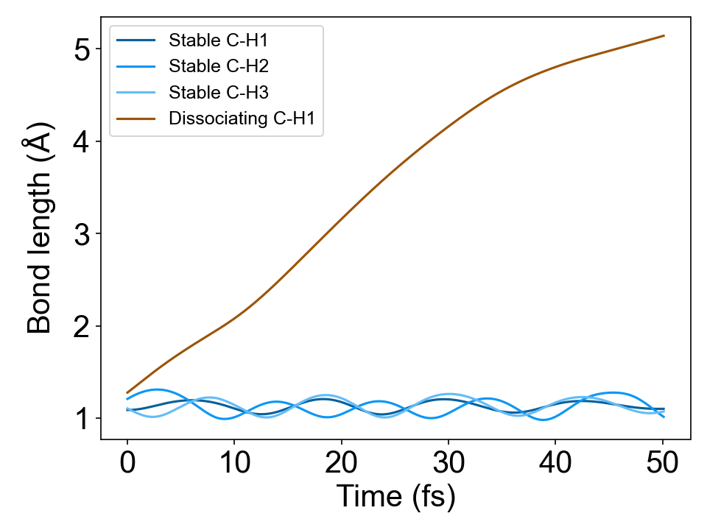
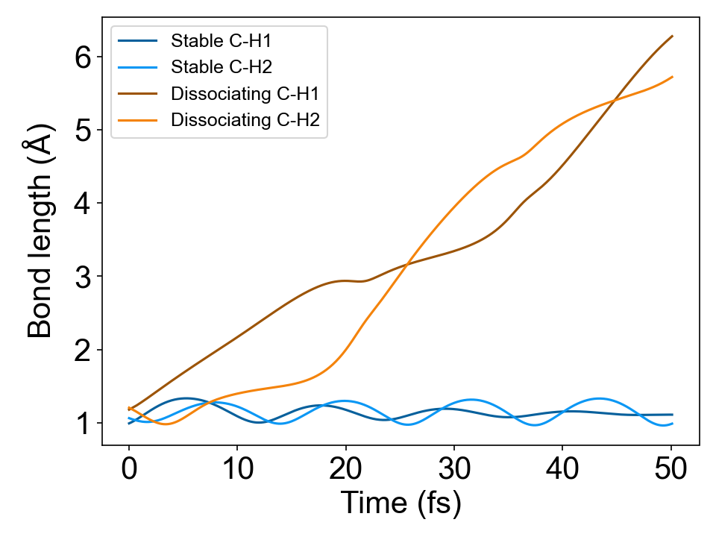
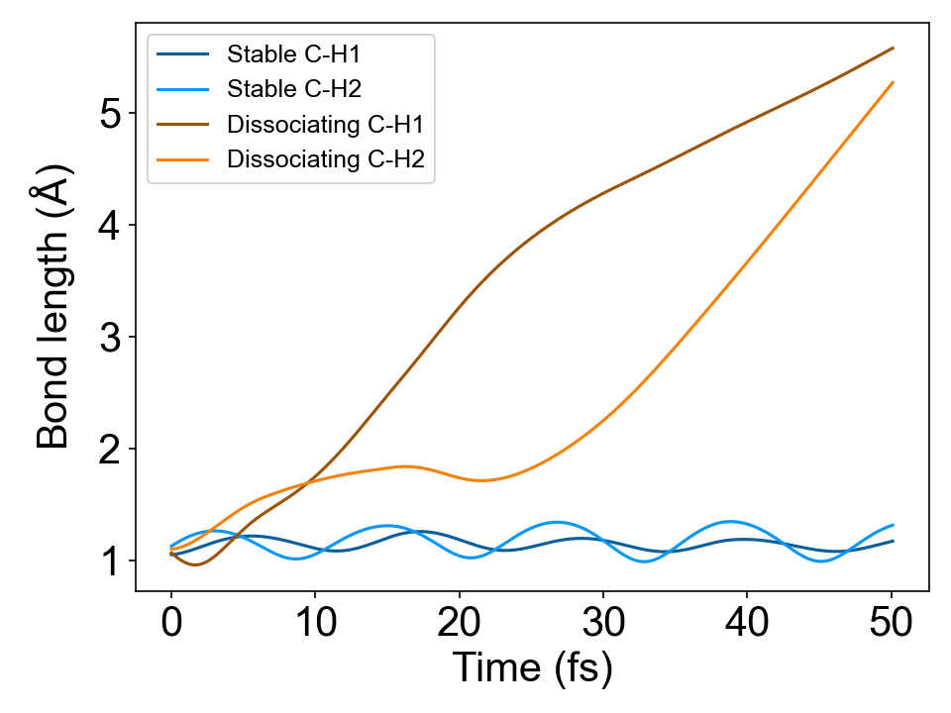
Change in C-H bond lengths
CH₃ + H (initial condition #25)
CH₂ + H₂ (initial condition #3)
CH₂ + 2H (initial condition #8)

Slide 11
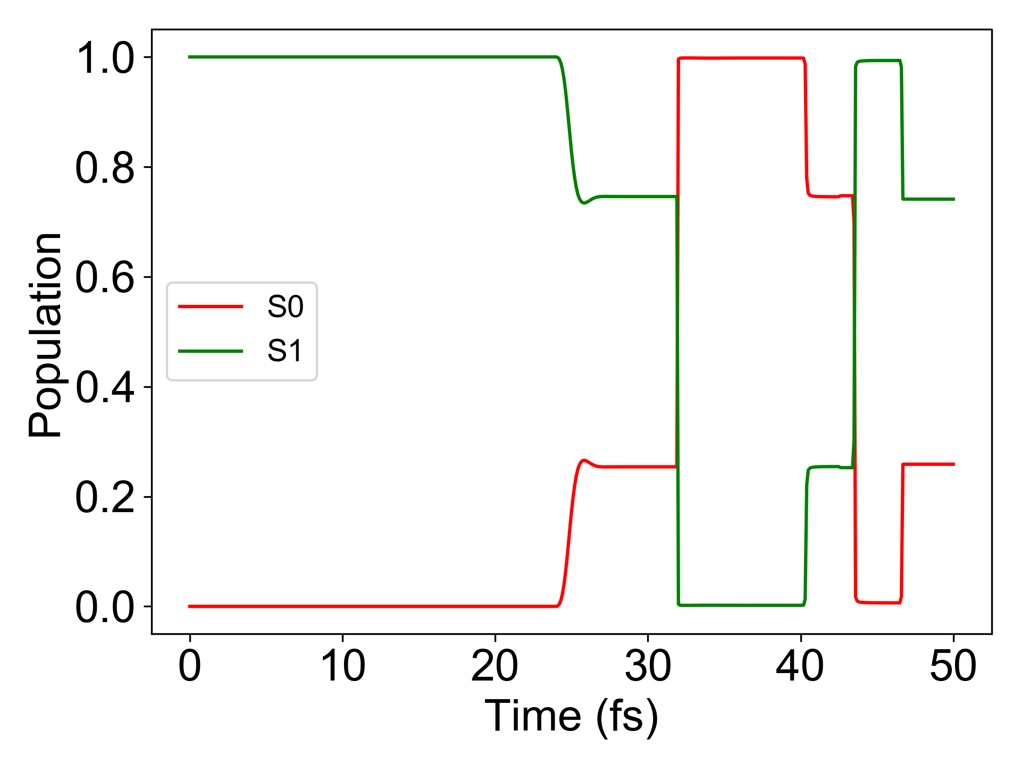
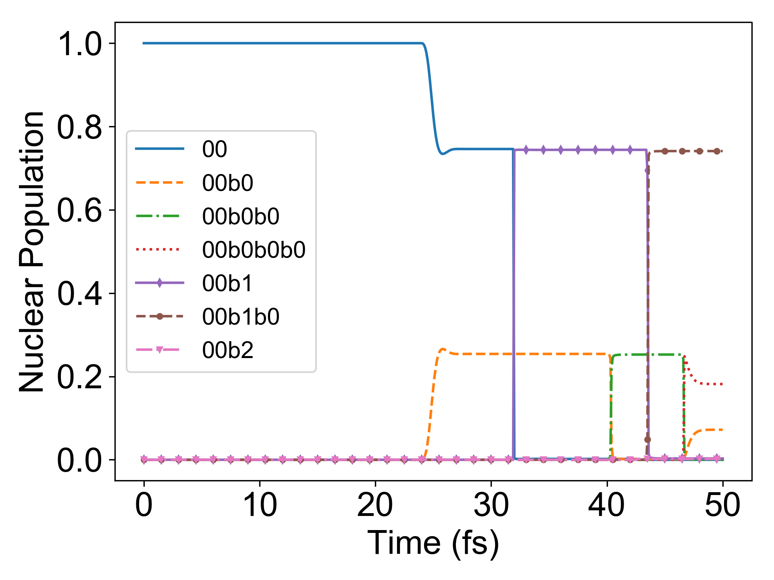
Simulation results of initial condition #32
Electronic population
Nuclear population
00: CH₂ + 2H
00b0: CH₂ + 2H
00b0b0: CH₂ + H₂
00b0b0b0: CH₂ + H₂
00b1: CH₂ + 2H
00b1b0: CH₂ + 2H
00b2: CH₂ + 2H

Slide 12
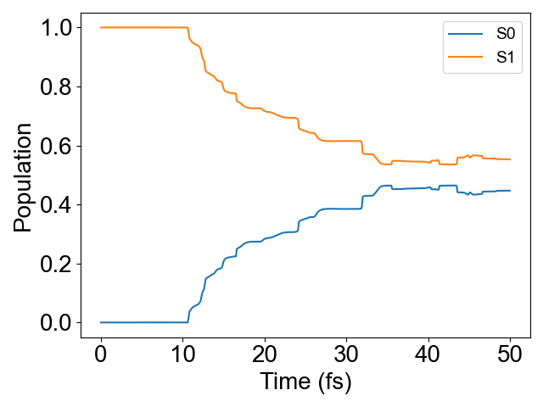
Electronic population evolution
The electronic population is averaged over all 32 simulations, showing the overall population transfer between electronic states as a function of time.

Slide 13
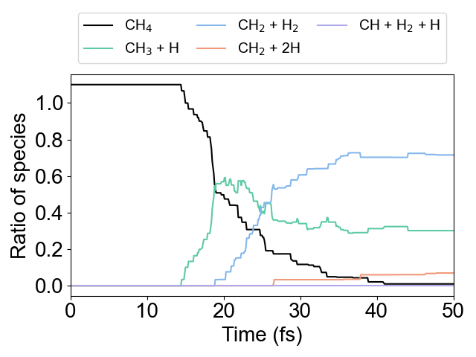
Branching ratio of different pathways
The ratio of species was calculated by considering the nuclear population of each trajectory across the 32 simulations.
 | AIMS | Ref. 1
CH₃ + H | 30% | 25%
CH₂ + H₂ | 72% | 70%
CH₂ + 2H | 7% | 6%
CH + H₂ + H | 0% | 3%
[1] J. Phys. Chem. A 128, 5273−5284 (2024)

Slide 14
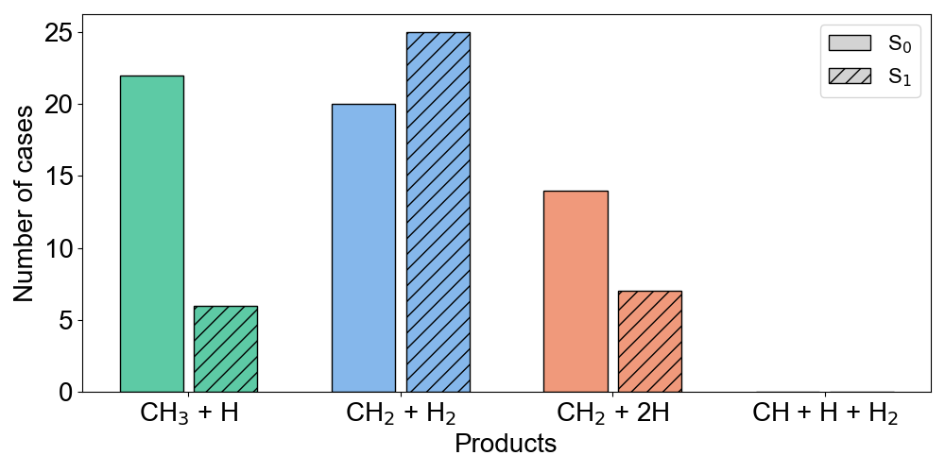
Electronic states of products
Majority of CH₃ + H was produced on ground state (internal conversion → dissociation).
CH₂ + H₂ was produced on both ground and excited state at similar ratio.
These are consistent previous study (J. Chem. Phys. 131, 224320 (2009)).

Slide 15
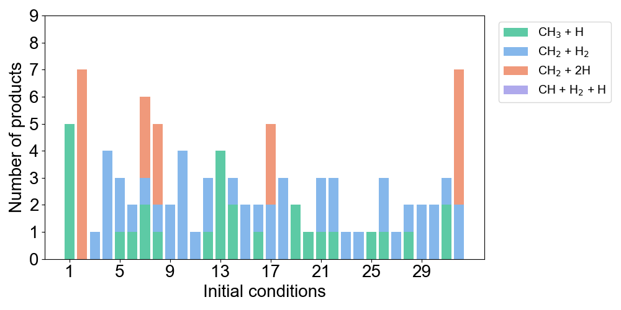
Number of observed products in each simulation
In a single simulation, up to three different dissociation pathways were observed.
In the point of view of sampling geometries for training machine learning potential for NAMD, AIMS method can be efficient way compared to TSH methods.

Slide 16
Summary
The AIMS method, using PySpawn/OpenMolcas, was applied to NAMD simulations of the CH₄ photodissociation reaction.
All 32 simulations showed branching ratios and electronic states of products similar to those from previous experimental and computational (TSH method) studies.
Within a single simulation, multiple trajectories following different reaction pathways were observed.
Hence, AIMS can be used as an efficient method for collecting training geometries for machine learning models.

