Slide 1
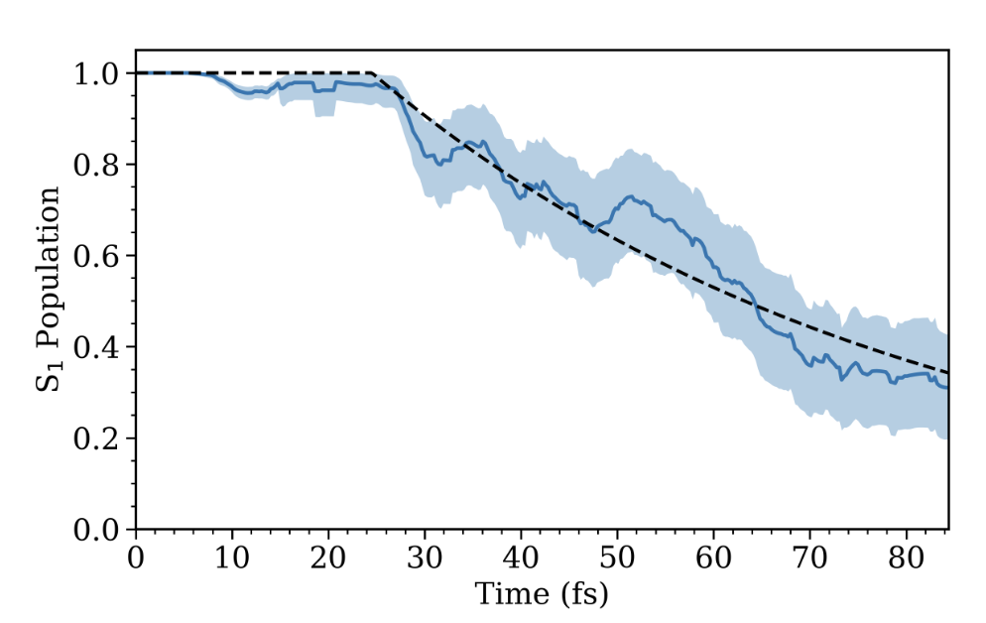
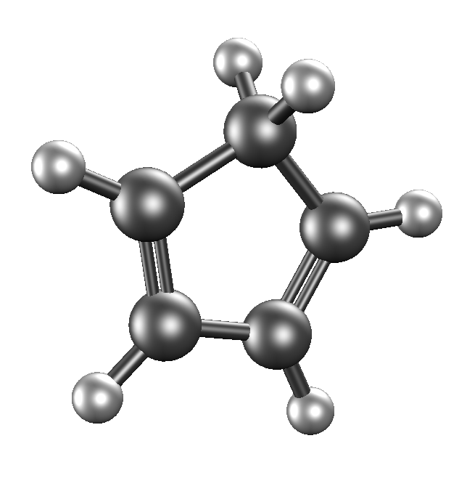
CyberTraining Workshop: Project Overview
Slater T. Bakenhaster
Kent State University
18 July 2026

Slide 2
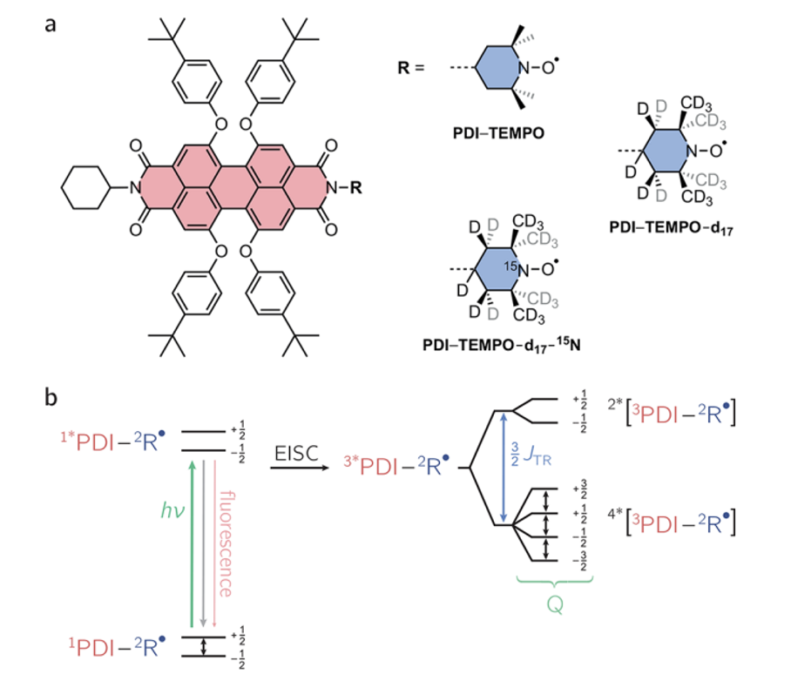
Motivation: Molecular Qubits for QIS
Example Molecular Qubit System and Relevant Electronic Energy Levels
Need:
Computational workflow to predict qubit performance
Must be “cost-effective”
Large molecules → too big for CAS-based
DFT methods → accuracy depends
Objective:
Use electronic structure software and AIMS to accurately model state population decays!
Maylander et al., JACS 2023

Slide 3


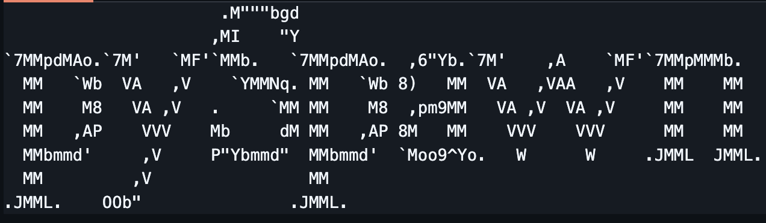
Planned Calculations
Test Molecule
Use small molecule to test efficiency
Analyze accuracy of DFT methods with different functionals
Use OpenMolcas/PySpawn to achieve population decays
Excited State Analysis!

Slide 4

Test Molecule: Cyclopentadiene
Stand-in for more complicated chromophores, nitroxides
Only C, H and 11 atoms
Calculate excited state energy levels and S1 population decay

Slide 5
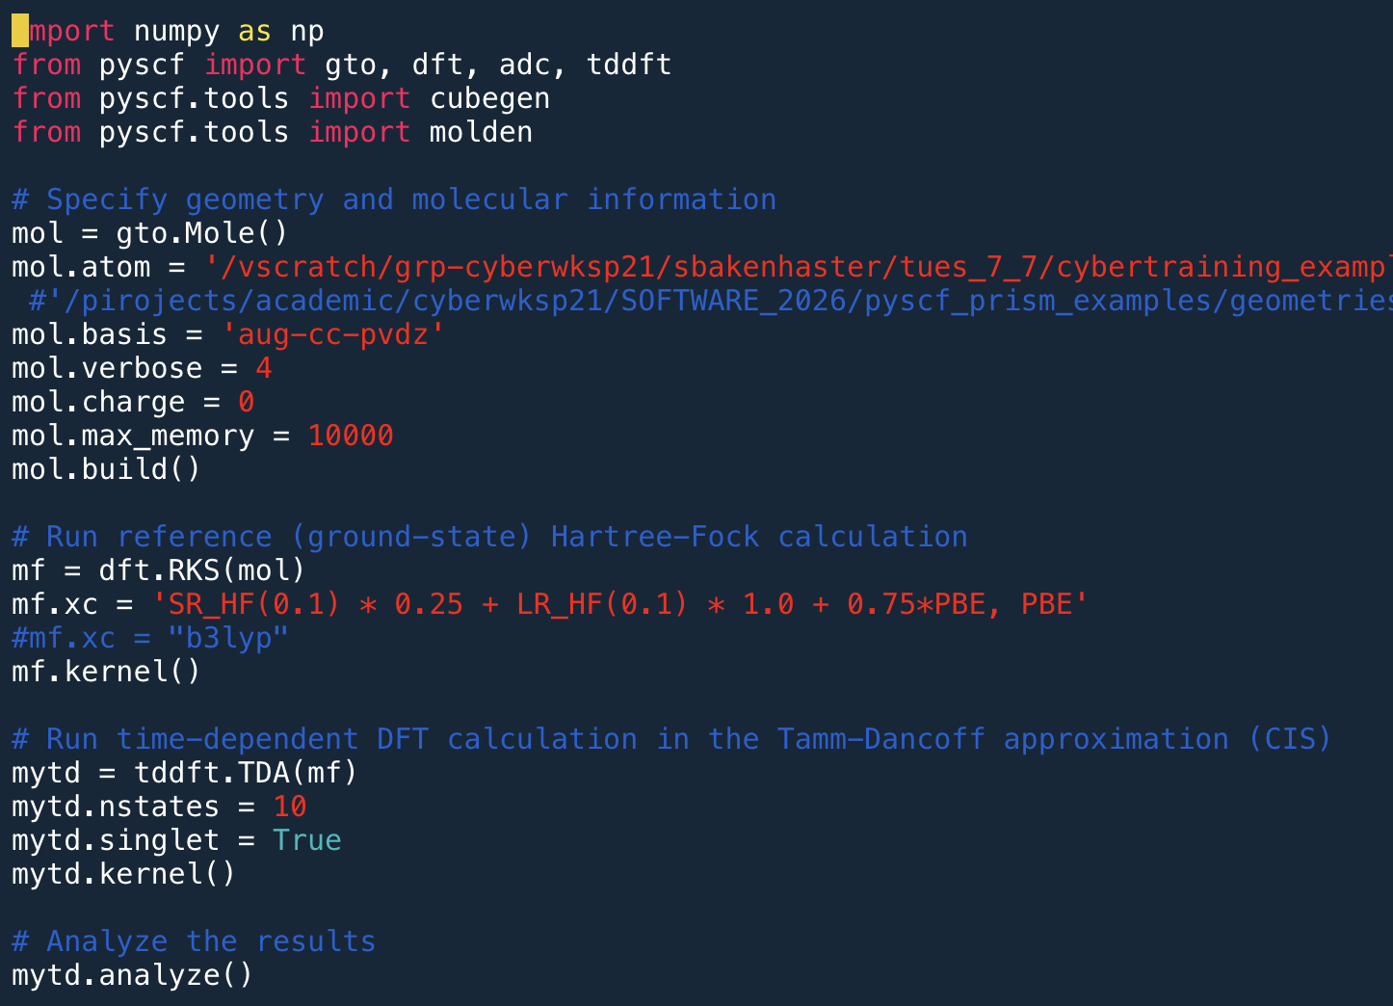
Analysis of Excitation Energies with DFT
Compared B3LYP with user-defined range-separated hybrid (RSH) functional
Partitions functional to have different fractions of exact exchange in short-range and long-range
Implementation of RSH Functional in PySCF
(Partial File)

Slide 6
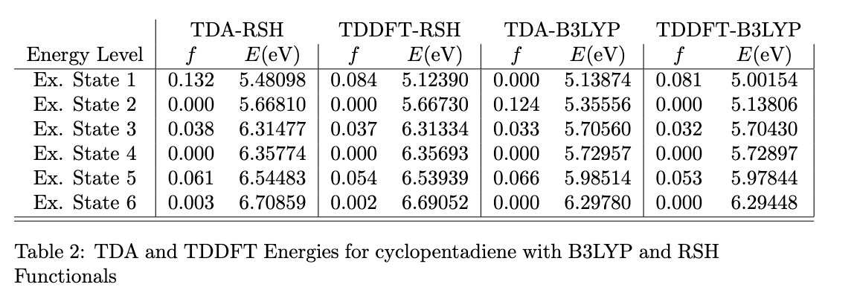
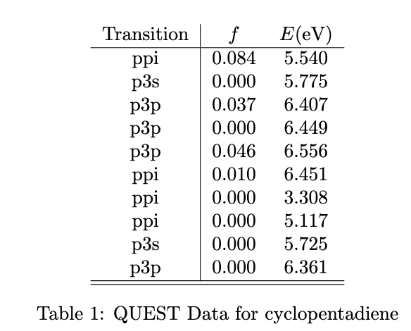
Analysis of Excitation Energies with DFT
Compared first 6 excited state energies to QUEST data set
B3LYP consistently underestimates
RSH accurately predicted both oscillator strengths and energies (~0.1 eV or less)

Slide 7
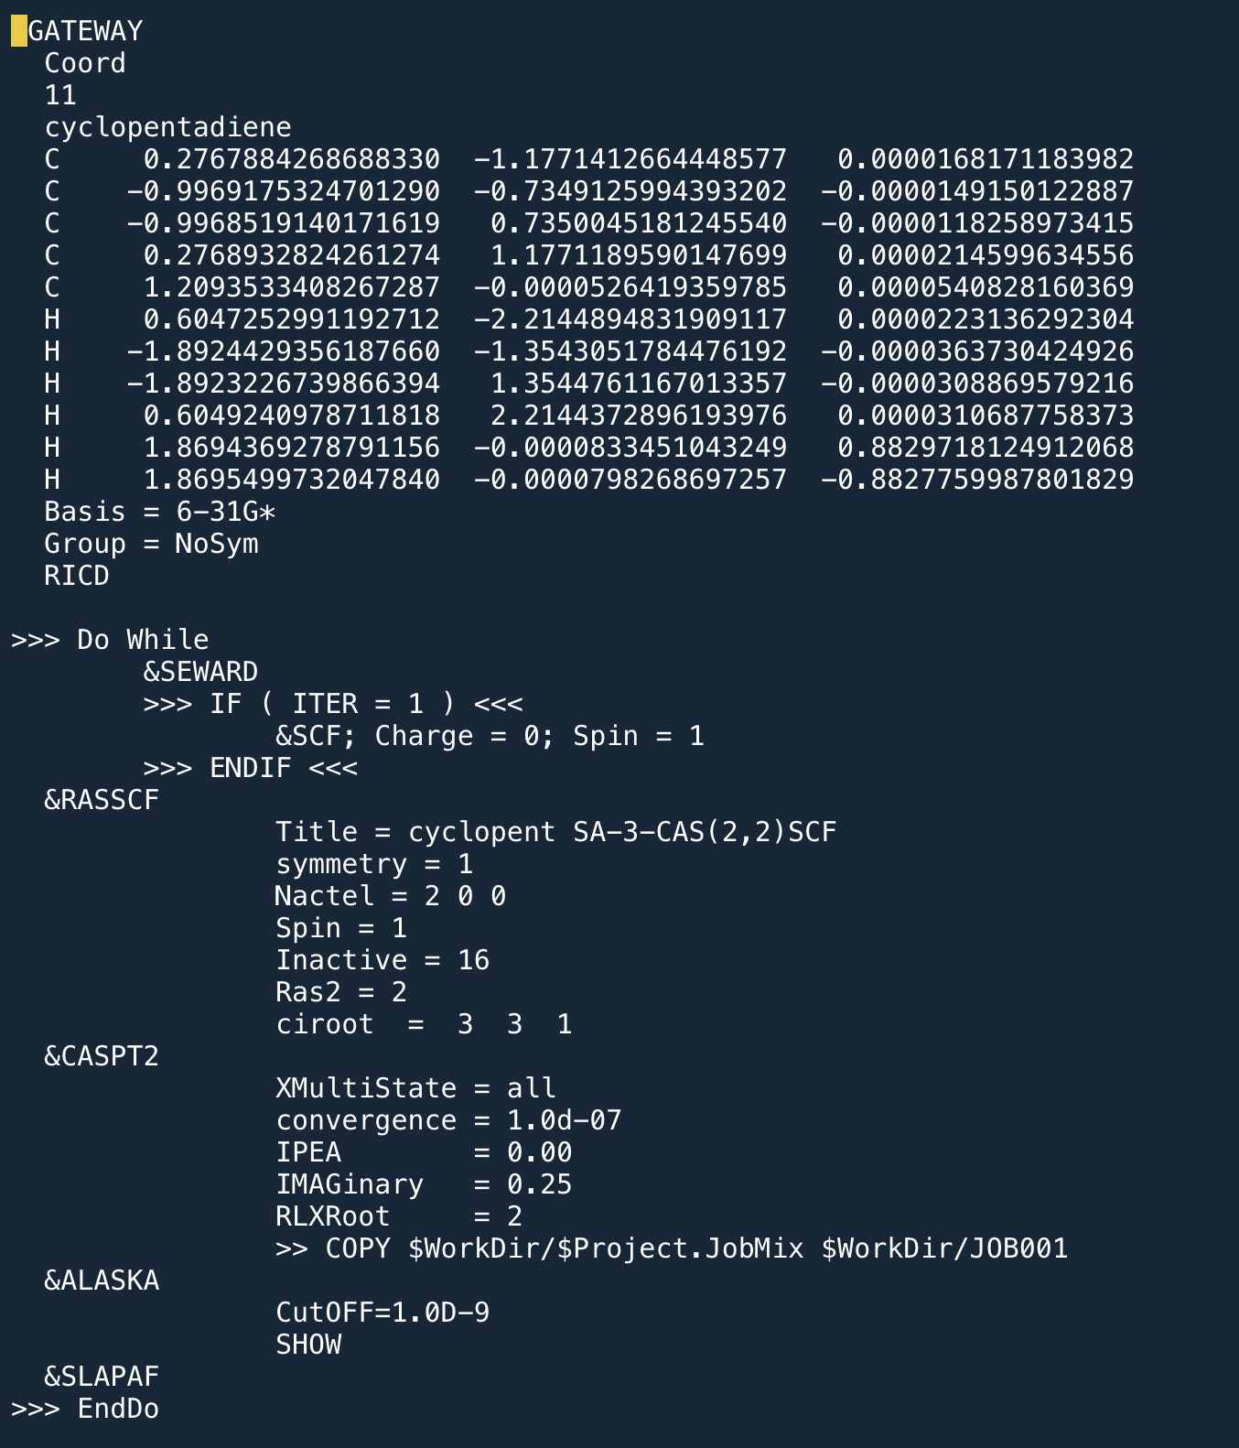
OpenMolcas/PySpawn for S1 Population Decay
Cyclopentadiene optimized on home resources
Geometry used in OpenMolcas
Adapted file from 03_S1 Tutorial
OpenMolcas Input for C₅H₆ (Partial Input)

Slide 8

PySpawn Utilization
Calculated Hessian from ORCA on home resources
Utilized script for transfer
Carried out Generate_ICs.sh script for PySpawn
S1 Population Decay Calculated

Slide 9
Preliminary Results: Concluding Remarks
Utilized PySCF and OpenMolcas to conduct high-level excited state calculations
Displayed the impact of proper functional choice on TDDFT/TDA accuracy
Performed PySpawn simulation on test system for further use in QIS studies

Slide 10
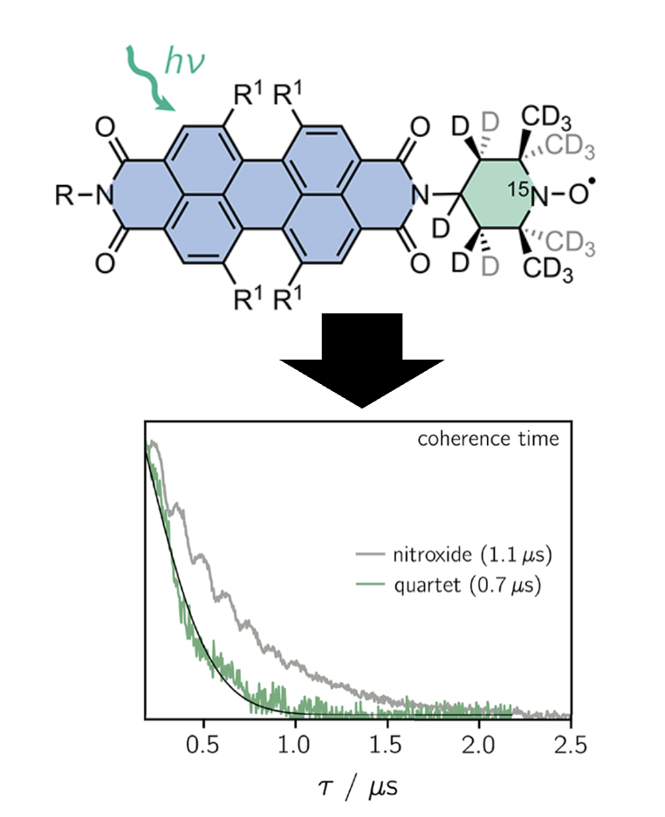

Preliminary Results: Future Plans
Connection of PySpawn to Q-Chem / ORCA software
Utilization of SRSH-PCM TDDFT methods for cost-effective, accurate excited states for AIMS
Expand to experimentally-examined qubits like PDI-derivatives, nitroxide-based
Utilization of disparate packages (i.e. TENSO) for similar computational studies
Maylander et al., JACS 2023

Slide 11
References
(1) Bonizzoni, C.; Ghirri, A.; Santanni, F.; Affronte, M. Quantum sensing of magnetic fields with molecular spins. npj Quantum Information 2024, 10 (1), 41. DOI: 10.1038/s41534-024-00838-5.
(2) Chen, Q.; Lodi, A.; Zhang, H.; Gee, A.; Wang, H. I.; Kong, F.; Clarke, M.; Edmondson, M.; Hart, J.; O’Shea, J. N.; et al. Porphyrin-fused graphene nanoribbons. Nature Chemistry 2024, 16 (7), 1133-1140. DOI: 10.1038/s41557-024-01477-1.
(3) Hou, L.; Zhang, Y.-S.; Zhang, Y.; Jiang, S.-D.; Wang, M. Tunable Quantum Coherence of Luminescent Molecular Spins Organized via Block Copolymer Self-Assembly. Advanced Quantum Technologies 2024, 7 (7), 2400064. DOI: https://doi.org/10.1002/qute.202400064 (accessed 2025/10/08).
(4) Mao, H.; Pažėra, G. J.; Young, R. M.; Krzyaniak, M. D.; Wasielewski, M. R. Quantum Gate Operations on a Spectrally Addressable Photogenerated Molecular Electron Spin-Qubit Pair. Journal of the American Chemical Society 2023, 145 (11), 6585-6593. DOI: 10.1021/jacs.3c01243.
(5) Mayländer, M.; Chen, S.; Lorenzo, E. R.; Wasielewski, M. R.; Richert, S. Exploring Photogenerated Molecular Quartet States as Spin Qubits and Qudits. Journal of the American Chemical Society 2021, 143 (18), 7050-7058. DOI: 10.1021/jacs.1c01620.
(6) Mayländer, M.; Kopp, K.; Nolden, O.; Franz, M.; Thielert, P.; Vargas Jentzsch, A.; Gilch, P.; Schiemann, O.; Richert, S. PDI–trityl dyads as photogenerated molecular spin qubit candidates. Chemical Science 2023, 14 (39), 10727-10735, 10.1039/D3SC04375D. DOI: 10.1039/D3SC04375D.
(7) Mayländer, M.; Nolden, O.; Franz, M.; Chen, S.; Bancroft, L.; Qiu, Y.; Wasielewski, M. R.; Gilch, P.; Richert, S. Accessing the triplet state of perylenediimide by radical-enhanced intersystem crossing. Chemical Science 2022, 13 (22), 6732-6743, 10.1039/D2SC01899C. DOI: 10.1039/D2SC01899C.
(8) Mayländer, M.; Thielert, P.; Quintes, T.; Vargas Jentzsch, A.; Richert, S. Room Temperature Electron Spin Coherence in Photogenerated Molecular Spin Qubit Candidates. Journal of the American Chemical Society 2023, 145 (25), 14064-14069. DOI: 10.1021/jacs.3c04021.
(9) McNamara, L. E.; Zhou, A.; Rajh, T.; Sun, L.; Anderson, J. S. Realizing solution-phase room temperature quantum coherence in a tetrathiafulvalene-based diradicaloid complex. Cell Reports Physical Science 2023, 4 (12), 101693. DOI: https://doi.org/10.1016/j.xcrp.2023.101693.
(10) Oanta, A. K.; Collins, K. A.; Evans, A. M.; Pratik, S. M.; Hall, L. A.; Strauss, M. J.; Marder, S. R.; D’Alessandro, D. M.; Rajh, T.; Freedman, D. E.; et al. Electronic Spin Qubit Candidates Arrayed within Layered Two-Dimensional Polymers. Journal of the American Chemical Society 2023, 145 (1), 689-696. DOI: 10.1021/jacs.2c11784.
(11) Qiu, Y.; Equbal, A.; Lin, C.; Huang, Y.; Brown, P. J.; Young, R. M.; Krzyaniak, M. D.; Wasielewski, M. R. Optical Spin Polarization of a Narrow-Linewidth Electron-Spin Qubit in a Chromophore/Stable-Radical System. Angewandte Chemie International Edition 2023, 62 (6), e202214668. DOI: https://doi.org/10.1002/anie.202214668 (accessed 2025/10/08).
(12) Shu, C.; Yang, Z.; Rajca, A. From Stable Radicals to Thermally Robust High-Spin Diradicals and Triradicals. Chemical Reviews 2023, 123 (20), 11954-12003. DOI: 10.1021/acs.chemrev.3c00406.
(13) Weidman, J. D.; Sajjan, M.; Mikolas, C.; Stewart, Z. J.; Pollanen, J.; Kais, S.; Wilson, A. K. Quantum computing and chemistry. Cell Reports Physical Science 2024, 5 (9), 102105. DOI: https://doi.org/10.1016/j.xcrp.2024.102105.
(14) Wu, W. Stable organic radicals – a material platform for developing molecular quantum technologies. Physical Chemistry Chemical Physics 2025, 27 (3), 1214-1221, 10.1039/D4CP02405B. DOI: 10.1039/D4CP02405B.
(15) Zhou, A.; Sun, Z.; Sun, L. Stable organic radical qubits and their applications in quantum information science. The Innovation 2024, 5 (5), 100662. DOI: https://doi.org/10.1016/j.xinn.2024.100662.

