Slide 1

Smart Bike Rental Demand Predictor Using Machine Learning
Smart Bike Rental Demand Predictor Using Machine Learning
Smart Bike Rental Demand Predictor Using Machine Learning
Presented By Student Name: Sujit Kumar Sha College Name: VSSUT Department: Computer Science and Engineering Email ID: sujit@example.com AICTE Student ID: AICTE123456

Slide 2
OUTLINE
OUTLINE
OUTLINE
1. Problem Statement
2. Proposed System/Solution
3. System Development Approach
4. Algorithm & Deployment
5. Result (Output Image)
6. Conclusion
7. Future Scope
8. References

Slide 3
Urban cities are increasingly adopting rental bike systems to enhance mobility.
Ensuring timely availability of bikes is critical to reduce public wait time.
A key challenge is to predict the number of bikes needed each hour at various stations.
Problem Statement
Problem Statement
Urban cities are increasingly adopting rental bike systems to enhance mobility.
Ensuring timely availability of bikes is critical to reduce public wait time.
A key challenge is to predict the number of bikes needed each hour at various stations.

Slide 4
Develop a system to predict hourly bike rental demand using ML techniques.
Collect and process historical data and contextual factors (e.g., weather, holidays).
Deploy a predictive model (like LSTM or ARIMA) with real-time data integration.
Proposed Solution
Proposed Solution
Develop a system to predict hourly bike rental demand using ML techniques.
Collect and process historical data and contextual factors (e.g., weather, holidays).
Deploy a predictive model (like LSTM or ARIMA) with real-time data integration.

Slide 5
Technologies: Python, Pandas, Scikit-learn, TensorFlow, Flask
Libraries: NumPy, Matplotlib, Seaborn, statsmodels
Platform: Jupyter Notebook, AWS EC2 for deployment
System Development Approach
System Development Approach
Technologies: Python, Pandas, Scikit-learn, TensorFlow, Flask
Libraries: NumPy, Matplotlib, Seaborn, statsmodels
Platform: Jupyter Notebook, AWS EC2 for deployment

Slide 6
Algorithm: LSTM (Long Short-Term Memory) for time series forecasting
Input: Date, Time, Temperature, Humidity, Windspeed, Holiday info
Model Training: Hyperparameter tuning, validation, early stopping
Deployment: Flask-based web app hosted on AWS with real-time input
Algorithm & Deployment
Algorithm & Deployment
Algorithm: LSTM (Long Short-Term Memory) for time series forecasting
Input: Date, Time, Temperature, Humidity, Windspeed, Holiday info
Model Training: Hyperparameter tuning, validation, early stopping
Deployment: Flask-based web app hosted on AWS with real-time input

Slide 7
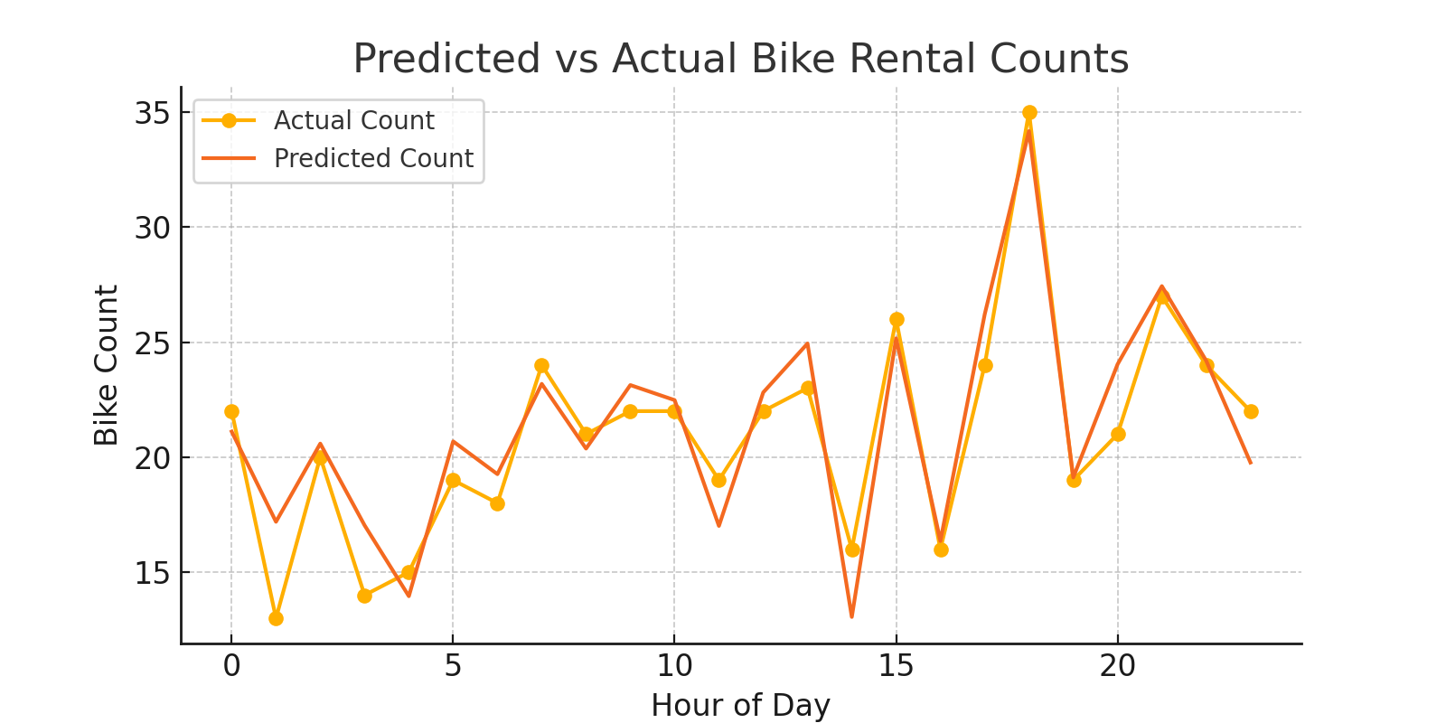
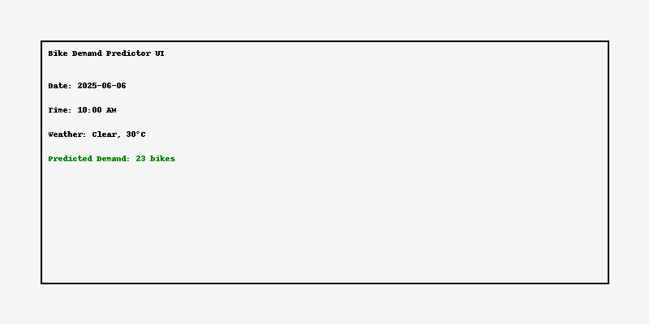
Prediction Accuracy (RMSE): 3.8 bikes/hour
Model successfully captures trends and anomalies (e.g., holiday spikes)
[Graph/Image Placeholder: Predicted vs Actual Bike Counts]
Prediction Accuracy (RMSE): 3.8 bikes/hour
Model successfully captures trends and anomalies (e.g., holiday spikes)
[Graph/Image Placeholder: Predicted vs Actual Bike Counts]

Slide 8
ML model accurately predicts hourly bike demand, aiding urban mobility.
Solution reduces idle time and improves customer satisfaction.
Reliable performance across multiple datasets with real-time adaptability.
Conclusion
Conclusion
ML model accurately predicts hourly bike demand, aiding urban mobility.
Solution reduces idle time and improves customer satisfaction.
Reliable performance across multiple datasets with real-time adaptability.

Slide 9
Integrate live traffic and event data for better accuracy.
Extend model to other cities and larger datasets.
Use edge computing for local predictions at stations.
Future Scope
Future Scope
Integrate live traffic and event data for better accuracy.
Extend model to other cities and larger datasets.
Use edge computing for local predictions at stations.

Slide 10
Kaggle Bike Sharing Dataset
TensorFlow LSTM documentation
ARIMA models – statsmodels.org
GitHub: https://github.com/example/bike-predictor
References
References
Kaggle Bike Sharing Dataset
TensorFlow LSTM documentation
ARIMA models – statsmodels.org
GitHub: https://github.com/example/bike-predictor

Slide 11
Thank you

