Slide 1
Retrieving Data Using the SQL SELECT Statement

Slide 2
Objectives
After completing this lesson, you should be able to do the following:
  List the capabilities of SQL SELECT statements
  Execute a basic SELECT statement
Notes:
Objectives
To extract data from the database, you need to use the structured query language (SQL) SELECT statement. You may need to restrict the columns that are displayed. This lesson describes all the SQL statements that are needed to perform these actions. You may want to create SELECT statements that can be used more than once.
This lesson also covers the iSQL*Plus environment in which you execute SQL statements.

Slide 3
Capabilities of SQL SELECT Statements
Projection
Selection
Table 1
Table 1
Join
Table 1
Table 2
Notes:
Capabilities of SQL SELECT Statements
A SELECT statement retrieves information from the database. With a SELECT statement, you can use the following capabilities:
Projection: Choose the columns in a table that are returned by a query. Choose as few or as many of the columns as needed
Selection: Choose the rows in a table that are returned by a query. Various criteria can be used to restrict the rows that are retrieved.
Joining: Bring together data that is stored in different tables by specifying the link between them. SQL joins are covered in more detail in a later lesson.

Slide 4
Basic SELECT Statement
SELECT *|{[DISTINCT] column|expression [alias],...}
FROM table;
  SELECT identifies the columns to be displayed
  FROM identifies the table containing those columns
Notes:
Basic SELECT Statement
In its simplest form, a SELECT statement must include the following:
A SELECT clause, which specifies the columns to be displayed
A FROM clause, which identifies the table containing the columns that are listed in the SELECT clause
In the syntax:
SELECT is a list of one or more columns
* selects all columns
DISTINCT suppresses duplicates
column|expression selects the named column or the expression
alias gives selected columns different headings
FROM table specifies the table containing the columns
Note: Throughout this course, the words keyword, clause, and statement are used as follows:
A keyword refers to an individual SQL element.
For example, SELECT and FROM are keywords.
A clause is a part of a SQL statement.
For example, SELECT employee_id, last_name, ... is a clause.
A statement is a combination of two or more clauses.
For example, SELECT * FROM employees is a SQL statement.

Slide 5
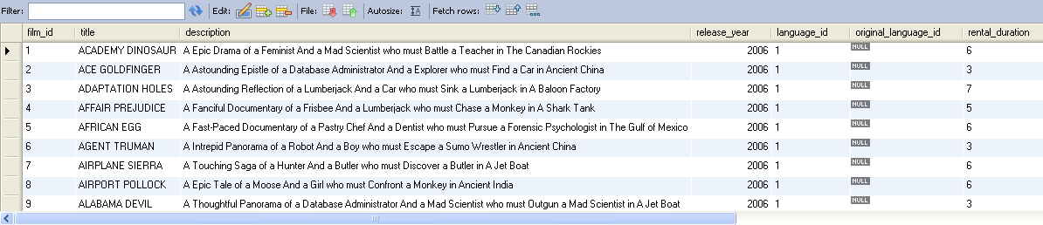
Selecting All Columns
select * from Film;
Notes:
Selecting All Columns of All Rows
You can display all columns of data in a table by following the SELECT keyword with an asterisk (*). In the example in the slide, the department table contains four columns: DEPARTMENT_ID, DEPARTMENT_NAME, MANAGER_ID, and LOCATION_ID. The table contains seven rows, one for each department.
You can also display all columns in the table by listing all the columns after the SELECT keyword. For example, the following SQL statement (like the example in the slide) displays all columns and all rows of the DEPARTMENTS table:
SELECT department_id, department_name, manager_id, location_id
FROM departments;

Slide 6
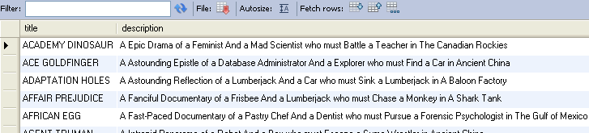
Selecting Specific Columns
select title, description
from film
Notes:
Selecting Specific Columns of All Rows
You can use the SELECT statement to display specific columns of the table by specifying the column names, separated by commas. The example in the slide displays all the department numbers and location numbers from the DEPARTMENTS table.
In the SELECT clause, specify the columns that you want, in the order in which you want them to appear in the output. For example, to display location before department number going from left to right, you use the following statement:
SELECT location_id, department_id
FROM departments;

Slide 7
Writing SQL Statements
  SQL statements are not case-sensitive.
  SQL statements can be on one or more lines.
  Keywords cannot be abbreviated or split
  across lines.
  Clauses are usually placed on separate lines.
  Indents are used to enhance readability.
Notes:
Writing SQL Statements
Using the following simple rules and guidelines, you can construct valid statements that are both easy to read and easy to edit:
SQL statements are not case-sensitive (unless indicated).
SQL statements can be entered on one or many lines.
• Keywords cannot be split across lines or abbreviated.
Clauses are usually placed on separate lines for readability and ease of editing.
• Indents should be used to make code more readable.
Keywords typically are entered in uppercase; all other words, such as table names and columns, are entered in lowercase.
Executing SQL Statements
Using iSQL*Plus, click the Execute button to run the command or commands in the editing window.
Using SQL*Plus, terminate the SQL statement with a semicolon and then press the Enter key to run the command.

Slide 8
Arithmetic Expressions
Create expressions with number and date data by using arithmetic operators.
Operator | Description
+ | Add
- | Subtract
* | Multiply
/ | Divide
Notes:
Arithmetic Expressions
You may need to modify the way in which data is displayed, or you may want to perform calculations or look at what-if scenarios. These are all possible using arithmetic expressions. An arithmetic expression can contain column names, constant numeric values, and the arithmetic operators.
Arithmetic Operators
The slide lists the arithmetic operators that are available in SQL. You can use arithmetic operators in any clause of a SQL statement (except the FROM clause).
Note: With DATE and TIMESTAMP data types, you can use the addition and subtraction operators only.

Slide 9
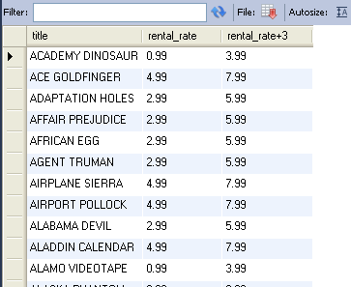
Using Arithmetic Operators
select title, rental_rate , rental_rate+3
from film
Notes:
Using Arithmetic Operators
The example in the slide uses the addition operator to calculate a salary increase of $300 for all employees. The slide also displays a SALARY+300 column in the output.
Note that the resultant calculated column SALARY+300 is not a new column in the EMPLOYEES table; it is for display only. By default, the name of a new column comes from the calculation that generated it—in this case, salary+300.
Note: The Oracle server ignores blank spaces before and after the arithmetic operator.
Operator Precedence
If an arithmetic expression contains more than one operator, multiplication and division are evaluated first. If operators in an expression are of the same priority, then evaluation is done from left to right.
You can use parentheses to force the expression that is enclosed by parentheses to be evaluated first.
Rules of Precedence:
Multiplication and division occur before addition and subtraction.
Operators of the same priority are evaluated from left to right.
Parentheses are used to override the default precedence or to clarify the statement.

Slide 10
Defining a Column Alias
A column alias:
  Renames a column heading
  Is useful with calculations
  Immediately follows the column name (There can also be the optional AS keyword between the column name and alias.)
  Requires double quotation marks if it contains spaces or special characters or if it is case-sensitive
Notes:
Column Aliases
When displaying the result of a query, iSQL*Plus normally uses the name of the selected column as the column heading. This heading may not be descriptive and hence may be difficult to understand. You can change a column heading by using a column alias.
Specify the alias after the column in the SELECT list using a space as a separator. By default, alias headings appear in uppercase. If the alias contains spaces or special characters (such as # or $), or if it is case-sensitive, enclose the alias in double quotation marks (" ").

Slide 11
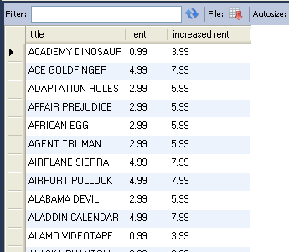
Using Column Aliases
select title, rental_rate As rent,
rental_rate+3 "increased rent“ from film
Notes:
Column Aliases (continued)
The first example displays the names and the commission percentages of all the employees. Notice that the optional AS keyword has been used before the column alias name. The result of the query is the same whether the AS keyword is used or not. Also notice that the SQL statement has the column aliases, name and comm, in lowercase, whereas the result of the query displays the column headings in uppercase. As mentioned in a previous slide, column headings appear in uppercase by default.
The second example displays the last names and annual salaries of all the employees. Because Annual Salary contains a space, it has been enclosed in double quotation marks. Notice that the column heading in the output is exactly the same as the column alias.

Slide 12

Duplicate Rows
The default display of queries is all rows, including duplicate rows.
select DISTINCT RELEASE_YEAR from film
Notes:
Duplicate Rows
Unless you indicate otherwise, iSQL*Plus displays the results of a query without eliminating duplicate rows. The first example in the slide displays all the department numbers from the EMPLOYEES table. Notice that the department numbers are repeated.
To eliminate duplicate rows in the result, include the DISTINCT keyword in the SELECT clause immediately after the SELECT keyword. In the second example in the slide, the EMPLOYEES table actually contains 20 rows, but there are only seven unique department numbers in the table.
You can specify multiple columns after the DISTINCT qualifier. The DISTINCT qualifier affects all the selected columns, and the result is every distinct combination of the columns.
SELECT DISTINCT department_id, job_id
FROM employees;

Slide 13
Summary
In this lesson, you should have learned how to:
  Write a SELECT statement that:
    Returns all rows and columns from a table
    Returns specified columns from a table
    Uses column aliases to display more descriptive column headings
SELECT *|{[DISTINCT] column|expression [alias],...}
FROM table;
Notes:
SELECT Statement
In this lesson, you should have learned how to retrieve data from a database table with the SELECT statement.
SELECT *|{[DISTINCT] column [alias],...}
FROM table;
In the syntax:
SELECT is a list of one or more columns
* selects all columns
DISTINCT suppresses duplicates
column|expression selects the named column or the expression
alias gives selected columns different headings
FROM table specifies the table containing the columns
iSQL*Plus
iSQL*Plus is an execution environment that you can use to send SQL statements to the database server and to edit and save SQL statements. Statements can be executed from the SQL prompt or from a script file.

Slide 14
Practice 1: Overview
This practice covers the following topics:
  Selecting all data from different tables
  Describing the structure of tables
  Performing arithmetic calculations and specifying column names
Notes:
Practice 1: Overview
This is the first of many practices in this course. The solutions (if you require them) can be found in Appendix A. Practices are intended to cover all topics that are presented in the corresponding lesson.
Note the following location for the lab files:
E:\labs\SQL1\labs
If you are asked to save any lab files, save them at this location.
To start ISQL*Plus, start your browser. You need to enter a URL to access iSQL*Plus. The URL requires the host name, which your instructor will provide. Enter the following command, replacing the host name with the value that your instructor provides: http://<HOSTNAME:5561>/isqlplus
In any practice, there may be exercises that are prefaced with the phrases “If you have time” or “If you want an extra challenge.” Work on these exercises only if you have completed all other exercises in the allocated time and would like a further challenge to your skills.
Perform the practices slowly and precisely. You can experiment with saving and running command files. If you have any questions at any time, ask your instructor.

