Slide 1
Restricting and Sorting Data

Slide 2
Objectives
After completing this lesson, you should be able to do the following:
  Limit the rows that are retrieved by a query
  Sort the rows that are retrieved by a query
Notes:
Objectives
When retrieving data from the database, you may need to do the following:
Restrict the rows of data that are displayed
Specify the order in which the rows are displayed
This lesson explains the SQL statements that you use to perform these actions.

Slide 3
Limiting the Rows That Are Selected
  Restrict the rows that are returned by using the WHERE clause:
  The WHERE clause follows the FROM clause.
SELECT *|{[DISTINCT] column|expression [alias],...}
FROM table
[WHERE condition(s)];
Notes:
Limiting the Rows That Are Selected
You can restrict the rows that are returned from the query by using the WHERE clause. A WHERE clause contains a condition that must be met, and it directly follows the FROM clause. If the condition is true, the row meeting the condition is returned.
In the syntax:
WHERE restricts the query to rows that meet a condition
condition is composed of column names, expressions, constants, and a comparison operator
The WHERE clause can compare values in columns, literal values, arithmetic expressions, or functions. It consists of three elements:
Column name
Comparison condition
Column name, constant, or list of values

Slide 4
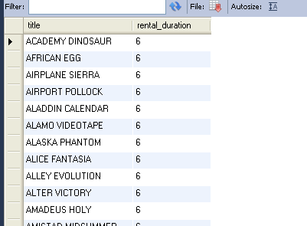
Using the WHERE Clause
select title, rental_duration from film
where rental_duration = 6;
Notes:
Using the WHERE Clause
In the example, the SELECT statement retrieves the employee ID, name, job ID, and department number of all employees who are in department 90.

Slide 5
Character Strings and Dates
  Character strings and date values are enclosed by single quotation marks.
select title, rental_duration
from film
where title = 'AFRICAN EGG'
Notes:
Character Strings and Dates
Character strings and dates in the WHERE clause must be enclosed by single quotation marks (''). Number constants, however, should not be enclosed by single quotation marks.
All character searches are case-sensitive. In the following example, no rows are returned because the EMPLOYEES table stores all the last names in mixed case:
SELECT last_name, job_id, department_id
FROM employees
WHERE last_name = 'WHALEN';
Oracle databases store dates in an internal numeric format, representing the century, year, month, day, hours, minutes, and seconds. The default date display is DD-MON-RR.
Note: For details about the RR format and about changing the default date format, see the next lesson.

Slide 6
Comparison Conditions
Operator | Meaning
= | Equal to
> | Greater than
>= | Greater than or equal to
< | Less than
<= | Less than or equal to
<> | Not equal to
BETWEEN ...AND... | Between two values (inclusive)
IN(set) | Match any of a list of values
LIKE | Match a character pattern
IS NULL | Is a null value
Notes:
Comparison Conditions
Comparison conditions are used in conditions that compare one expression to another value or expression. They are used in the WHERE clause in the following format:
Syntax
... WHERE expr operator value
Example
... WHERE hire_date = '01-JAN-95'
... WHERE salary >= 6000
... WHERE last_name = 'Smith'
An alias cannot be used in the WHERE clause.
Note: The symbols != and ^= can also represent the not equal to condition.

Slide 7
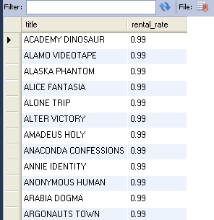
Using Comparison Conditions
select title, rental_rate
from film
where rental_rate < 1
Notes:
Using Comparison Conditions
In the example, the SELECT statement retrieves the last name and salary from the EMPLOYEES table for any employee whose salary is less than or equal to $3,000. Note that there is an explicit value supplied to the WHERE clause. The explicit value of 3000 is compared to the salary value in the SALARY column of the EMPLOYEES table.

Slide 8
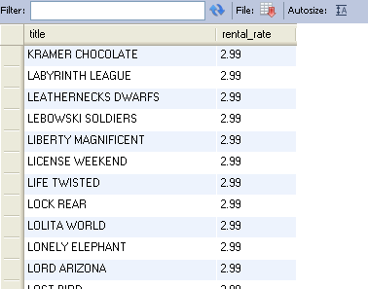
Using the BETWEEN Condition
Use the BETWEEN condition to display rows based on a range of values:
select title, rental_rate
from film
where rental_rate between 2 and 3
Lower limit
Upper limit
Notes:
Using the BETWEEN Condition
You can display rows based on a range of values using the BETWEEN range condition. The range that you specify contains a lower limit and an upper limit.
The SELECT statement in the slide returns rows from the EMPLOYEES table for any employee whose salary is between $2,500 and $3,500.
Values that are specified with the BETWEEN condition are inclusive. You must specify the lower limit first.
You can also use the BETWEEN condition on character values:
SELECT last_name
FROM employees
WHERE last_name BETWEEN 'King' AND 'Smith';

Slide 9
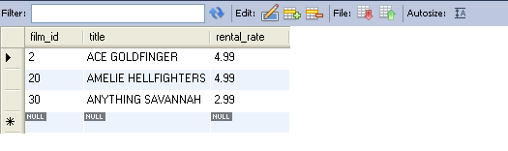
Using the IN Condition
Use the IN membership condition to test for values in a list:
select film_id , title , rental_rate from film
where film_id in (2,20,30)
Notes:
Using the IN Condition
To test for values in a specified set of values, use the IN condition. The IN condition is also known as the membership condition.
The slide example displays employee numbers, last names, salaries, and manager’s employee numbers for all the employees whose manager’s employee number is 100, 101, or 201.
The IN condition can be used with any data type. The following example returns a row from the EMPLOYEES table for any employee whose last name is included in the list of names in the WHERE clause:
SELECT employee_id, manager_id, department_id
FROM employees
WHERE last_name IN ('Hartstein', 'Vargas');
If characters or dates are used in the list, they must be enclosed by single quotation marks ('').

Slide 10
Using the LIKE Condition
  Use the LIKE condition to perform wildcard searches of valid search string values.
  Search conditions can contain either literal characters or numbers:
    % denotes zero or many characters.
    _ denotes one character.
select first_name, last_name
from actor
where first_name like 'S%'
Notes:
Using the LIKE Condition
You may not always know the exact value to search for. You can select rows that match a character pattern by using the LIKE condition. The character pattern–matching operation is referred to as a wildcard search. Two symbols can be used to construct the search string.
The SELECT statement in the slide returns the employee first name from the EMPLOYEES table for any employee whose first name begins with the letter S. Note the uppercase S. Names beginning with an s are not returned.
The LIKE condition can be used as a shortcut for some BETWEEN comparisons. The following example displays the last names and hire dates of all employees who joined between January 1995 and December 1995:
SELECT last_name, hire_date
FROM employees
WHERE hire_date LIKE '%95';

Slide 11
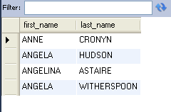
Using the LIKE Condition
  You can combine pattern-matching characters:
select first_name, last_name from actor
where first_name like '_n%'
Notes:
Combining Wildcard Characters
The % and _ symbols can be used in any combination with literal characters. The example in the slide displays the names of all employees whose last names have the letter o as the second character.
ESCAPE Option
When you need to have an exact match for the actual % and _ characters, use the ESCAPE option. This option specifies what the escape character is. If you want to search for strings that contain ‘SA_’, you can use the following SQL statement:
SELECT employee_id, last_name, job_id
FROM employees WHERE job_id LIKE '%SA\_%' ESCAPE '\';
The ESCAPE option identifies the backslash (\) as the escape character. In the pattern, the escape character precedes the underscore (_). This causes the Oracle Server to interpret the underscore literally.

Slide 12
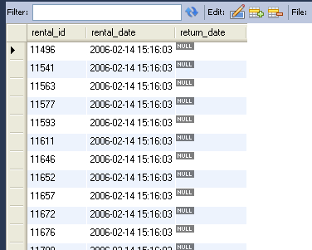
Using the NULL Conditions
Test for nulls with the IS NULL operator.
select rental_id, rental_date, return_date
from rental
where return_date is null
Notes:
Using the NULL Conditions
The NULL conditions include the IS NULL condition and the IS NOT NULL condition.
The IS NULL condition tests for nulls. A null value means the value is unavailable, unassigned, unknown, or inapplicable. Therefore, you cannot test with = because a null cannot be equal or unequal to any value. The slide example retrieves the last names and managers of all employees who do not have a manager.
Here is another example: To display last name, job ID, and commission for all employees who are not entitled to receive a commission, use the following SQL statement:
SELECT last_name, job_id, commission_pct
FROM employees
WHERE commission_pct IS NULL;
…

Slide 13
Logical Conditions
Operator | Meaning
AND | Returns TRUE if both component conditions are true
OR | Returns TRUE if either component condition is true
NOT | Returns TRUE if the following condition is false
Notes:
Logical Conditions
A logical condition combines the result of two component conditions to produce a single result based on those conditions, or it inverts the result of a single condition. A row is returned only if the overall result of the condition is true.
Three logical operators are available in SQL:
AND
OR
NOT
All the examples so far have specified only one condition in the WHERE clause. You can use several conditions in one WHERE clause using the AND and OR operators.

Slide 14
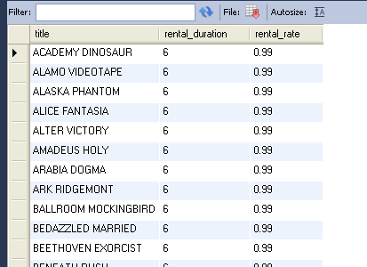
Using the AND Operator
AND requires both conditions to be true:
select title, rental_duration, rental_rate
from film
Where rental_duration =6
and rental_rate<1
Notes:
Using the AND Operator
In the example, both conditions must be true for any record to be selected. Therefore, only employees who have a job title that contains the string ‘MAN’ and earn $10,000 or more are selected.
All character searches are case-sensitive. No rows are returned if ‘MAN’ is not uppercase. Character strings must be enclosed by quotation marks.
AND Truth Table
The following table shows the results of combining two expressions with AND:

Slide 15
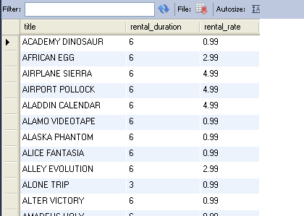
Using the OR Operator
  OR requires either condition to be true:
select title, rental_duration, rental_rate from film
Where rental_duration = 6
or rental_rate < 1
Notes:
Using the OR Operator
In the example, either condition can be true for any record to be selected. Therefore, any employee who has a job ID that contains the string ‘MAN’ or earns $10,000 or more is selected.
OR Truth Table
The following table shows the results of combining two expressions with OR:

Slide 16
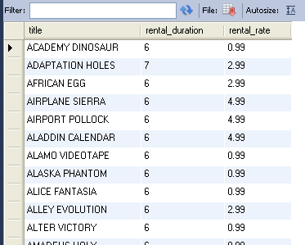
Using the NOT Operator
select title, rental_duration, rental_rate from film
where rental_duration
NOT in (3, 4, 5)
Notes:
Using the NOT Operator
The slide example displays the last name and job ID of all employees whose job ID is not IT_PROG, ST_CLERK, or SA_REP.
NOT Truth Table
The following table shows the result of applying the NOT operator to a condition:
Note: The NOT operator can also be used with other SQL operators, such as BETWEEN, LIKE, and NULL.
... WHERE job_id NOT IN ('AC_ACCOUNT', 'AD_VP')
... WHERE salary NOT BETWEEN 10000 AND 15000
... WHERE last_name NOT LIKE '%A%'
... WHERE commission_pct IS NOT NULL

Slide 17
Rules of Precedence
Operator | Meaning
1 | Arithmetic operators
2 | Concatenation operator
3 | Comparison conditions
4 | IS [NOT] NULL, LIKE, [NOT] IN
5 | [NOT] BETWEEN
6 | Not equal to
7 | NOT logical condition
8 | AND logical condition
9 | OR logical condition
You can use parentheses to override rules of precedence.
Notes:
Rules of Precedence
The rules of precedence determine the order in which expressions are evaluated and calculated. The table lists the default order of precedence. You can override the default order by using parentheses around the expressions that you want to calculate first.

Slide 18
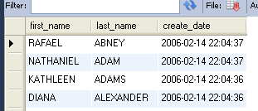
Using the ORDER BY Clause
  Sort retrieved rows with the ORDER BY clause:
    ASC: ascending order, default
    DESC: descending order
  The ORDER BY clause comes last in the SELECT statement:
select first_name, last_name, create_date
from customer
order by last_name
Notes:
Using the ORDER BY Clause
The order of rows that are returned in a query result is undefined. The ORDER BY clause can be used to sort the rows. If you use the ORDER BY clause, it must be the last clause of the SQL statement. You can specify an expression, an alias, or a column position as the sort condition.
Syntax
SELECT expr
FROM table
[WHERE condition(s)]
[ORDER BY {column, expr, numeric_position} [ASC|DESC]];
In the syntax:
ORDER BY specifies the order in which the retrieved rows are displayed
ASC orders the rows in ascending order (this is the default order)
DESC orders the rows in descending order
If the ORDER BY clause is not used, the sort order is undefined, and the Oracle server may not fetch rows in the same order for the same query twice. Use the ORDER BY clause to display the rows in a specific order.

Slide 19
Sorting
  Sorting in descending order:
  Sorting by column alias:
  Sorting by multiple columns:
select first_name, last_name, create_date
from customer
order by last_name desc
1
select title,rental_rate,rental_rate*1.1 'Incr_rate'
from film
order by Incr_rate
2
select title, rental_rate
from film
order by rental_rate, title desc
3
Notes:
Default Ordering of Data
The default sort order is ascending:
Numeric values are displayed with the lowest values first (for example, 1 to 999).
Date values are displayed with the earliest value first (for example, 01-JAN-92 before
01-JAN-95).
Character values are displayed in alphabetical order (for example, A first and Z last).
Null values are displayed last for ascending sequences and first for descending sequences.
You can sort by a column that is not in the SELECT list.
Examples
1. To reverse the order in which rows are displayed, specify the DESC keyword after the column name in the ORDER BY clause. The slide example sorts the result by the most recently hired employee.
2. You can use a column alias in the ORDER BY clause. The slide example sorts the data by annual salary.
3. You can sort query results by more than one column. The sort limit is the number of columns in the given table. In the ORDER BY clause, specify the columns and separate the column names using commas. If you want to reverse the order of a column, specify DESC after its name.

Slide 20
Summary
In this lesson, you should have learned how to:
  Use the WHERE clause to restrict rows of output:
    Use the comparison conditions
    Use the BETWEEN, IN, LIKE, and NULL conditions
    Apply the logical AND, OR, and NOT operators
  Use the ORDER BY clause to sort rows of output:
SELECT *|{[DISTINCT] column|expression [alias],...}
FROM table
[WHERE condition(s)]
[ORDER BY {column, expr, alias} [ASC|DESC]] ;
Notes:
Summary
In this lesson, you should have learned about restricting and sorting rows that are returned by the SELECT statement. You should also have learned how to implement various operators and conditions.
By using the iSQL*Plus substitution variables, you can add flexibility to your SQL statements. You can query users at run time and enable them to specify criteria.

Slide 21
Practice 2: Overview
This practice covers the following topics:
  Selecting data and changing the order of
  the rows that are displayed
  Restricting rows by using the WHERE clause
  Sorting rows by using the ORDER BY clause
Notes:
Practice 2: Overview
In this practice, you build more reports, including statements that use the WHERE clause and the ORDER BY clause. You make the SQL statements more reusable and generic by including ampersand substitution.

