Slide 1
Reporting Aggregated Data
Using the Group Functions

Slide 2
Objectives
After completing this lesson, you should be able to do the following:
  Identify the available group functions
  Describe the use of group functions
  Group data by using the GROUP BY clause
  Include or exclude grouped rows by using the HAVING clause
Notes:
Objectives
This lesson further addresses functions. It focuses on obtaining summary information (such as averages) for groups of rows. It discusses how to group rows in a table into smaller sets and how to specify search criteria for groups of rows.

Slide 3


What Are Group Functions?
Group functions operate on sets of rows to give one result per group.
EMPLOYEES
Maximum salary in EMPLOYEES table
…
Notes:
Group Functions
Unlike single-row functions, group functions operate on sets of rows to give one result per group. These sets may comprise the entire table or the table split into groups.

Slide 4
Types of Group Functions
  AVG
  COUNT
  MAX
  MIN
  STDDEV
  SUM
  VARIANCE
Group
functions
Notes:
Types of Group Functions
Each of the functions accepts an argument. The following table identifies the options that you can use in the syntax:

Slide 5
Group Functions: Syntax
SELECT [column,] group_function(column), ...
FROM table
[WHERE condition]
[GROUP BY column]
[ORDER BY column];
Notes:
Guidelines for Using Group Functions
DISTINCT makes the function consider only nonduplicate values; ALL makes it consider every value, including duplicates. The default is ALL and therefore does not need to be specified.
The data types for the functions with an expr argument may be CHAR, VARCHAR2, NUMBER, or DATE.
All group functions ignore null values. To substitute a value for null values, use the NVL, NVL2, or COALESCE functions.

Slide 6

Using the AVG and SUM Functions
You can use AVG and SUM for numeric data.
select avg(rental_rate), max(rental_rate),
min(rental_rate), sum(rental_rate)
from film
Notes:
Using the Group Functions
You can use AVG, SUM, MIN, and MAX functions against columns that can store numeric data. The example in the slide displays the average, highest, lowest, and sum of monthly salaries for all sales representatives.

Slide 7
Creating Groups of Data:
GROUP BY Clause Syntax
You can divide rows in a table into smaller groups by using the GROUP BY clause.
SELECT column, group_function(column)
FROM table
[WHERE condition]
[GROUP BY group_by_expression]
[ORDER BY column];
Notes:
GROUP BY Clause
You can use the GROUP BY clause to divide the rows in a table into groups. You can then use the group functions to return summary information for each group.
In the syntax:
group_by_expression specifies columns whose values determine the basis for
grouping rows
Guidelines
If you include a group function in a SELECT clause, you cannot select individual results as well, unless the individual column appears in the GROUP BY clause. You receive an error message if you fail to include the column list in the GROUP BY clause.
Using a WHERE clause, you can exclude rows before dividing them into groups.
You must include the columns in the GROUP BY clause.
You cannot use a column alias in the GROUP BY clause.

Slide 8
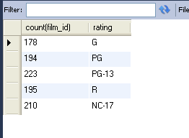
Using the GROUP BY Clause
All columns in the SELECT list that are not in group functions must be in the GROUP BY clause.
select count(film_id), rating
from film
group by rating;
Notes:
Using the GROUP BY Clause
When using the GROUP BY clause, make sure that all columns in the SELECT list that are not group functions are included in the GROUP BY clause. The example in the slide displays the department number and the average salary for each department. Here is how this SELECT statement, containing a GROUP BY clause, is evaluated:
The SELECT clause specifies the columns to be retrieved, as follows:
Department number column in the EMPLOYEES table
The average of all the salaries in the group that you specified in the GROUP BY clause
The FROM clause specifies the tables that the database must access: the EMPLOYEES table.
The WHERE clause specifies the rows to be retrieved. Because there is no WHERE clause, all rows are retrieved by default.
The GROUP BY clause specifies how the rows should be grouped. The rows are grouped by department number, so the AVG function that is applied to the salary column calculates the average salary for each department.

Slide 9
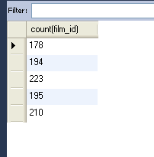
Using the GROUP BY Clause
The GROUP BY column does not have to be in the SELECT list.
select count(film_id)
from film
group by rating
Notes:
Using the GROUP BY Clause (continued)
The GROUP BY column does not have to be in the SELECT clause. For example, the SELECT statement in the slide displays the average salaries for each department without displaying the respective department numbers. Without the department numbers, however, the results do not look meaningful.
You can use the group function in the ORDER BY clause:
SELECT department_id, AVG(salary)
FROM employees
GROUP BY department_id
ORDER BY AVG(salary);

Slide 10
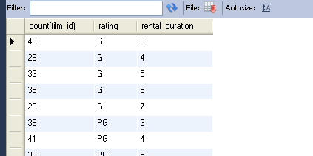
Using the GROUP BY Clause on Multiple Columns
select count(film_id), rating, rental_duration
from film
group by rating, rental_duration
Notes:
Groups Within Groups (continued)
You can return summary results for groups and subgroups by listing more than one GROUP BY column. You can determine the default sort order of the results by the order of the columns in the GROUP BY clause. In the slide example, the SELECT statement containing a GROUP BY clause is evaluated as follows:
The SELECT clause specifies the column to be retrieved:
Department number in the EMPLOYEES table
Job ID in the EMPLOYEES table
The sum of all the salaries in the group that you specified in the GROUP BY clause
The FROM clause specifies the tables that the database must access: the EMPLOYEES table.
The GROUP BY clause specifies how you must group the rows:
First, the rows are grouped by department number.
Second, the rows are grouped by job ID in the department number groups.
So the SUM function is applied to the salary column for all job IDs in each department number group.

Slide 11
Restricting Group Results with the HAVING Clause
When you use the HAVING clause
1. Rows are grouped.
  2. The group function is applied.
  3. Groups matching the HAVING clause are displayed.
SELECT column, group_function
FROM table
[WHERE condition]
[GROUP BY group_by_expression]
[HAVING group_condition]
[ORDER BY column];
Notes:
Restricting Group Results with the HAVING Clause
You use the HAVING clause to specify which groups are to be displayed, thus further restricting the groups on the basis of aggregate information.
In the syntax, group_condition restricts the groups of rows returned to those groups for which the specified condition is true.
The Oracle server performs the following steps when you use the HAVING clause:
1. Rows are grouped.
2. The group function is applied to the group.
3. The groups that match the criteria in the HAVING clause are displayed.
The HAVING clause can precede the GROUP BY clause, but it is recommended that you place the GROUP BY clause first because that is more logical. Groups are formed and group functions are calculated before the HAVING clause is applied to the groups in the SELECT list.

Slide 12
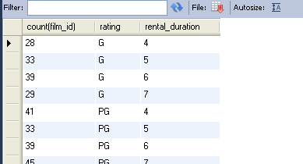
Using the HAVING Clause
select count(film_id), rating, rental_duration
from film
group by rating, rental_duration
having rental_duration > 3
Notes:
Using the HAVING Clause
The slide example displays department numbers and maximum salaries for those departments with a maximum salary that is greater than $10,000.
You can use the GROUP BY clause without using a group function in the SELECT list.
If you restrict rows based on the result of a group function, you must have a GROUP BY clause as well as the HAVING clause.
The following example displays the department numbers and average salaries for those departments with a maximum salary that is greater than $10,000:
SELECT department_id, AVG(salary)
FROM employees
GROUP BY department_id
HAVING max(salary)>10000;

Slide 13
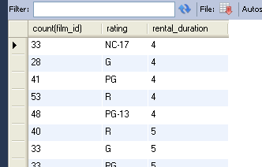
Using the HAVING Clause
select count(film_id), rating, rental_duration
from film
group by rating, rental_duration
having rental_duration > 3
order by rental_duration
Notes:
Using the HAVING Clause (continued)
The slide example displays the job ID and total monthly salary for each job that has a total payroll exceeding $13,000. The example excludes sales representatives and sorts the list by the total monthly salary.

Slide 14
Summary
In this lesson, you should have learned how to:
  Use the group functions COUNT, MAX, MIN, and AVG
  Write queries that use the GROUP BY clause
  Write queries that use the HAVING clause
SELECT column, group_function
FROM table
[WHERE condition]
[GROUP BY group_by_expression]
[HAVING group_condition]
[ORDER BY column];
Notes:
Summary
Several group functions are available in SQL, such as the following:
AVG, COUNT, MAX, MIN, SUM, STDDEV, and VARIANCE
You can create subgroups by using the GROUP BY clause. Groups can be restricted using the HAVING clause.
Place the HAVING and GROUP BY clauses after the WHERE clause in a statement. The order of the HAVING and GROUP clauses following the WHERE clause is not important. Place the ORDER BY clause last.
The Oracle server evaluates the clauses in the following order:
1. If the statement contains a WHERE clause, the server establishes the candidate rows.
2. The server identifies the groups that are specified in the GROUP BY clause.
3. The HAVING clause further restricts result groups that do not meet the group criteria in the HAVING clause.
Note: For a complete list of the group functions, see Oracle SQL Reference.

