Slide 1
KPMG VIRTUAL INTERSHIP
Sujit Kumar Rai
B Tech (CSE)

Slide 2
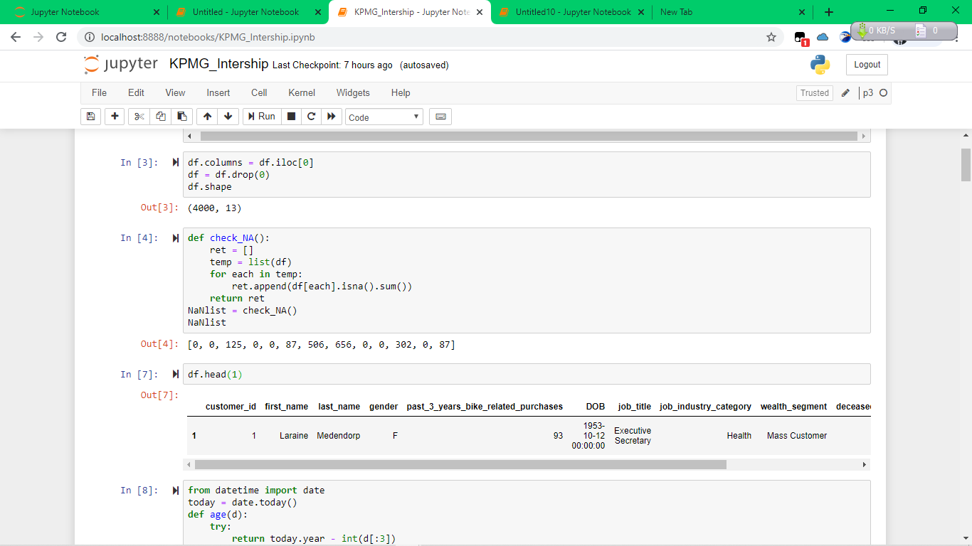
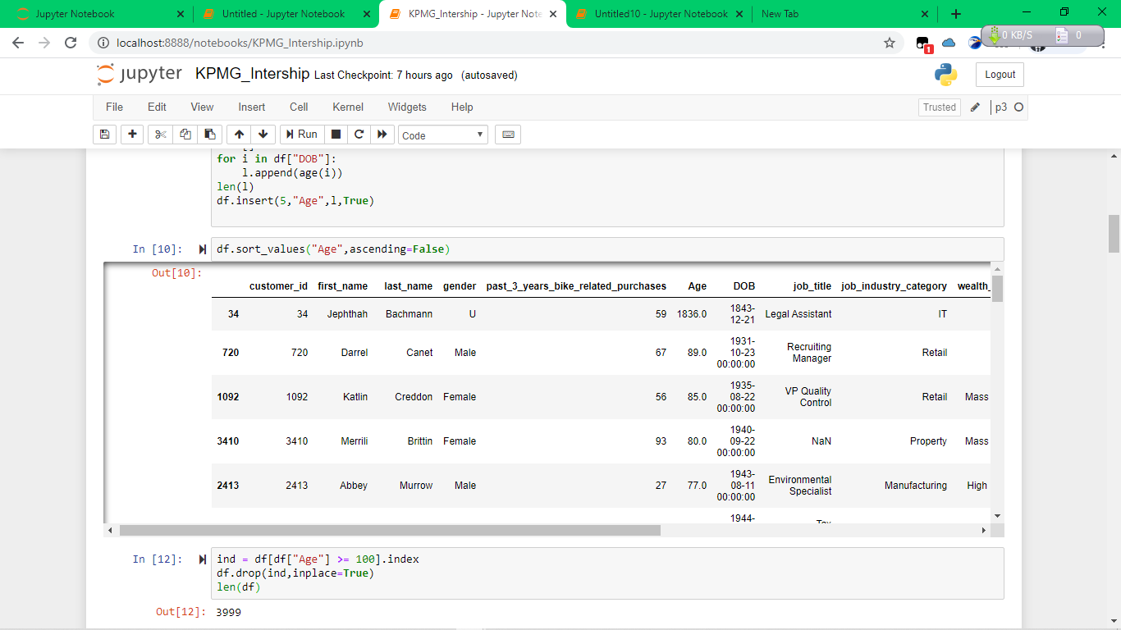
Data Cleaning
Data have many blank values which create problem in getting desired result.
Some customers have age more than possible age of a person

Slide 3
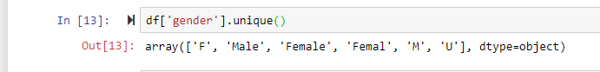
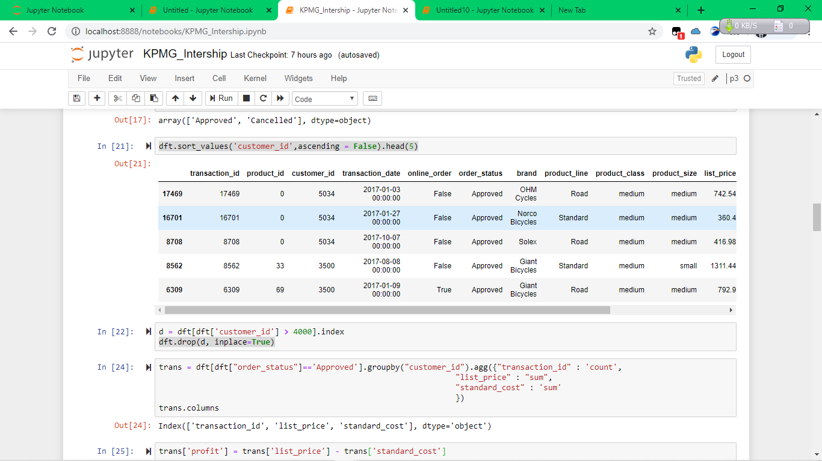
Data Cleaning
Some columns have more than one name for same value
Some rows are not usefull i.e. customer id more than 4000 in transaction sheet.

Slide 4
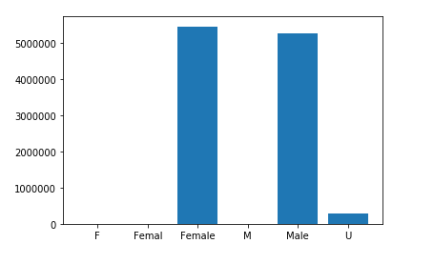
Data exploration
In this we combine all the sheet in one dataframe and find the correlation between different columns.
Females are more contributing than males and unspecified genders are neglectable i.e. graph between profit and gender shown .

Slide 5
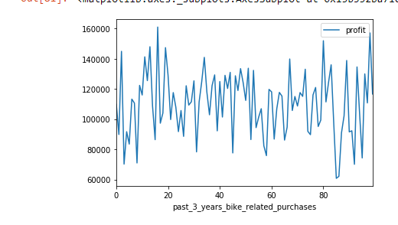
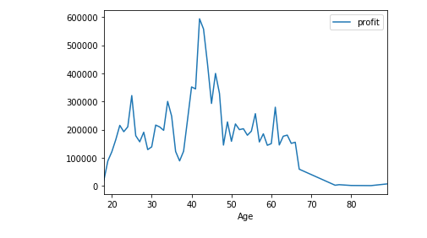
Data exploration
Person whose age between 22 to 68 are main contributor to profit.
The relation between past_3_years_bike_related_purchases column and profit are not relatable

Slide 6
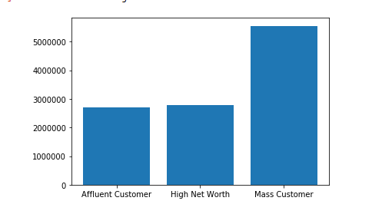
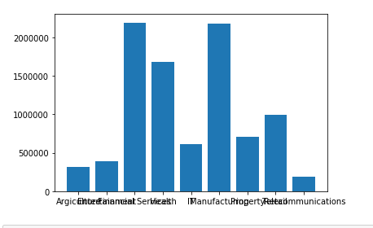
Data exploration
Financial Services, Health and Manufacturing industries category are more contributing.
Mass customer wealth segment are contributing 50 percent merely.

Slide 7
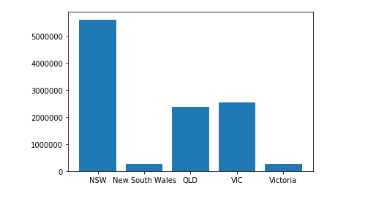
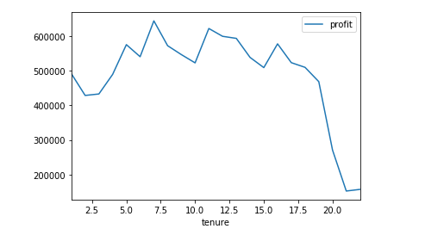
Data exploration
The persons whose tenure between 3 to 19 are more contributing.
NSW is contributing approx. 50 percent and QLD and VIC city also contributng

Slide 8
Model development
The information which we get from the previous correlations are used here to target our top customers.
We choose our customers with the help of information we gather from previous tasks.

Slide 9
Interpretation
It is easily interpreted that which age group or city or gender contributing and it helps getting our top customers.

