Slide 1
MongoDB

Slide 2

What is Data?
facts and statistics collected together for reference or analysis- Oxford Dictionary.
data” is that data is different types of information usually formatted in a particular manner.

Slide 3

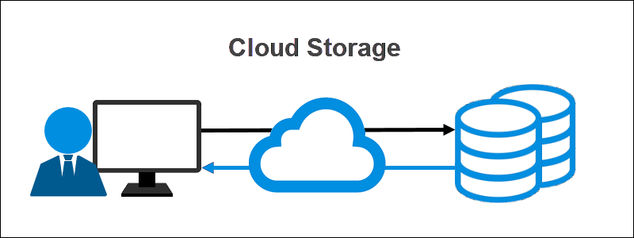
What is Data Storage
Data storage refers to magnetic, optical or mechanical media that records and preserves digital information for ongoing or future operations.- https://www.ibm.com/topics/data-storage

Slide 4
Why Data Needs to be Stored?
Collection of data is processed to extract information- report, budget report, financial projection etc.
It is needed for future reference.

Slide 5
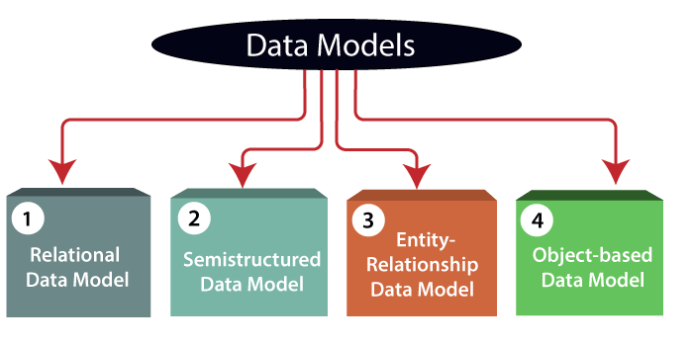
What is Data Model and Why it is Needed?
Data Model is the modeling of the data description, data semantics, and consistency constraints of the data.
It provides the conceptual tools for describing the design of a database at each level of data abstraction.

Slide 6
What is the problem with relational Model
It is not powerful, flexible and expressive enough- Hardwick and Spooner(1989).
Fragmentation. Data about the object is in different relations- Liu et al.(1996).
Performance problems due to fragmentation- Hardwick and Spooner.
Lack of powerful type system- Taylor et. al.
Poor support to data that represents graph structures. Lack of facilities for making queries based on such data including finding transitive closure-Miguel et.al.(1990),Katz(1990)
Inappropriate transaction model for the engineering systems

Slide 7
Current era of Data
Data is commodity.
Possession of data is not enough.
Data is part of Digital Economy.
Data is “new oil”.
Data is unstructured or semi-structured.
Refinement can take huge amount of time

Slide 8
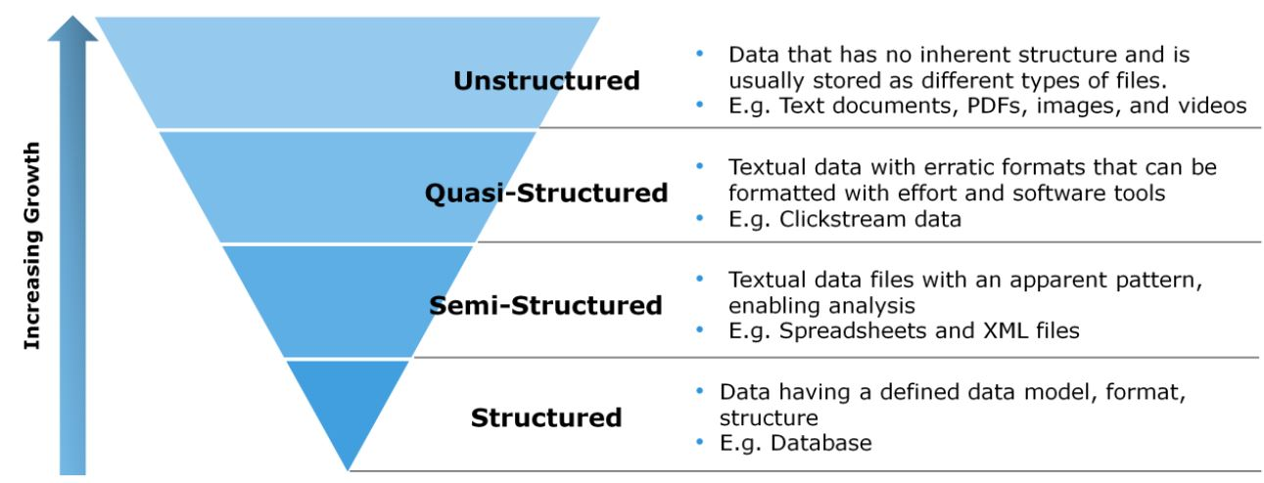
Types of Data

Slide 9
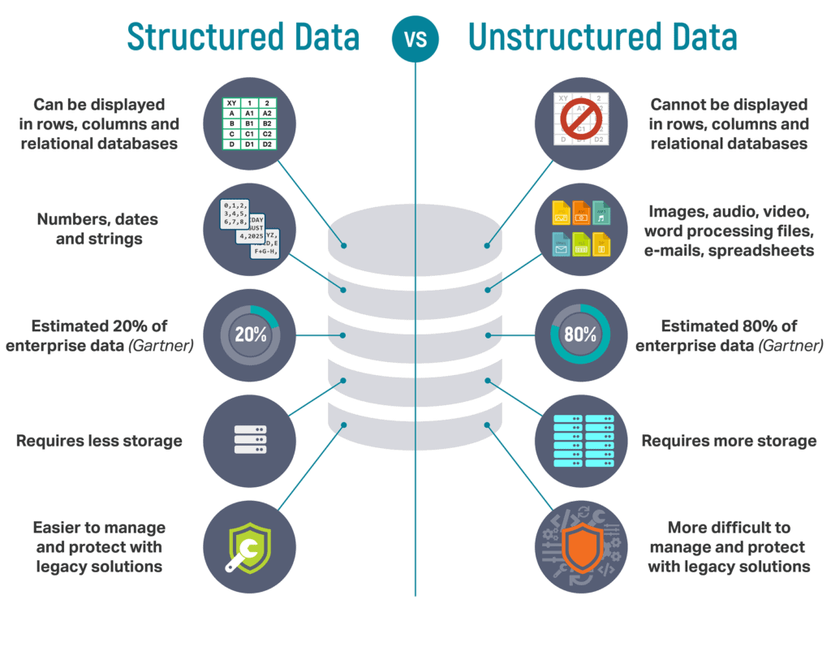
Structured Vs Unstructured data

Slide 10
Data Hierarchy
Structured Data
Rest of the Data
Semi-structured Data
Unstructured Data
Approx 80% od Data

Slide 11
Semi-structured Data
Semi structure data refers to data that is not captured or formatted in a conventional ways.
Semi structure data does not follow the format of a tabular data model or relational databases because it does not have a fixed schema.
the data is not completely raw or unstructured and does not contain some structural element such as tags and organizational metadata that make it easy at to analyze

Slide 12
Data Base
Structured Data- RDBMS
Unstructured & Semi-structured Data:
No-Sql
Mongo-DB

Slide 13
No-Sql
Stands for Not Only SQL. Term was redefined by Eric Evan after Carlos Strozzi
Class of non-relational data storage systems
Do not require a fixed table schema nor do they use the concept of joins. Class of non-relational data storage systems
Relaxation for one or more of the ACID properties using CAP theorem

Slide 14
Need for No-SQL Database
Explosion of social media sites(Facebook, Twitter, Google etc.) with large data needs.
Rise of cloud based solution such as Amazon S3 simple storage solution
Just as moving to dynamically type languages Ruby or groovy, a shift to dynamically typed data with frequent schema changes
Expansion of open source community
NoSQL solution is more acceptable to a client now then a year ago

Slide 15
NoSQl Types
NoSQL database are classified into four types :
key- value pair based
column based
document based
graph based

Slide 16
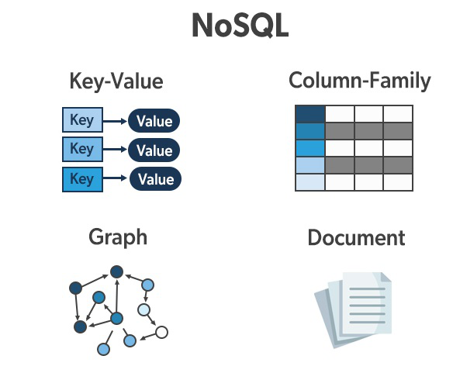
NoSQl Types

Slide 17
Introduction to MongoDB

Slide 18

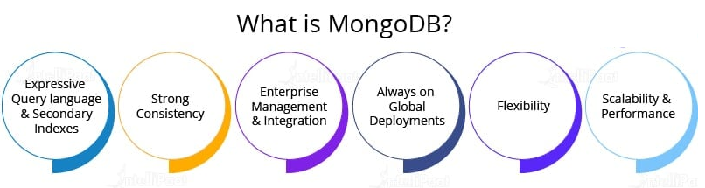
What is MongoDB
MongoDB is a NoSQL database.
It is used to store high-volume data
Around the year 2000, it came in the light.
It is written in C++ programming language,
It works on the concept of collection and documentation.
MongoDB storing data as JSON-like documents, i.e., from document to document, fields can vary.

Slide 19
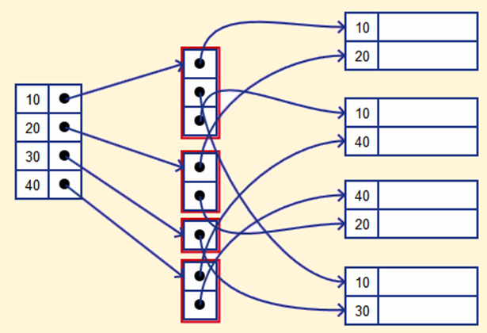
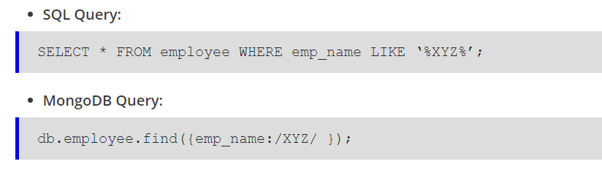
Secondary Index
Expressive Query

Slide 20
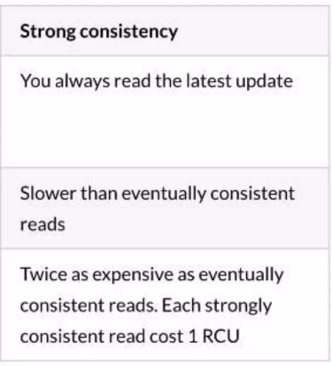

Slide 21
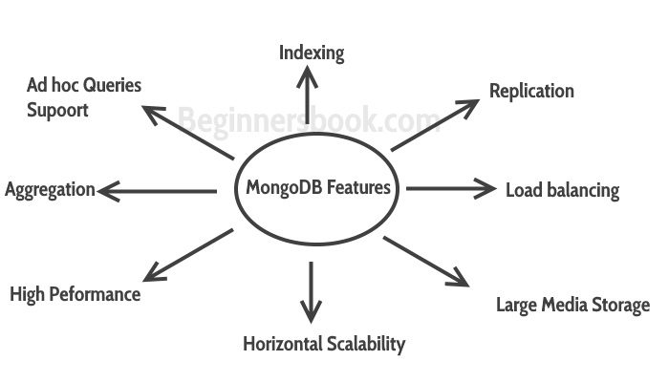
MongoDB Features

Slide 22
MongoDB Features
Aggregation: A MongoDB server has multiple databases, each of which is a physical container for collections; further, each collection is a group of documents. Now, a document is a set of key-value pairs that has a dynamic schema, i.e., all documents in a particular collection might not have the same set of fields or structure, and the common fields among documents might hold different data types.

Slide 23
MongoDB Features
Document-oriented: The document structure in it is more in line with how developers construct their classes and objects in their respective programming languages. Developers often say that the classes are not in rows and columns but have a clear structure as key-value pairs.

Slide 24
MongoDB Features
Schema-less Database: In NoSQL databases, the rows (or documents as called in it) don’t need to have a schema that is defined beforehand. It is a schema-less database written in C++. The MongoDB data modelling available in it which allows you to represent hierarchical relationships to store arrays and other more complex structures with ease.

Slide 25
MongoDB Features
Ad-hoc queries: It supports ad-hoc queries, i.e., in MongoDB, you can search by field, range query, etc. and it also supports regular expression searches.
Indexing: It shows indexes with which you can index any fields in a document.
Sharding: For horizontal scalability, it supports auto-sharding. It has an automatic load balancing configuration because it distributes data across shards in the cluster.

Slide 26
MongoDB Features
GridFS: For storing and retrieving large files, which can be images, audio, video, etc., GridFS is used in it. GridFS is a file system that only stores the files, and their data is stored within MongoDB collections. GridFS can store files greater than its document size within the limit of 16 MB.
High Performance: All the above features make it a high-performance database. These facts differentiate it from other databases and make it unique.

Slide 27
Additional Features
There are some more features of MongoDB. Let’s check out:
It uses JavaScript instead of using its own procedures.
It stores files of any size easily without complicating your stack.
It supports various data formats:
JSON data model with dynamic schemas
BSON data model, etc.

Slide 28
Why MongoDB?
These are some facts that have made MongoDB popular:
Aggregation Framework
BSON Format
Sharding
Ad-hoc Queries
Indexing

Slide 29
Aggregation Framework
Users can use the aggregation framework in a very efficient manner in it. For aggregation operations, MapReduce can be used. When large datasets process and generate results with the help of parallel and distributed algorithms on clusters, it is called MapReduce.
MapReduce itself consists of two sets of operations, which are: map() and reduce(). Let’s see what these are:
map(): Map is used to perform operations like filtering datasets and then performing sorting on those filtered datasets.
reduce(): After map() is performed, the operation of summarizing all the data is done by reduce().

Slide 30
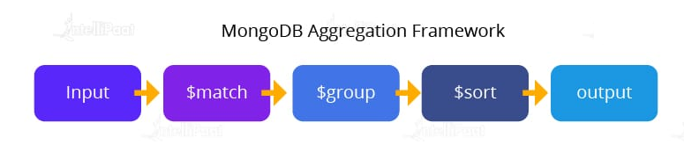
Aggregation Framework

Slide 31
BSON Format
BSON stands for Binary JSON, and it is JSON-like storage.
MongoDB uses BSON, which is a binary-encoded serialization of JSON-like documents while storing documents in collections.
As a primary key, the BSON format uses _id. As _id is used as a primary key, it should have a unique value associated with it, which is called ObjectId.
The ObjectId is either generated by the application driver or the MongoDB service.

Slide 32
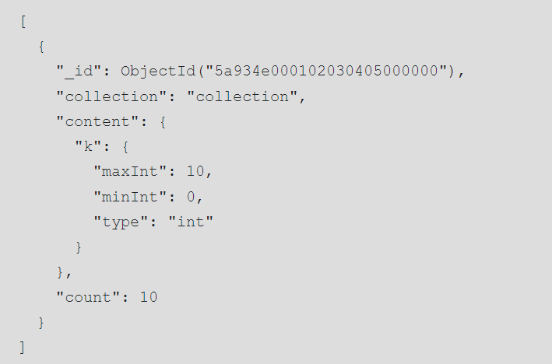
BSON Format Example

Slide 33
Sharding
The major problem with any web/mobile application is scaling.
MongoDB provides sharding that helps users with its awesome features.
Sharding is a method in which data is distributed across multiple machines.
With the help of sharding, it is able to offer horizontal scalability.

Slide 34
Sharding
Sharding is a complicated process and is done with the help of several shards.
Each shard holds some part of the data and functions as a separate database.
Merging all the shards together forms a single logical database. Operations over here are performed by query routers.

Slide 35
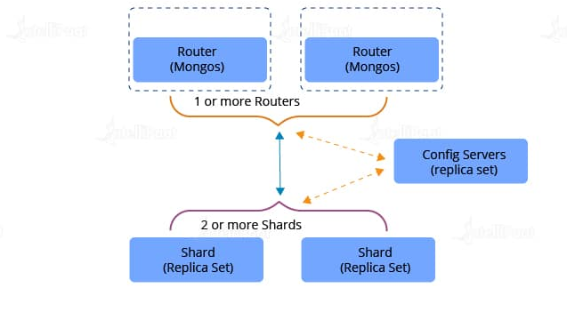
Sharding

Slide 36
Ad-hoc Queries
MongoDB supports range query, MongoDB regular expression, and many other types of searches.
The queries in it include user-defined JavaScript functions and they return specific fields from the documents.
By indexing BSON documents, it can support ad-hoc queries

Slide 37
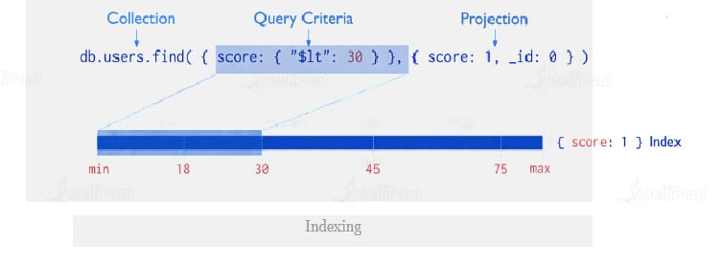
Indexing
MongoDB index is used to improve the performance of searches. Any field in a MongoDB document can be indexed as either primary or secondary. This lets the database engine to efficiently resolve the queries.

Slide 38
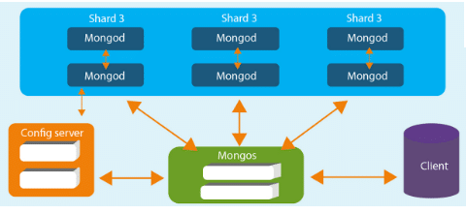
MongoDB Architecture

Slide 39
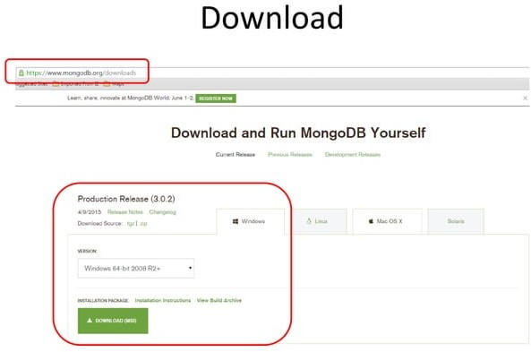
MogoDB Setup
www.mongodb.org/download

Slide 40

MogoDB Setup

Slide 41
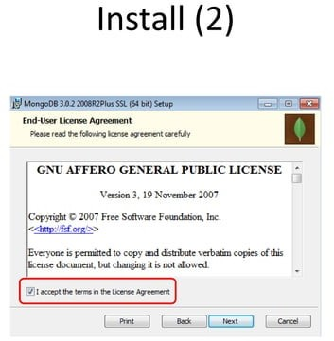
MogoDB Setup

Slide 42
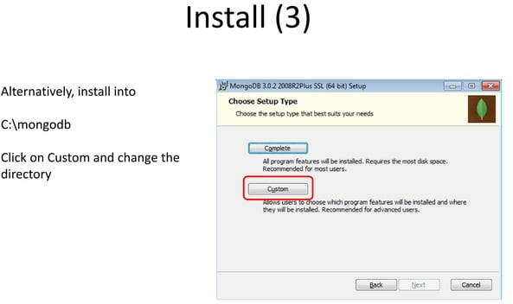
MogoDB Setup

Slide 43
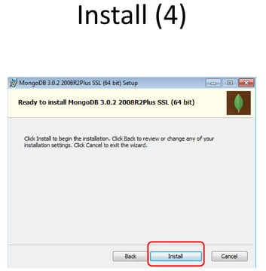
MogoDB Setup

Slide 44
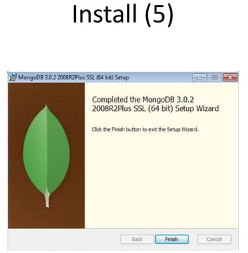
MogoDB Setup

Slide 45
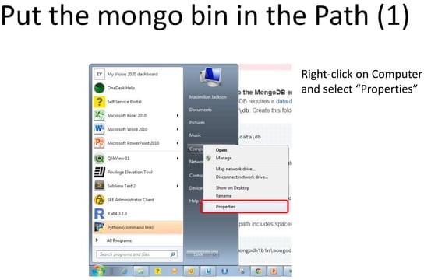
MogoDB Setup

Slide 46
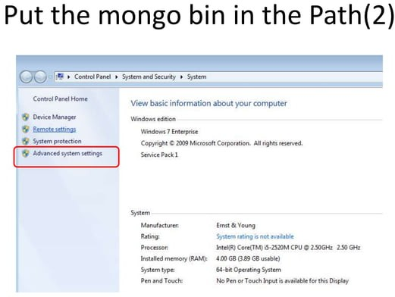
MogoDB Setup

Slide 47
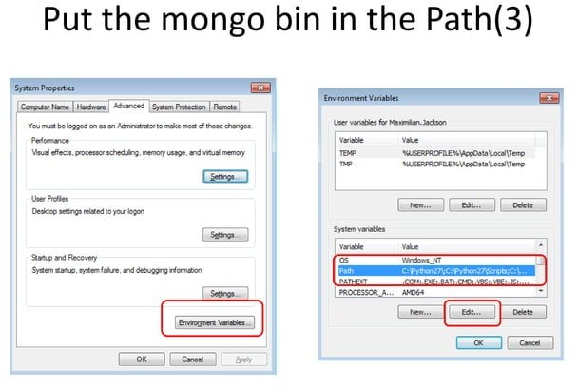
MogoDB Setup

Slide 48
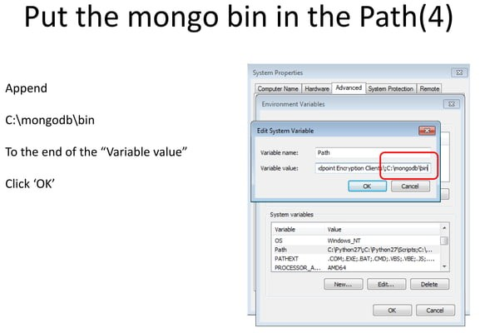
MogoDB Setup

Slide 49
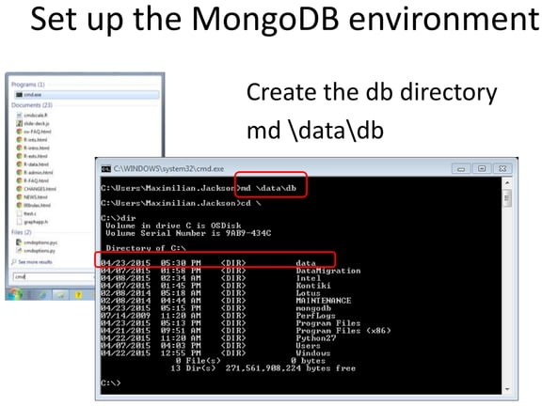
MogoDB Setup

Slide 50
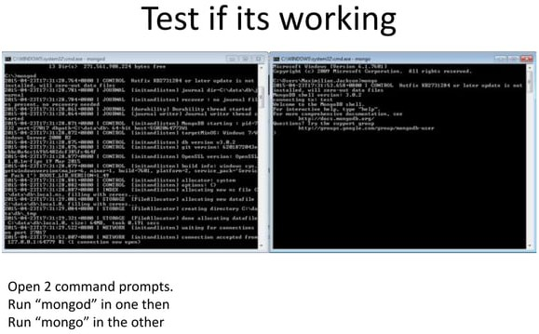
MogoDB Setup

Slide 51
MogoDB Compass Setup
Compass requires:
64-bit version of Microsoft Windows 7 or later.
MongoDB 3.6 or later.
Microsoft .NET Framework version 4.5 or later.
The Compass installer prompts you to install the minimum required version of the .NET framework if it is not already installed on your system.
Starting the installation as an administrator if you are running a silent installation using Microsoft PowerShell or installing on Azure Virtual Desktop Infrastructure (VDI).

Slide 52
MogoDB Compass Setup
Download Compass
To download Compass, you can use your preferred web browser.
Open the downloads page.
Select the installer you prefer. The MongoDB Compass installer is available as a .exe or .msi package or a .zip archive.
Download the latest version of MongoDB Compass for Windows.

Slide 53
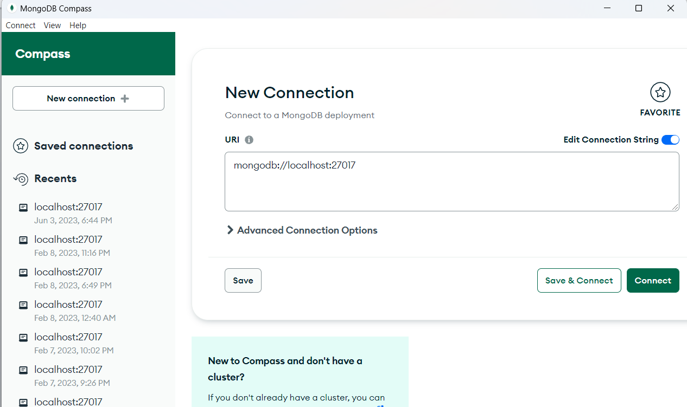
MogoDB Compass

Slide 54
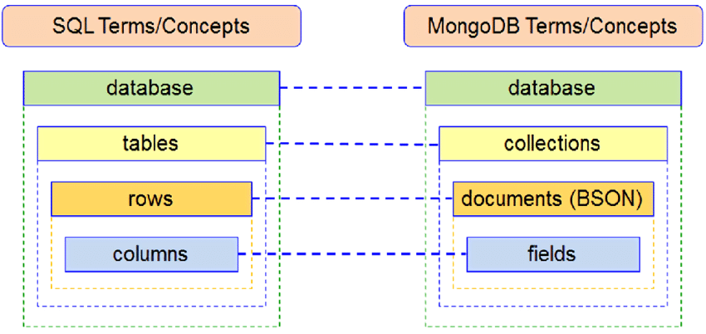
RDBMS Vs MongoDB

Slide 55
MongoDb CRUD Operation
Go to mongodb shell
To create a database we need write:
use <database name>
Example:
use new_db
It will create a database and a new propmt will be created with database name:
new_db>

Slide 56
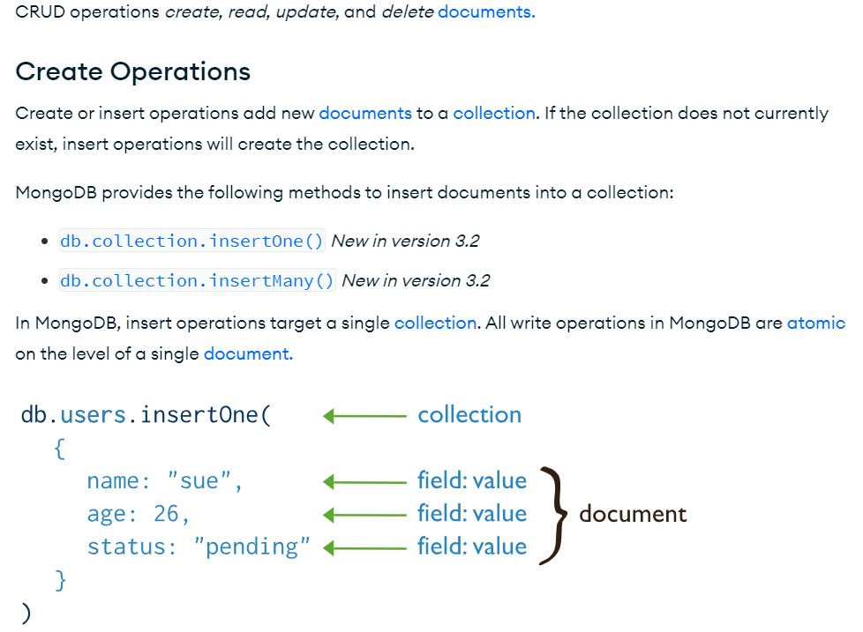

MongoDb CRUD Operation

Slide 57
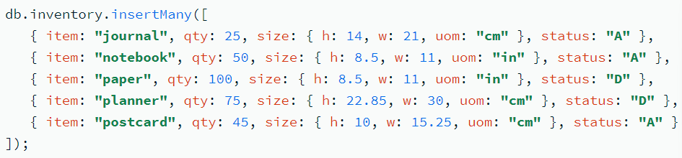
MongoDb CRUD Operation
Example for insertmany

Slide 58
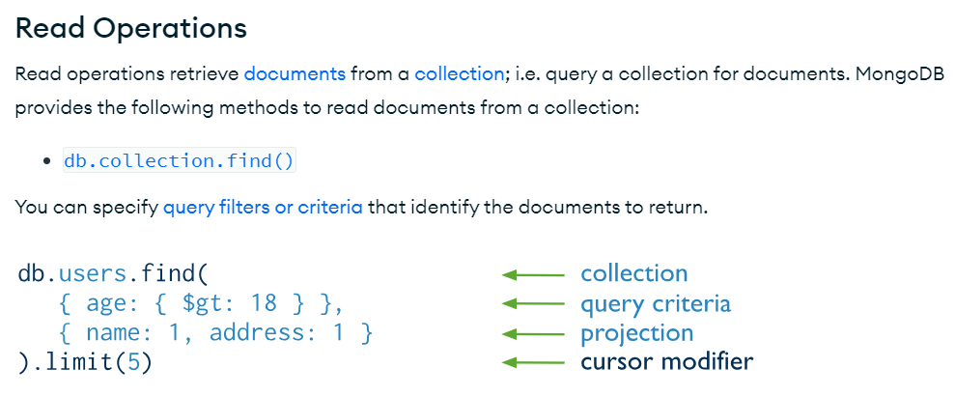
MongoDb CRUD Operation

Slide 59
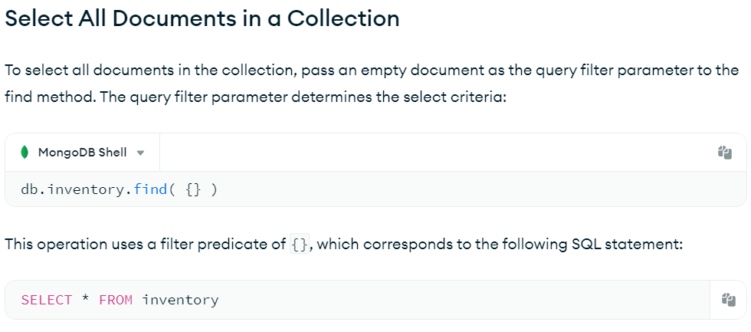
MongoDb CRUD Operation

Slide 60
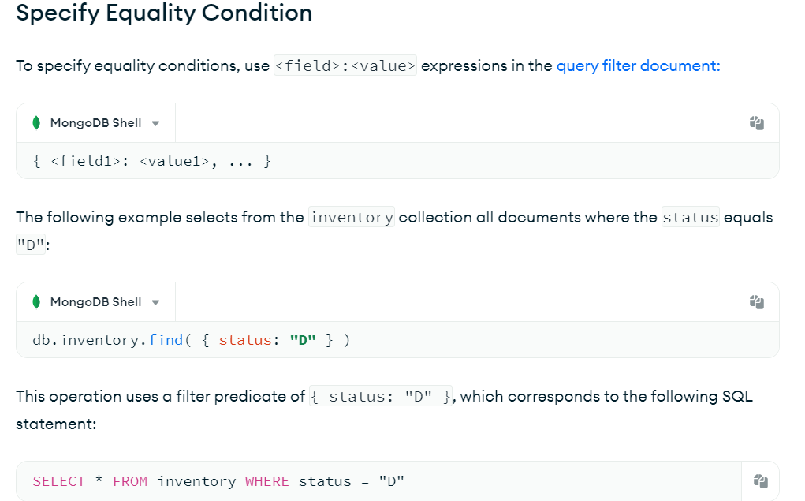
MongoDb CRUD Operation

Slide 61
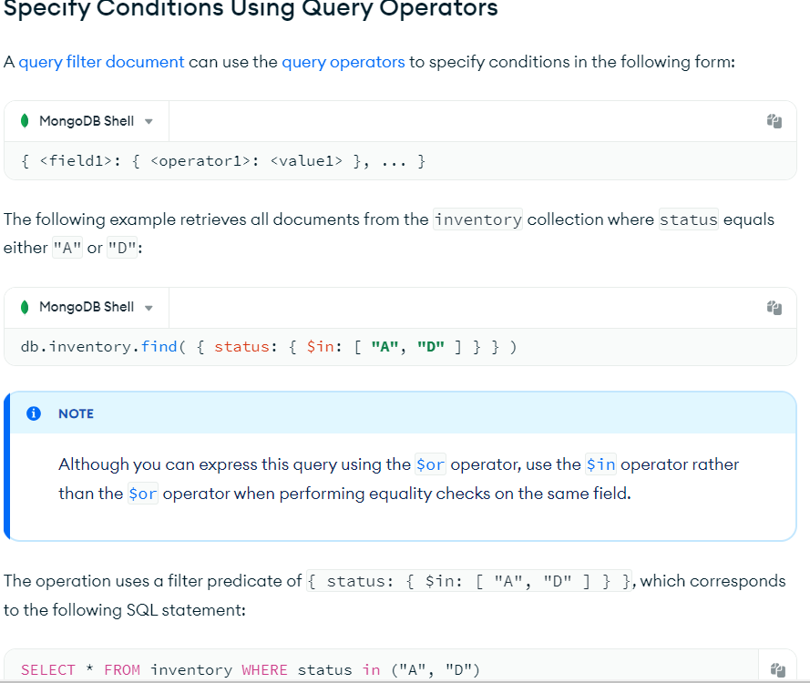
MongoDb CRUD Operation

Slide 62
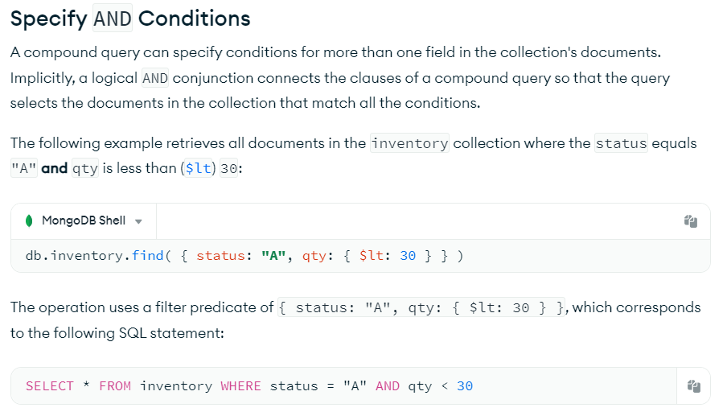
MongoDb CRUD Operation

Slide 63
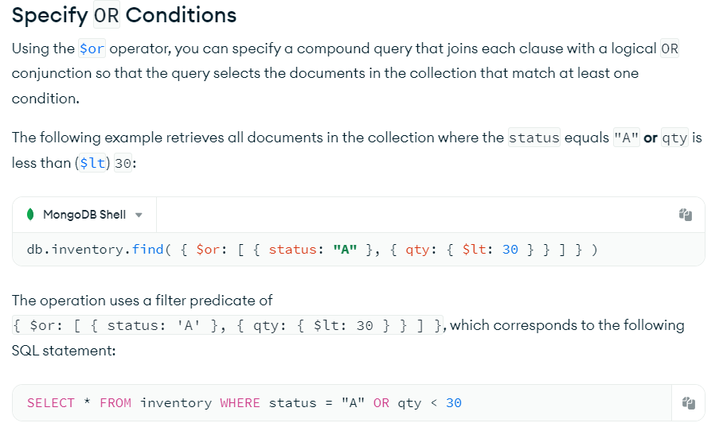
MongoDb CRUD Operation

Slide 64
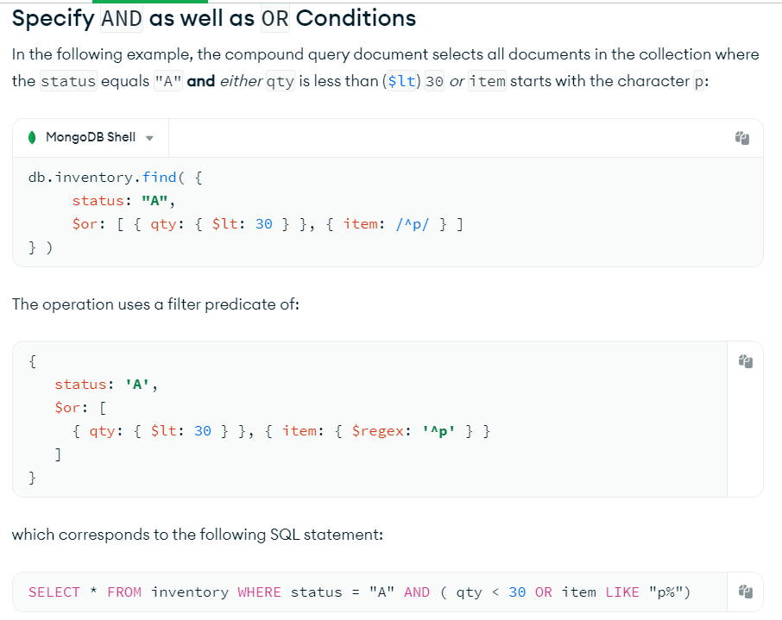
MongoDb CRUD Operation

Slide 65
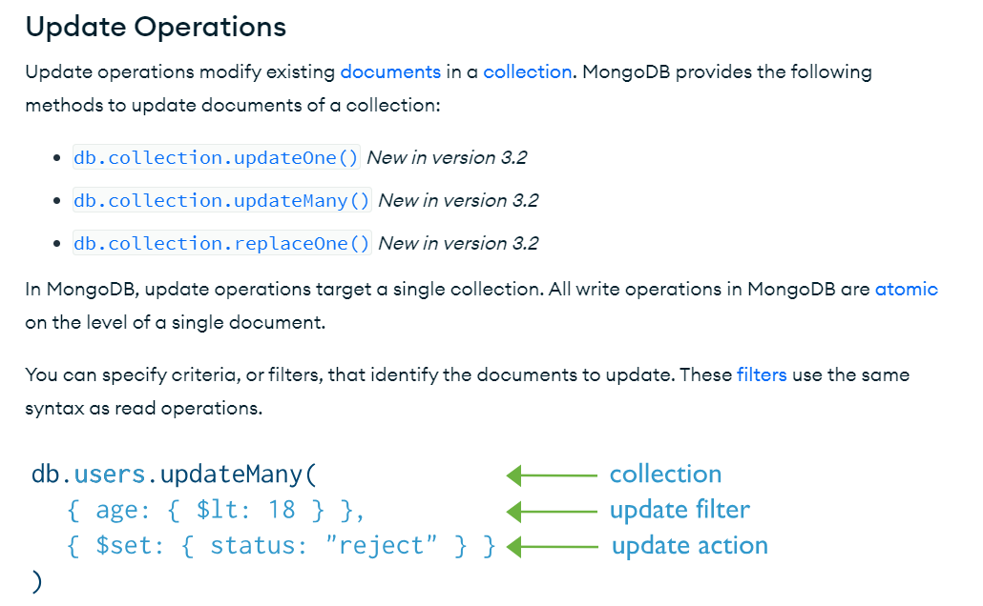
MongoDb CRUD Operation

Slide 66
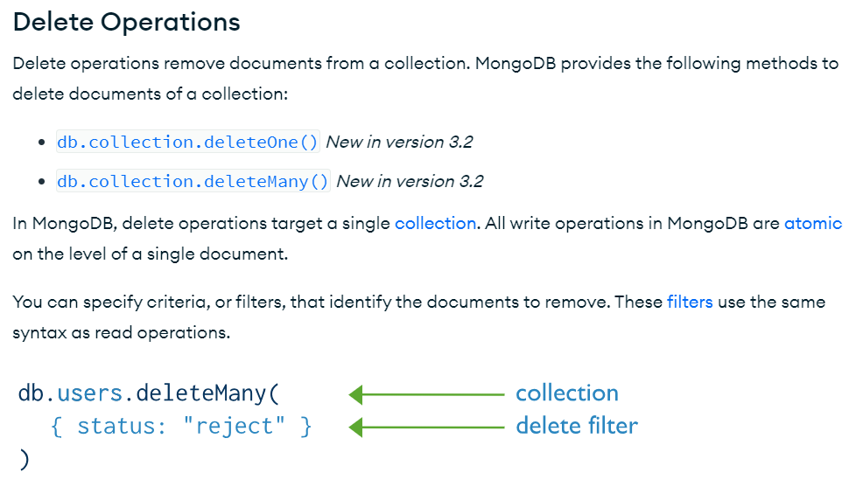
MongoDb CRUD Operation

Slide 67
MongoDb CRUD Operation

Slide 68
MongoDb CRUD Operation

Slide 69
MongoDb CRUD Operation

