Slide 1


K.RAMAKRISHNAN COLLEGE OF ENGINEERING
(AUTONOMOUS)
MOVIE TICKET BOOKING SYSTEM
Presented by,
Name : G S SUJITKUMAAR
Register No. : 8115U24AM054
Roll No. : AM2454
Year : II CSE (AIML)
Date of Review : 06.05.2026

Slide 2
PRESENTATION OVERVIEW
Objective
Introduction
Abstract
Architecture Diagram
Module Description
Implementation
Conclusion

Slide 3
Objective
To allow users to book movie tickets easily.
To manage seat availability automatically.
To avoid double booking of tickets.
To maintain booking records safely and efficiently.
To keep booking records safely.

Slide 4
INTRODUCTION
Movie Ticket Booking System is a database-based application.
It helps customers book tickets online instead of manual booking.
Users can view movies, show timings, and available seats.
The system stores customer and booking information.
It makes ticket management fast and accurate.

Slide 5
ABSTRACT
Movie Ticket Booking System is an online application for booking movie tickets.
Users can view movies and check show timings.
It allows seat selection and ticket booking easily.
Reduces waiting time and avoids long queues.
Provides a simple and user-friendly interface.
Admin can manage movies, shows, and bookings.
Makes the booking process fast, easy, and convenient.
.

Slide 6
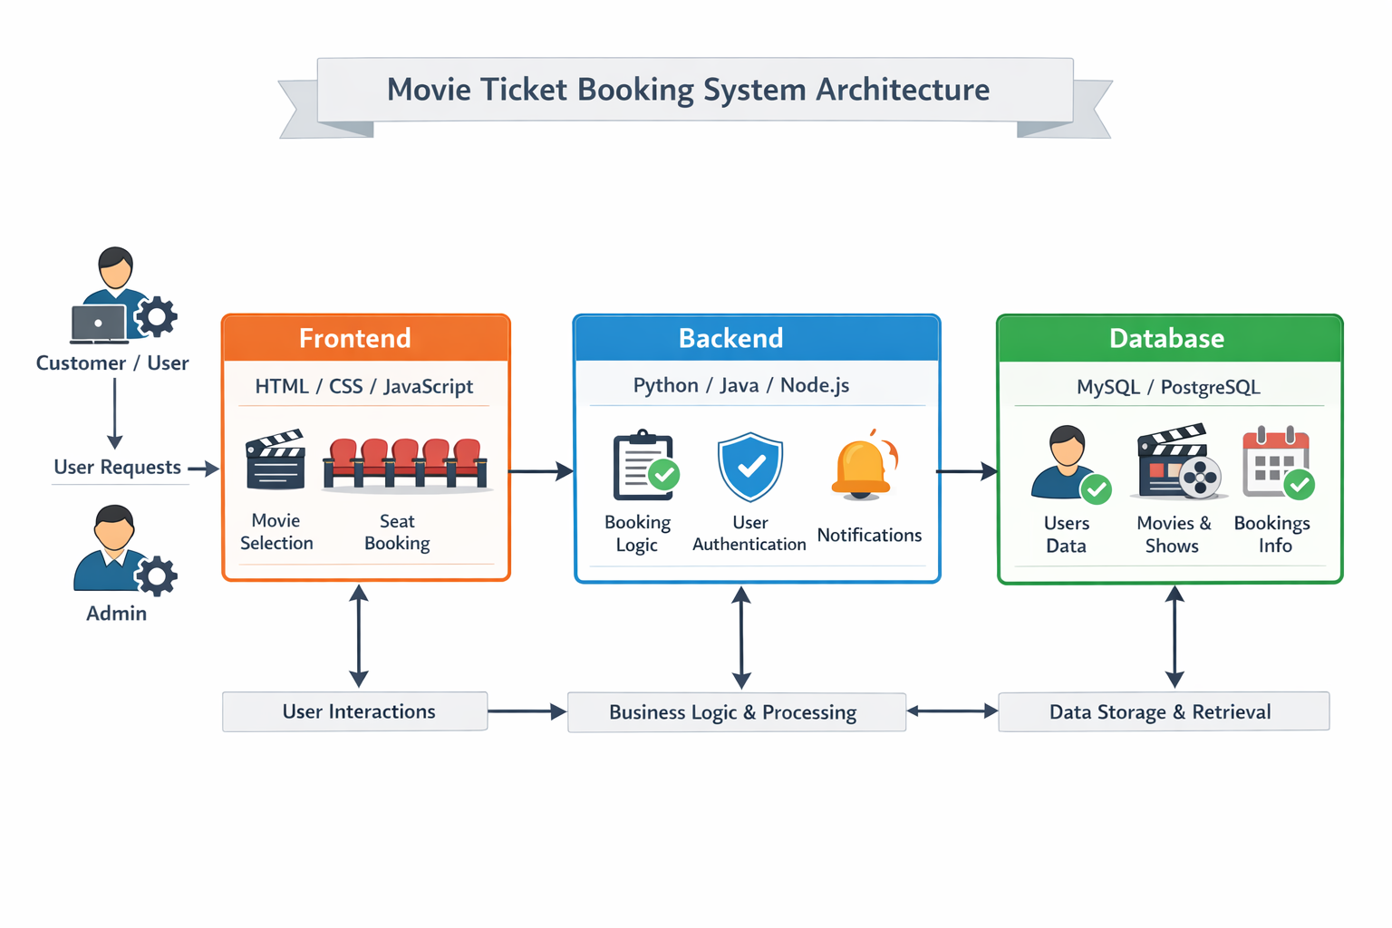
ARCHITECTURE DIAGRAM
.

Slide 7
MODULE DESCRIPTION
User Module
Register and login to the system
View movies and show timings
Book tickets and select seats
Admin Module
Add, update, or delete movies
Manage show timings
View all bookings
Movie Management Module
Store movie details
Update movie information
Display available movies
.

Slide 8
MODULE DESCRIPTION
Booking Module
Select seats for booking
Confirm ticket booking
Generate booking details
Payment Module
Make online payment
Verify payment status
Confirm ticket after payment
Seat Management Module
Show available seats
Block booked seats
Prevent double booking
Notification Module
Send booking confirmation
Notify via SMS or email
Provide ticket details

Slide 9
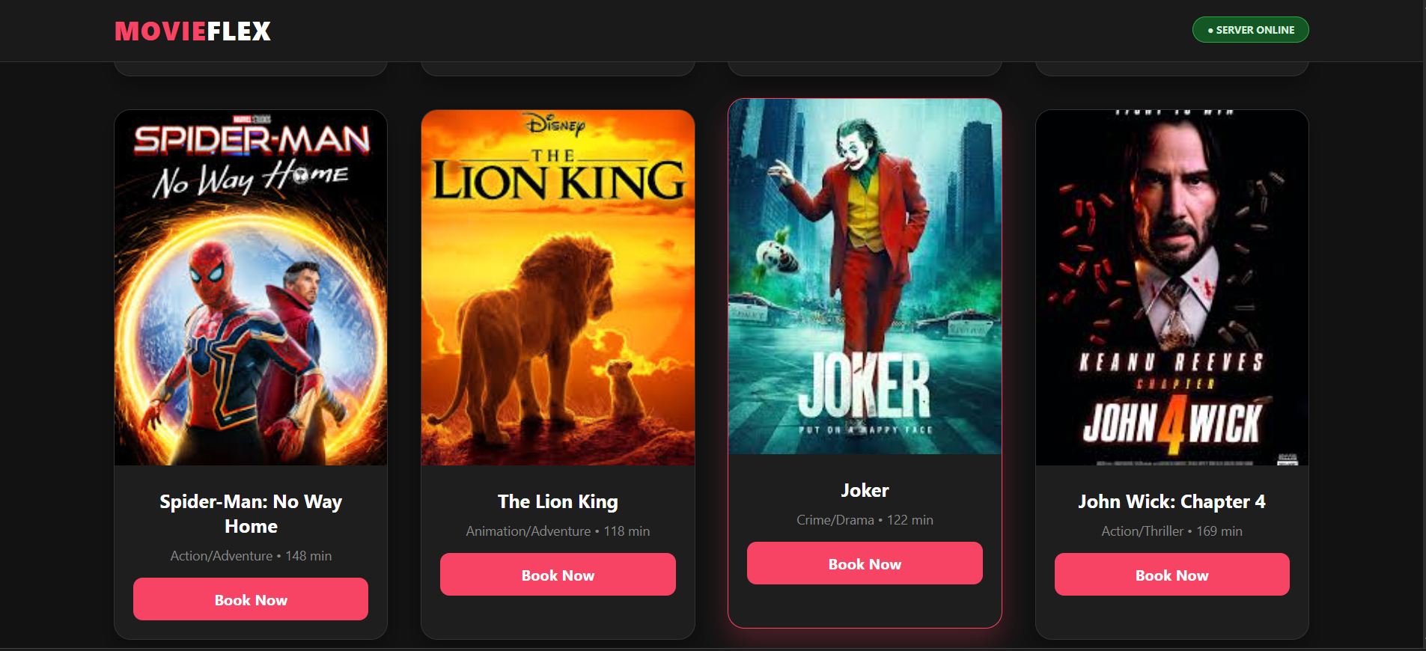
IMPLEMENTATION

Slide 10
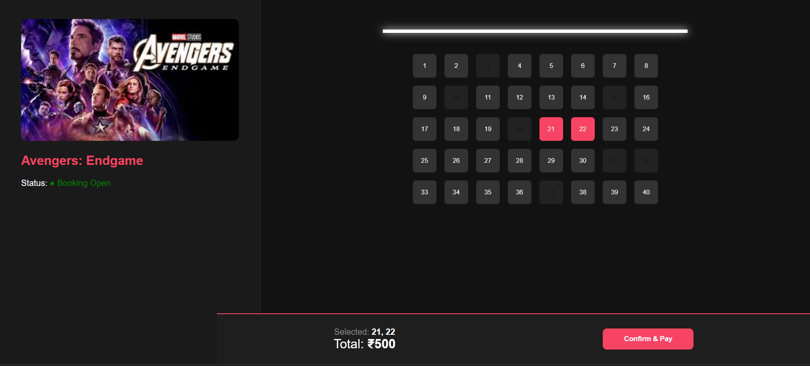
IMPLEMENTATION

Slide 11


