Slide 1

SMART INDIA HACKATHON 2026
TITLE PAGE
Problem Statement ID –26189
Problem Statement Title-
AI-Powered Criminal Network Analysis System
Theme- Block chain and security
PS Category- Software
Team ID- SIH26-A0H-T238
Team Name- ISIS

Slide 2
AI-Powered Criminal Network Analysis System
ISIS
Your Team Name
Idea/Solution
Problem Resolution:
❖ Converts fragmented data into a connected criminal network, reducing manual effort in linking information.
❖ Enables faster identification of hidden relationships that may be difficult to detect through traditional investigation methods.
❖ Provides AI-assisted pattern and anomaly detection to highlight potentially suspicious activities for investigator review.
❖ Offers visual and analytical insights that help investigators understand complex networks more efficiently.
❖ AI-Powered Intelligence Pipeline to process fragmented structured and unstructured criminal data from multiple investigation sources.
❖ NLP-Based Entity Extraction to automatically identify people, locations, organizations, vehicles, phone numbers, and events from reports.
❖ Relationship & Network Mapping to connect extracted entities and uncover hidden associations between suspects and activities.
❖ Graph Analytics + AI to identify key influencers, criminal communities, suspicious patterns, and unusual activities.
❖ Interactive Investigator Dashboard for visualizing networks, exploring connections, searching entities, and analysing timelines.
❖ Blockchain-Based Audit Layer to ensure tamper-evident records, data integrity, and secure access to sensitive investigation data.
Unique Value Propositions:
❖ Unified Intelligence Pipeline – Multiple data sources → AI → Knowledge Graph.
❖ Hidden Network Discovery through relationship mapping and graph analytics.
❖ AI-Assisted Investigation using entity extraction and anomaly detection.
❖ Interactive Visual Intelligence with network graphs and timeline analysis.
❖ Blockchain-Backed Data Integrity with tamper-evident audit trails.

Slide 3
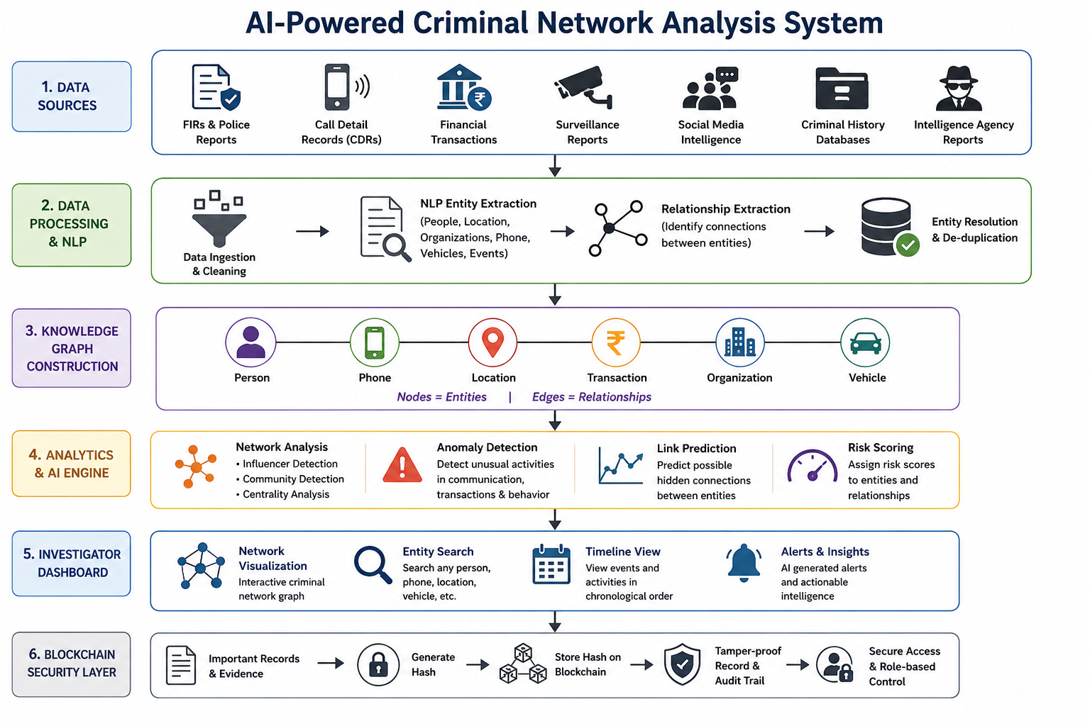
TECHNICAL APPROACH
ISIS

Slide 4
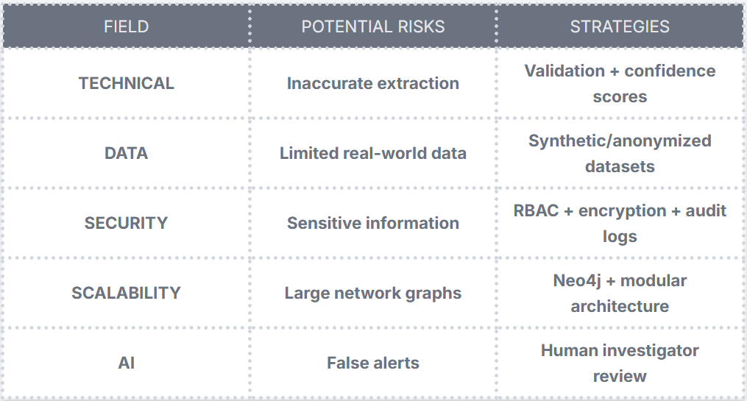
FEASIBILITY AND VIABILITY
Your Team Name
ISIS
Feasibility Overview
❖ TECHNICAL: Open-source AI, NLP, ML and graph technologies enable practical implementation.
❖ FINANCIAL: Low-cost development using open-source tools and pretrained models.
❖ OPERATIONAL: Visual dashboards simplify complex criminal network analysis.
❖ SCALABILITY: Graph-based architecture can expand as data sources increase.

Slide 5
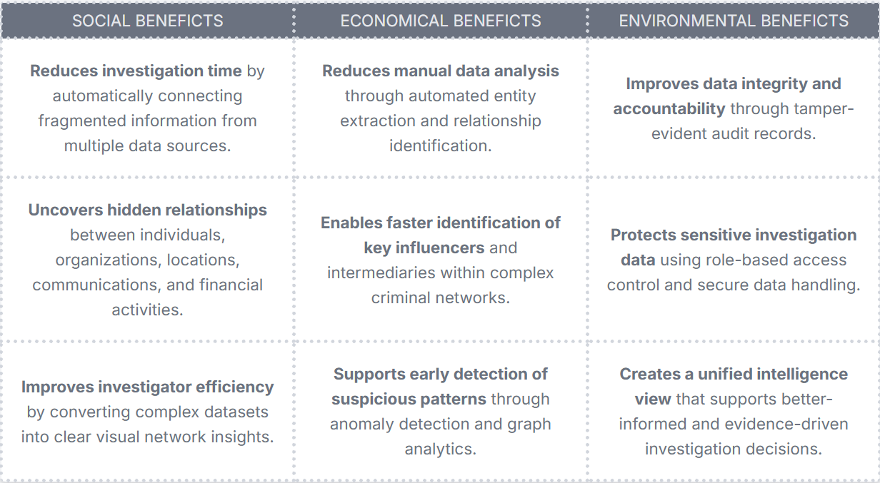
IMPACT AND BENEFITS
Your Team Name
ISIS

Slide 6
RESEARCH AND REFERENCES
Your Team Name
ISIS
Criminal Network Analysis : Link Prediction in Criminal Networks
Graph Analytics : Neo4j Graph Data Science — Centrality Algorithms
Neo4j Graph Data Science — Community Detection
Dataset for AI / Anomaly Detection : IBM AML-Data — Synthetic Financial Transaction Dataset IBM AMLSim — Synthetic Transaction Network Generator
Blockchain & Cybersecurity - Regueiro et al. (2021) — A Blockchain-Based Audit Trail Mechanism: Design and Implementation

