Slide 1


ElectViz Election Data Visualization for Media
Infosys Springboard 6.0
Presented By
SUJIT BEHERA
NAGA VENKATA VASAVI JAYAVARAPU
A ARCHNA
DARSHAN SINDHE
YAMINI
Team - A
INFOSYS SPRINGBOARD
Supervised By
Prof. NITYASHRI S J
Project Guide
INFOSYS SPRINGBOARD

Slide 2
OVER VIEW :
It Focus on Transform complex election data into clear, interactive, and easily understandable dashboard
It Analysis National and regional election results, voter demographics, and comprehensive trend analysis
It Enhance understanding and engagement through interactive and static visualizations
The dashboard enables year-wise, state-wise, party-wise, and candidate-wise analysis

Slide 3
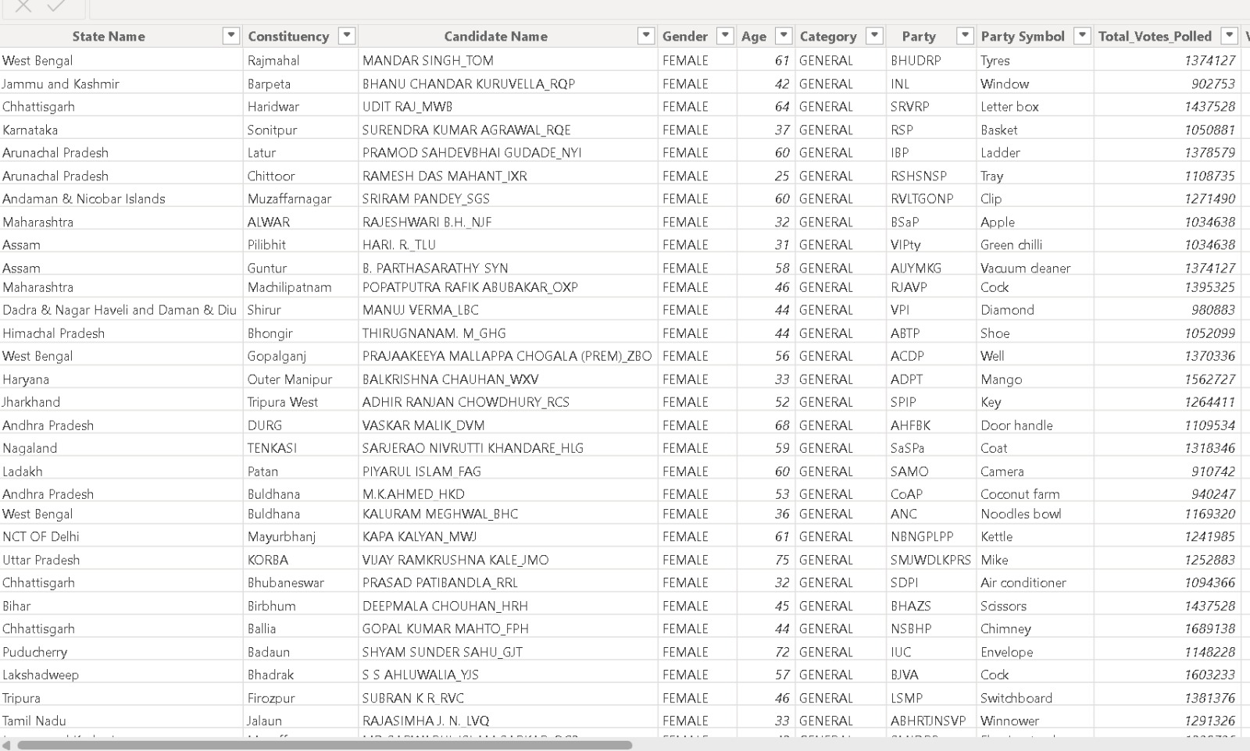
DATA SOURCE:
The dataset provides detailed information on election candidates, results, and performance across all Indian states
DATE
3/01/2026

Slide 4
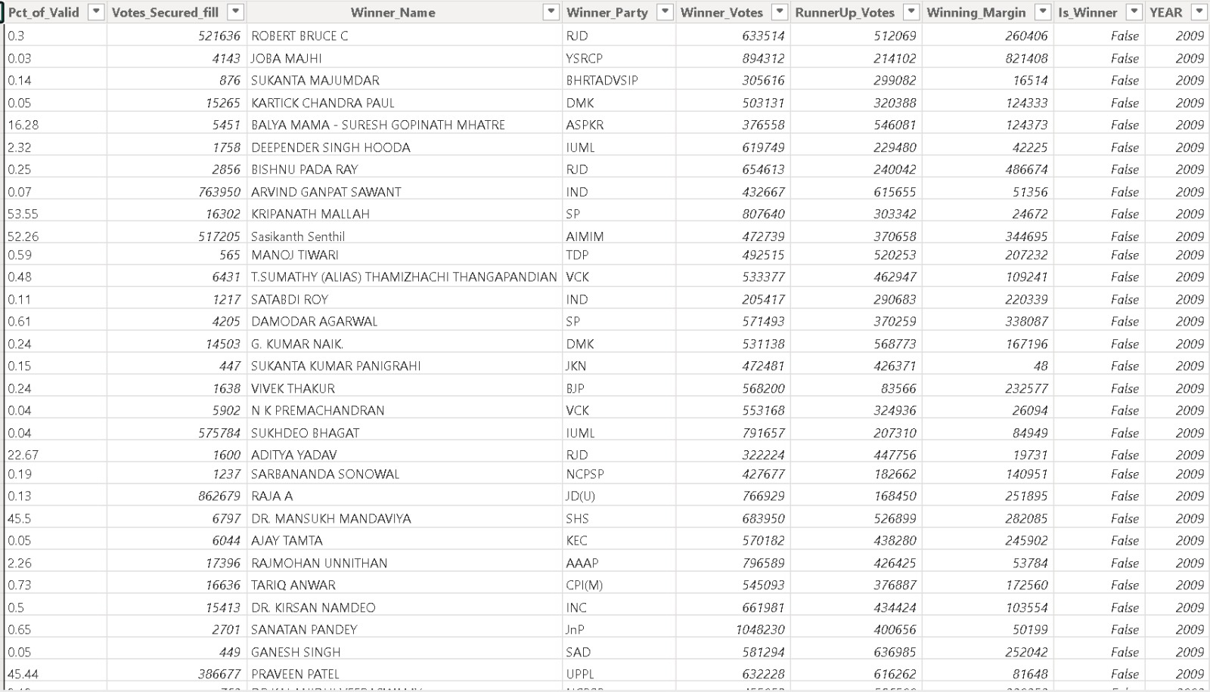
DATA SOURCE
DATE
3/01/2026

Slide 5
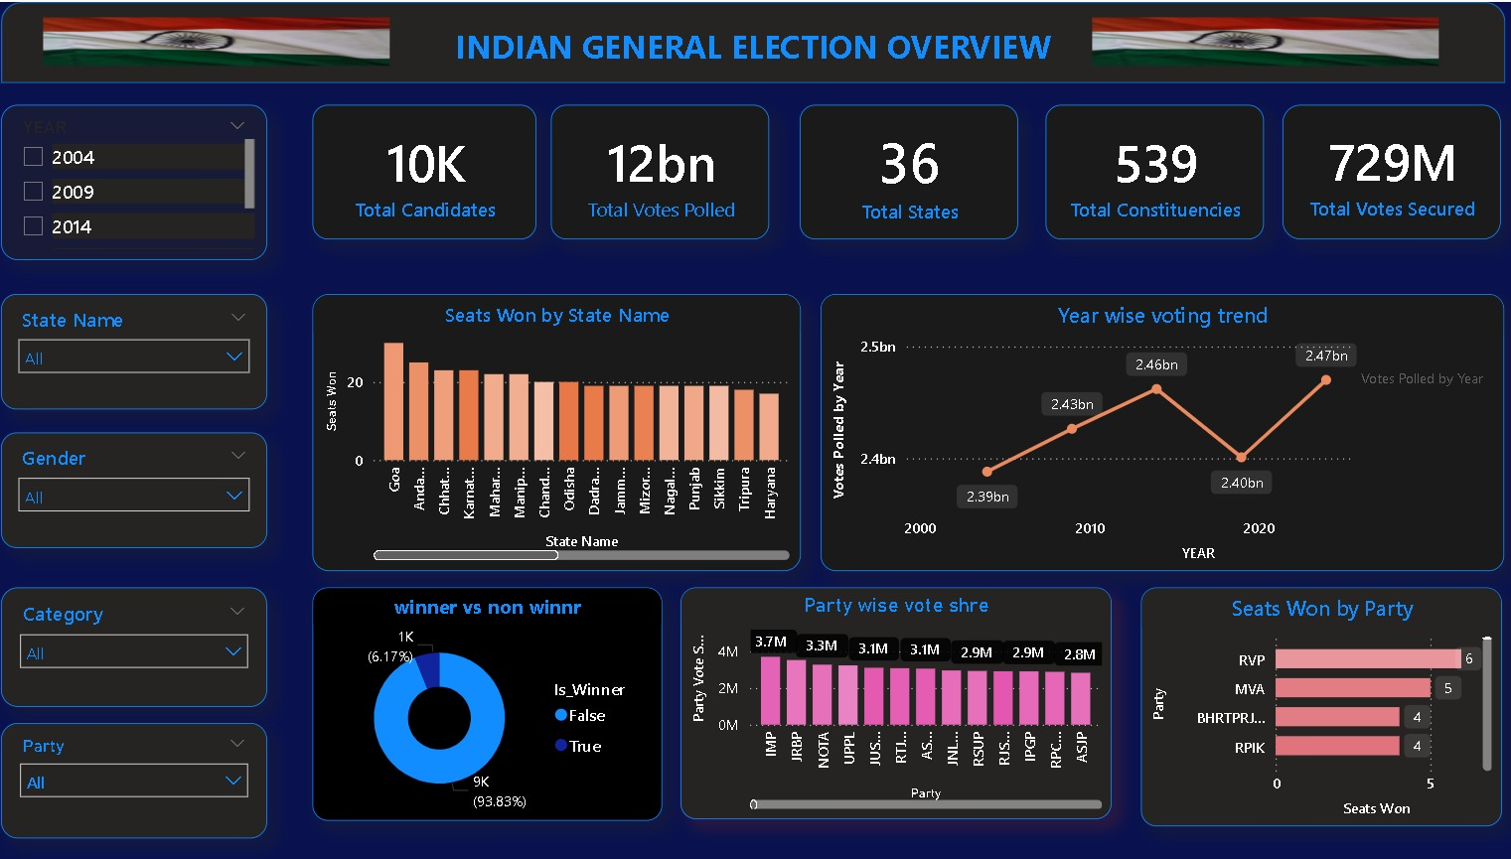
VISUALIZATION:
DATE
3/01/2026

Slide 6
DAX MEASUREMENT:
Seats Won =
CALCULATE(
DISTINCTCOUNT('Indian General Election'[Constituency]),
'Indian General Election'[Is_Winner] = TRUE())
Votes Polled by Year =
SUM('Indian General Election'[Total_Votes_Polled])
Seats Won =
CALCULATE(
DISTINCTCOUNT('Indian General Election'[Constituency]),
'Indian General Election'[Is_Winner] = TRUE()
)
Total Candidates =
DISTINCTCOUNT('Indian General Election'[Candidate Name])
Total Votes Polled =
SUM('Indian General Election'[Total_Votes_Polled])
Total States =
DISTINCTCOUNT('Indian General Election'[State Name])
Total Constituencies =
DISTINCTCOUNT('Indian General Election'[Constituency])
Total Votes Secured =
SUM('Indian General Election'[Votes_Secured])
Candidate Count =
COUNT('Indian General Election'[Candidate Name])
)
DATE
3/01/2026

Slide 7
VISUALIZATION TOOL :
KEY VISUALS :
Bar Chart – Seats Won by Party
Column Chart – Seat own by state name
❖ Donut Chart – winner vs non winner
❖ Line chart - year wise votting trend
KPI card:
❖ Total vote polled - 12bn
❖ Total candidates - 10k
❖ Total vote secured 729M
❖ Avg state -36
Total constituencies-539
DATE
3/01/2026

Slide 8
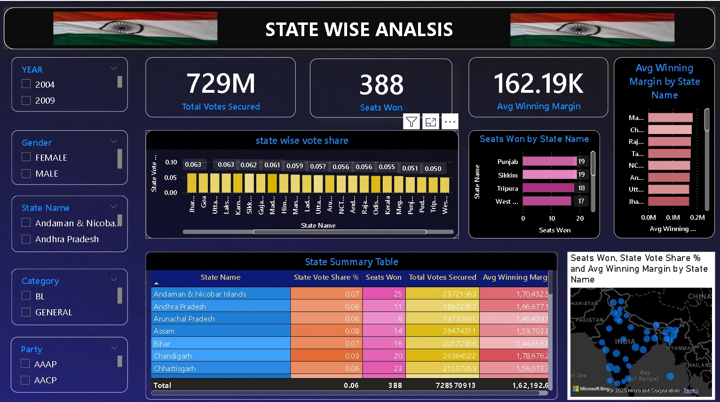
STATE WISE ANALYSIS :
DATE
3/01/2026

Slide 9
DAX MEASUREMENT
Seats Won =
CALCULATE(
DISTINCTCOUNT('Indian General Election'[Constituency]),
'Indian General Election'[Is_Winner] = TRUE()
)
Total Votes Secured =
SUM('Indian General Election'[Votes_Secured])
Vote Share % =
AVERAGE('Indian General Election'[Pct_of_Valid])
Avg Winning Margin =
AVERAGE('Indian General Election'[Winning_Margin])
DATE
3/01/2026
DATE
25/11/2025

Slide 10
VISUALIZATION TOOL :
Key Visuals:
❖ Bar Chart – avg winning margin by state name
❖ Column Chart – State wise vote share
❖ Donut Chart – Party Seat Share %
❖ Map – Seats won by party across states
❖ Summary Table – state name, state vote share%, seat own , avg winning margin
kpi cards:
Total vote secured 79M
❖ state own -388
avg winning margin-126.19k
DATE
3/01/2026
DATE
25/11/2025

Slide 11
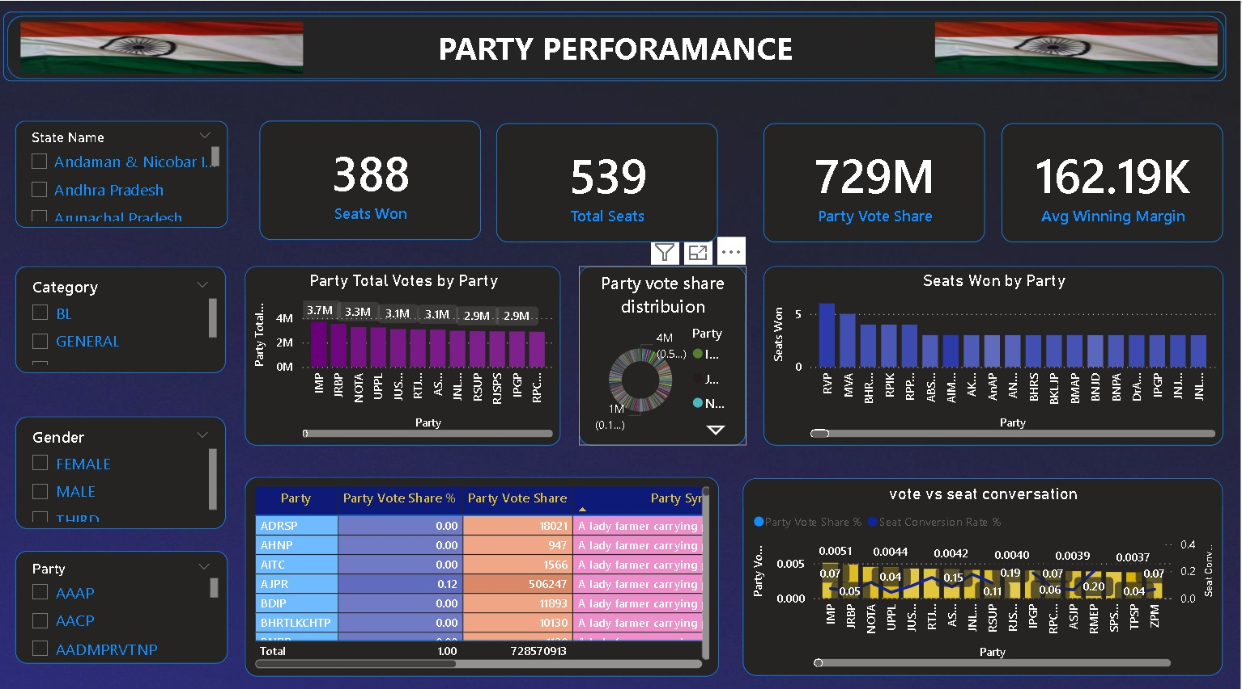
PARTY PERFORMANCE :
DATE
3/01/2026
DATE
25/11/2025

Slide 12
DAX MEASUREMENT:
Seats Won =
CALCULATE(
DISTINCTCOUNT('Indian General Election'[Constituency]),
'Indian General Election'[Is_Winner] = TRUE())
Total Seats =
DISTINCTCOUNT('Indian General Election'[Constituency])
Party Vote Share =
SUM('Indian General Election'[Votes_Secured])
Avg Winning Margin =
AVERAGE('Indian General Election'[Winning_Margin])
Party Total Votes =
SUM('Indian General Election'[Votes_Secured])
DATE
3/01/2026
DATE
25/11/2025

Slide 13
DAX MEASUREMENT:
Party Seats Won =
CALCULATE(
DISTINCTCOUNT('Indian General Election'[Constituency]),
'Indian General Election'[Is_Winner] = TRUE())
Total Seats =
DISTINCTCOUNT('Indian General Election'[Constituency])
Party Vote Share % =
DIVIDE(
[Party Total Votes],
CALCULATE(
SUM('Indian General Election'[Votes_Secured]),
ALL('Indian General Election'[Party]))
DATE
25/11/2025
DATE
3/01/2026

Slide 14
VISUALIZATION TOOL :
Key Visuals:
Bar Chart – Seats Won by Party
Column Chart – Total Votes by Party
❖ Donut Chart – Party vote share distribution
❖ Summary Table – Party,party vote share%,party vote share
KPI card show:
seat own - 388
Total seat - 539
party vote share-729 M
Avg winning margin 162.19K
DATE
3/01/2026
DATE
25/11/2025

Slide 15
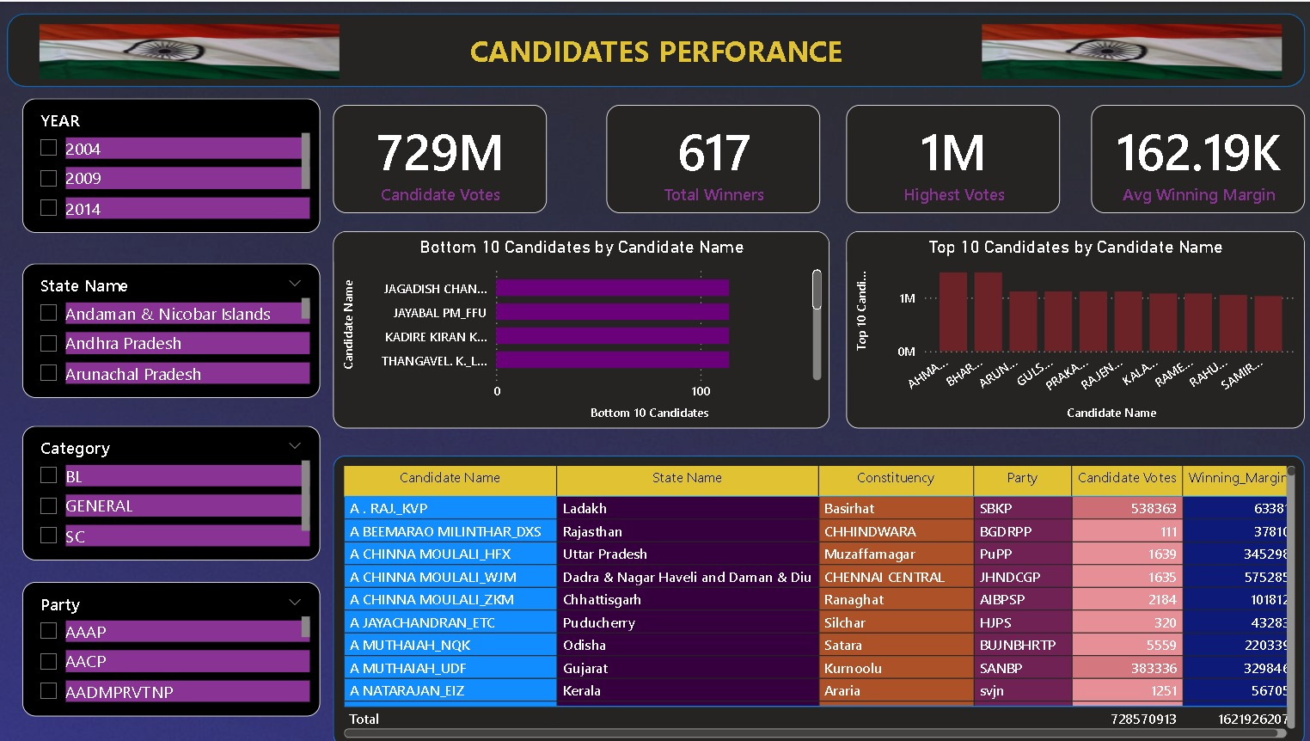
CANDIDATES PERFORMANCE
DATE
3/01/2026
DATE
25/11/2025

Slide 16
DAX MEASUREMENT:
Candidate Votes =
SUM('Indian General Election'[Votes_Secured])
Total Winners =
COUNTROWS(FILTER('Indian General Election', 'Indian General Election'[Is_Winner] = TRUE()))
Highest Votes =
MAX('Indian General Election'[Votes_Secured])
Avg Winning Margin =
AVERAGE('Indian General Election'[Winning_Margin])
Candidate Rank =
RANKX(
ALL('Indian General Election'[Candidate Name]),
[Candidate Votes],
,
DESC
)
DATE
3/01/2026
DATE
25/11/2025

Slide 17
DAX MEASUREMENT:
Bottom 10 Candidates =
IF(
RANKX(
ALL('Indian General Election'[Candidate Name]),
[Candidate Votes],
, ASC
) <= 10,
10 Candidates =
IF(
[Candidate Rank] <= 10,
[Candidate Votes]
)
DATE
3/01/2026
DATE
25/11/2025

Slide 18
VISUALIZATION TOOL :
Key Visuals:
❖ Bar Chart – Bottom 10 candidates by candidates name
❖ Column Chart – top 10 candidates by candidates name
❖ Summary Table – candidates name,state name, constituency,party,candidates vote Avg Winning Margin
KPI card show:
candidates vote - 729M
❖ Total Winner- 617
❖ highest vote-1M
❖ Avg winning margin - 162.19K
DATE
3/01/2026
DATE
25/11/2025

Slide 19
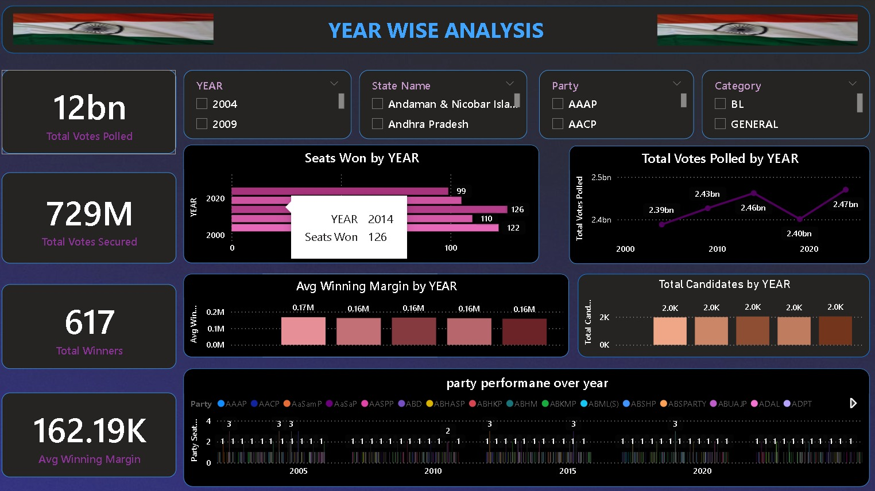
YEAR WISE ANALYSIS :
DATE
3/01/2026
DATE
25/11/2025

Slide 20
DAX MEASUREMENT:
Total Votes Polled =
SUM('Indian General Election'[Total_Votes_Polled])
Total Votes Secured =
SUM('Indian General Election'[Votes_Secured])
Total Seats =
DISTINCTCOUNT('Indian General Election'[Constituency])
Total Winners =
COUNTROWS(FILTER('Indian General Election', 'Indian General Election'[Is_Winner] = TRUE()))
Avg Winning Margin =
AVERAGE('Indian General Election'[Winning_Margin])
)
DATE
3/01/2026
DATE
25/11/2025

Slide 21
DAX MEASUREMENT:
Party Seats Won =
CALCULATE(
DISTINCTCOUNT('Indian General Election'[Constituency]),
'Indian General Election'[Is_Winner] = TRUE()
)
Seats Won =
CALCULATE(
DISTINCTCOUNT('Indian General Election'[Constituency]),
'Indian General Election'[Is_Winner] = TRUE()
DATE
3/01/2026
DATE
25/11/2025

Slide 22
VISUALIZATION TOOL :
Key Visuals:
❖ Bar Chart – Seats Won by year
❖ Column Chart – avg winning margin by year
Line chart - total vote polled by year
KPI card show:
❖ Total vote polles- 12bn
❖ Total vote secured - 729M
❖ Total winner-617
❖ Avg winning margin 162.19K
DATE
3/01/2026
DATE
25/11/2025

Slide 23
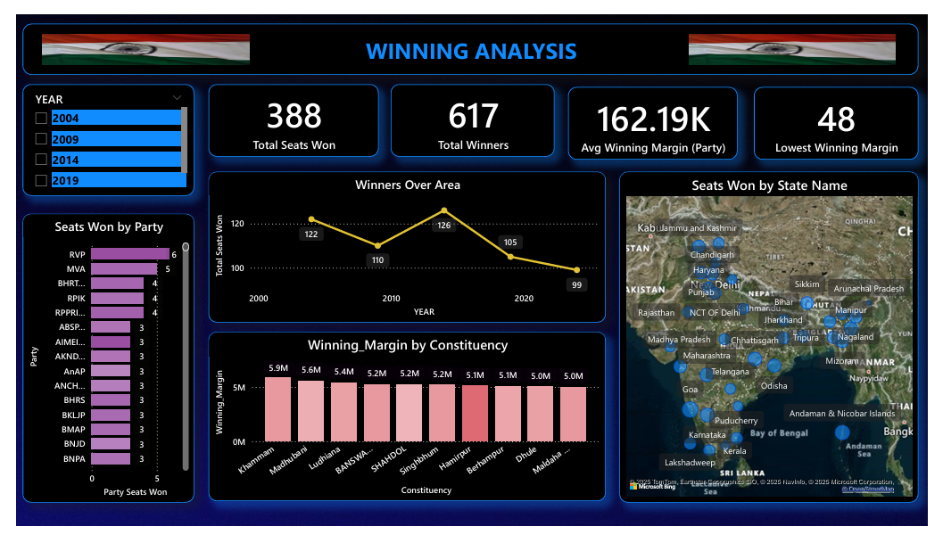
WINNING ANALYSIS
DATE
3/01/2026
DATE
25/11/2025

Slide 24
DAX MEASUREMENT
Total Seats Won =
CALCULATE(
DISTINCTCOUNT('Indian General Election'[Constituency]),
'Indian General Election'[Is_Winner] = TRUE()
)
Total Winners =
COUNTROWS(FILTER('Indian General Election', 'Indian General Election'[Is_Winner] =TRUE()))
Avg Winning Margin =
AVERAGE('Indian General Election'[Winning_Margin])
Lowest Winning Margin =
MIN('Indian General Election'[Winning_Margin])
DATE
3/01/2026
DATE
25/11/2025

Slide 25
DAX MEASUREMENT
Lowest Winning Margin =
MIN('Indian General Election'[Winning_Margin])
Party Seats Won =
CALCULATE(
DISTINCTCOUNT('Indian General Election'[Constituency]),
'Indian General Election'[Is_Winner] = TRUE()
)
State Seats Won =
CALCULATE(
DISTINCTCOUNT('Indian General Election'[Constituency]),
'Indian General Election'[Is_Winner] = TRUE()
)
DATE
3/01/2026
DATE
25/11/2025

Slide 26
DAX MEASUREMENT
Total Seats Won =
CALCULATE(
DISTINCTCOUNT('Indian General Election'[Constituency]),
'Indian General Election'[Is_Winner] = TRUE()
)
DATE
3/01/2026
DATE
25/11/2025

Slide 27
VISUALIZATION TOOL
Key Visuals:
❖ Bar Chart – Seats Won by Party
❖ Column Chart –winning margin by constituency
❖ Line Chart –winner over area
❖ Map – Seats won by states
KPI card show:
❖ Total seat own- 388
❖ Total winner - 617
❖ Lowest winning margin-48
❖ Avg winning margin 135.63K
DATE
3/01/2026
DATE
25/11/2025

Slide 28
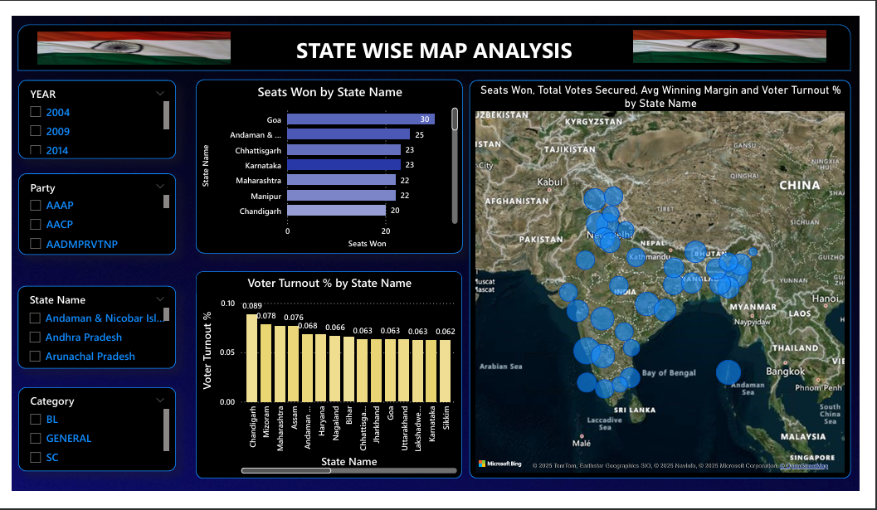
STATW WISE MAP ANALYSIS
DATE
3/01/2026
DATE
25/11/2025

Slide 29
DAX MEASUREMENT
Seats Won =
CALCULATE(
DISTINCTCOUNT('Indian General Election'[Constituency]),
'Indian General Election'[Is_Winner] = TRUE()
)
Total Votes Secured =
SUM('Indian General Election'[Votes_Secured])
Vote Share % =
AVERAGE('Indian General Election'[Pct_of_Valid])
Avg Winning Margin =
AVERAGE('Indian General Election'[Winning_Margin])
DATE
3/01/2026
DATE
25/11/2025

Slide 30
VISUALIZATION TOOL
Key Visuals:
❖ Bar Chart – Seats Won by State name
❖ Column Chart –Voter turner% by Party State name
❖ Map –Seats Won,Total vote secured,winning margin,voter turnover%
DATE
3/01/2026
DATE
25/11/2025

Slide 31
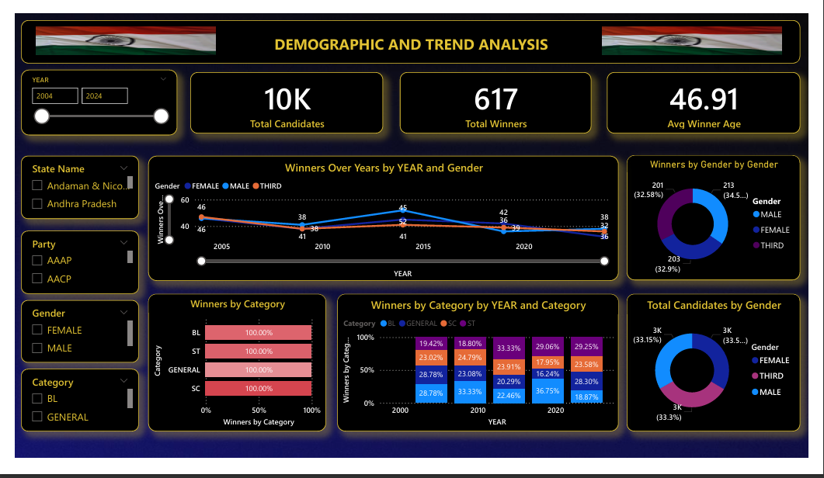
DEMOGRAPHIC ANALYSIS
DATE
3/01/2026
DATE
25/11/2025

Slide 32
DAX MEASUREMENT
Total Candidates =
DISTINCTCOUNT('Indian General Election'[Candidate Name])
Total Winners =
COUNTROWS(FILTER('Indian General Election', 'Indian General Election'[Is_Winner] =TRUE()))
Avg Winner Age =
CALCULATE(
AVERAGE('Indian General Election'[Age]),
'Indian General Election'[Is_Winner] = TRUE()
)
DATE
3/01/2026
DATE
25/11/2025

Slide 33
DAX MEASUREMENT
Winners by Gender =
CALCULATE(
DISTINCTCOUNT('Indian General Election'[Candidate Name]),
'Indian General Election'[Is_Winner] = TRUE())
Winners by Category =
CALCULATE(
DISTINCTCOUNT('Indian General Election'[Candidate Name]),
'Indian General Election'[Is_Winner] = TRUE())
Avg Winner Age =
CALCULATE(
AVERAGE('Indian General Election'[Age]),
'Indian General Election'[Is_Winner] = TRUE())
DATE
3/01/2026
DATE
25/11/2025

Slide 34
DAX MEASUREMENT
Winners Over Years =
CALCULATE(
DISTINCTCOUNT('Indian General Election'[Candidate Name]),
'Indian General Election'[Is_Winner] = TRUE()
)
DATE
3/01/2026
DATE
25/11/2025

Slide 35
VISUALIZATION TOOL
Key Visuals:
❖ Bar Chart –Winner by catagory
❖ Column Chart – Winner by catagory by year
❖ Donut Chart – candidate by gender
KPI card show:
❖ Total winner- 617
❖ Total candidates - 10k
❖ Avg winning age-46.91
DATE
3/01/2026
DATE
25/11/2025

Slide 36
FUTURE SCOPE:
Sentiment Analysis Integration
Link social media sentiment patterns with election data for
comprehensive public opinion tracking
Mobile Dashboards
Develop responsive, touch-optimized interfaces for
seamless mobile access and engagement
Local Elections Expansion
Extend coverage to municipal elections, school boards,
and local referenda for comprehensive civic data
DATE
3/01/2026
DATE
25/12/2025

Slide 37
Any Queries ?
ElectViz Election Data Visualization for Media
Infosys Springboard 6.0
THANK YOU
Presented By
SUJIT BEHERA
NAGA VENKATA VASAVI JAYAVARAPU
A ARCHNA
DARSHAN SINDHE
YAMINI
Team - A
INFOSYS SPRINGBOARD
DATE
3/01/2026

