Slide 1
Hadoop 2.0 and YARN
Subash D’Souza

Slide 2
Who am I?
Senior Specialist Engineer at Shopzilla
Co-Organizer for the Los Angeles Hadoop User group
Organizer for Los Angeles HBase User Group
Reviewer on Apache Flume: Distributed Log Processing, Packt Publishing
3+ years working on Big Data

Slide 3
YARN
Yet Another Resource Negotiator
YARN Application Resource Negotiator(Recursive Acronym)
Remedies the scalability shortcomings of “classic” MapReduce
Is more of a general purpose framework of which classic mapreduce is one application.

Slide 4
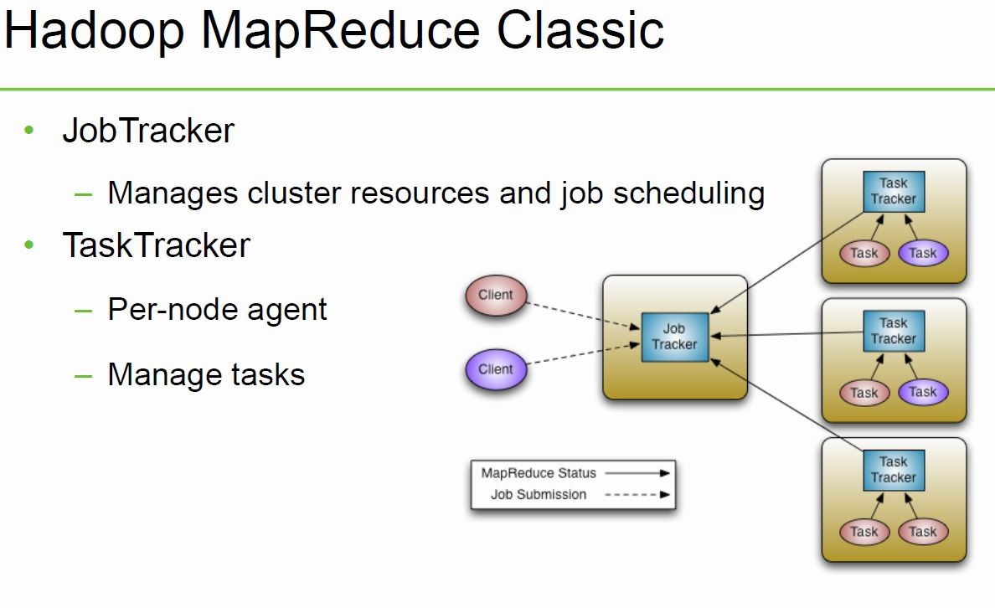

Slide 5
Current MapReduce Limitations
Scalability
Maximum Cluster Size – 4000 Nodes
Maximum Concurrent Tasks – 40000
Coarse synchronization in Job Tracker
Single point of failure
Failure kills all queued and running jobs
Jobs need to be resubmitted by users
Restart is very tricky due to complex state

Slide 6
YARN
Splits up the two major functions of JobTracker
Global Resource Manager - Cluster resource management
Application Master - Job scheduling and monitoring (one per application). The Application Master negotiates resource containers from the Scheduler, tracking their status and monitoring for progress. Application Master itself runs as a normal container.
Tasktracker
NodeManager (NM) - A new per-node slave is responsible for launching the applications’ containers, monitoring their resource usage (cpu, memory, disk, network) and reporting to the Resource Manager.
YARN maintains compatibility with existing MapReduce applications and users.

Slide 7
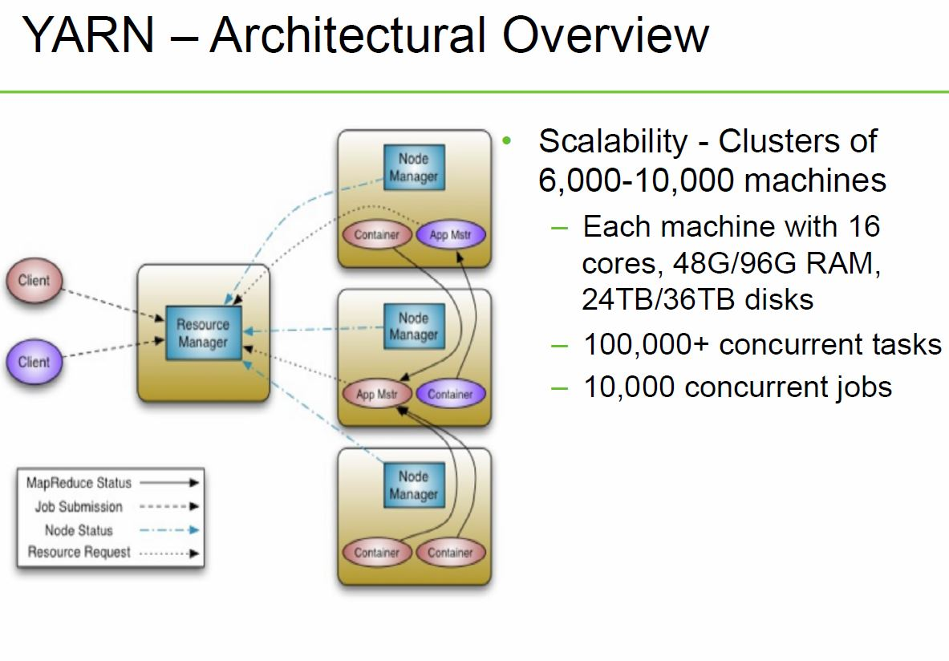

Slide 8
Classic MapReduce vs. YARN
Fault Tolerance and Availability
Resource Manager
No single point of failure – state saved in ZooKeeper
Application Masters are restarted automatically on RM restart
Application Master
Optional failover via application-specific checkpoint
MapReduce applications pick up where they left off via state saved in HDFS
Wire Compatibility
Protocols are wire-compatible
Old clients can talk to new servers
Rolling upgrades

Slide 9
Classic MapReduce vs. YARN
Support for programming paradigms other than MapReduce (Multi tenancy)
Tez – Generic framework to run a complex DAG
HBase on YARN(HOYA)
Machine Learning: Spark
Graph processing: Giraph
Real-time processing: Storm
Enabled by allowing the use of paradigm-specific application master
Run all on the same Hadoop cluster!

Slide 10
Storm on YARN
Motivations
Collocating real-time processing with batch processing
Provides a huge potential for elasticity.
Reduces network transfer rates by moving storm closer to Mapreduce.
Notes:
Collocating real-time processing with batch processing offers a number of advantages over segregated clusters.
It provides a huge potential for elasticity. Real-time processing will rarely produce a constant and predictable load. As such, Storm needs more resources to keep up with spikes in demand. Collocating Storm with batch processing allows Storm to steal resources from batch jobs when needed and give them back when demand subsides. The Storm-YARN effort lays the groundwork to make this possible.
Many applications use Storm for low-latency processing and Map/Reduce for batch processing while sharing data between Storm and Map/Reduce. By placing Storm physically closer to the data source and/or other components in the same pipeline we can reduce network transfers and in turn the total cost of acquiring the data.

Slide 11
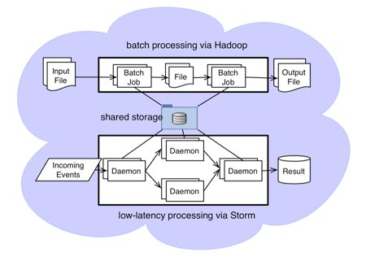
Storm on YARN @Yahoo
Notes:
To compute user interest, Yahoo process billions of events from our over 700 million users, and analyze 2.2 billion content every day. Since users' change interest over time, we need to update user profiles to reflect their current interests.

Slide 12
Storm on YARN @Yahoo
Yahoo enhanced Storm to support Hadoop style security mechanisms
Storm is being integrated into Hadoop YARN for resource management.
Storm-on-YARN enables Storm applications to utilize the computational resources in our tens of thousands of Hadoop computation nodes.
YARN is used to launch the Storm application master (Nimbus) on demand, and enables Nimbus to request resources for Storm application slaves (Supervisors).
Notes:
Yahoo enhanced Storm to support Hadoop style security mechanisms (including Kerberos authentication), and thus enable Storm applications to access Hadoop datasets stored in our secure HDFS and Hbase clusters.
Storm is being integrated into Hadoop YARN for resource management. Storm-on-YARN enables Storm applications to utilize the computational resources in our tens of thousands of Hadoop computation nodes. YARN is used to launch the Storm application master (Nimbus) on demand, and enables Nimbus to request resources for Storm application slaves (Supervisors).

Slide 13
Tez on YARN
Hindi for speed
Currently in development
Provides a general-purpose, highly customizable framework that creates simplifies data-processing tasks across both small scale (low-latency) and large-scale (high throughput) workloads in Hadoop.
Generalizes the MapReduce paradigm to a more powerful framework by providing the ability to execute a complex DAG
Enables Apache Hive, Apache Pig and Cascading can meet requirements for human-interactive response times and extreme throughput at petabyte scale

Slide 14
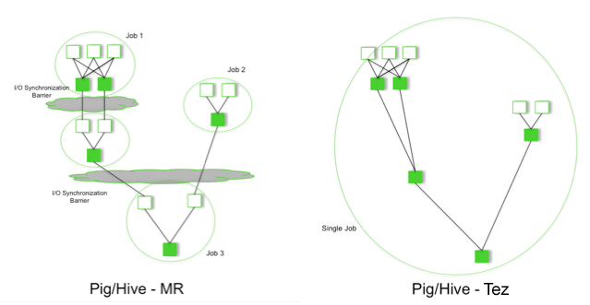
Tez on YARN

Slide 15
Tez on YARN
Performance gains over Mapreduce
Eliminates replicated write barrier between successive computations
Eliminates job launch overhead of workflow jobs
Eliminates extra stage of map reads in every workflow job
Eliminates queue and resource contention suffered by workflow jobs that are started after a predecessor job completes

Slide 16
Tez on YARN
Is part of the Stinger Initiative
Should be deployed as part of Phase 2

Slide 17
HBase on YARN(HOYA)
Currently in prototype
Be able to create on-demand HBase clusters easily -by and or in apps
With different versions of HBase potentially (for testing etc.)
Be able to configure different HBase instances differently
For example, different configs for read/write workload instances
Better isolation
Run arbitrary co-processors in user’s private cluster
User will own the data that the hbase daemons create

Slide 18
HBase on YARN(HOYA)
MR jobs should find it simple to create (transient) HBase clusters
For Map-side joins where table data is all in HBase, for example
Elasticity of clusters for analytic / batch workload processing
Stop / Suspend / Resume clusters as needed
Expand / shrink clusters as needed
Be able to utilize cluster resources better
Run MR jobs while maintaining HBase’s low latency SLAs

Slide 19
EMR/EHR
Electronic medical records (EMRs) are a digital version of the paper charts in the clinician’s office. It allows Healthcare professionals
Track data over time
Easily identify which patients are due for preventive screenings or checkups
Check how their patients are doing on certain parameters—such as blood pressure readings or vaccinations
Monitor and improve overall quality of care within the practice
Electronic health records (EHRs) do all those things—and more. EHRs focus on the total health of the patient—going beyond standard clinical data collected in the provider’s office and inclusive of a broader view on a patient’s care. EHRs are designed to reach out beyond the health organization that originally collects and compiles the information.

Slide 20
Expertise in healthcare
None
Spouse works as RN so that the closest I have gotten to understanding healthcare
Using Hadoop to gain insight into your data means being able to predict or at least analyze at a more minute level certain aspects of people’s health's across communities or other physical traits
Of course keeping HIPAA in compliance
Obamacare requiring all hospitals to be compliant by 2015 to be able to accept Medicare patients
But how many of these healthcare institutions will actually be making use of the data other than just being compliant?

Slide 21
Classic Mapreduce or YARN for Healthcare
YARN is still under development(in beta now)
Still has a ways to go before it matures
Will GA end of 2013/beginning of 2014
Other organizations other than Yahoo will have to share their experience(Currently Ebay and Linkedin are trying/implementing YARN in production)
Not recommended to be deployed in production currently
Currently stick with Classic Mapreduce

Slide 22
Classic MapReduce vs. YARN
Biggest advantage(atleast IMHO) is multi-tenancy, being able to run multiple paradigms simultaneously is a big plus.
Wait until it goes GA and then start testing it.
You can still implement HA without implementing YARN

Slide 23
Hadoop 2.0
So Hadoop 2.0 includes YARN, High Availability and Federation
High Availability takes away the Single Point of failure from namenode and introduces the concept of the QuorumJournalNodes to sync edit logs between active and standby namenodes
Federation allows multiple independent namespaces(private namespaces, or hadoop as a service)

Slide 24
Credits
Hortonworks, Cloudera, Yahoo
Email: sawjd@yahoo.com
Twitter: @sawjd22
Big Data Camp LA – November 16th
Free Hadoop Training Classes
Questions?

