Slide 1

Service Oriented Architecture
Week 2: Technical Foundations
Master of Information System Management

Slide 2
Today’s Topics
Review of EIP and Oracle OSB slides
Discuss Homework 1
XML Schema
XPATH Expressions
WSDL
SOAP
ESB
Master of Information System Management

Slide 3
XML Schema
SOA involves the passing of messages from one process to another. Messages may be document style or tightly coupled RPC style (not in vogue.)
Each process needs to know the overall message structure as well as the low level data types.
XML Schema is a W3C Recommendation.
Master of Information System Management

Slide 4
Type Systems
Found in many programming languages
Specify a set of values and operations on those values
Classify values and expressions,e.g.,
3.0 * 2.4 is of type real
In C, the types are packaged up in header files and we include them in our code with
#include<stdio.h>
In Java, we use the import statement along with a classpath to be searched.
XML Schema is used by web services to describe the types of messages sent and received
Master of Information System Management

Slide 5
PO Example From W3C (1)
<?xml version="1.0"?>
<purchaseOrder orderDate="1999-10-20">
<shipTo country="US">
<name>Alice Smith</name>
<street>123 Maple Street</street>
<city>Mill Valley</city>
<state>CA</state>
<zip>90952</zip>
</shipTo>
Master of Information System Management

Slide 6
PO Example From W3C (2)
<billTo country="US">
<name>Robert Smith</name>
<street>8 Oak Avenue</street>
<city>Old Town</city>
<state>PA</state>
<zip>95819</zip>
</billTo>
<comment>Hurry, my lawn is going wild<!/comment>
Master of Information System Management

Slide 7
PO Example From W3C (3)
<items>
<item partNum="872-AA">
<productName>Lawnmower</productName>
<quantity>1</quantity>
<USPrice>148.95</USPrice>
<comment>Confirm this is electric</comment>
</item>
Master of Information System Management

Slide 8
PO Example From W3C (4)
<item partNum="926-AA">
<productName>Baby Monitor</productName>
<quantity>1</quantity>
<USPrice>39.98</USPrice>
<shipDate>1999-05-21</shipDate>
</item>
</items>
</purchaseOrder>
Master of Information System Management

Slide 9
PO Schema Example From W3C (1)
<xsd:schema xmlns:xsd="http://www.w3.org/2001/XMLSchema"> <xsd:annotation>
<xsd:documentation xml:lang="en">
Purchase order schema for Example.com.
Copyright 2000 Example.com. All rights reserved.
</xsd:documentation>
</xsd:annotation>
<xsd:element name="purchaseOrder"
type="PurchaseOrderType"/>
<xsd:element name="comment" type="xsd:string"/>
Master of Information System Management

Slide 10
PO Schema Example From W3C (2)
<xsd:complexType name="PurchaseOrderType">
<xsd:sequence>
<xsd:element name="shipTo" type="USAddress"/>
<xsd:element name="billTo" type="USAddress"/>
<xsd:element ref="comment" minOccurs="0"/>
<xsd:element name="items" type="Items"/>
</xsd:sequence>
<xsd:attribute name="orderDate" type="xsd:date"/> </xsd:complexType>
Master of Information System Management

Slide 11
PO Schema Example From W3C (3)
<xsd:complexType name="USAddress">
<xsd:sequence>
<xsd:element name="name" type="xsd:string"/>
<xsd:element name="street" type="xsd:string"/>
<xsd:element name="city" type="xsd:string"/>
<xsd:element name="state" type="xsd:string"/>
<xsd:element name="zip" type="xsd:decimal"/>
</xsd:sequence>
<xsd:attribute name="country" type="xsd:NMTOKEN" fixed="US"/>
</xsd:complexType>
Master of Information System Management

Slide 12
PO Schema Example From W3C (4)
<xsd:complexType name="Items">
<xsd:sequence>
<xsd:element name="item" minOccurs="0" maxOccurs="unbounded">
<xsd:complexType>
<xsd:sequence>
<xsd:element name="productName" type="xsd:string"/>
<xsd:element name="quantity">
<xsd:simpleType>
<xsd:restriction base="xsd:positiveInteger">
<xsd:maxExclusive value="100"/>
</xsd:restriction>
</xsd:simpleType>
</xsd:element>
<xsd:element name="USPrice" type="xsd:decimal"/>
<xsd:element ref="comment" minOccurs="0"/>
<xsd:element name="shipDate" type="xsd:date" minOccurs="0"/>
</xsd:sequence>
<xsd:attribute name="partNum" type="SKU" use="required"/>
</xsd:complexType> </xsd:element></xsd:sequence></xsd:complexType>
Master of Information System Management

Slide 13
PO Schema Example From W3C (5)
<!-- Stock Keeping Unit, a code for identifying products --> <xsd:simpleType name="SKU">
<xsd:restriction base="xsd:string">
<xsd:pattern value="d{3}-[A-Z]{2}"/>
</xsd:restriction>
</xsd:simpleType>
</xsd:schema>
Master of Information System Management

Slide 14
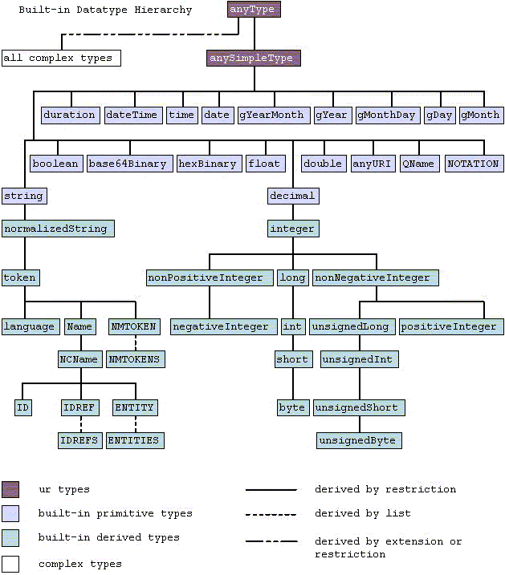
XML Schema
Data Types
W3C
Master of Information System Management

Slide 15
XPATH
With XML Schema, we can describe messages with program level specificity.
We still need a general way to address component parts from these messages.
The primary purpose of XPath is to address parts of an XML document (W3C).
Master of Information System Management

Slide 16
The Tree Structure of an XML Document
See Harold Pg. 147
<?xml version="1.0" ?>
<?xml-stylesheet type="text/xsl" href = "pi.xsl" ?>
<people>
<person born="1912" died = "1954" id="p342">
<name>
<first_name>Alan</first_name>
<last_name>Turing</last_name>
</name>
<!-- Did the word "computer scientist" exist in Turing's day? -->
<profession>computer scientist</profession>
<profession>mathematician</profession>
<profession>cryptographer</profession>
</person>
Master of Information System Management

Slide 17
<person born="1918" died = "1988" id="p4567">
<name>
<first_name>Richard</first_name>
<middle_initial>&#x4D;</middle_initial>
<last_name>Feynman</last_name>
</name>
<profession>physicist</profession>
<hobby>Playing the bongoes</hobby>
</person>
</people>
Unicode ‘M’
Master of Information System Management

Slide 18
/
<?xml-stylesheet type="text/xsl" href = “some.xsl" ?>
person
born = “1914”
person
died = “1952”
id=“p342”
name
<!– Did the word
“computer scientist”
exist in Turing’s day?”-- >
profession
first_name
Alan
Master of Information System Management

Slide 19
XPATH
Location Paths such as a/b/c that drill down into the XML tree
Axes allow us to specify the direction of travel through the tree
e.g., child, ancestor, previous-sibling.
Node Tests and predicates allow us to select parts of the XML based on conditions
Master of Information System Management

Slide 20
XPATH Examples
The XPATH expression “//name/last_name/text()” means to
search from the root to the text under the name/last_name
elements and return that result.
The XPATH expression “//profession[.='physicist']/../name”
means to search from the root for any profession element
whose content is physicist and then travel to the parent of the
profession element and select, along the child axis, the name
element.
Master of Information System Management

Slide 21
WSDL2.0
Web Service Description Language
W3C Recommendation June 2005
Tools are readily available that automatically generate WSDL from existing applications.
Tools are readily available that generate client side proxy code from the WSDL description
Master of Information System Management

Slide 22
WSDL2.0
Two parts to a WSDL document
- abstract part
What needs done
Interfaces and MEPS
- concrete part
How it’s done and where
Master of Information System Management

Slide 23
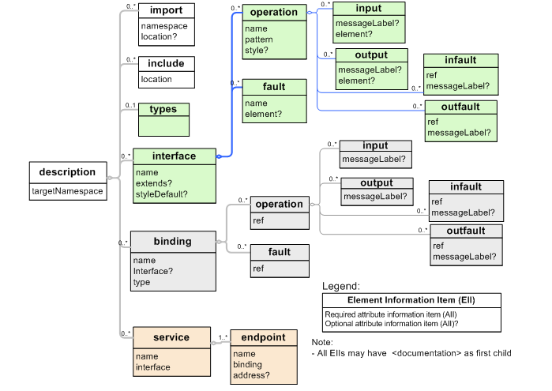
The XML Infoset for a WSDL 2.0 document.
From W3C
http://www.w3.org/TR/wsdl20-primer/
Master of Information System Management

Slide 24
Key Abstract WSDL Elements (1)
<types>
XML Schema constructs or the
import of existing XML Schema
documents
<interface>
represents service interfaces
and can reference multiple
operations
Notes from Erl
Master of Information System Management

Slide 25
Key Abstract WSDL Elements(2)
<operations>
represents web service functions
and can reference multiple
messages
Have inputs and outputs and may
generate faults
Notes from
Erl
Master of Information System Management

Slide 26
Key Concrete WSDL Elements(3)
<binding>
This element specifies the transport
and wire formats for
interfaces
<service>
<endpoint>
These elements associate themselves
with operation constructs and specify
a location
Notes from
Erl modified
For wsdl 2.0
Master of Information System Management

Slide 27
Problem Description(1)
Hotel GreatH (a fictional hotel) is located in a remote island.
It has been relying on fax and phone to provide room reservations.
Even though the facilities and prices at GreatH are better than what
its competitor offers, GreatH notices that its competitor is getting
more customers than GreatH. After research, GreatH realizes that
this is because the competitor offers a Web service that permits
travel agent reservation systems to reserve rooms directly over
the Internet. GreatH then hires us to build a reservation Web
service with the following functionality:
From W3C WSDL2.0
primer
Master of Information System Management

Slide 28
Problem Description (2)
CheckAvailability. To check availability, the client must
specify a check-in date, a check-out date, and room type.
The Web service will return a room rate (a floating point
number in USD$) if such a room is available, or a zero
room rate if not. If any input data is invalid, the service
should return an error. Thus, the service will accept a
checkAvailability message and return a
checkAvailabilityResponse or invalidDataFault message.
Master of Information System Management

Slide 29
Problem Description (3)
MakeReservation. To make a reservation, a client must
provide a name, address, and credit card information,
and the service will return a confirmation number if
the reservation is successful. The service will return
an error message if the credit card number or any
other data field is invalid.
Thus, the service will accept a makeReservation message and
return a makeReservationResponse or invalidCreditCardFault
message.
Master of Information System Management

Slide 30
Problem Description (4)
We know that we will later need to build a complete system
that supports transactions and secured transmission, but
initially we will implement only minimal functionality.
In fact, to simplify our first example, we will implement
only the CheckAvailability operation.
Master of Information System Management

Slide 31
Hotel WSDL
<?xml version="1.0" encoding="utf-8" ?>
<description
xmlns="http://www.w3.org/2006/01/wsdl"
targetNamespace= "http://greath.example.com/2004/wsdl/resSvc"
xmlns:tns= "http://greath.example.com/2004/wsdl/resSvc"
xmlns:ghns = "http://greath.example.com/2004/schemas/resSvc"
xmlns:wsoap= "http://www.w3.org/2006/01/wsdl/soap"
xmlns:soap="http://www.w3.org/2003/05/soap-envelope"
xmlns:wsdlx= "http://www.w3.org/2006/01/wsdl-extensions">
From W3C WSDL2.0
primer
Master of Information System Management

Slide 32
<documentation>
This document describes the GreatH Web service. Additional
application-level requirements for use of this service --
beyond what WSDL 2.0 is able to describe -- are available
at http://greath.example.com/2004/reservation-documentation.html
</documentation>
Master of Information System Management

Slide 33
WSDL uses XML Schema.
<types>
<xs:schema
xmlns:xs="http://www.w3.org/2001/XMLSchema"
targetNamespace=
"http://greath.example.com/2004/schemas/resSvc"
xmlns="http://greath.example.com/2004/schemas/resSvc">
<xs:element name="checkAvailability"
type="tCheckAvailability"/>
<xs:complexType name="tCheckAvailability">
<xs:sequence>
<xs:element name="checkInDate" type="xs:date"/>
<xs:element name="checkOutDate" type="xs:date"/>
<xs:element name="roomType" type="xs:string"/>
</xs:sequence>
</xs:complexType>
Master of Information System Management

Slide 34
<xs:element name=
"checkAvailabilityResponse" type="xs:double"/>
<xs:element name="invalidDataError" type="xs:string"/>
</xs:schema>
</types>
Master of Information System Management

Slide 35
Operations and
faults are described.
<interface name = "reservationInterface" >
<fault name = "invalidDataFault"
element = "ghns:invalidDataError"/>
<operation name="opCheckAvailability"
pattern="http://www.w3.org/2006/01/wsdl/in-out"
style="http://www.w3.org/2006/01/wsdl/style/iri"
wsdlx:safe = "true">
<input messageLabel="In"
element="ghns:checkAvailability" />
<output messageLabel="Out"
element="ghns:checkAvailabilityResponse" />
<outfault ref="tns:invalidDataFault" messageLabel="Out"/>
</operation>
</interface>
Note the Message
exchange pattern
in-out is specified.
Master of Information System Management

Slide 36
Above we specified what
gets exchanged now we
specify how.
The binding specifies
the format and
transmission
protocol for each
operation in an
interface.
<binding name="reservationSOAPBinding"
interface="tns:reservationInterface"
type="http://www.w3.org/2006/01/wsdl/soap"
wsoap:protocol=
"http://www.w3.org/2003/05/soap/bindings/HTTP">
<fault ref="tns:invalidDataFault"
wsoap:code="soap:Sender"/>
<operation ref="tns:opCheckAvailability"
wsoap:mep=
"http://www.w3.org/2003/05/soap/mep/soap-response"/>
</binding>
Master of Information System Management

Slide 37
The above tells us what and how.
The service element tells us where.
<service name="reservationService"
interface="tns:reservationInterface">
<endpoint name="reservationEndpoint"
binding="tns:reservationSOAPBinding"
address =
"http://greath.example.com/2004/reservation"/>
</service>
</description>
A WSDL 2.0 service specifies a single
interface that the service will support, and a
list of endpoint locations where that service
can be accessed. Each endpoint must also
reference a previously defined binding to
indicate what protocols and transmission
formats are to be used at that endpoint. From the
W3C Primer
Master of Information System Management

Slide 38
WSDL2.0 Message Exchange Patterns
In-only One message received no fault generated
Robust In-only One message received with a possible error
sent
In-out One message received in and one sent
out (fault replaces out)
In-Optional-Out One message received in with one possibly
sent out (fault replaces out)
Out-Only One message sent no fault return expected
Robust Out-Only One message sent fault return expected
Out-In One message sent and return expected
(fault replaces return)
Out-Optional-In One message sent and may receive a return
(fault replaces return)
Master of Information System Management

Slide 39
SOAP
Was “Simple Object Access Protocol”
Now people are using “Service Oriented Application Protocol”
May be fine grained RPC style messages
<foo>34</foo> where foo is the
name of a method
Or may be course grained document style where the input message is an entire document.
Master of Information System Management

Slide 40
SOAP XML Structure
<Envelope>
<Header> WS-* specifications
: are placed in the
header area and will be
</Header> handled by intermediaries
<Body>
: Message payload including
fault messages
</Body> as well-formed XML.
</Envelope>
Master of Information System Management

Slide 41
Figure 1-2. Breakdown of service components
_x0015__x0015_Understanding SOA with Web Services, Eric Newcomer and Greg Lomow, p. 9
Service
Implementation/
Executable Agent
Service
Requester
Mapping
Layers
NET
JEE
Service
Descriptions
Service
Requests
The JEE agent may
provide a coarse
grained service while
the legacy services
may be fined grained.
CORBA
IMS
Service
Implementation/
Executable Agent
Service
Implementation/
Executable Agent

Slide 42
Figure 1-2. Breakdown of service components
_x0015__x0015_Understanding SOA with Web Services, Eric Newcomer and Greg Lomow, p. 9
Service
Implementation/
Executable Agent
Service
Requester
Mapping
Layers
NET
JEE
Service
Descriptions
Service
Requests
With web service based
SOA we can, for the first
time, easily mix and match
executable agents.
CORBA
IMS
Service
Implementation/
Executable Agent
Service
Implementation/
Executable Agent

Slide 43
Figure 1-2. Breakdown of service components
_x0015__x0015_Understanding SOA with Web Services, Eric Newcomer and Greg Lomow, p. 9
Service
Implementation/
Executable Agent
Service
Requester
Mapping
Layers
NET
JEE
Service
Descriptions
Service
Requests
The mapping layers
are stubs and skeletons that
transform the SOAP requests
to requests specific to the
executable agents.
CORBA
IMS
Service
Implementation/
Executable Agent
Service
Implementation/
Executable Agent

Slide 44
What is an ESB?
Many vendors have an ESB product.
JBoss has an open source ESB.
CMU has recently chosen Oracle’s ESB.
An ESB usually includes:
- Content Transformations (often via XSLT)
- Queuing and waiting until services are
available
- Routing (often using WS-Addressing)
- Event driven publish/subscribe
- Protocol mediation
- Monitoring and logging
Master of Information System Management
Master of Information System Management

Slide 45
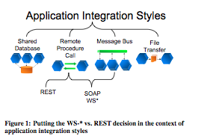
Integration Styles
From “RESTFul Web Services vs. “Big Web Services”: Making the
Right architectural decision by Paufasso, Zimmerman and Leymann.
Master of Information System Management

Slide 46
An Open Source ESB from JBoss
See http://www.jboss.org/jbossesb.
You can purchase support from RedHat.
It’s the next generation of EAI.
Business logic is left to higher levels.
It's about infrastructure logic.
- An ESB is needed when we map abstract SOA to a concrete implementation.
From JBOSS ESB Documentation
Master of Information System Management

Slide 47
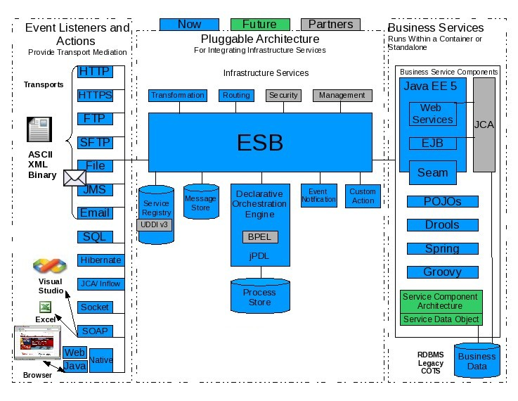
From JBoss ESB Documentation
Master of Information System Management

Slide 48
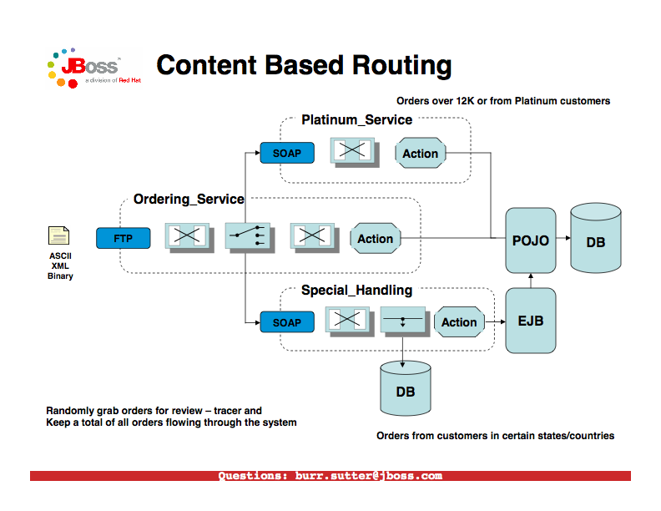
From JBoss ESB Documentation
Master of Information System Management

Slide 49
JBoss Recommendations
To Ensure Loose Coupling:
Use one-way messages rather than request-response style.
- Do not expose service back-end implementation choices.
- Use an extensible message structure so that it may
be versioned over time, for backward compatibility.
- Do not use the distributed object approach of fine
grained services.
- One way message delivery requires that we encode
return address information in the message. Use WS-
Addressing.
From JBoss ESB Documentation
Master of Information System Management

Slide 50
Some JBoss ESB Components
- The Message Store Service
A pluggable persistence service designed for audit tracking. Every event is recorded.
- Data Transformation Service
Often clients and services will use the same vocabulary.
If not, on the fly transformation is provided.
JBoss uses Smooks and XSLT (Smooks can read an EDI
message and generate a corresponding Java object).
- Content based routing
JBossESB can route messages based on arbitrarily complex rules. It uses XPath and JBoss Rules (Drools).
From JBoss ESB Documentation
Master of Information System Management

Slide 51
Some JBoss ESB Components (2)
- Registry Service (UDDI) is at the heart of JBossESB.
Services can self-publish their endpoint references (EPRs) into the Registry when they are activated, and remove them when they are taken out of service.
- Consumers can introspect over the Registry
to determine the EPR for the right service for the work at hand.
From JBoss ESB Documentation
Master of Information System Management

Slide 52
Simple WS Without an ESB
Alice
SOAP
Bob
SOAP
Bob’s WSDL is available to Alice.
Master of Information System Management

Slide 53
Simple WS With an ESB
Alice
Bob
Bob’s WSDL available
to ESB.
ESB’s WSDL available
to Alice.
The backend protocol may
be different from the front end.
Bob may be a legacy
application with a
web service front end.
Master of Information System Management

Slide 54
Oracle’s ESB (OSB)
JEE
Weblogic
Alice
Bob
Alice may be calling Bob as part of a business orchestration. She might
be running BPEL. Another orchestration may exist within the ESB - but
working at a lower level.
Master of Information System Management

Slide 55
Protocol Mediation
JEE
Weblogic
Alice
Bob
Alice may be passing an XML message to the ESB. The ESB may be
communicating with Bob via sftp.
Master of Information System Management

Slide 56
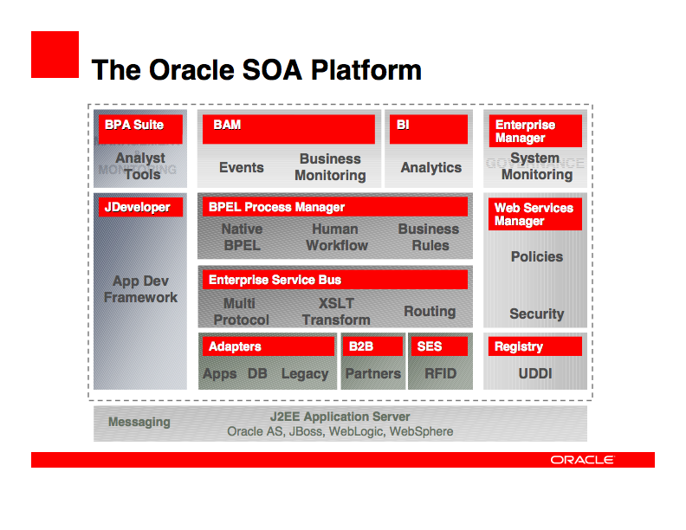
Master of Information System Management

Slide 57
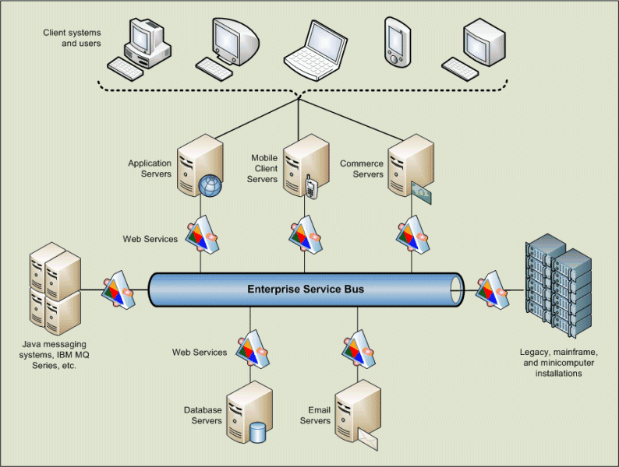
And From Microsoft
Master of Information System Management

Slide 58
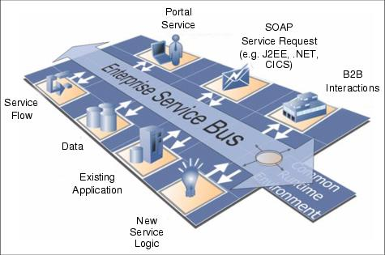
ESB’s From IBM (1)
Master of Information System Management

Slide 59
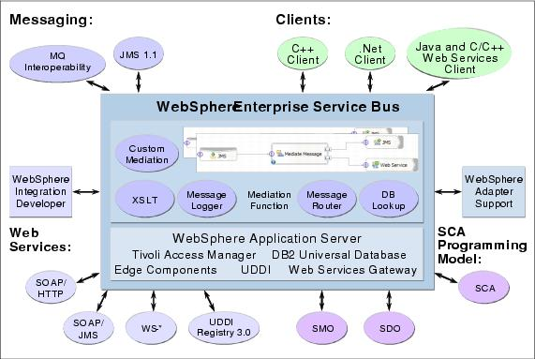
ESB’s From IBM (2)
Master of Information System Management

Slide 60
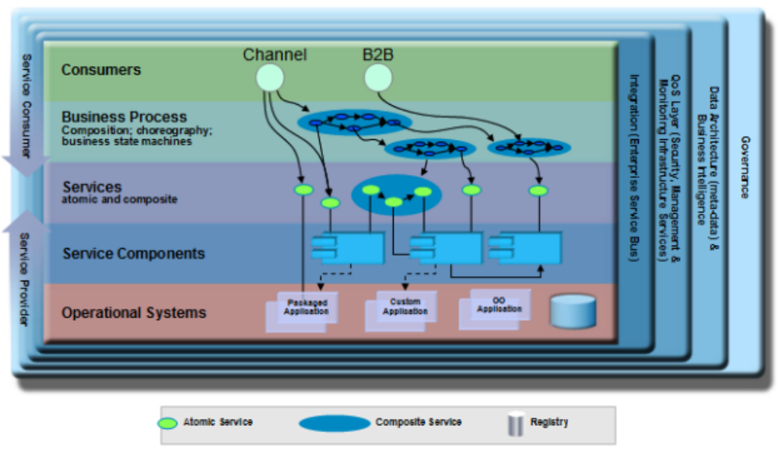
IBM’s Solution Stack View
Master of Information System Management
Master of Information System Management

